Slide 1
KBC Group
Company presentation
Spring 2006
Web site: www.kbc.com
Ticker codes: KBC BB (Bloomberg)
KBKBT BR (Reuters)

Slide 2
Contact information
Investor Relations Office
Luc Cool, Head of IR
Luc Albrecht, Financial Communications
Tamara Bollaerts, IR Coordinator
Marina Kanamori, CSR Communications
Nele Kindt, IR Analyst
E-mail: investor.relations@kbc.com
Surf to www.kbc.com for the latest update.

Slide 3
Important information for investors
This presentation is provided for informational purposes only. It does not constitute an offer to sell or the solicitation to buy any security issued by the KBC Group.
KBC believes that this presentation is reliable, although some information is condensed and therefore incomplete.
This presentation contains forward-looking statements with respect to the strategy, earnings and capital trends of KBC, involving numerous assumptions and uncertainties. The risk exists that these statements may not be fulfilled and that future developments differ materially. Moreover, KBC does not undertake any obligation to update the presentation in line with new developments.
By reading this presentation, each investor is deemed to represent that it possesses sufficient expertise to understand the risks involved.

Slide 4
Table of contents
Company profile and strategy
2005 financial highlights
Additional information to the 2005 accounts
Closing remarks on the valuation of the share

Slide 5
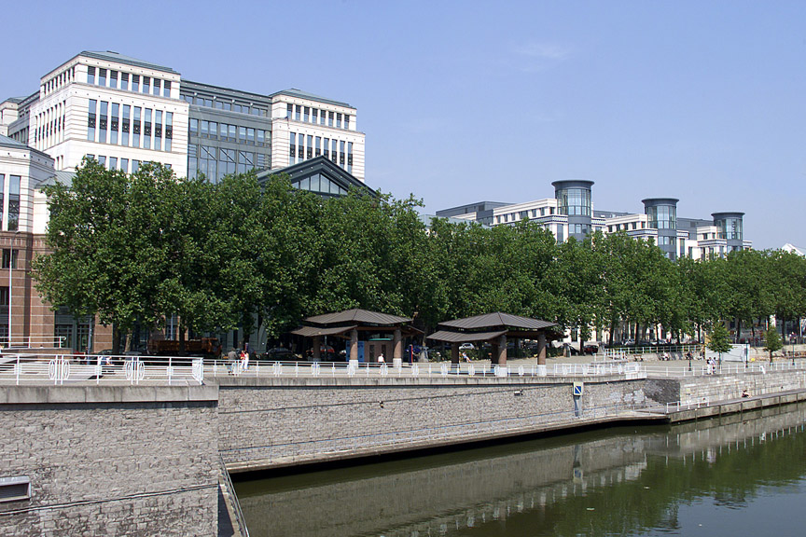
Foto gebouw
1
Company profile
and strategy

Slide 6

Strong, attractive franchises today
Strong bancassurance
footprint in home markets
Selected niche
strategies
Retail
Belgium
Retail
Czech Rep.
& Slovakia
Retail
Hungary
Retail
Poland
Retail
Slovenia
Offshore private banking
Onshore private
banking
W. Europe
Consumer
finance
Poland
Retail
asset
mgt.
Private banking networks
SME/corp. banking networks
Leasing
Domestic
corporate
finance
& equity
brokerage
Internat’l
(mid-)corp. banking
Institut’l market activities
Institut’l
asset
mgt
Operations & IT
Operations & IT
Operations
& IT
Operations
& IT
Operations
& IT
Strategy, capital & risk management
Over the past few years, KBC has strengthened its bancassurance position in its historic home market, Belgium (representing ca. 55 % of FY05 income), while building up an additional franchise (representing
ca. 25% of FY05 income) in 5 CEE countries and holding a top-3 position in that region.
Earnings growth in Belgium has been surprisingly high, driven by strong savings flows, intensive bancassurance activities and an underleveraged consumer base.
By merging with Almanij in 2005, KBC has added on the option of developing a European private banking franchise (presence in 10 countries) and it also operates in selected other markets, pursuing niche strategies.

Slide 7
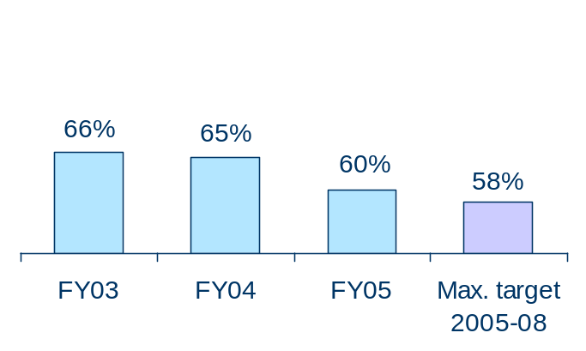
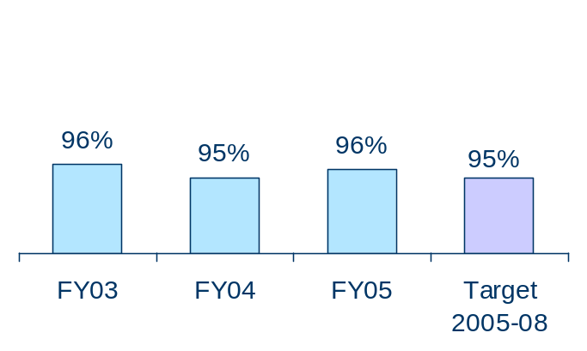
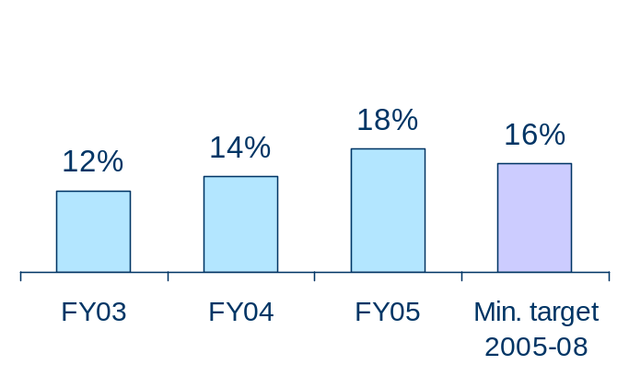
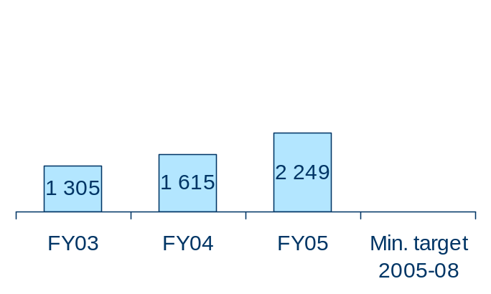
Financial track record
Cost/income, banking
Combined ratio, non-life
Return on equity
Net profit growth
In m EUR
CAGR +10%
KBC has delivered well on its financial targets and is committed to improve its performance levels further whilst maintaining a conservative risk culture and solid solvency levels.
Pro forma post-merger figures for 2003 and 2004

Slide 8
Profit outlook, 2006
KBC is confident about the growth potential of its strategy and currently has a predominantly positive outlook on the economic environment. In light of this, KBC is optimistic on its business developments in 2006
Moreover, the 2006 share buy-back programme (1 bn euros) will further enhance the growth of KBC’s earnings per share

Slide 9
Mid-term outlook
Belgium:
 | Gross income | C/I, banking | Loan-loss ratio | Net profit
Retail | 5% CAGR | Low 60s | < 0.25% | >10% CAGR
Business customers | >2% on RWA | < 43% | < 0.35% | >10% CAGR
 | RWA, CAGR | Profit, CAGR | Loan-loss ratio | Cost/Income
Banking | 10% – 15% | 10% – 15% | < 0.50% | < 60%
CEE:
 | Premium income, CAGR | Net profit , CAGR | Combined ratio
Insurance | 15% – 25% | 25% - 35% | 95%
 | AUM growth, mutual funds | AUM growth, pension products
AM | 15% – 20% | 10% - 20%
Financial outlook as disclosed in June 2005

Slide 10
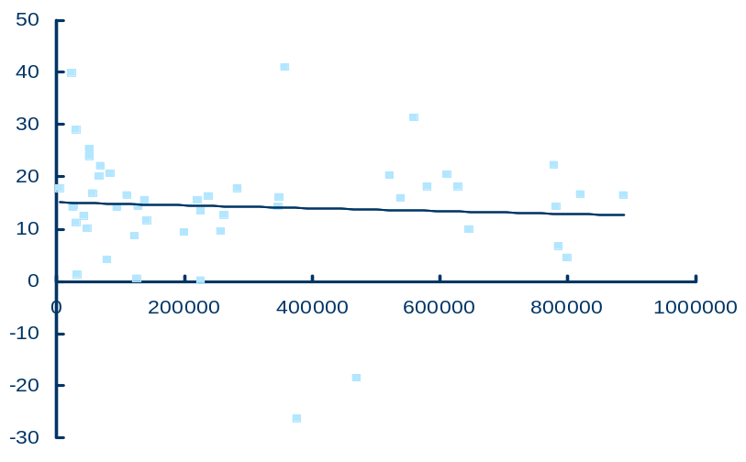
Anticipating future challenges
ROE
In %
Europe’s top 50 and Belgium’s top 10
Total assets
In millions of EUR
Source: McKinsey, 2003 data
When looking at the key success factors in retail financial services, KBC believes that the company’s scale is not necessarily the most important factor. We believe that it is vital to hold significant market share in the relevant individual markets, and, at the same time, excelling in the implementation of distribution and operating models.
We therefore focus on designing initiatives to further strengthen the current franchises and to ensure ‘distribution excellence’ and ‘lean processing’. We will not enter into completely new lines of business or geographic zones. If necessary, further opportunistic operational alliances may be set up in certain areas to generate additional scale effects.

Slide 11
Recent strategy initiatives - examples
Management objective | Examples | Required mgt. attention 2006-07 | Additional capital 2006-07
Strengthening CEE franchise: - Buy-out of third parties - Acquisitions - Accelerated organic growth | - e.g., 40% of K&H (Hungary), 7% of CSOB Bank - e.g., the Balkans, Romania, Poland - e.g., SME, HNWI & consumer finance development
Strengthening the Belgian franchise | - Strengthening of non-life distribution channels, launch of innovative ‘longevity’ life products, etc.
Strengthening the Private Banking franchise | - Setting up of cost-saving central back-office functions (potentially, small add-on acquisitions)
Distribution excellence | - Integration of distribution channel management per local market, setting up of a distribution competence centre to leverage distribution experience throughout the Group, etc.
Lean operations | - Setting up of Group product factories and shared services, co-sourcing of selected activities, etc.










 High

Low
We identified some 25 ‘business initiatives’ - illustrated in the above table – in order
to strengthen current franchises (better market penetration, product offering, distribution channels, management control, etc.) and to ensure further ‘distribution excellence’ and ‘lean processing’ in the future.
The implementation will be spread over a 3-to-5-year period and will enable KBC to safeguard its competitive position and growth prospects in the long term. In 2006, management attention and capital allocation will be focused on the buy-out of third-party interests in CEE (since these are expected to be immediately value-enhancing) and on the implementation of a new organisational structure (for more details, see further).

Slide 12
  Organic growth:
  Accelerating business development
  (e.g., bancassurance, SME, HNWI and consumer finance business, branch openings)
  Buy-out of third-party interests
Russia
Estonia
Latvia
Lithuania
Current presence
(5 countries – 65 m inhabitants)
Geographic add-ons:
  The Balkans
  Romania, e.g., via greenfield
  Poland (banking) and Hungary (insurance) to increase existing foothold (expected to occur post-2007)
  Depending on opportunities
Belarus
Poland
Czech
Ukraine
Slovakia
Moldova
Slovenia
Hungary
Romania
Croatia
Bulgaria
Bosnia
Serbia
Albania
Macedonia
Turkey
KBC’s CEE strategy is focused on accelerating organic growth (incl. buying out third-party interests) and making selected geographic add-on investments.
The additional allocation of capital for third-party buy-outs and add-on acquisitions will be assessed on the basis of a set of conservative parameters, both strategic and financial, in line with our past track record in this respect.

Slide 13
Planned capital deployment in 2006-07
 |  | Available Capital | Required Capital | Immediately available excess
Capital as at Nov-2005 |  |  |  | 2.5 bn
Planned capital investments: - Buy-out of third parties, CEE - Acquisitions, mainly in CEE - Accelerated organic development |  |  | +1.4 bn +1.0 bn +0.1 bn | -1.4 bn -1.0 bn -0.1 bn
Organic capital generation 2006-07 ¹ |  |  |  | +1.9 bn
Share buy-back, 2006 | -1.0 bn |  |  | -1.0 bn
Further de-leveraging of Holding Company | -0.5 bn |  |  | -0.5 bn
Immediately available excess capital as at Dec. 2007 (estimate) |  |  |  | 0.4 bn
Remaining leverage at Holding-Company level at end of 2007 |  |  |  | -0.8 bn
At the start of 2006, the level of excess capital amounted to ca. 2.5 bn euros
(of which 1.3 bn euros funded by the existing debt leverage at holding-company level).
By the end of 2007, this amount will be used up by the planned capital investments. The buy-out of third parties includes the already announced buy-out of ABN-Amro’s stake in K&H Bank, Hungary (0.5 bn). Naturally, the projected external growth will be dependent on market opportunities.
The newly generated excess capital in 2006-2007 will be used to further reduce the debt leverage of the Holding Company (0.5 bn euros) and fund the 2006 share buy-back programme (1 bn).
1 It is not our intention to provide any guidance on 2006-07 earnings and assets growth. Therefore, the earnings and asset growth assumptions used in the above capital model (e.g., 2006 and 2007 net profit levels equal to expected 2005 net profit of 2.2 bn) should be viewed as purely hypothetical.

Slide 14
Organisational structure
Group Executive Committee
& Group Centre functions
1
Belgium
Retail &
Private
Banc-
assurance
2
CEE
Private Banking
Merchant Banking
Czech Rep.
Banc-
assurance
Slovakia
Banc-
assurance
Poland
Banc-
assurance
Hungary
Banc-
assurance
Slovenia
Banc-
assurance
No majority control
3
4
Merchant Banking:
±2 000 FTE
± 36% of Group profit
3.4 bn allocated equity
Belgium:
± 10 000 FTE
±47% of Group profit
4 bn allocated equity
CEE:
± 26 000 FTE
± 20% of Group profit
1.5 bn allocated equity
Private Banking:
± 4 000 FTE
± 8% of Group profit
1.3 bn allocated equity
Group-wide Product Factories
& Shared Services
5
In 2006, the organisational structure will be adjusted to strengthen the international dimension of the Group and to ensure strict compliance with Group standards and effective Group management
Furthermore, the new structure will allow KBC to increasingly lever its competitive advantage in bancassurance (via the integration of retail banking, network-driven private banking and insurance in local geographic areas into single business units) and will facilitate further progress towards ‘lean processing (by bringing together the manufacturing activities of the product factories and support operations under ‘shared services’ and creating the new position of Group COO).

Slide 15
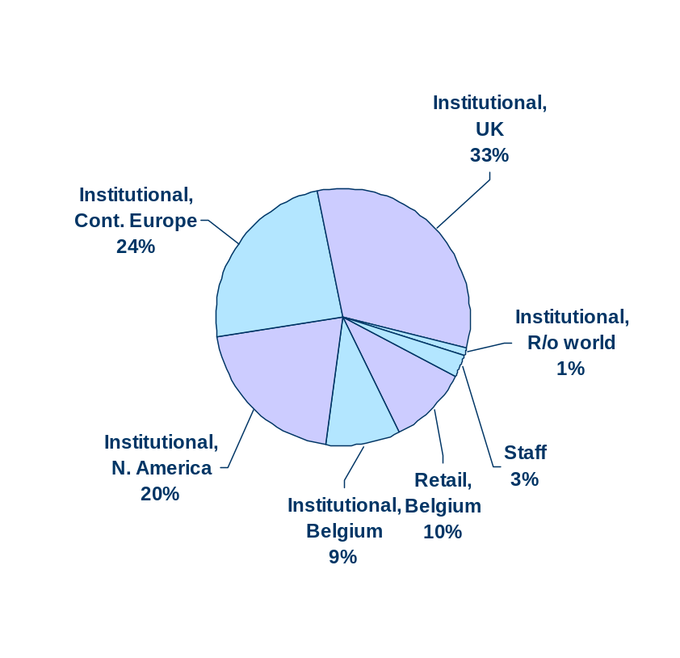
Shareholder structure
Free float
CERA/Almancora
27.1%
MRBB
11.6%
Free float
47.1%
Other committed
shareholders 11.7%
KBC
(own shares:2.5% *)
Situation as at 31-Dec-05
* Including ESOP hedge
Shareholder identification survey
as at 31-Dec-05
KBC’s market value more then tripled during the past 2 years (from 10 bn at the end of 2003 to 32 bn euros currently).
KBC is 50%-owned by a syndicate of shareholders, providing continuity to pursue long-term strategic goals. Committed holders include the Cera/Almancora Group (co-operative investment company), a farmers’ association (MRBB) and a group of industrialist families
The free float is chiefly held by a large variety of international institutional investors.

Slide 16
Foto gebouw
2
FY 2005
financial highlights

Slide 17
2005 highlights
Presentation of results
- Group financial performance
- Headlines per segment
2006 outlook
Foto gebouw

Slide 18
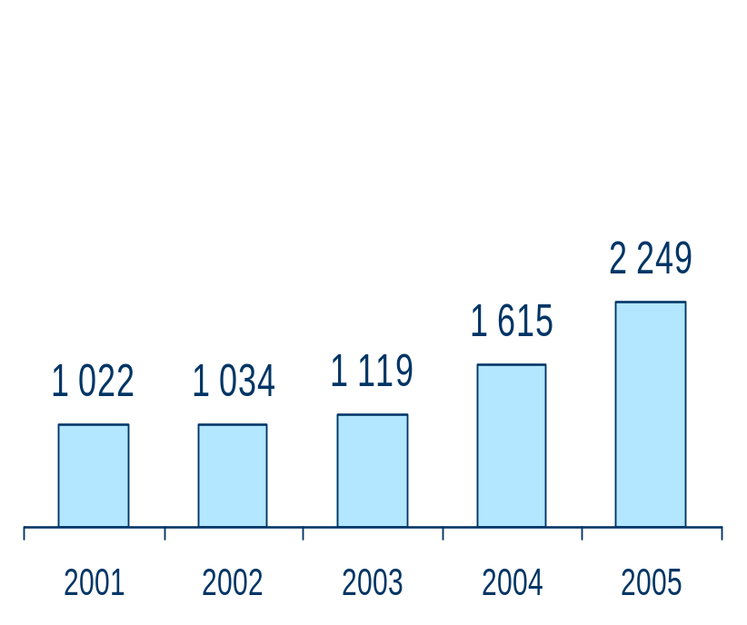
2005 at a glance – net profit
Net profit
2005 has seen very strong financial earnings:
  Net profit of 2.25 bn euro
  39% year-on-year growth
  Return on equity: 18%
This resulted from:
  Solid revenue dynamics
  Successful cost-management strategy
  Historically low loan losses
  (and no impairments on shares)
+39%
in m EUR
Note: “Old KBC” figures for the 2001-2003 period. Pro forma “new KBC” figures for 2004.

Slide 19
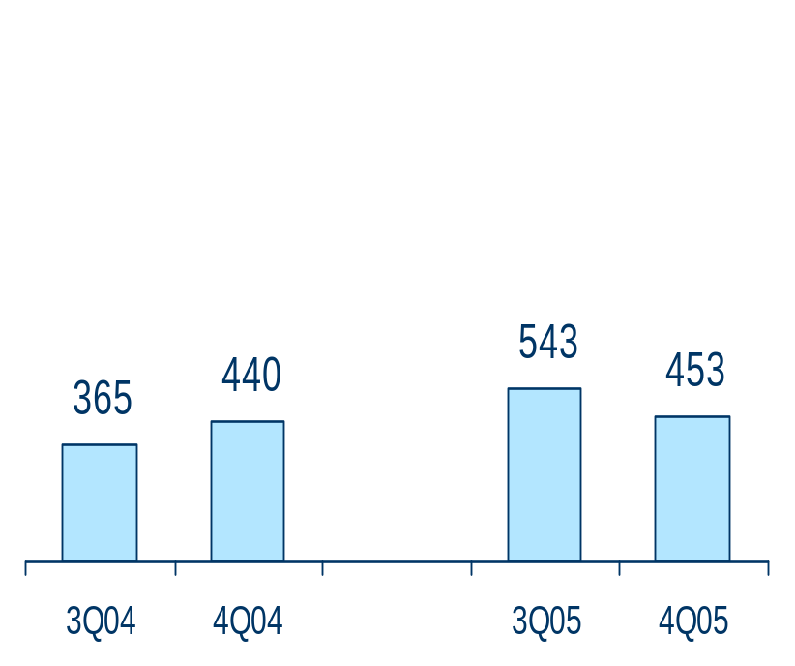
2005 at a glance – 4th quarter
In many views, Q4 results are excellent:
  Continued strong growth momentum (mortgages +6%q/q, life reserves +16%, AUM +6%)
  Positive impact of developments in interest-rate and equity markets
  Low impairments (no additional credit-risk provisioning)
A 100m one-off pension expense, a 40m ‘carve out’ charge, a 49m impairment on the Agfa-Gevaert stake and several seasonal expenses (similar to Q4 2004) were booked *
Profit in CEE was down, despite the solid top-line performance, due to the increased cost level (partly seasonal and partly non-recurring)
Net profit
in m EUR
* All amounts are pre-tax ; the “carve out charge” relates to the change in portfolio hedging methodology

Slide 20
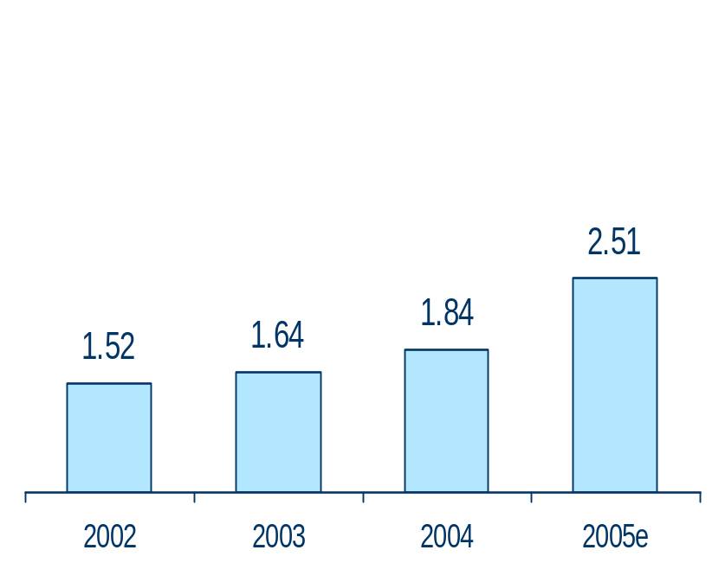
2005 at a glance - dividend
Gross dividend* per share
Gross 2005 dividend* is at 2.51 euro per share
Payout ratio at 40%, in line with historical average (40-45%)
The gross dividend* yield (relative to 2005 average share price) is 3.8%
The dividend will be paid out on 2 May 2006
+36%
EUR
Note: “old KBC” figures for the 2002-2003 period
* Subject to AGM approval

Slide 21
2005 at a glance - business developments
Strengthening of long-term strategy
(project ‘Next’)
New group management structure along business lines (start: May-06)
Share buy-back programme of
1 bn euro
Enhancement of both cross-selling and cost-savings projects within the European private banking network
Acquisitions to further strengthen the European private banking franchise
Integration of Gevaert’s activities within other Group entities and divestment of non-core activities
Streamlining of corporate identities of CEE operations (use of KBC logo)
Cross-border integration of asset management and investment banking activities in CEE
Renewal of the long-term strategic distribution agreement with the Czech Postal Office
Decision to open new branches in Poland (organic growth)
Decision to open new branches in Hungary (organic growth)
Agreement to buy-out of ABN-Amro’s stake in the Hungarian bank, K&H

Slide 22
2005 highlights
Presentation of results
- Group financial performance
- Headlines per segment
2006 outlook
Foto gebouw

Slide 23
Financial headlines
In m euros | FY04 | FY05
Net interest income Gross earned premium, insur. Dividend income Net gains from FI at FV Net realised gains from AFS Net fee and comm. income Other income | 3 833 5 158 231 725 503 1 404 479 | 4 348 3 550 235 513 458 1 819 574
Gross income | 12 333 | 11 498
Operating expenses Impairments - loans and receivables - AFS assets - goodwill - other Gross technical charges, insur. Ceded reinsurance result Share in results, associates | - 4 944 - 365 - 198 - 150 0 - 17 - 4 633 - 68 22 | - 4 914 - 103 - 35 6 - 20 - 54 - 3 059 - 69 16
Profit before taxes | 2 345 | 3 369
Income tax expense Minority interests | - 537 - 193 | - 925 - 194
Net profit | 1 615 | 2 249
Strong business volume growth across our activities / geographic areas, generating strong commission income and offsetting impact of flattened yield curve
Collected insurance premiums
on a comparable basis up 56% to 8.0 bn from 5.2 bn (mainly unit-linked life)
Profit from marking-to-market of financial instruments and realised capital gains on investments signifcantly lower than 2004 (though partly due to IFRS valuation rules)
Downtrend in expenses (-1%)
Very low credit-risk provisioning (loan-loss ratio: 0.01%) / no net impairments on the AFS investment portfolio
Sustained sound non-life underwriting performance (combined ratio: 96%)
Reminder: comparison of individual P/L lines with pro forma 2004 figures distorted by application of IFRS 32/39 and IFRS 4 as of 2005

Slide 24
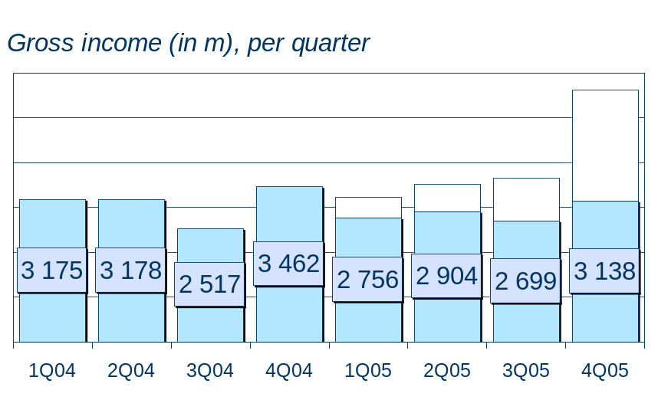
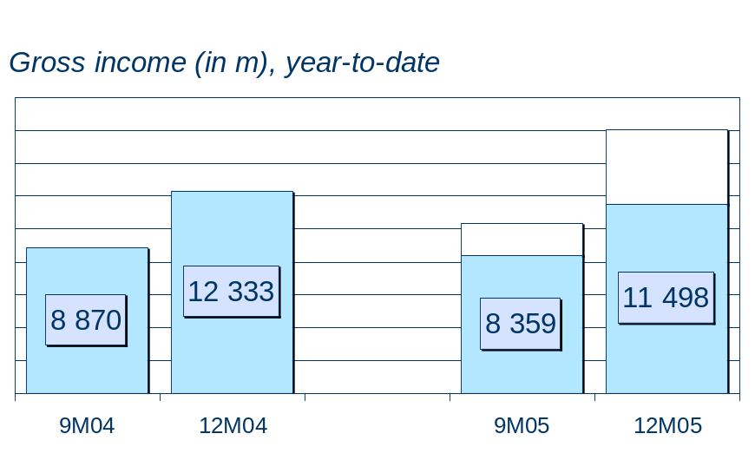
Solid revenue trend
IFRS 2004
IFRS 2005
2.5 bn*
0.5 bn*
0.6 bn*
1.0 bn*
4.6 bn*
2.1 bn*
(Reminder) IFRS distort y/y comparison (among other things, non-recognition of unit-linked premiums)
Solid trend in F&C continued in Q4
Record level of life premium income
(3.1 bn), mostly unit-linked, driven by low interest rates and good stock market performance
Very strong life insurance premium income (6.4 bn) and strong F&C income (+30%)
Volume growth (+refinancing fees) more than offsetting negative impact on NII of flattened yield curve (NIM down 9 bps to 1.6%).
Lower profit from trading and M2M of portfolios (though partly due to IFRS**) and lower capital gains
* Sales of unit-linked life insurance, recognised differently under IFRS 2005 - ** interest result of trading derivatives recognised as NII in 2004, gain of FI at FV in 2005

Slide 25
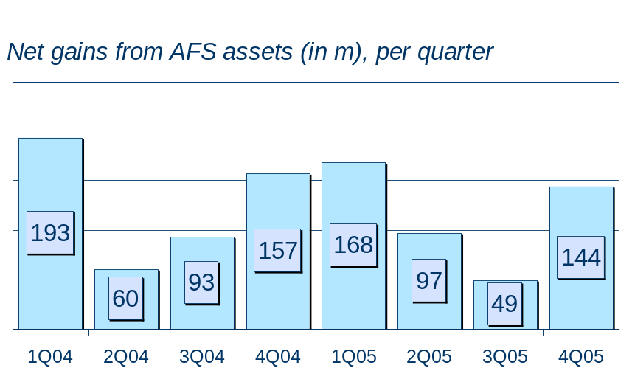
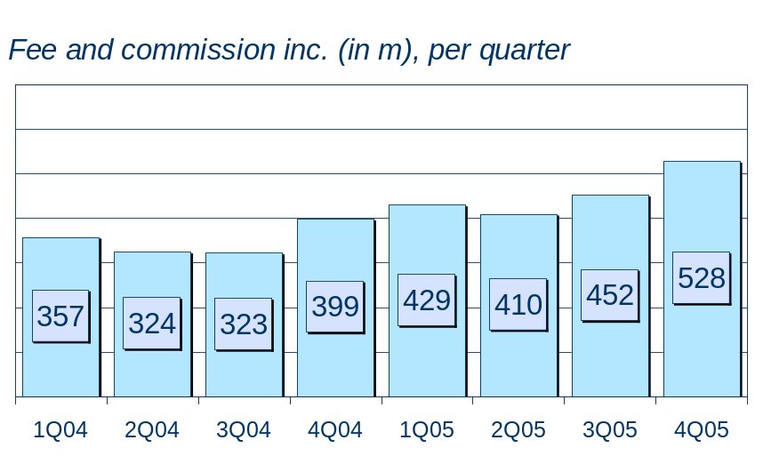
Solid revenue trend – 4th quarter close-up
*
144m realised gains on investments in 4Q:
  Bonds (38m), mainly due to bond arbitrage in the banking book (also change in way of portfolio hedging)
  Equity (106m), mainly due to sale of a re-insurance vehicle (37m) and disposals to avoid permanently exceeding VAR limits (driven by the buoyant stock market performance)
Growth trend in F&C income continued in 4Q (up17% q/q and 31% y/y)
Main driver was the strong sales of unit-linked life products, besides more entry fees on mutual funds and higher AUM
* Remind accouting differences between IFRS 2004 and IFRS 2005

Slide 26
Business volumes, growth trend
 | Total loans | Of which mortgages | Customer deposits | Life reserves | AUM
Outstanding (in bn) | 119 | 34 | 158 | 19 | 196
Growth, 4Q05 (q/q) | +6% | +6% | +0% | +16% | +6%
Belgium | +3% | +4% | +2% | +16% | +8%
CEE - CZ/Slovakia - Hungary - Poland | +3% +4% +4% -1% | +9% +11% +6% +11% | -3% -7% +9% +3% | +13% +11% +16% +17% | +8% +7% +10% +9%
Rest of the world | +7% | +8% | -1% | - | +2%
Growth, FY05 (y/y) | +12% | +23% | +8% | +38% | +25%
Belgium | +10% | +16% | +4% | +38% | +31%
CEE - CZ/Slovakia - Hungary - Poland | +12% +17% +17% -10% | +39% +41% +41% +29% | +18% +20% +21% +6% | +39% +30% +78% +62% | +43% +41% +116% +25%
Rest of the world | +17% | +35% | +11% | - | +16%
Note: growth trend excl. (reverse) repo and interbank activity

Slide 27
NIM / IR sensitivity
 | Q1 05 (q/q trend) | Q2 05 (q/q trend) | Q3 05 (q/q trend) | Q4 05 (q/q trend) | 12M 05 (y/y trend)
NIM trend
Banking, total | +0.01% | -0.02% | +0.00%* | -0.02% | -0.09%
whereof Belgium | +0.00% | -0.10% | +0.06% | +0.03% | -0.01%
whereof CEE | -0.10% | -0.06% | -0.13% | -0.02% | -0.38%
For the purpose of comparison vis-a-vis 2004, impact of IFRS 32/39 has been been neutralised
Ytd NIM is down 9 bps, impacted by the flattened yield curve and by margin erosion in CEE (however, offset by volume growth and increasing F&C income)
The P/L impact of a 50-bps parallel upward shift of the yield curve would have a positive impact of approx. 10 m euros (assuming deposit rate in Belgium remains stable)
*Restated figure to neutralise technical distortion

Slide 28
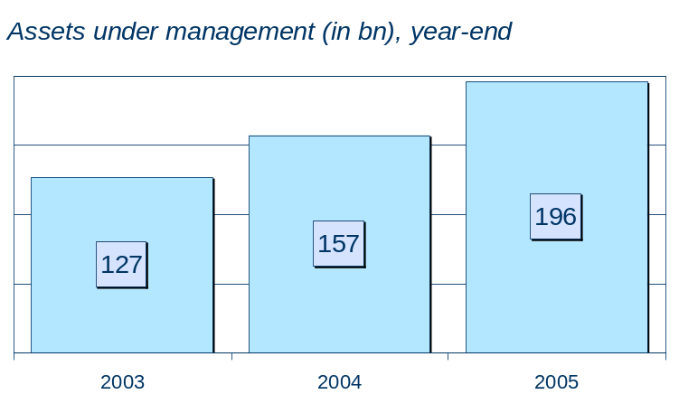
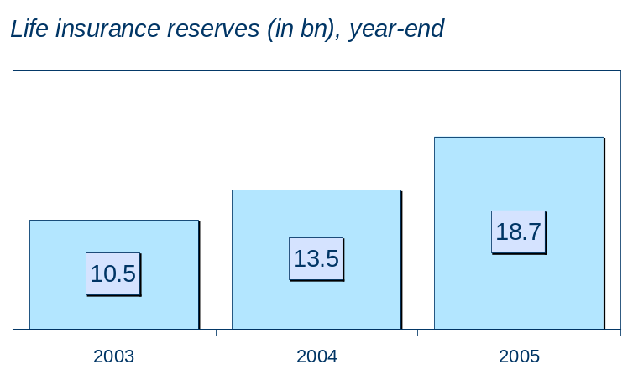
Strengthening of market positions
+25%
+38%
*
*
Market share, retail funds (estimates)
Belgium: 33% (+1.5 pp)
Czech Republic: 27% (+5.0 pp)
Slovenia: 13% (+5.0 pp)
Hungary: 12% (+3.3 pp)
Slovakia: 7% (+0.5 pp)
Poland: 5% (+1.1 pp)
Market share, life premiums (estimates)
Belgium: 22% (+7.4 pp)
Czech Republic: 9% (+1.3 pp)
Slovenia: 8% (+2.0 pp)
Hungary: 4% (+1.0 pp)
Slovakia: 4% (- 0.3 pp)
Poland: 3% (+0.1 pp)
KBC further expanded its share in (retail) asset management and (retail) life insurance on almost all markets. The integrated bancassurance model continues to deliver…
Pro forma for the “new” KBC Group

Slide 29
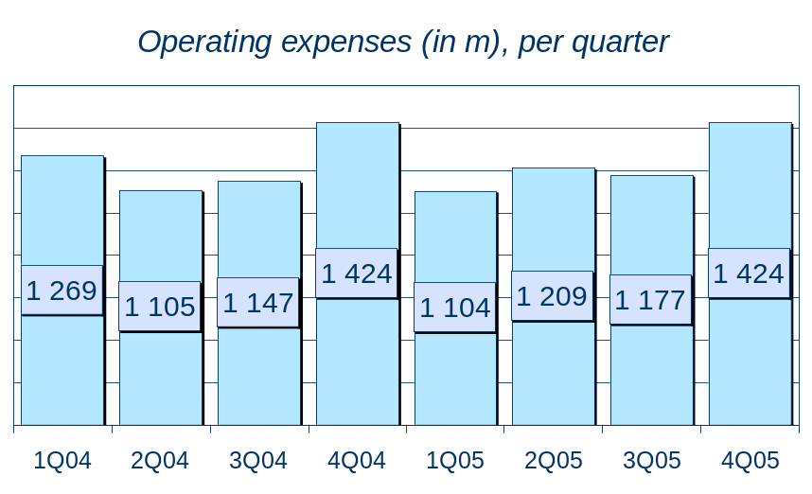
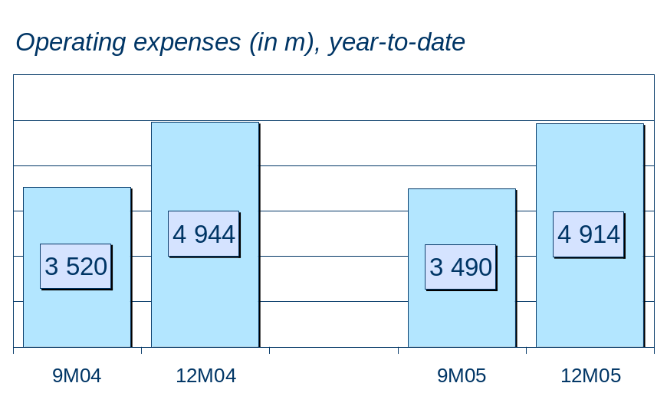
Favourable full-year cost trend
-1%
As expected, cost level up significantly q/q (247m) q/q due to:
  the one-off extra charge for the pension fund scheme (100 m),
  some seasonal effects and the increased cost of profit-sharing bonuses
  one-off costs related to the Prague real-estate project.
Ytd expenses down 30m (-1%), mainly due to lower restructuring charges in epb, the integration of Gevaert and the cost-cutting efforts in the Belgian banking business in 2004
Cost/income ratio, banking, down from 65% to 60%

Slide 30
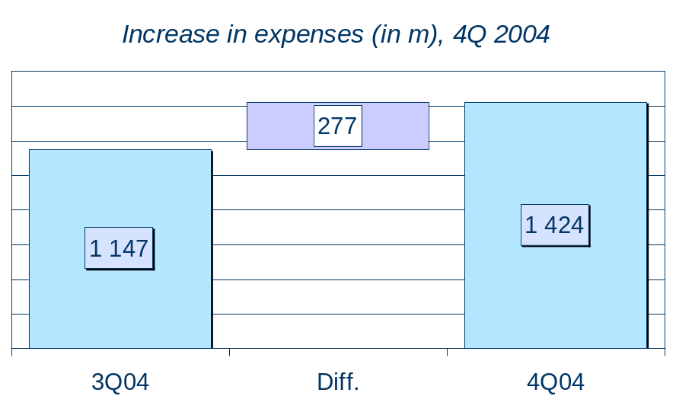
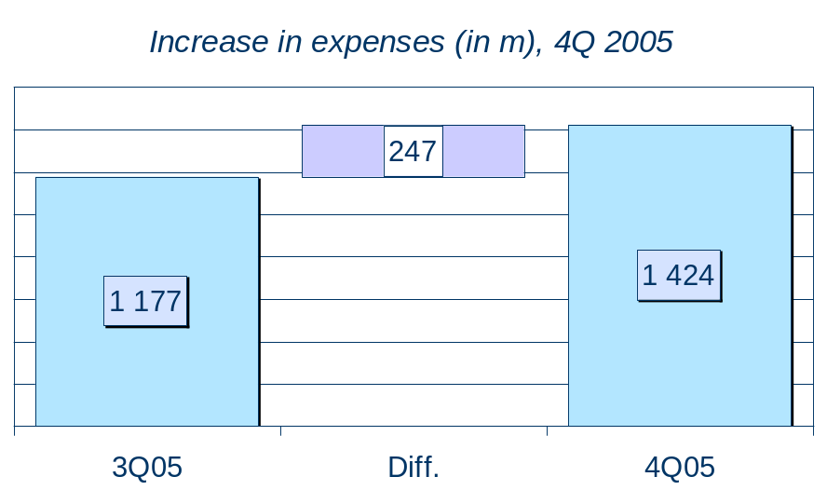
Close-up: end-of-year cost effect
Like other banks/bancassurers in Europe, KBC saw a significant 4th quarter cost increase
(up 247m, i.e. +21% q/q)
However:
  the 4Q05 cost level is not more than that of 4Q04 (1 424m)
  when stripping out the main one-off items in both 4Q04 (130m restructuring charges
  in the European banking division) and 4Q05 (100m pension liability charge in Belgium), the 4Q05 cost increase is the same of that of 4Q04 (147m)

Slide 31
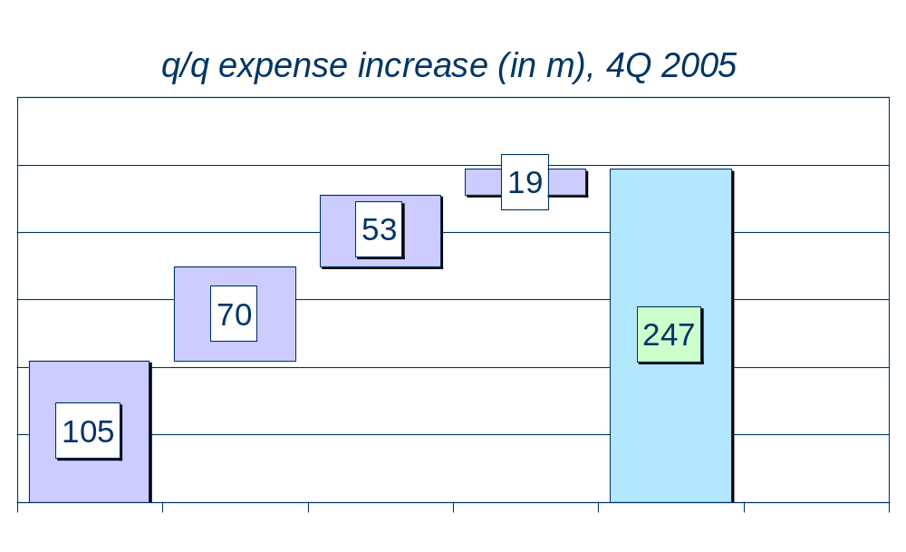
Close-up: end-of-year cost effect
Other
Total
Markets
CEE
Retail
The q/q cost increase in 4Q05 was, to a large extent, non-recurring and/or seasonal in nature or related to the higher income in the capital markets division.
Main items include:
  Retail: one-off pension charge (86m) and FY profit-sharing staff bonus adjustments (20m)
  CEE: one-off real-estate-related costs (ca. 20m) and seasonal marketing (and rebranding) costs to underpin growth (ca. 15m vs. 10m in 4Q04), among other things
  Markets: income-related staff costs (+50m q/q)
  Other areas of activity: one-off pension charge (ca. 10m)

Slide 32
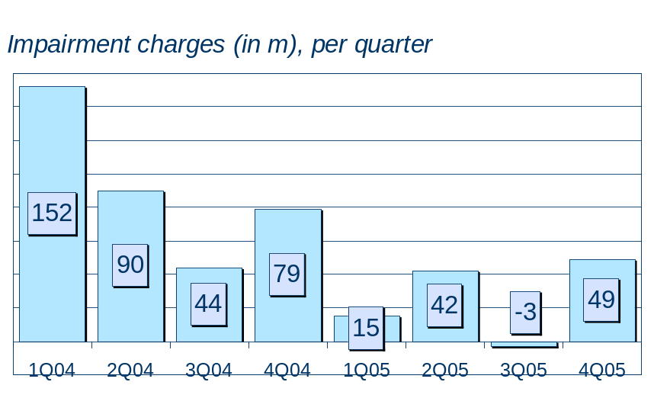
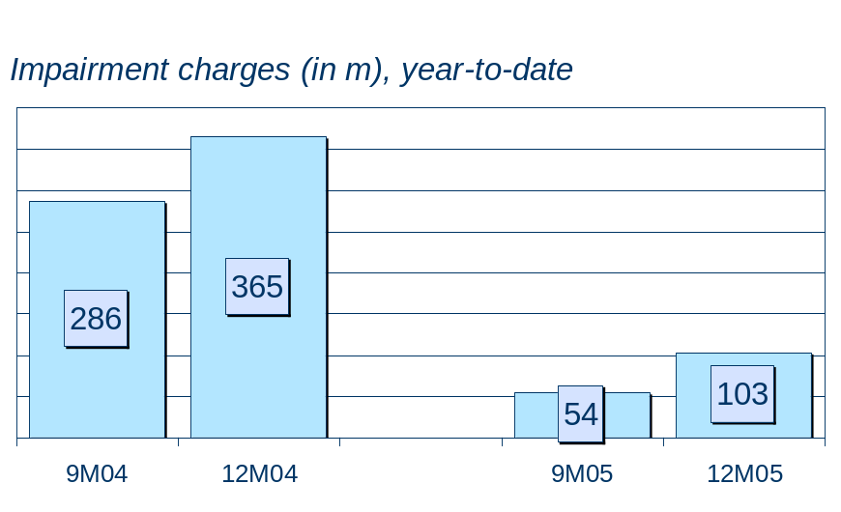
Historic low impairment level
-254%
Impairments down 262m (very low credit-risk charges)
Loan-loss ratio down from 0.20% to 0.01%
Q4 impairments remain at historic low levels (net write-back of 5m regarding the impairment on loans and receivables)
Impairment on the participation of Agfa-Gevaert to reflect the drop in share price and the discount for the cost of sale
LLR | FY 03 | FY 04 | FY 05
Belgium | 0.24% | 0.09% | 0.03%
CR/Slovakia | 0.34% | 0.26% | 0.40%
Hungary | 0.32% | 0.64% | 0.69%
Poland | 8.68% | 0.69% | 0.00%
International | 0.48% | 0.26% | 0.00%
Total | 0.71% | 0.20% | 0.01%

Slide 33
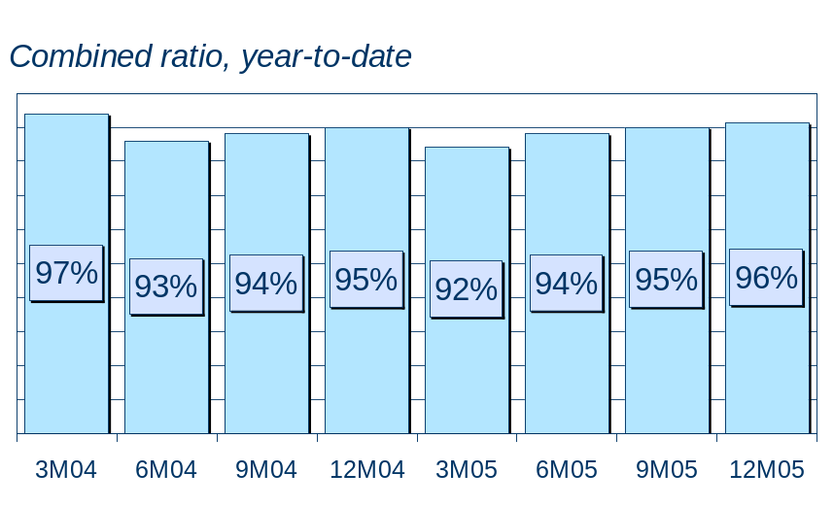
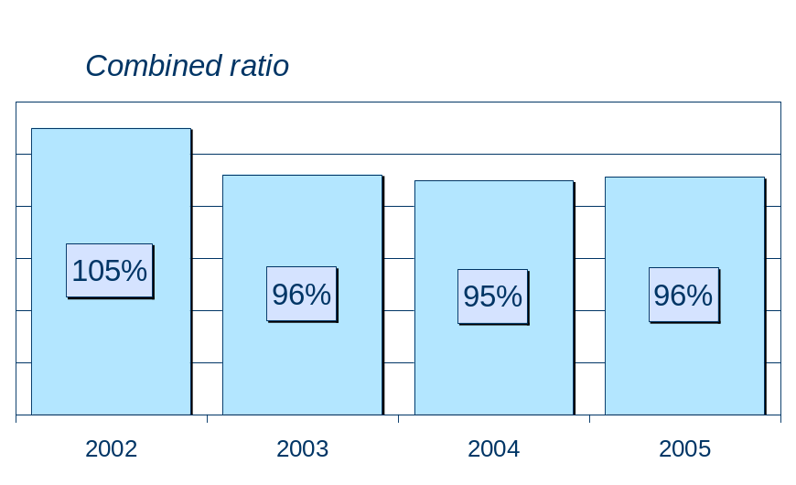
Excellent underwriting result, non-life
Q4 sligthly higher q/q, mainly due to seasonal pattern in expense ratio
Combined ratio at 96% on the back of:
  Sound risk management (claims ratio at 63%)
  Good cost control (expense ratio at 33%)
C/R | FY03 | FY04 | FY05
Belgium | 93% | 92% | 95%
Czech Rep. | 102% | 99% | 98%
Slovakia | 146% | 138% | 120%
Hungary | 103% | 98% | 97%
Poland | - | 95% | 98%
R/I | 100% | 98% | 92%
Total | 96% | 95% | 96%

Slide 34
2005 highlights
Presentation of results
- Group financial performance
- Headlines per segment
2006 outlook
Foto gebouw

Slide 35
Areas of activity
KBC Group NV
Banking
Insurance
Asset
Management
Private
banking
Gevaert
1
Retail and private bancassurance
2
SME/corporate customers
3
CEE
4
Markets
5
European
private banking
6
Gevaert

Slide 36
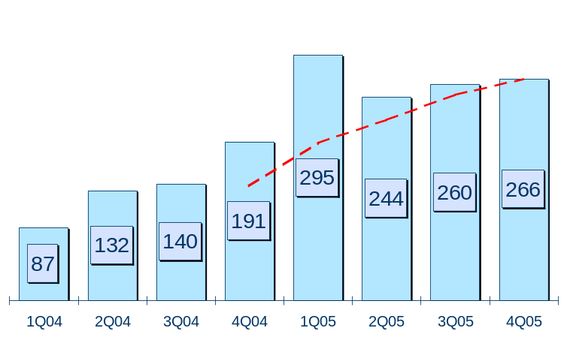
Retail (mainly) Belgium
4Q performance:
Strong profitability trend continues in Q4
Profit up 6m q/q, supported by the repeated strong performance in life insurance (record level, anticipating the change in fiscal treatment as of 2006) and AM, offsetting the 86m* one-off pension charge
Full-year trend:
FY profit at 1064m, up 514m (x2), generating ROAC of 28% (16% in FY04):
  Sound revenue growth (esp. related to investment products and life insurance)
  Sustained cost discipline: cost/income 59%, down from 67% in FY04
  Solid P&C underwriting performance: combined ratio at 95%
  Absence of credit provisioning and the normalisation of value impairments on the investment portfolio (162m in FY04)
The Belgian ‘Private banking’ sub-segment contributes 70m (vs. 42 m in FY04)
Net profit (in m)
4 Q moving average
Key data 2005:
- Gross income growth: +19%**
- Cost/income, banking: 59%
- Loan-loss ratio: 0%
- Combined ratio, non-life: 95%
* 100m of which 86m in retail - ** gross income excl. technical charges, insurance

Slide 37
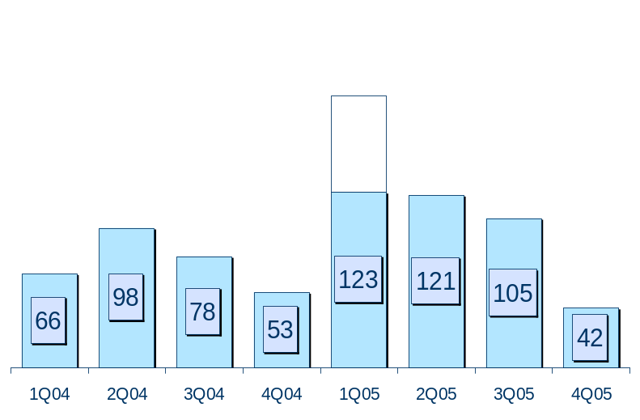
CEE
4Q performance:
Net profit at 42m
Continued top-line growth trend
negatively impacted by higher costs and
a 20m catch-up of life deficiency reserves
Full-year trend:
Profit at 458m, up 165m (+56%) generating
a return on allocated capital of 39% (29% in ‘04):
  In CR/Slovakia: net profit 296m, driven by steady volume (RWA+20%) and income growth. C/I and LLR at resp. 53% and 0.40%
  Poland: net profit 100m (incl. 21m net deferred taxes) due to sound cost trend
  (-1%), absence of loan losses and higher contribution from insurance (+13m)
  Hungary: net profit 42m with operating income up 40%, but higher provisions for NPL’s (LLR 0.69%, however still lower than major peer)
  Slovenia (minority): net contribution 20m
Net profit (in m)
*
* excl. 68m one-off net income in 1Q05
Key data 2005:
- Gross income growth: +16%
- Cost/income, banking: 62%
- Loan-loss ratio: 0.37%
- Combined ratio, non-life: 99%

Slide 38
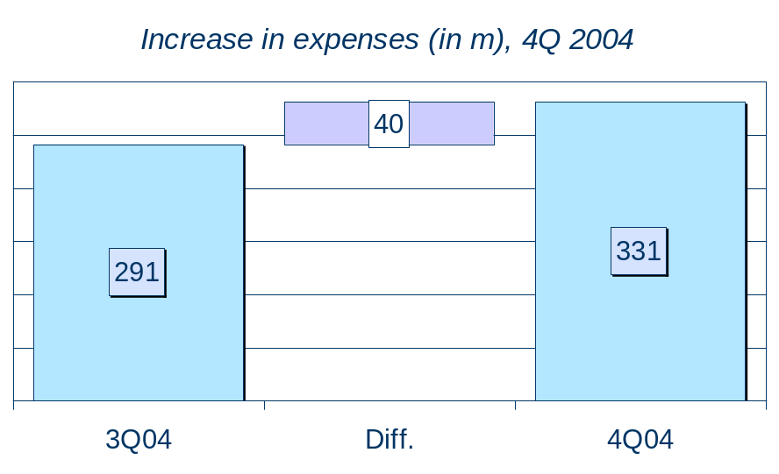
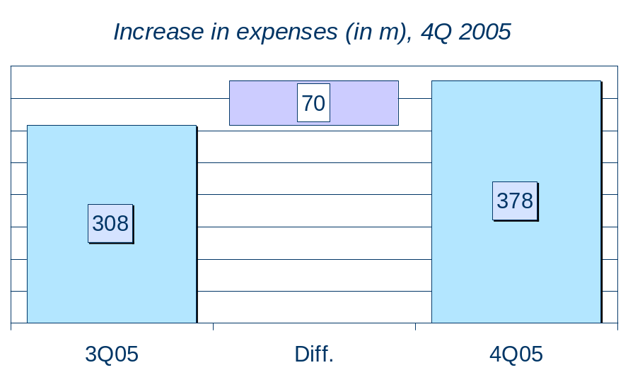
CEE: end-of-year cost increase
4Q05 profitability was depressed by a significant increase in costs (30m more than that of 4Q04)
Ca. 20m (one-off) of this was related to the Prague real-estate project (including relocation of head-office function outside of Prague’s historical centre). However, this cost item has been more than offset by:
  10m reversal of impairments on real estate in 4Q05 (recognised on an other P&L line)
  Ca. 30m income in Jan-2006 on the occasion of the settlement of real-estate sales transaction (“quarter mismatch” of income and expenses)
Ca 5m was related to one-off marketing and rebranding costs

Slide 39
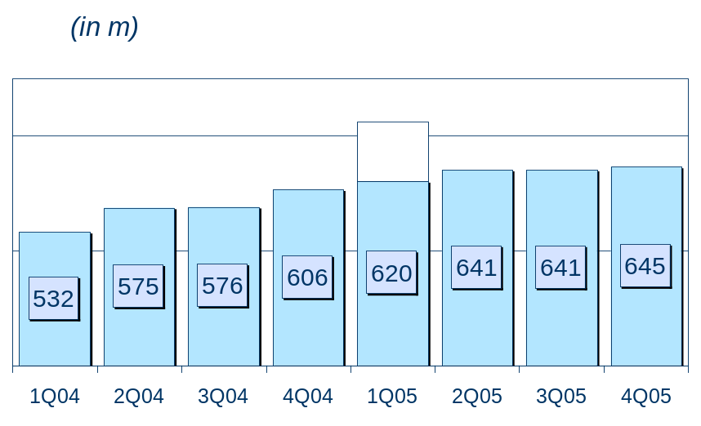
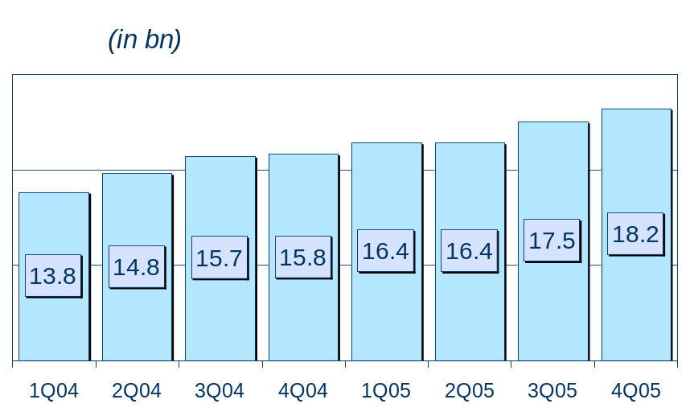
CEE – organic business growth
Gross income
Risk-weighted assets
FY2005
+16% y/y
FY2005
+15% y/y
*
Revenue in CEE has grown steadily every quarter
The gross margin (on RWA) increased somewhat from 9.6% to 9.9%, i.e. growth of non-interest income offsets pressure on NIM
* excl. one-off income related to the settlement of a non-performing loan to the Slovak State

Slide 40
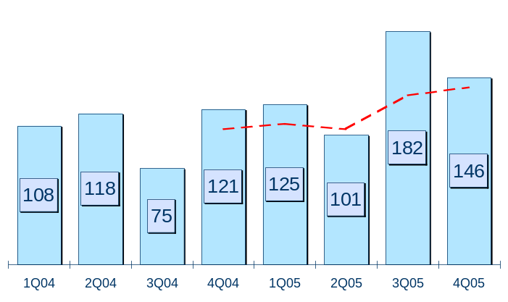
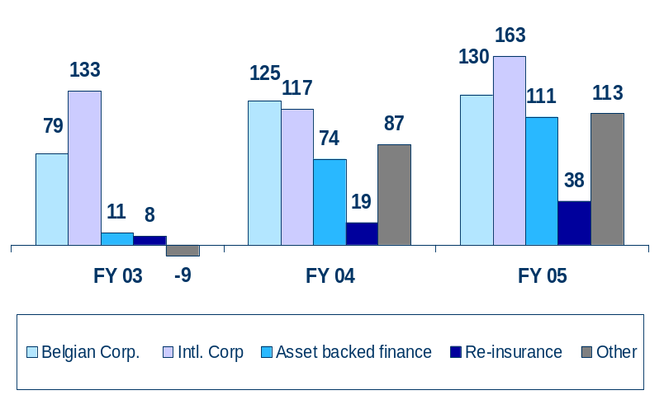
SME/Corporate customers
Q4 performance:
Profit contribution (146m) down q/q after Q3 income was boosted by the revaluation of the private equity portfolio (since Telenet was IPO’ed, it is valued on FV basis)
Full-year trend:
Net profit at 554m, up 132m y/y (+31%)
Successful income growth on the back of sound asset growth (RWA +19%) and stable gross margin incl. fee-business (gross margin on RWA at 2.9%)
Sustained high cost efficiency: cost/income ratio at 35% (stable y/y)
Net write-back of loan-loss charges (i.e. loan-loss ratio 0%) resulting from limited loan losses in Belgium (15m) and write-backs on the international loan book (partly ‘US energy’)
Solid underwriting result of inbound re-insurance activities: combined ratio at 92% (98% in ‘04)
Return on allocated capital of 24% (19% in ‘04)
Net profit (in m)
4 Q moving average
Net profit (in m), geographical breakdown
*
* incl. project finance, real estate finance, trade finance, leasing, factoring

Slide 41
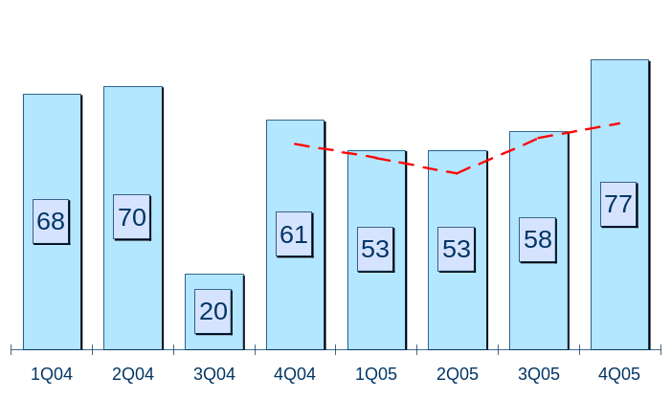
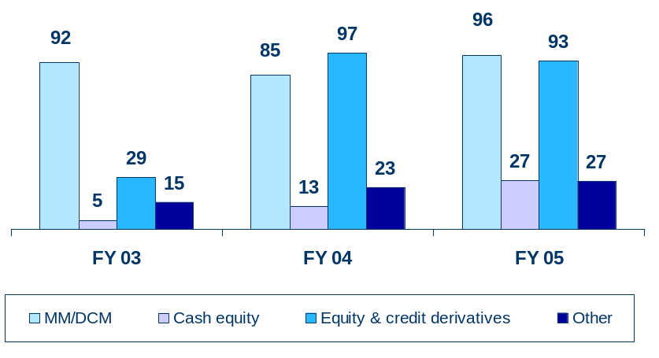
Capital markets
Q4 performance:
Profit (77m) at highest level in the last 2 years
Strong income (mostly related to the structured credit business), partly offset by higher income-related staff expenses and taxes
Full-year trend:
Net profit at 241m, up 22m y/y (+10%)
Results improved in:
  Money & debt markets: up 13% to 96m
  Cash equity business: x2 to 27m
Results of equity & credit derivatives markets (total of 93m) saw a mixed picture:
  Equity derivates/convertibles: x6
  Alternative Investment Management significantly weaker (down 78%)
  Structured credit: up 14%
Cost/income at 58% (61% in ‘04)
Return on allocated capital: 32% (34% in ‘04)
Net profit (in m)
4 Q moving average
Net profit (in m), activity breakdown
*
* incl. AIM and structured credit products

Slide 42
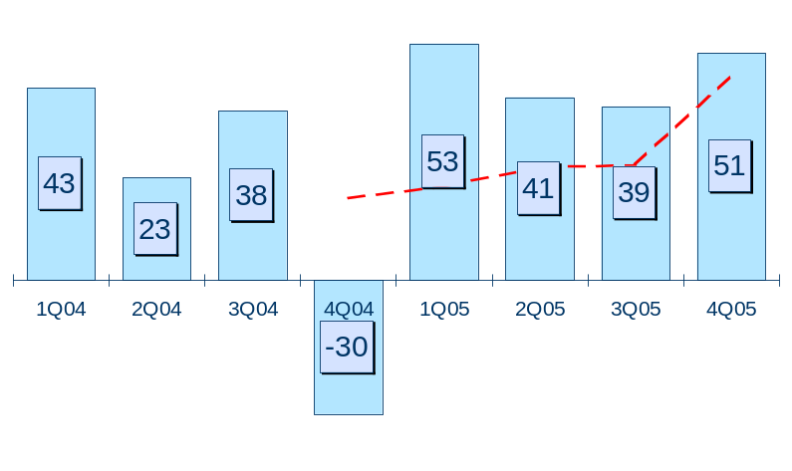
European private banking
Q4 performance:
Profit contribution (51m) higher than previous 2 quarters:
  Steady growth of F&C income (AUM up 8% q/q)
  M2M of trading instruments compensated by better NII of trading instruments and the write-back of impaiments on AFS assets
Full-year trend:
Net profit at 184m, up 110m (x2.5)
  Income up 5% - sustained growth trend of F&C income out of private banking and custody operations
  Expenses down 11% (lower restructuring costs) – cost/income ratio down to 72% from 85%
  AUM up 29% to 65 bn (though partly due to expansion of the consolidation scope)
  Risk-weighted assets down 10% (further reduction of commercial credit exposure, in line with strategy) and zero loan loss charges
Net profit (in m)
4 Q moving average
Key data 2005:
- AUM growth: +29%
- Gross income growth: +5%
- Cost/income: 72%

Slide 43
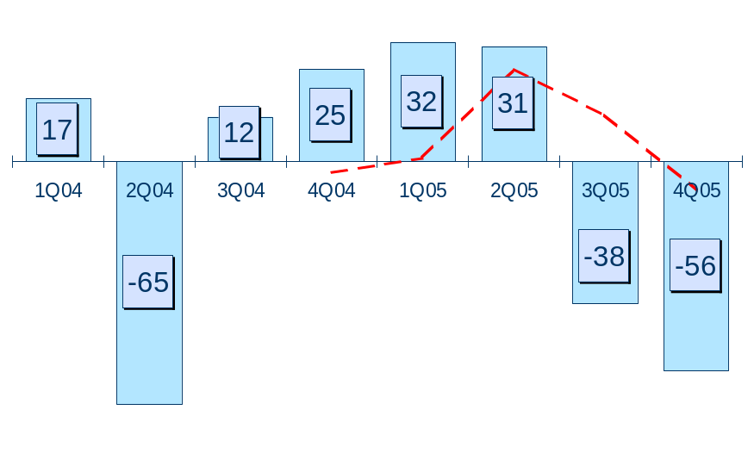
Gevaert
Q4 performance:
Loss (-56m) mainly related to the 49m impairment on the Agfa-Gevaert (AG) stake
Since AG - a stock-listed company - will publish its Q4 results after KBC, its Q4 results are not taken into KBC accounts
Full-year trend:
Activities have been divested (except for AG, which - given its size - takes some more time to dispose of)
Loss (-32m) largely the result of:
  The ‘integration process’, witnessed by 40m gains on disposals, 14m impairment losses and taxes on dividend upstreaming
  Loss charges on the stake in AG (restructuring provisions at AG-level and impairment on the equity holding at KBC-level)
Net profit (in m)
4 Q moving average
Gevaert is a 100% subsidiary of KBC and holds 34.1 million shares of Agfa-Gevaert (Bloomberg ticker code AGFB BB), which represents a 27% stake. The investment in Agfa-Gvevaert is considered to be non-core. Its book value in KBC’s accounts stands at 495m euros at 31-Dec-05.

Slide 44
2005 highlights
Presentation of results
- Group financial performance
- Headlines per segment
2006 outlook
Foto gebouw

Slide 45
Update on capital strategy
 | Capital plan 2006-’07 | Achieved 1Q 2006
Immediately available excess, Start | 2.5 bn
Organic capital generation | +1.9 bn | n/a
Investments: - Buy-out of third parties, CEE - Acquisitions, mainly in CEE - Accelerated organic development | -2.5 bn | -0.5 bn
Share buy-back, 2006 | -1.0 bn | -0.2 bn
Reduction of debt position of Holding Co | -0.5 bn | -0.4 bn
Immediately available excess, End | 0.4 bn
The capital spending initiatives that were announced in Dec-05, have been launched and preparation/execution is progressing according to plan
To date, an amount of 1.1 bn has been used towards the buy-out of the third-party stake in K&H Bank (Hungary – 0.5 bn), the share buy-back programme (0.2 bn) and the reduction of the net debt position of the Group’s holding company (0.4 bn)
Within the share buy-back programme, in the first two months of 2006, 2 335 750 shares have been acquired (representing 11% of the year-to-date trading volume) at a an average price of 84.17 euros.

Slide 46
Profit outlook, 2006
KBC is confident about the growth potential of its strategy and currently has a predominantly positive outlook on the economic environment. In light of this, KBC is optimistic on its business developments in 2006
Moreover, the 2006 share buy-back programme (1 bn euros) will further enhance the growth of KBC’s earnings per share

Slide 47
Additional information
Since the buy-out of minority stake in K&H Bank (Hungary) is expected to be settled in Q1, the P/L impact of this transaction (discontinuation of minorities adjustments and additional funding charges) will most probably come through as of Q1
As part of our head-office relocation programme in Prague, the downtown area real-estate property has been sold, generating a Q1 pre-tax profit of 30m
(situation as at end of Feb-06)
The disposal of a share holding (AFS portfolio) in Q1 on the occasion of a tender offer will generate a value gain of appx. 68m
(Reminder) A new segment-reporting format will be used as of 1Q 2006, and pro forma 2005 quarterlies will be published accordingly (date of publication: 31 March 2006)
As over the last 12 months Gevaert’s activities have been integrated (except Agfa Gevaert), the legal entity will cease to exist after the legal merger with KBC Group NV (to be achieved in April 2006). This is expected to generate both some transaction costs (mostly tax-related) and some benefits (in the area of pension liabilities)

Slide 48
Financial calendar
Pro forma 2005 quarterly segment accounts (new 2006 format)
31 March 2006
AGM (annual accounts, dividend, etc.)
EGM (legal merger by absorption of Gevaert by KBC Group NV)
27 April 2006
Embedded value as at 31-12-05, insurance business
28 April 2006
Dividend payout
2 May 2006
1Q 2006 earnings
30 May 2006

Slide 49
Foto gebouw
3
Additional information
on the 2005 accounts

Slide 50
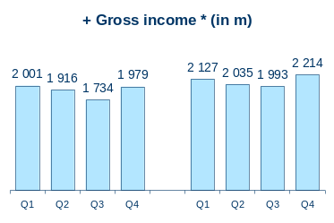
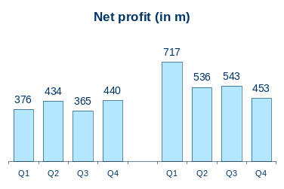
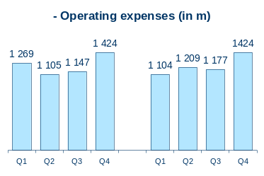
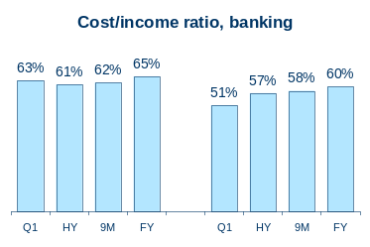
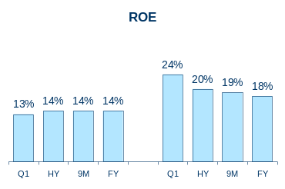
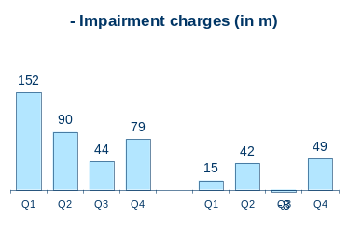
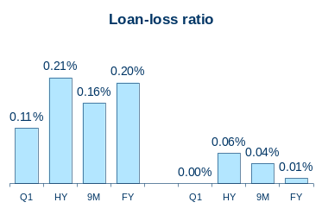
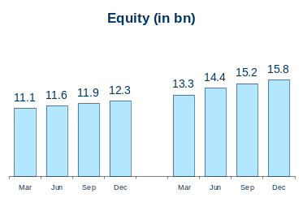
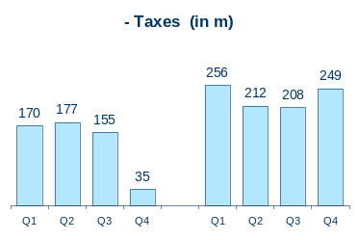
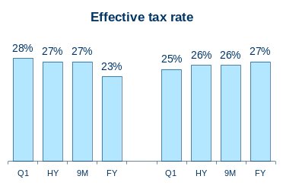
Financial performance, quick scan
* Gross income minus
technical charges, insurance
2004
2005
2004
2005
Return on adjusted equity
2004
2005

Slide 51
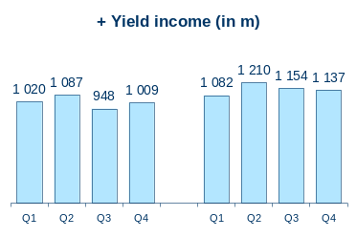
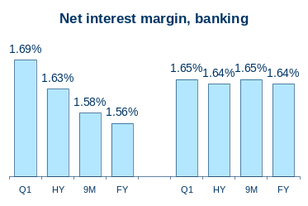
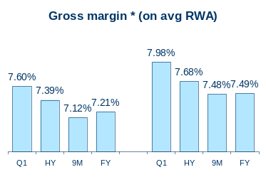








Financial performance, quick scan (2)
2004
2005
*Gross income minus technical chgs, insurance
2004
2005
*Gross income minus technical charges, insurance
* in 2005, only partly recognised as ‘income’
2004
2005
*Gross income minus technical chgs, insurance

Slide 52
Group earnings, by quarter
(IFRS, in m euros) | 1Q04 | 2Q04 | 3Q04 | 4Q04 | 1Q05 | 2Q05 | 3Q05 | 4Q05
Net interest income Gross earned premium, insurance Dividend income Net gains from FI at FV Net realised gains from AFS assets Net fee and commission income Other income | 995 1 275 25 224 193 357 106 | 966 1 404 121 191 60 324 113 | 910 901 39 123 93 323 128 | 963 1 577 46 187 157 399 132 | 1 048 729 34 133 168 429 215 | 1 074 978 135 92 97 410 118 | 1 129 810 25 123 49 452 112 | 1 097 1 034 41 165 144 528 130
Gross income | 3 175 | 3 178 | 2 517 | 3 462 | 2 756 | 2 904 | 2 699 | 3 138
Operating expenses Impairments - of which on loans and receivables - of which on AFS assets Gross technical charges, insurance Ceded reinsurance result Share in results, associated companies | -1 269 -152 -33 -119 - 1 169 -5 20 | - 1 105 -90 -74 -12 -1 240 -22 -60 | -1 147 -44 -15 -18 -771 -12 34 | -1 424 -79 -76 -2 -1 454 -29 28 | -1 104 -15 3 -16 -612 -17 21 | -1 209 -42 -38 0 -852 -17 13 | -1 177 3 -5 13 -696 -10 19 | - 1 424 - 49 5 9 - 899 - 26 2
Profit before taxes | 602 | 662 | 577 | 504 | 1 030 | 797 | 800 | 743
Income tax expense Minority interests | -170 -55 | -177 -51 | -155 -57 | -35 -29 | -256 -57 | -212 -48 | -208 -48 | - 249 - 41
Net profit | 376 | 434 | 365 | 440 | 717 | 536 | 543 | 453
Of which banking insurance asset management european private banking Gevaert holding company | 332 -55 51 43 17 -12 | 367 58 58 23 -65 -7 | 246 30 53 38 12 -13 | 318 89 66 -30 25 -27 | 470 122 58 53 32 -18 | 314 124 68 41 31 -41 | 363 120 74 39 -38 -14 | 313 95 86 51 - 56 -36

Slide 53
FY05 earnings, by area of activity
(in m euros) | Retail | CEE | SME/ Corp. | Markets | European private banking | Gevaert | Total
Banking and AM
Gross income Operating expenses Impairments Income tax expense Minority interests Net profit – group share | 2 609 - 1 538 16 - 341 0 747 | 1 795 - 1 115 - 73 - 99 - 73 438 | 1 073 - 377 32 - 205 - 8 516 | 880 - 508 - 3 - 128 0 241 | 782 - 563 23 - 53 - 7 184 | 137 - 70 - 62 - 22 0 - 32 | 7 302 - 4 368 - 73 - 781 - 199 1 897
Insurance
Gross income (- tech. ch.) Operating expenses Impairments Income tax expense Minority interests Net profit – group share | 740 - 320 - 19 - 91 7 318 | 217 - 178 - 1 - 8 - 10 20 | 86 - 26 - 1 - 19 - 1 38 |  |  |  | 1 129 - 523 - 30 - 118 - 5 462
Holding Co
Net profit – group share |  |  |  |  |  |  | - 109
Group total
Net profit – Group share Share in group result ROAC | 1 064 47% 28% | 458 20% 39% | 554 25% 24% | 241 11% 32% | 184 8% 32% | - 32 - 1% - | 2 249 100% 18%
Excl. non-allocated results

Slide 54
Reminder: changes in segment reporting, 2006
In order to further increase its financial transparency, as of 1Q2006, KBC plans to:
discontinue to use its current matrix reporting format and apply its new business unit structure as the major segment reporting criterion (i.e. Retail & PB Belgium, CEE, European private banking, Merchant Banking, Group Centre);
no longer restate historical time series;
disclose its area of activity results in a full P&L format (which was previously not the case);
fully allocate the results of each subsidiary to a single segment (e.g., KBC Lease’s activities will be allocated entirely to the merchant banking division, whereas previously, part of the results – although predominantly ‘corporate’ – had been recognised under the ‘retail’ division); ¹
stop imputing the impact of capital ‘normalisation’ adjustments on the segment bottom-line ². In return, the funding costs of the equity participations will be allocated to the relevant segments;
considerably limit the number of ‘group centre’ items to:
  the results of the holding company and the non-allocated expenses of KBC Bank NV that can be deemed holding-company overheads (e.g., strategic consultancy fees, BoD expenses, ‘group-level’ operating provisions, etc.)
  the results of the co-sourcing vehicles (such as Fin-Force) and special purpose funding vehicles. As a rule, within these entities, expenditure is covered by the service users, so, barring any timing differences, the impact on the bottom line tends to be immaterial;
  results of non-core equity holdings, such as Agfa-Gevaert (as long as it belongs to the Group) and the equity investment portfolio of KBC Bank NV.
  ¹ An exception has to be made for KBC Bank NV Belgium’s activities.
  ² However, for calculating the return on allocated capital, the current capital allocation methodology (8% Tier-1, etc.) will be left unchanged.

Slide 55
Retail segment, by quarter
(in m euros) | 1Q04 | 2Q04 | 3Q04 | 4Q04 | 1Q05 | 2Q05 | 3Q05 | 4Q05
Banking and AM
Gross income Operating expenses Impairments Income tax expense Minority interests Net profit – group share | 585 - 377 - 7 - 55 0 145 | 559 - 391 - 10 - 56 0 101 | 528 - 359 - 3 - 51 0 114 | 567 - 370 - 12 - 59 0 126 | 659 -371 12 -87 0 213 | 629 - 363 - 6 - 91 0 170 | 620 - 355 3 - 83 0 185 | 701 - 449 6 - 80 0 178
Insurance
Gross income (- techn. ch.) Operating expenses Impairments Income tax expense Minority interests Net profit – group share | 152 - 78 - 127 - 10 0 - 58 | 168 - 79 - 35 - 30 0 30 | 129 - 71 - 22 - 18 0 26 | 136 - 81 22 -14 0 65 | 178 -74 - 11 - 11 0 82 | 195 - 82 - 3 - 35 0 74 | 146 - 76 6 - 19 17 75 | 221 - 87 - 10 - 26 - 9 87
Group total
Net profit – Group share Share in group result ROAC | 87 23% 11% | 132 30% 16% | 140 38% 17% | 191 43% 23% | 295 41% 33% | 244 45% 27% | 260 48% 27% | 266 59% 29%

Slide 56
CEE segment, by quarter
(in m euros) | 1Q04 | 2Q04 | 3Q04 | 4Q04 | 1Q05 | 2Q05 | 3Q05 | 4Q05
Banking and AM
Gross income Operating expenses Impairments Income tax expense Minority interests Net profit – group share | 355 - 239 3 - 33 - 19 70 | 379 - 248 - 23 - 25 - 11 73 | 393 - 245 - 36 - 26 - 15 75 | 400 - 284 - 19 - 27 - 12 59 | 522 - 253 - 5 - 59 - 25 181 | 403 - 273 - 2 -11 - 16 101 | 439 -265 -34 - 26 - 16 100 | 431 - 325 - 32 - 3 - 15 56
Insurance
Gross income (- techn. ch.) Operating expenses Impairments Income tax expense Minority interests Net profit – group share | 32 - 41 0 3 0 - 58 | 75 - 42 - 1 - 4 - 4 24 | 54 - 45 0 - 5 - 2 3 | 42 - 47 - 3 2 0 - 6 | 61 - 41 - 1 - 6 - 2 10 | 70 - 42 0 - 4 - 4 19 | 53 - 43 0 - 3 - 2 5 | 34 - 53 0 0 - 1 - 14
Group total
Net profit – Group share Share in group result ROAC | 66 17% 28% | 98 23% 38% | 78 21% 31% | 53 12% 21% | 191 27% 66% | 121 22% 42% | 105 19% 37% | 42 9% 16%

Slide 57

Banking in CR/Slovakia, by quarter
Income statement, CSOB Bank (CR/Slovakia) (in m euros) |  | 1Q04 | 2Q04 | 3Q04 | 4Q04 | 1Q05 | 2Q05 | 3Q05 | 4Q05
Statutory accounts | Net interest income Dividend income Net gains from FI at FV Net realised gains from AFS Net fee and commission income Other income Gross income, total | 123 1 6 5 50 17 202 | 120 -1 23 8 51 14 216 | 111 1 29 -0 53 8 201 | 124 2 12 -2 52 13 202 | 124 4 19 4 58 114 323 | 128 2 26 2 57 9 224 | 129 -4 26 7 60 41 259 | 138 0 26 6 60 21 251
 | Operating expenses | -114 | -120 | -122 | -124 | -122 | -143 | -120 | -180
 | Subtotal | 88 | 96 | 79 | 78 | 200 | 81 | 140 | 72
 | Impairments Share in result of associated companies Taxes | -4 0 -28 | -6 0 -20 | -14 0 -19 | -9 0 -23 | 5 0 -54 | 2 0 - 7 | -23 0 - 31 | -27 0 - 5
 | Net statutory profit | 56 | 69 | 46 | 47 | 151 | 76 | 86 | 39
Profit contribution to Group | Net statutory profit Consolidation adjustments Minority interests | 56 -1 -8 | 69 -1 -4 | 46 -1 -4 | 47 0 -4 | 151 19 -17 | 76 -0 -7 | 86 -1 -7 | 39 -5 -3
 | Subtotal | 48 | 65 | 41 | 42 | 154 | 69 | 78 | 32
 | Transfer of income on excess capital to ‘Group item’ | -6 | -6 | -5 | -4 | -6 | -6 | -9 | -8
 | Profit contribution, Group share | 42 | 59 | 35 | 38 | 148 | 63 | 68 | 24
Return | Return on allocated capital, Ytd Return on investment, Ytd | 44% 12% | 49% 14% | 42% 13% | 39% 12% | 120% 34% | 83% 26% | 73% 24% | 56% 20%

Slide 58

Banking in Hungary, by quarter
Income statement, K&H Bank (in m euros) |  | 1Q04 | 2Q04 | 3Q04 | 4Q04 | 1Q05 | 2Q05 | 3Q05 | 4Q05
Statutory accounts | Net interest income Dividend income Net gains from FI at FV Net realised gains from AFS Net fee and commission income Other income Gross income, total | 51 0 20 1 16 4 91 | 54 0 18 -0 18 1 90 | 63 0 17 0 23 3 106 | 59 0 42 0 37 6 144 | 54 0 25 -0 25 3 106 | 54 0 25 0 18 4 101 | 61 0 23 0 22 3 109 | 58 0 24 0 28 5 115
 | Operating expenses | -63 | -66 | -70 | -101 | -68 | -74 | -84 | -74
 | Subtotal | 28 | 24 | 37 | 43 | 38 | 28 | 25 | 41
 | Impairments Share in result of associated companies Taxes | 9 1 -7 | -11 1 -1 | -10 1 -5 | -26 0 -11 | -10 1 -8 | -16 1 - 3 | -5 1 -5 | -7 0 -8
 | Net statutory profit | 31 | 13 | 23 | 6 | 21 | 10 | 16 | 26
Profit contribution to Group | Net statutory profit Consolidation adjustments Minority interests | 31 -0 -8 | 13 -0 -5 | 23 -0 -7 | 6 -1 -7 | 21 -0 -5 | 10 -0 -5 | 16 -0 -6 | 26 -1 -10
 | Subtotal | 23 | 8 | 16 | -2 | 15 | 5 | 10 | 15
 | Transfer of income on excess capital to ‘Group item’ | -11 | -1 | -7 | 12 | -8 | 3 | -1 | -1
 | Profit contribution, Group share | 12 | 7 | 10 | 10 | 7 | 7 | 9 | 15
Return | Return on allocated capital, Ytd Return on investment, Ytd | 29% 23% | 22% 16% | 23% 16% | 23% 15% | 17% 15% | 18% 11% | 18% 11% | 21% 13%

Slide 59

Banking in Poland, by quarter
Income statement, Kredyt Bank (in m euros) |  | 1Q04 | 2Q04 | 3Q04 | 4Q04 | 1Q05 | 2Q05 | 3Q05 | 4Q05
Statutory accounts | Net interest income Dividend income Net gains from FI at FV Net realised gains from AFS Net fee and commission income Other income Gross income, total | 54 0 3 3 10 4 74 | 53 0 6 -0 13 4 76 | 44 0 9 9 11 8 81 | 41 0 11 0 17 13 82 | 50 0 12 1 16 3 83 | 51 0 6 -3 6 5 66 | 52 0 7 2 13 3 78 | 56 0 10 -6 15 6 82
 | Operating expenses | -60 | -60 | -51 | -71 | -59 | -54 | -59 | -69
 | Subtotal | 15 | 17 | 29 | 11 | 24 | 12 | 19 | 13
 | Impairments Share in result of associated companies Taxes | -2 2 -1 | -7 1 -1 | -12 4 -1 | -3 0 -1 | 0 1 -1 | 12 -0 10 | -6 0 9 | 3 0 5
 | Net statutory profit | 14 | 9 | 20 | 7 | 23 | 34 | 23 | 21
Profit contribution to Group | Net statutory profit Consolidation adjustments Minority interests | 14 -0 -3 | 9 -0 -2 | 20 -0 -4 | 7 -1 -1 | 23 -1 -3 | 34 -0 -5 | 23 -0 -3 | 21 -1 -3
 | Subtotal | 11 | 7 | 15 | 5 | 19 | 29 | 20 | 18
 | Transfer of income on excess capital to ‘Group item’ | -0 | 0 | -1 | -2 | -2 | -1 | -4 | -3
 | Profit contribution, Group share | 10 | 7 | 14 | 3 | 17 | 28 | 16 | 18
Return | Return on allocated capital, Ytd Return on investment, Ytd | 25% 6% | 23% 5% | 25% 6% | 20% 6% | 32% 11% | 32% 11% | 40% 13% | 21% 13%

Slide 60
Corporate segment, by quarter
(in m euros) | 1Q04 | 2Q04 | 3Q04 | 4Q04 | 1Q05 | 2Q05 | 3Q05 | 4Q05
Banking and AM
Gross income Operating expenses Impairments Income tax expense Minority interests Net profit – group share | 229 - 82 -6 - 38 0 103 | 246 - 87 - 15 - 30 0 115 | 220 - 81 - 19 - 42 0 78 | 265 - 87 - 42 - 30 0 106 | 258 - 94 -12 - 39 0 113 | 250 - 89 - 21 - 45 0 95 | 313 - 86 31 - 64 - 17 176 | 252 - 109 34 - 56 10 131
Insurance
Gross income (- techn. ch.) Operating expenses Impairments Income tax expense Minority interests Net profit – group share | 17 - 7 - 1 - 4 0 5 | 11 - 7 1 - 2 0 2 | 10 - 7 - 5 - 1 - 0 - 3 | 16 - 7 10 - 4 - 1 15 | 25 - 8 -4 -1 0 12 | 22 - 7 0 - 8 0 6 | 18 - 7 2 - 6 0 6 | 20 - 4 1 - 3 - 1 15
Group total
Net profit – Group share Share in group result ROAC | 108 29% 21% | 118 27% 22% | 75 21% 14% | 121 27% 22% | 125 17% 23% | 101 19% 18% | 182 34% 35% | 146 32% 23%

Slide 61
Capital markets segment, by quarter
(in m euros) | 1Q04 | 2Q04 | 3Q04 | 4Q04 | 1Q05 | 2Q05 | 3Q05 | 4Q05
Banking and AM
Gross income Operating expenses Impairments Income tax expense Minority interests Net profit – group share | 257 - 149 0 - 40 0 68 | 199 - 112 - 3 - 14 0 70 | 123 - 94 0 - 10 0 20 | 178 - 109 0 - 8 0 61 | 175 - 93 0 - 29 0 53 | 235 - 142 - 2 - 38 0 53 | 183 -110 0 - 15 0 58 | 288 - 163 0 - 47 0 77
Insurance
Gross income (- techn. ch.) Operating expenses Impairments Income tax expense Minority interests Net profit – group share
Group total
Net profit – Group share Share in group result ROAC | 68 18% 40% | 70 16% 39% | 20 5% 12% | 61 14% 38% | 53 7% 30% | 53 10% 28% | 58 11% 30% | 77 17% 41%
Excl. non-allocated results

Slide 62
European private banking, by quarter
(in m euros) | 1Q04 | 2Q04 | 3Q04 | 4Q04 | 1Q05 | 2Q05 | 3Q05 | 4Q05
Banking and AM
Gross income Operating expenses Impairments Income tax expense Minority interests Net profit – group share | 187 -122 13 -22 -13 43 | 157 -134 12 -7 -6 23 | 193 -140 10 -16 -10 38 | 210 -236 -20 7 8 -30 | 211 -134 -1 -21 -3 53 | 218 -155 -4 -18 -1 41 | 169 -144 11 4 -1 39 | 184 -130 17 -18 -2 51
Insurance
Gross income (- techn. ch.) Operating expenses Impairments Income tax expense Minority interests Net profit – group share
Group total
Net profit – Group share Share in group result | 43 12% | 23 5% | 38 10% | -30 -7% | 53 7% | 41 8% | 39 7% | 51 11%
Excl. non-allocated results

Slide 63
Number of shares outstanding
As at 31-Dec-05, the number of ordinary shares outstanding was 366.6 million
In 2006, a share buy-back programme in the amount of 1 bn euros will be carried out. At an average (hypothetical) share price of 85 euros, this corresponds to some 11.8 million shares. A proposal for deletion of shares will be submitted.
KBC reports its EPS according to a well-defined method under IFRS. The number of MCBs must be added to the number of ordinary shares, while the number of treasury shares must be deducted to come to the total number of shares outstanding. Moreover, for the calculation of the EPS, period averages are to be used .
In millions | 31/12/04 | 31/12/05
No. of ordinary shares outstanding | 366.4 | 366.6
Avg. No. of shares for basic EPS: - ordinary shares - mandatory convertibles (+) - treasury shares (-) - total, end of period - total, average year-to-date | 366.4 2.6 -9.6 359.5 359.4 | 366.6 2.6 -9.2 360.0 359.1

Slide 64
Impact of Bazel II (2007+)
Reminder:
  Credit risk: IRB Foundation method (initially)
  Operational risk: Standardised method
  Start: 2007
Impact on required capital:
  Operational risk would require approx. 1 bn euros in capital (new)
  Basel II is expected to result in lower capital requirements taken into account credit, market and operational risks
  It should be remembered that regulatory ‘floors’ will apply in 2007-09 for all institutions within the EU:
    2007: max. 5% capital savings
    2008: max. 10% capital savings
    2009: max. 20% capital savings
Our long-term capital planning (‘next project’) did take into accounts the expected impact of Bazel II

Slide 65
Foto gebouw
4
Closing remarks on
equity valuation

Slide 66

Return track record
Total shareholder return
The increased share visibility, reinforced risk management and consecutive earnings upgrades have been beneficial for the Group’s market value. Capital markets have begun to further recognise the attractiveness of KBC’s strategy.
Today, the question still remains as to whether valuation multiples fully incorporate KBC’s (recently strengthened) long-term growth potential.

Slide 67
Current valuation
Key figures:
Share price: 85.8 euros
Net asset value: 43.8 euros
FY 2005 EPS: 6.26 euros
Dailed traded volume 2005 : 44 m euro
Analyst estimates: ¹
2006 EPS consensus: 6.75 (+8.% y/y)
2006 P/E: 12.7
Recommendations:
Positive: 75%
Neutral: 25%
Negative: 0%
Valuation relative to peer group:
 | weighted P/E 2006 | unweighted P/E 2006
CEE banks ² | 17.7 | 18.5
CEE-exposed banks ³ | 15.5 | 17.1
Euro-zone banks ⁴ | 13.2 | 14.1
KBC ¹ | 12.7 | 12.7
BEL banks ⁵ | 11.2 | 11.5
Weighted and unweighted averages of IBES data :
² OTP, Komercni, Pekao, BPH PBK, BRE
³ BA-CA, Erste, Unicredit, Soc. Gen., Intesa BCI, RZB Int.
⁴ Top-20 DJ Euro Stoxx Banks
⁵ Fortis, Dexia
Situation as at 17 February 2006
¹ Smart consensus collected by KBC (20 estimates)

Slide 68
Dividend policy
(euros) | 2001 | 2002 | 2003 | 2004 | 2005
EPS | 3.39 | 3.42 | 3.68 | 5.66 | 6.26
DPS | 1.48 | 1.52 | 1.64 | 1.84 | 2.51
Payout | 44% | 44% | 45% | 41% | 40%
Yield ¹ | 3.6% | 4.2% | 4.9% | 3.7% | 3.8%
Gross DPS versus average share price - average share price 2005 = 66.18 EUR
It is KBC’s policy to maintain a steadily growing dividend. Gross DPS increased
at a CAGR of 14% over the last 5 years.
The historical average cash payout stands at 40-45%

Slide 69


















Analysts’ opinions
Broker | Name analyst | Tel | Rating | Target price
 | Ron Heydenrijk | +44 20 7678 0442 | Add | 90
 | Ivan Lathouders | +32 2 287 91 76 | Hold | 83
 | Jaap Meijer | +31 20 573 06 66 | Outperform | 94
 | Ivan Vatchkov | +44 20 7888 0873 | Outperform | 89
 | Carlo Ponfoort | +32 3 204 77 11 | Buy | 99
 | Gaelle Jarrousse | +44 20 7547 6226 | Hold | 82
 | Patrick Leclerc | +33 1 42 99 25 12 | Neutral | 90
 | Kurt Debaenst | +32 2 565 60 42 | Buy | 94
 | Alain Tchibozo | +33 1 56 39 32 84 | Buy | 106
 | Christophe Ricetti | +33 1 58 55 05 22 | Add | 87.5
 | Paul Formanko | +44 20 7325 6028 | Overweight | 92
 | Jean-Pierre Lambert | +44 20 7663 5292 | Outperform | 100
 | Albert Ploegh | +31 20 563 2382 | Buy | 91
 | Denise Vergot-Holle | +44 20 7995 1746 | Buy | 90
 | Scander Bentchikou | +33 1 44 51 83 08 | Add | 87
 | Ton Gietman | +31 20 573 54 63 | Hold | 78
 | Bart van der Feen de Lille | +31 20 460 48 65 | Hold | 92
 | Esther Dijkman | +33 1 42 13 84 17 | Neutral | Review
 | Simon Chiavarini | +44 20 7568 2131 | Buy | 101
 | Ralf Breuer | +49 211 826 4987 | Outperform | 90

