Slide 1
Printfarmer
A networking solution to 3D Printing Arrays
Chris Thierauf

Slide 2

Background- 3D Printing
3D Printing allows for complex physical objects to be created cheaply
Much more cost effective in low volumes than traditional manufacturing solutions
Can create parts that would be impractical for other techniques (e.g., injection molding)
3D printing as a tool for mass production becoming much more popular

Slide 3
Problem Statement
Mass production requires a large array of printers
Printers are controlled independently
  More time consuming to operate, time = money
Printers are monitored independently
  Harder to access and view all states
  Larger risk of failed prints or damaged machines

Slide 4
Solution
Put all printers on the same network
Have a control station on that same network
Allow users to control all printers from that control station
Host a local control website on the control station
Port-forward the control website to the rest of the network

Slide 5
Application
IEEE Lab space
Has 2 operational printers, will soon have 4
Similar scenario to previous problem
Having this solution would allow for greater productivity in projects

Slide 6
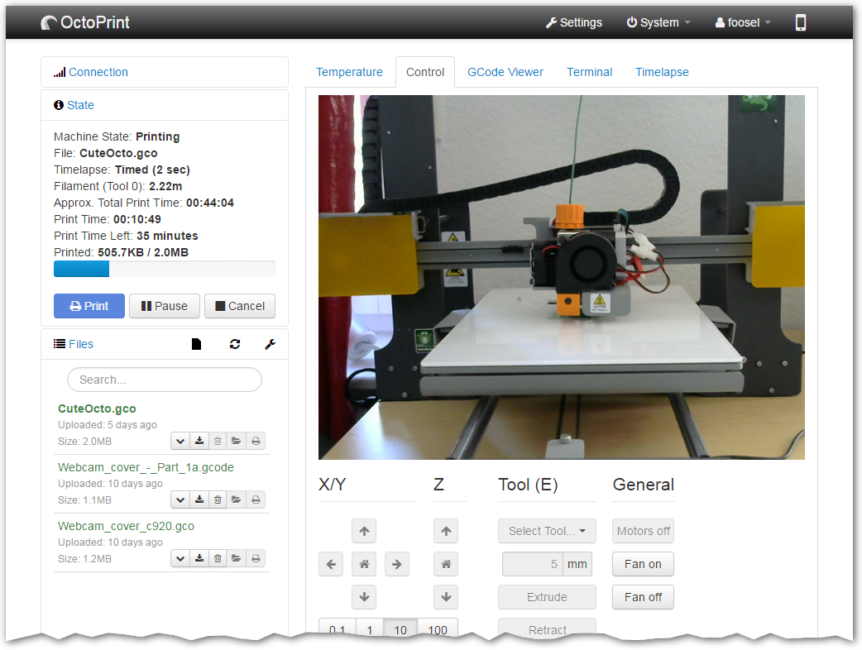
OctoPrint
3D Printers typically controlled over USB-B and do not connect to a network
OctoPrint runs on a computer
Connects to the printer and to the network, allowing for network control of the printer
OctoPrint credit Gina Häußge et al.
OctoPrint web interface. Image credit Gina Häußge.

Slide 7
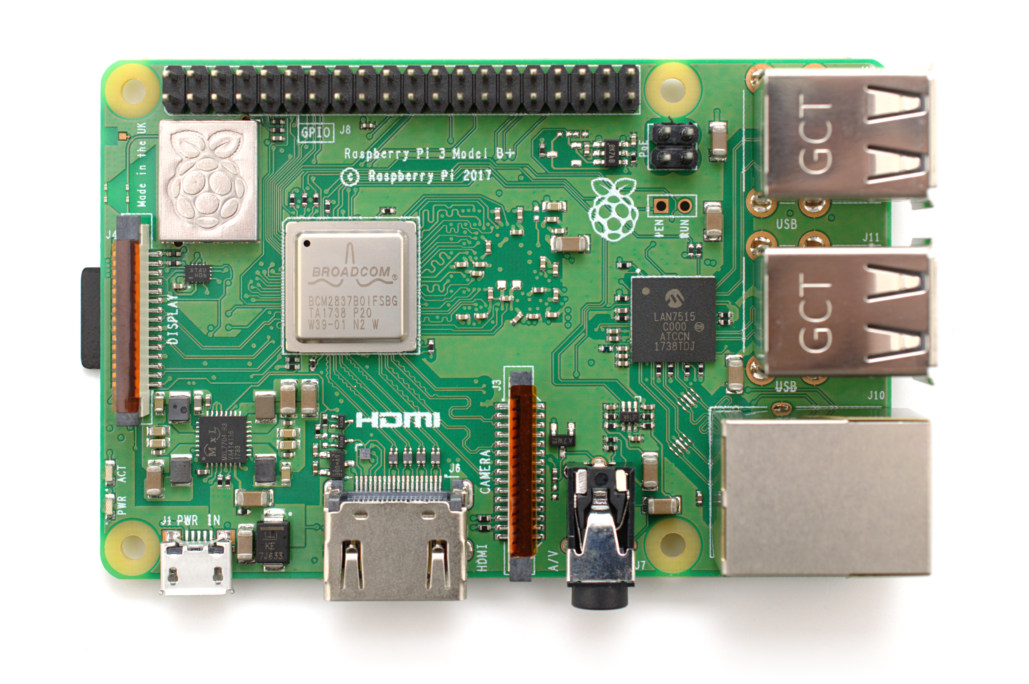
OctoPi
OctoPrint adapted for the Raspberry Pi
Allows for a Raspberry Pi to control the printer
Modern models have built-in wifi chips and enough memory to control printer
Relatively inexpensive
OctoPi Credit Guy Sheffer.
Raspberry Pi 3 Model B+. Image credit Gareth Halfacree (2018 cc-by-sa)

Slide 8
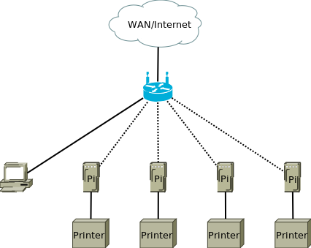
Network Topology
Private router allows for greater control of network
Pi’s connected wirelessly for convenience/cleanliness
Control station connected via Ethernet by necessity

Slide 9
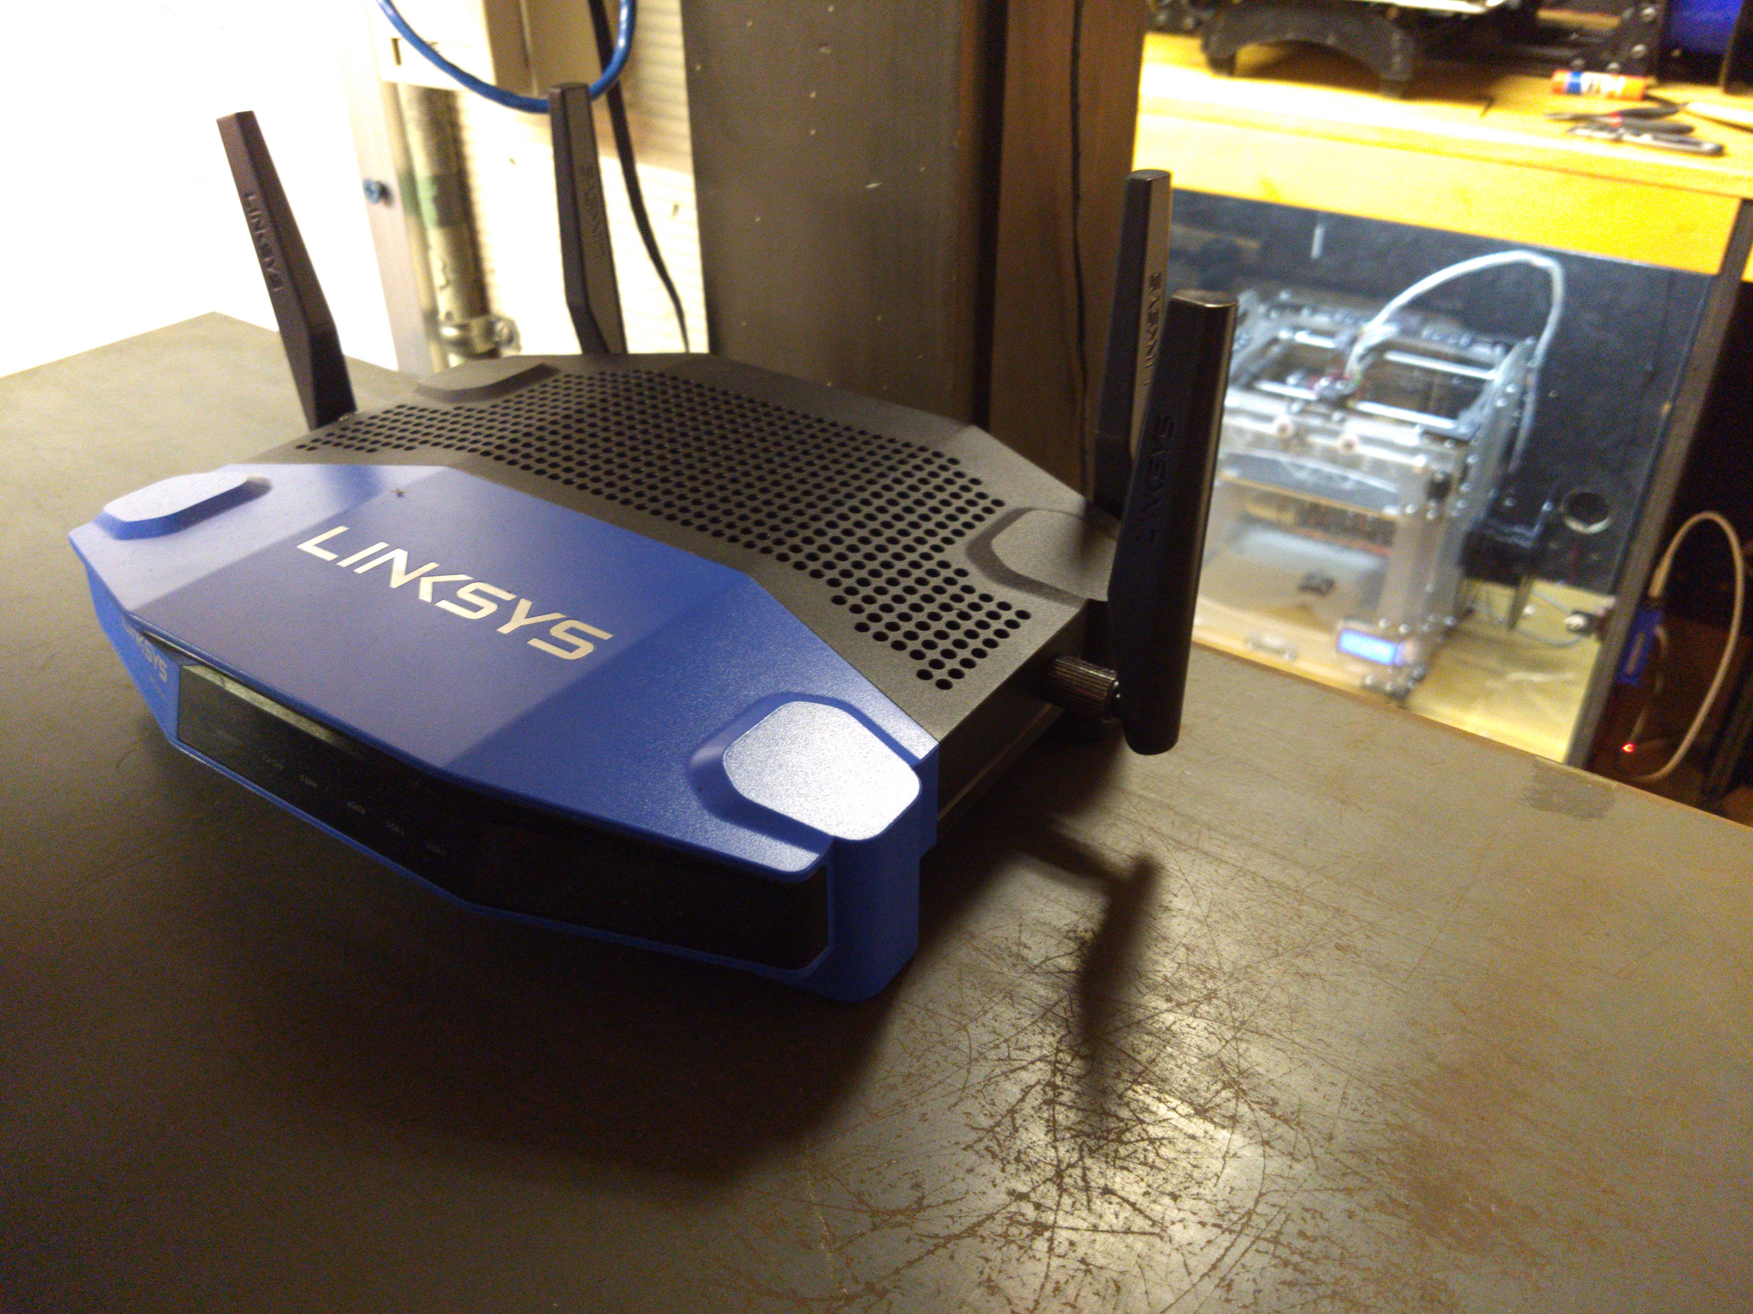
Router Setup
Router connected to Wentworth network
Linksys router with OpenWRT used
Set up using WPA2
  Most secure pi-friendly option available

Slide 10
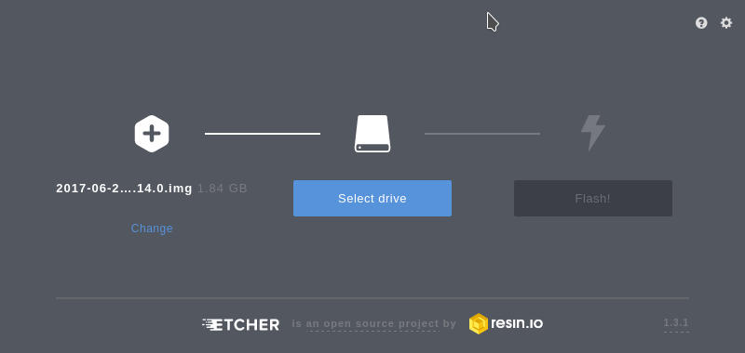
Installing OctoPi
Etcher was used to install OctoPi on each SD card
octopi-network.txt was edited to tell the Pi how to connect to the network

Slide 11
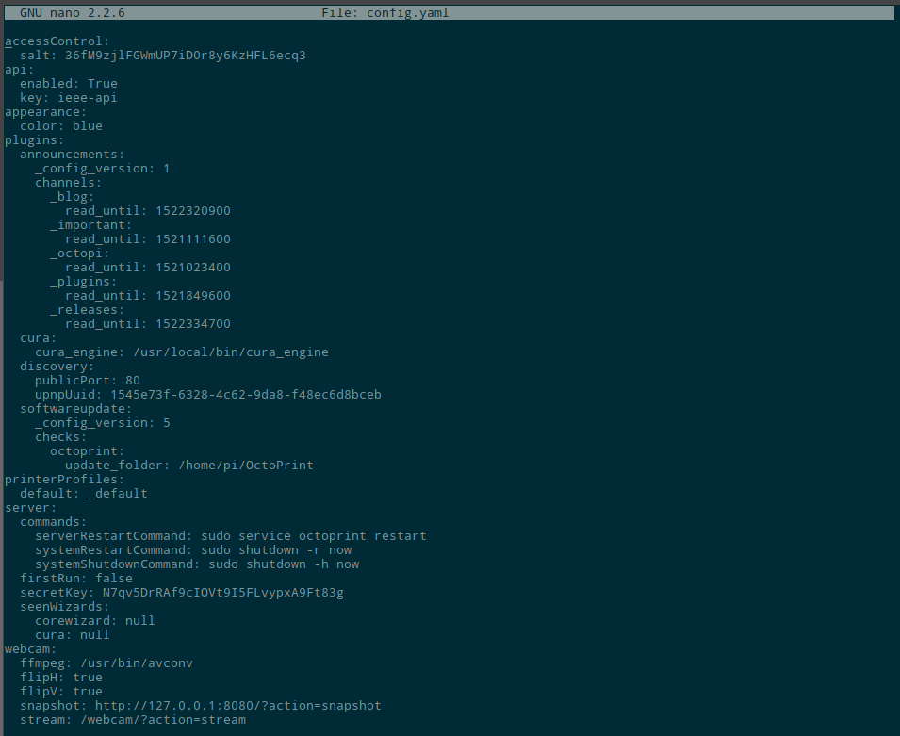
Configuring Pi’s by SSH
From a device on the network, each Pi was ssh’d into.
  Password changed
  IP made static
  API enabled
  API key made human-readable

Slide 12
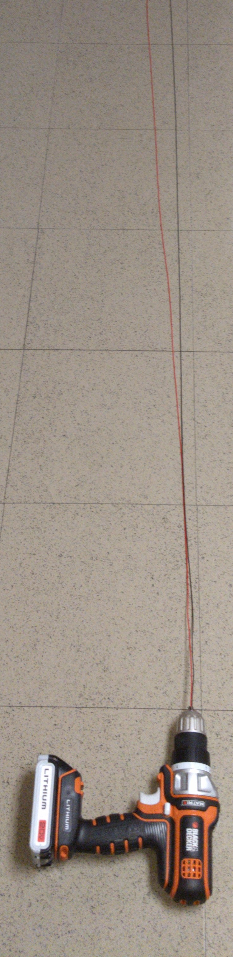
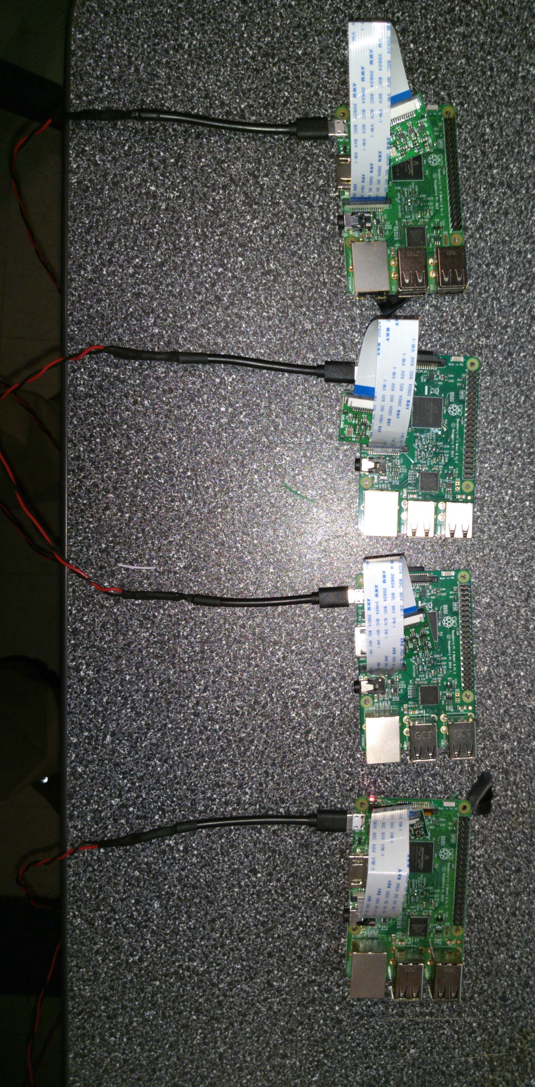
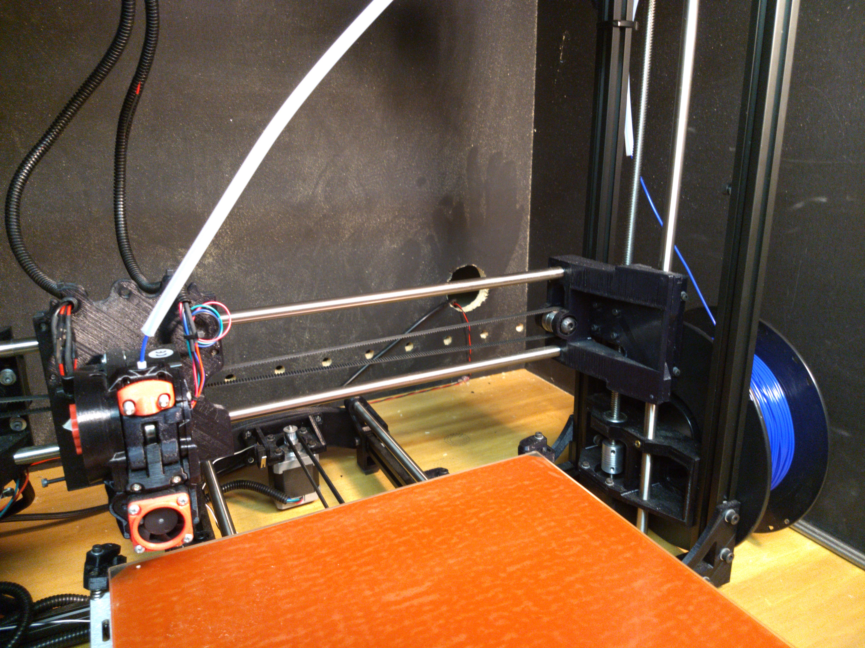
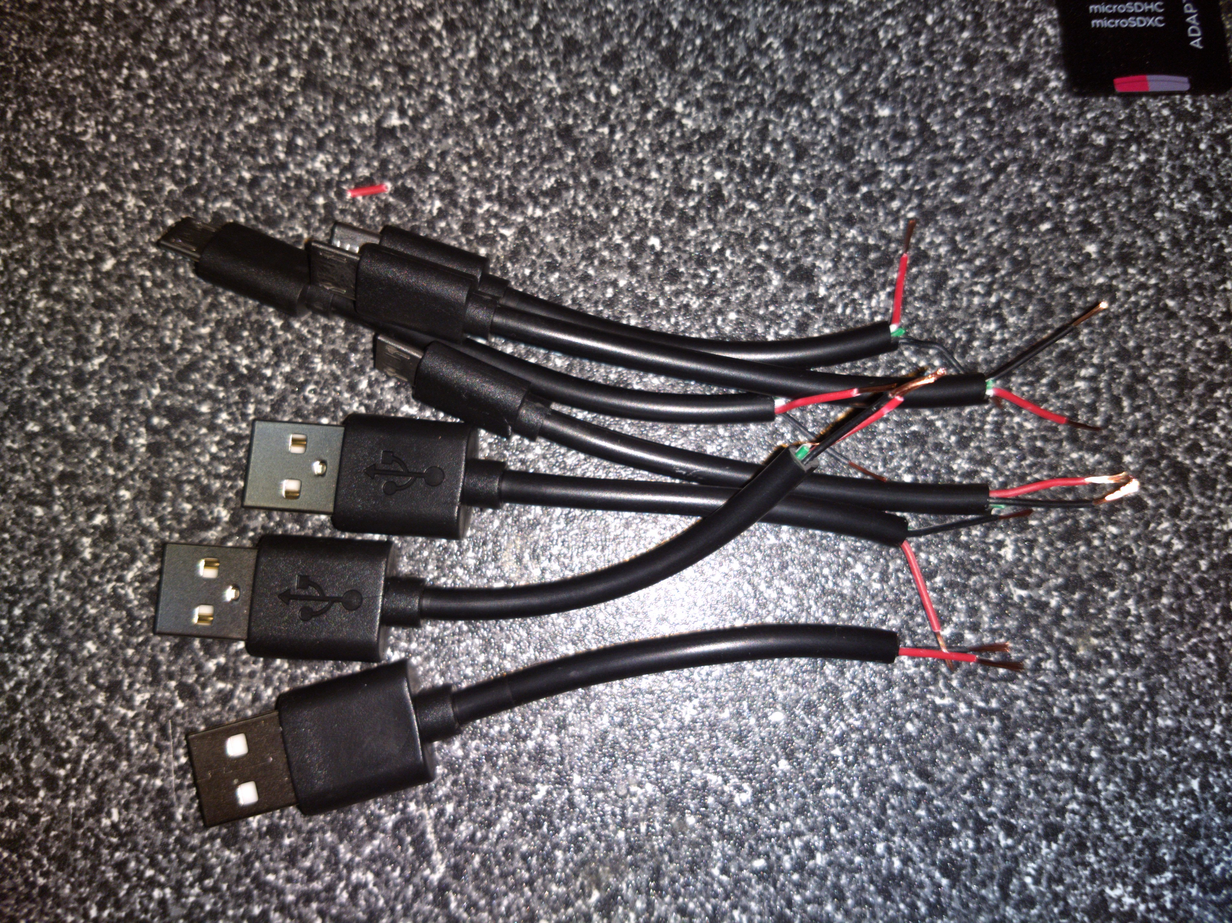
Power Management
Hole drilled in the back of each enclosure to run cabling for printers and Pi’s
Custom-made cables power each Pi

Slide 13
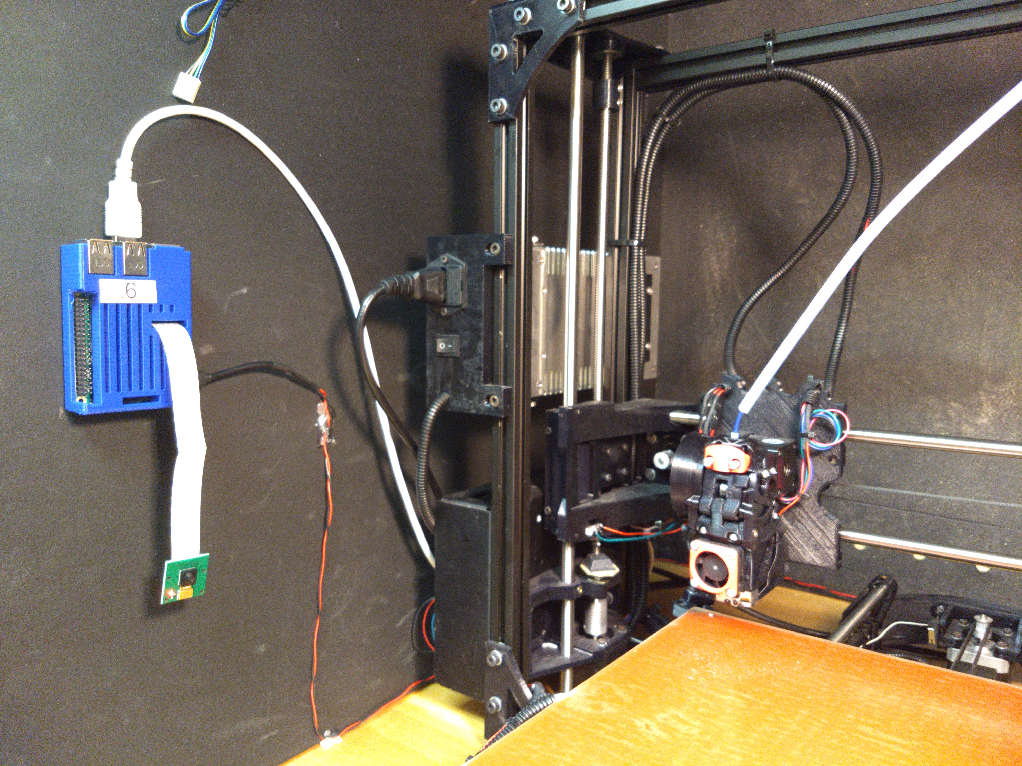
Pi Enclosures
Case 3D printed for each Pi and camera
Case glued to wall of enclosure, Pi inserted and powered, cables managed, each Pi labeled
Pi connected to printer via serial connection (115200 baud)

Slide 14
Cura
Cura is a tool for preparing 3D prints
  Takes 3D files, turns them into instructions that the printer understands
Has an OctoPi plugin, allowing for OctoPi integration

Slide 15
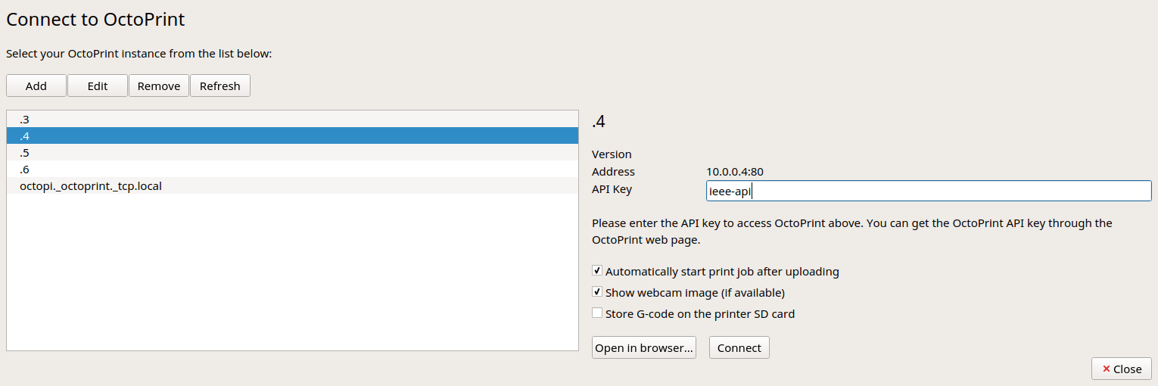
Configuring Cura
Cura was set up with a profile for each printer
  Individual settings and tunings per printer
Each printer profile was associated with its Pi

Slide 16
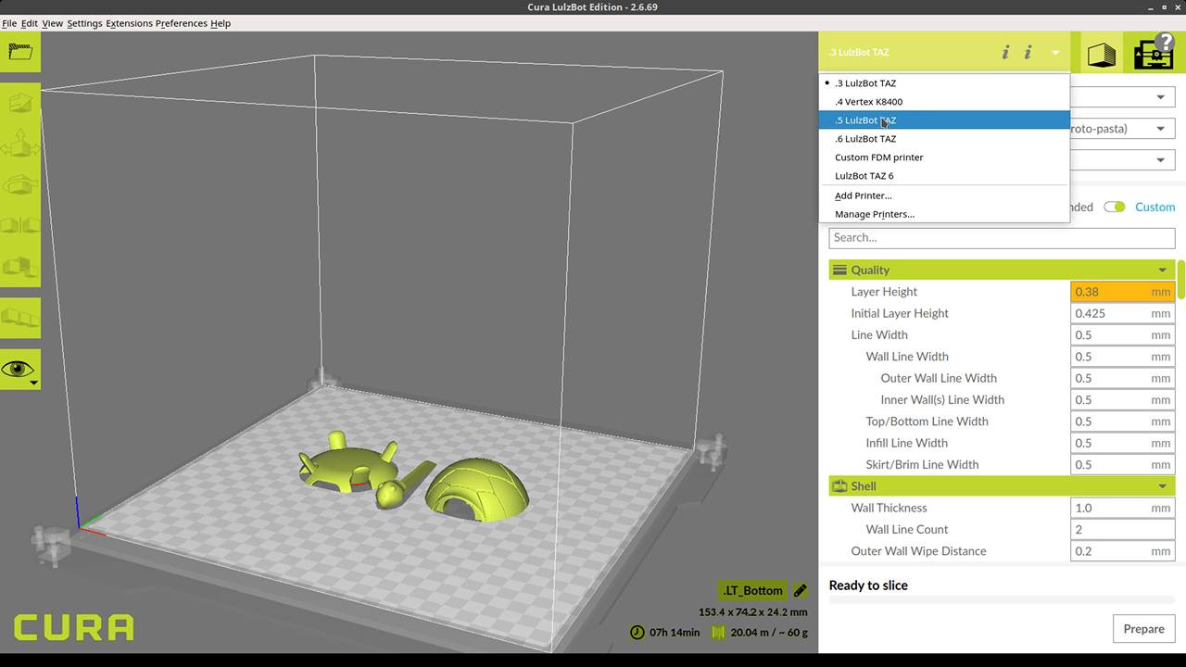
Using Cura

Slide 17
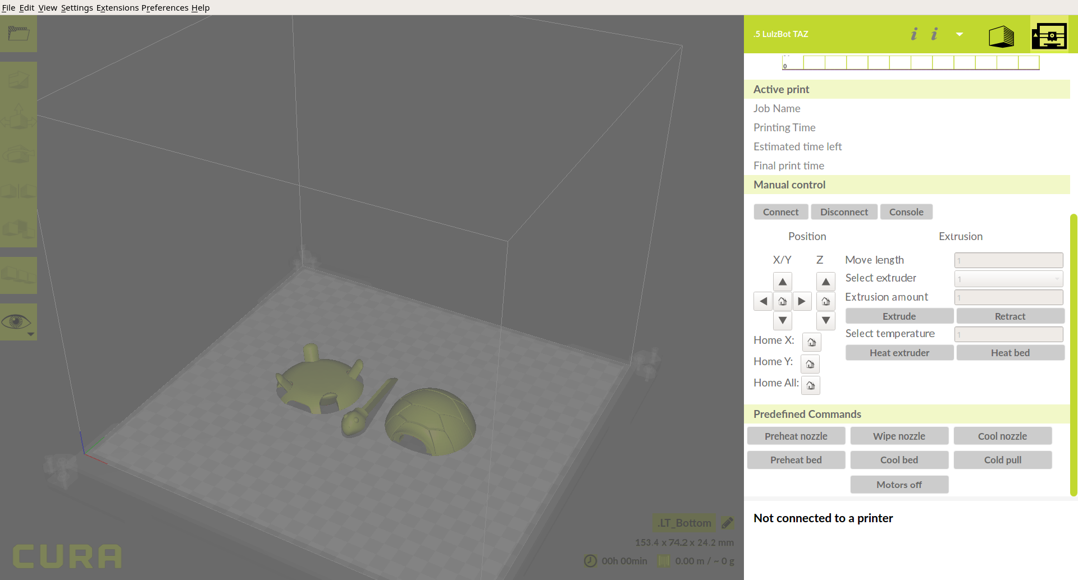
Using Cura

Slide 18
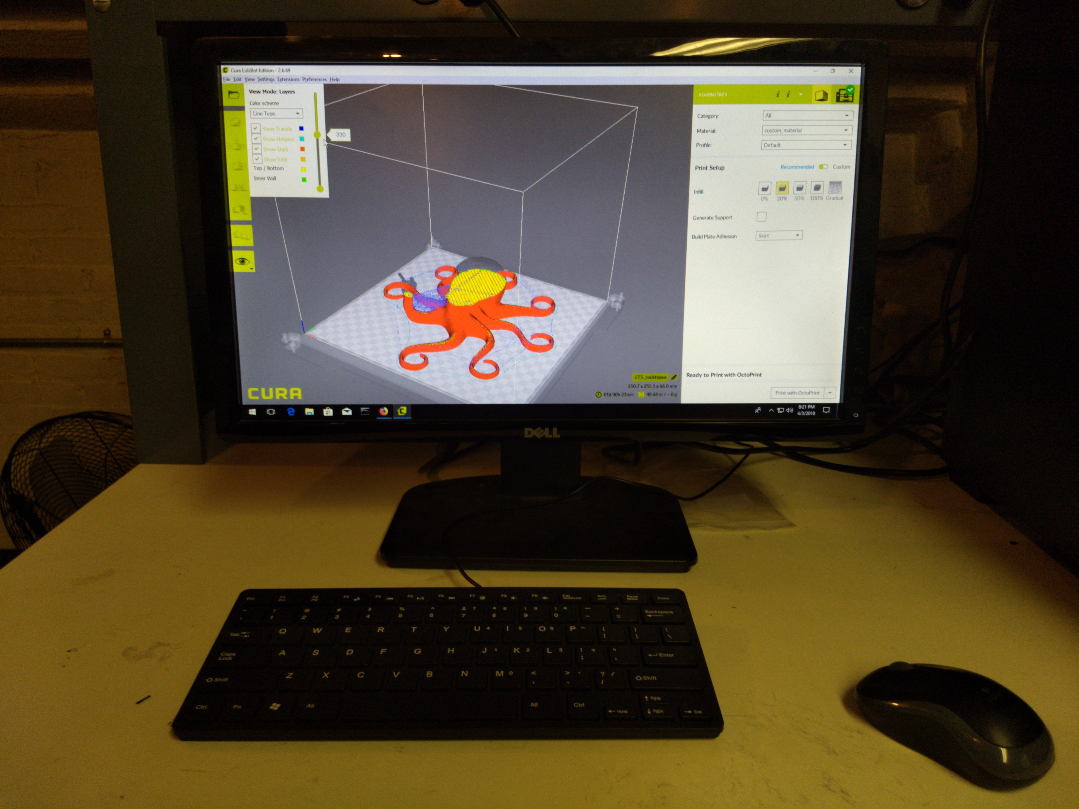
Printing from Control Station

Slide 19
Network Panel
OctoPrint API allows for data to be retrieved from each Pi
By running a website on the control station that accesses this API, printer information can be viewed

Slide 20
Network Panel Setup
XAMPP installed to give quick and easy access to Apache
‘index’ in C:/xampp/htdocs/dashboard edited to show simple webpage
Network panel port-forwarded
Control Station PC IP made static
witieee.com/printers made to redirect to router

Slide 21
More Network Panel Stuff
Using the OctoPrint API, the webpage is able to display various statistics
  Nozzle temperature
  Bed temperature
  Connection status
  Print status
  Etc.
This is done for each printer

Slide 22
Final Result
All printers networked, with room for more
Printers can be controlled from a single control point, or by anyone with access to the network from their own devices
Printer state individually monitorable via control panel and webcam
Status updates on each machine viewable only on campus through witieee.com/printers

Slide 23
Future Considerations
Make better use of the API to allow for control of printers
Send webcam stream over website
General site improvements
Automate process of adding another device

