Slide 1
I.T.S FINAL PROJECT REVIEW
電資四 簡少澤
電資四 鍾欣哲
電資四 李昇原
電資四 吳彥陞

Slide 2
Contributions
(25%)簡少澤：Line、Email API analysis
(25%)鍾欣哲：Website UI、backend 、Test
(25%)李昇原：Website UI、backend
(25%)吳彥陞：Robotframework analysis、Test

Slide 3
TEAM MEETING

Slide 4
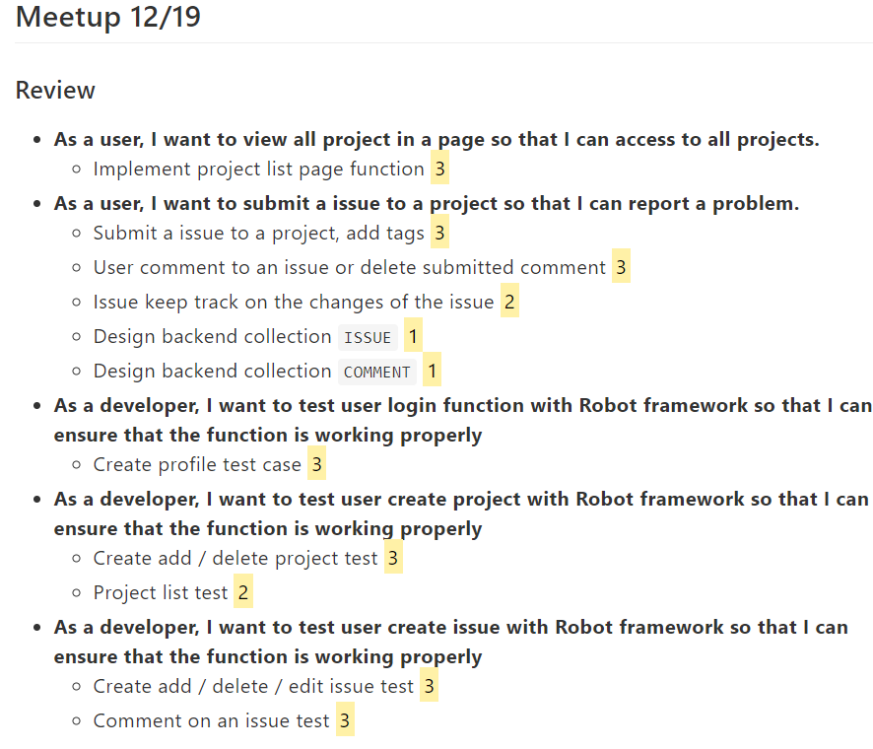
TEAM MEETING – (12/19)

Slide 5
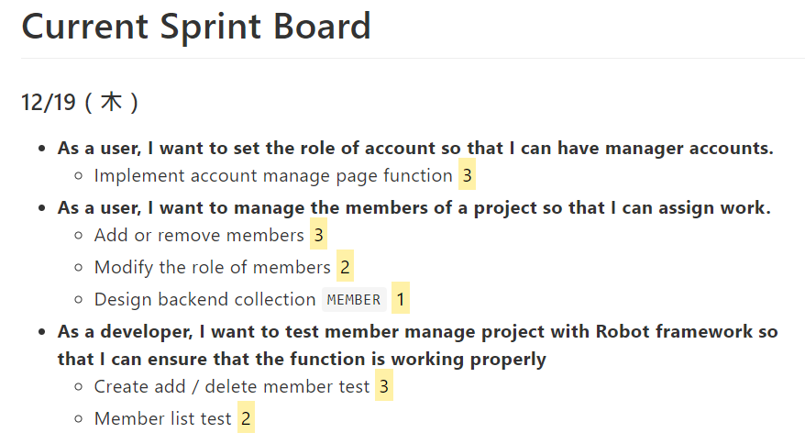
TEAM MEETING – (12/19)

Slide 6
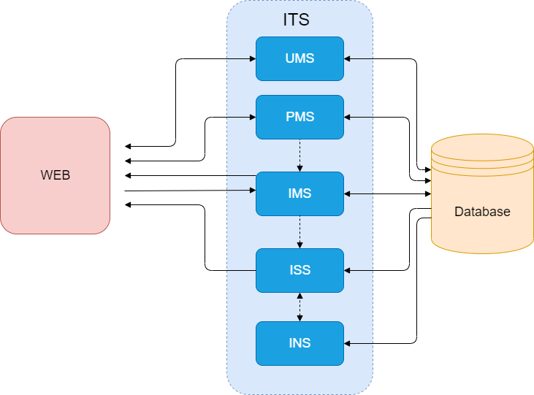
System Block Diagram

Slide 7
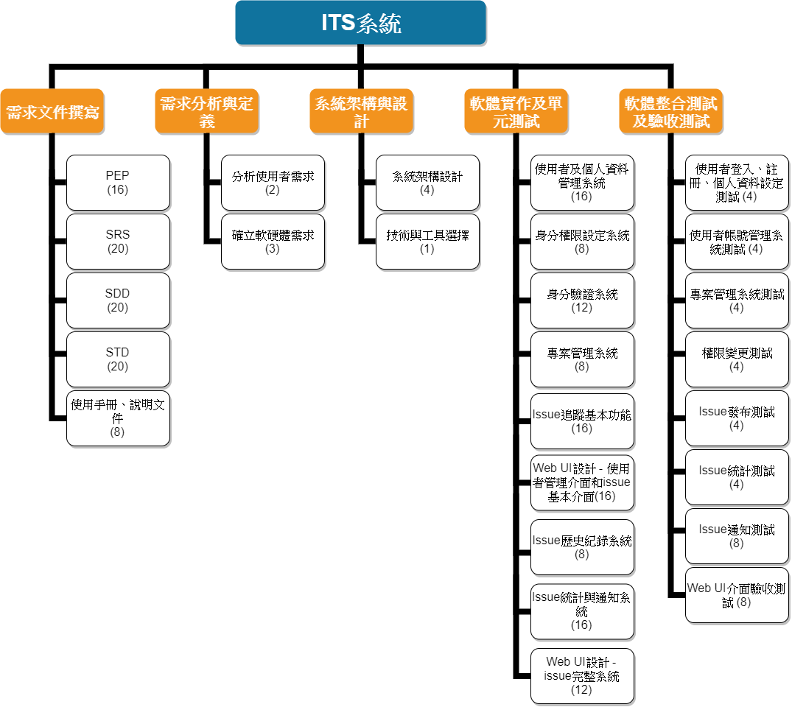
Work Breakdown Structure

Slide 8
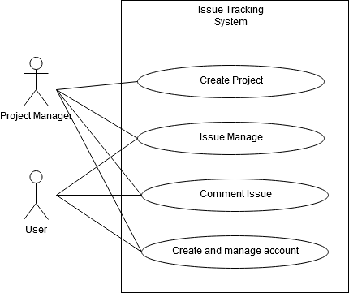
Use Case Diagram

Slide 9
Using Tools
React.js
Flask
Robotframework with Selenium
GitHub

Slide 10
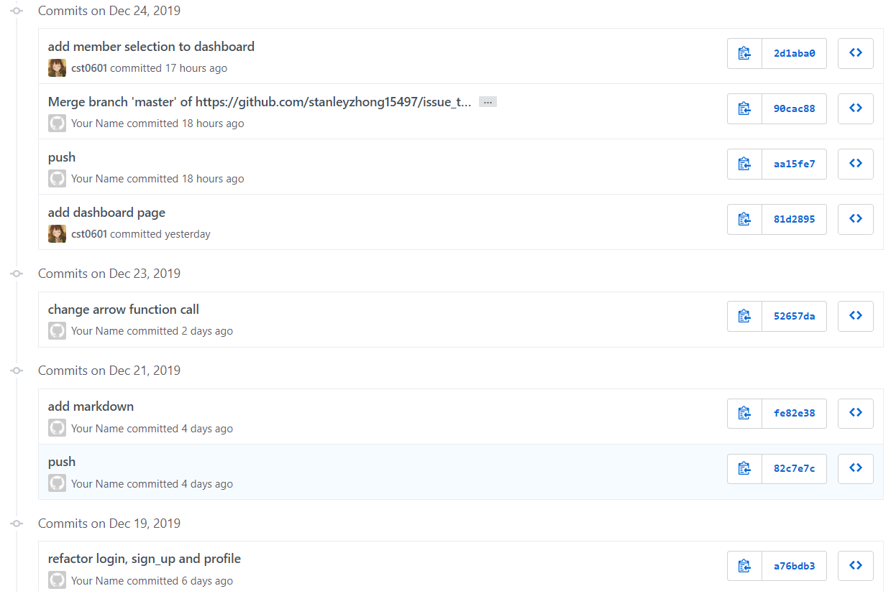
Change History

Slide 11
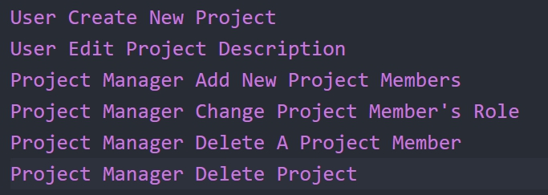
Use Cases

Slide 12
Project Retrospective
Follow the process?
評估不周，導致後期進度緊繃
Satisfy the requirement?
除了Line API功能未完善，其餘需求皆滿足
Was our team successful?
對於大家努力參與專案，我們認為相當成功，但還能繼續進步

Slide 13
DEMO PROTOTYPE

