Slide 1
CMPS 470/570 FINAL PROJECT
TEAM: C.K.

Slide 2
DESCRIPTION OF THE PROJECT
Completed a successful algorithm that can help predict if market prices will rise or fall based on previous data in the market. Our data is the price for one ounce of gold from 2001-2021.
Data-Tree:
Predicts if the price will go up or down in the following week. Our data-tree model returns a boolean result, so winning 1$ two weeks in a row and losing 20$ the next week still returns two wins and one loss. Data-tree is overall a poor choice based on our data.
ANN:
Predicts a floating point number that represents the percentage of change in the price of 1 troy ounce of gold for the week to come. We have an example at the end showing our results as if we only had money in the market on the weeks that we predicted a win greater than a +0.5% increase in price.
SVM:
Same as ANN as in we’re predicting the percentage of profit. We also run a simulation as if we only kept our investment in on winning weeks.

Slide 3
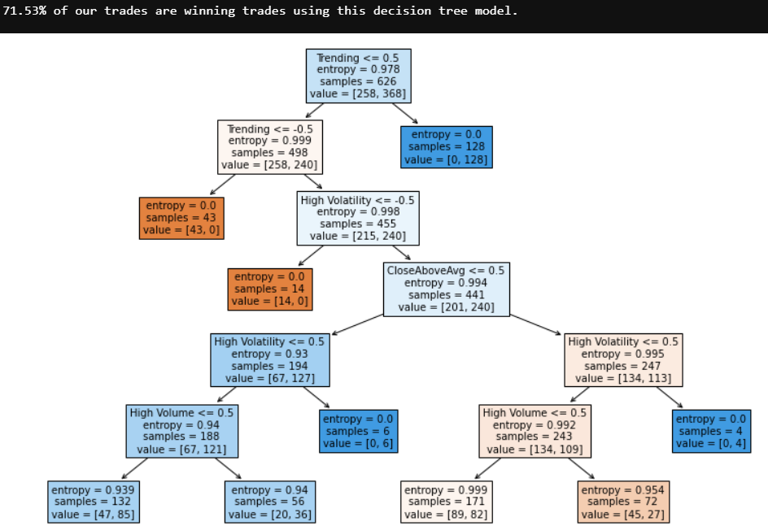
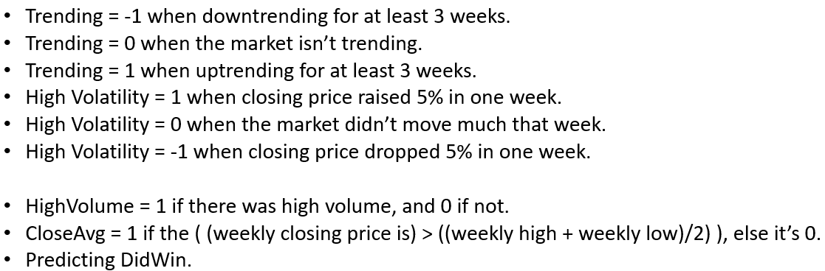
DESCRIPTION OF MODEL: DT

Slide 4
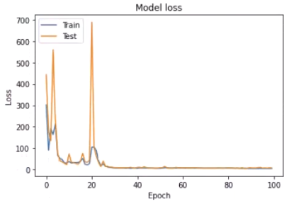
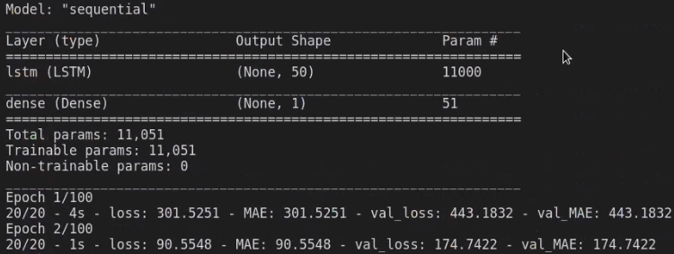
DESCRIPTION OF MODEL: ANN
100 Epochs;
50 Nodes;
10 previous datapoints/loopbacks used to make the next prediction;
Linear Activation Function;
In our example, we’re buying if the prediction expects greater than a 0.5% weekly profit;
Mean Absolute Error

Slide 5
DESCRIPTION OF MODEL: SVM
Infinite iterations until Epsilon was less than 0.1.
Linear kernel function.
In our example, we’re buying if the prediction expects greater than a 0.5% weekly profit;

Slide 6
DESCRIPTION OF DATA
Data source
https://finance.yahoo.com/
Attributes
Dates, opening prices, closing prices, and volume. We used gold prices, but any market can work the same.
Distribution of values for each attributes (use chart)
Charts on slide #10
Preprocessing
Removed unused attributes, such as dates.
Converted from contiguous to categorical for the decision tree.

Slide 7
PERFORMANCE OF MODEL:
Assessment method: Decision Tree
Distribution of training, test data sets
60%, 20%, 20% for the weekly gold price chart over 10 years of data.
Performance measures
Accuracy
Specificity
Sensitivity
F1

Slide 8

PERFORMANCE OF MODEL
Assessment method: ANN/RNN
Distribution of training, test data sets
60%, 20%, 20% for the weekly gold price chart over 10 years of data.
Performance measures
Loss function: Mean Absolute Error.
Metrics: Mean Absolute Error.
100 Epochs; 50 Nodes; 10 previous datapoints/loopbacks used to make the next prediction; Linear Activation Function; In our example, we’re buying if the prediction expects greater than a 0.5% weekly profit;
Mean Absolute Error is the only important measure in this case since there’s an equal value to both losing money, and a missing a good opportunity.

Slide 9

PERFORMANCE OF MODEL
Assessment method: SVM
Distribution of training, test data sets
60%, 20%, 20% for the weekly gold price chart over 10 years of data.
Performance measures
Loss function: epsilon insensitive loss.
Metrics: epsilon insensitive loss.
Regularization parameter = 1/10.
In our example, we’re buying if the prediction expects greater than a 0.5% weekly profit, otherwise we’re exiting the market and waiting for a better time to put money back into the market.

Slide 10
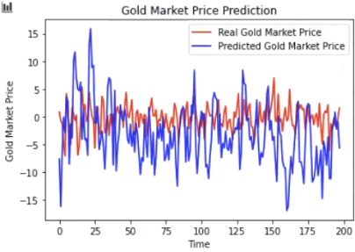
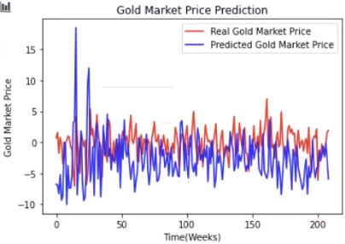
Data Tree: ANN: SVM:
% change
% change
(Number of weeks)

