Slide 1




Ontologies and Other Things
Carl G. Stahmer
Director of Data and Digital Scholarship
Associate Director for Humanities
UC Davis Data Science Initiative
www.carlstahmer.com
www.digitalscholarslab.org
@cstahmer
Rare Book School
Digital Approaches to Bibliography and Book History
July 2017

Slide 2
P
RDF
FRAMEWORK
SCHEMA
KITCHEN
SINK
AUTHORITY
M
O
D
E
L
ONTOLOGY
T
A
G
S
CONTROLLED VOCABLARY
GRAPH
RELATIONAL DATABASE
@cstahmer
Notes:
What the hell are we talking about? Lots of terms being used with little specificity.

Slide 3
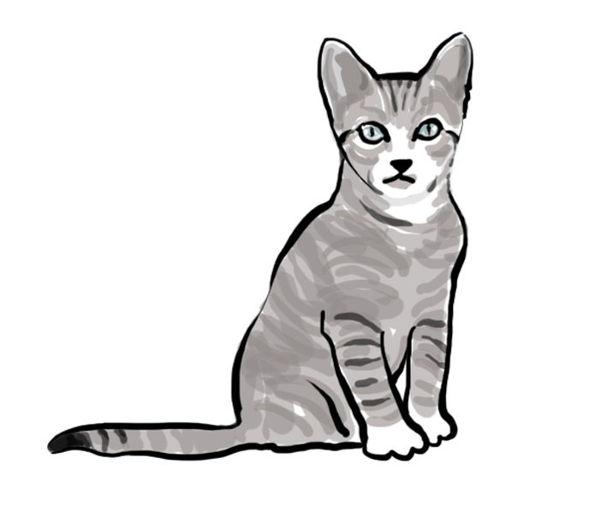

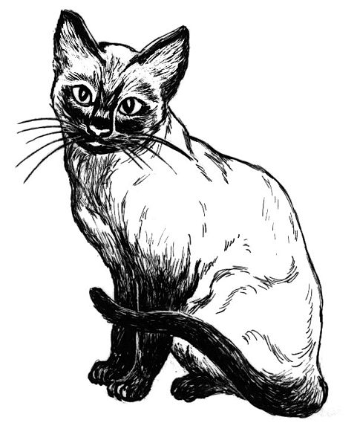
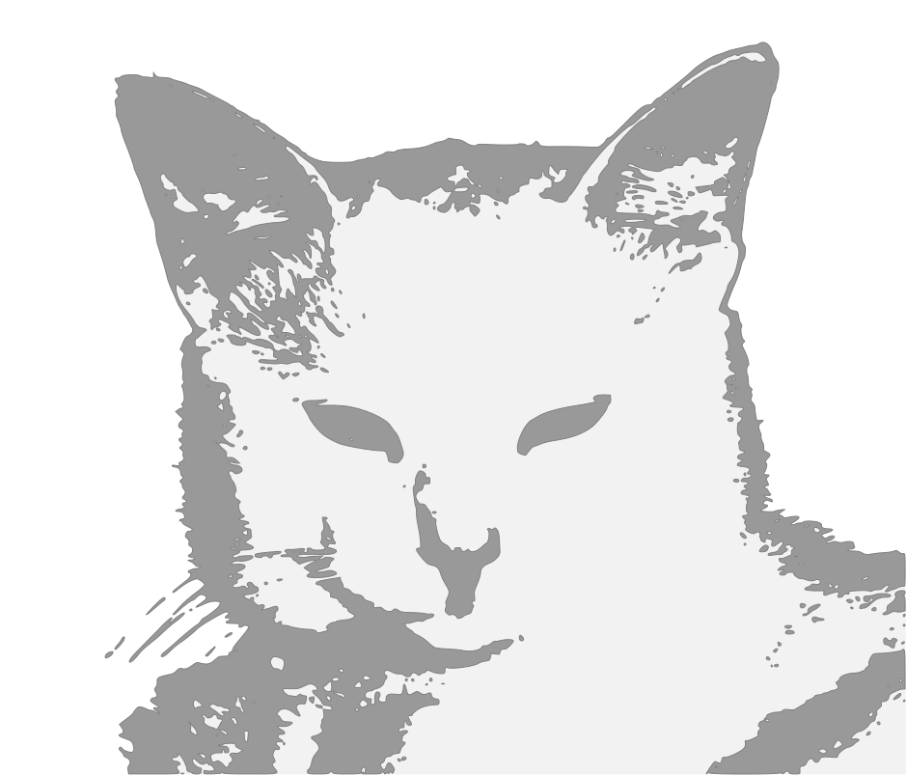

Ontological Reality
Platonic view of the information universe.
Ideal Cat
Peer Reviewed Social Curation.
@cstahmer

Slide 4
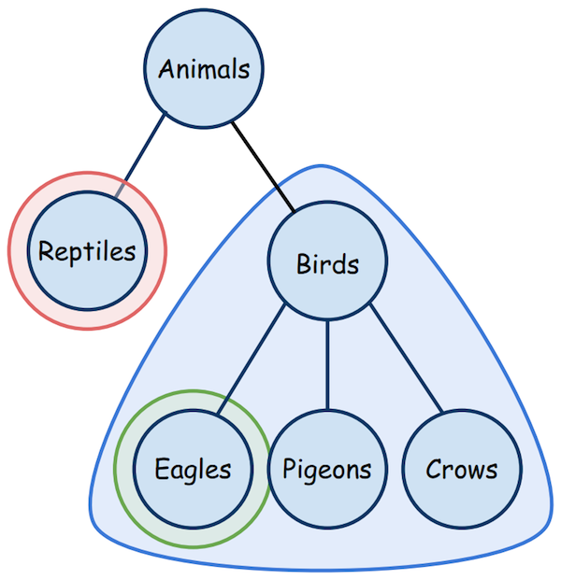
Reality Simple
Peer Reviewed Social Curation.
@cstahmer

Slide 5
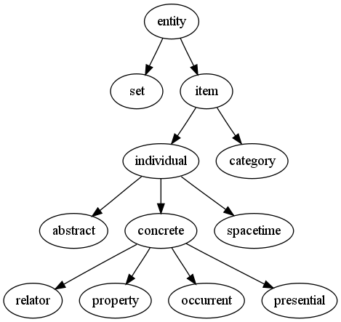
Reality Complex
Peer Reviewed Social Curation.
@cstahmer

Slide 6
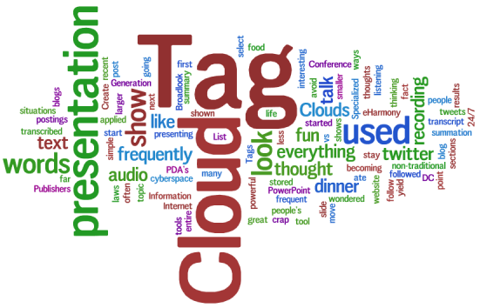
Information Anarchy
Peer Reviewed Social Curation.
@cstahmer

Slide 7
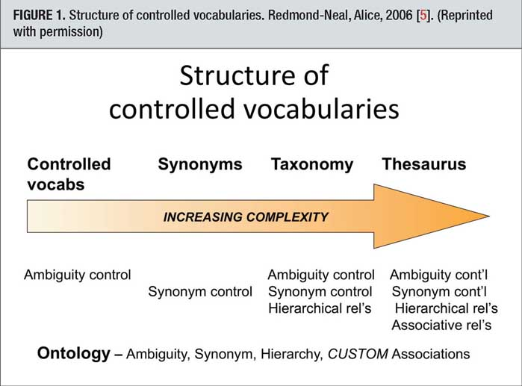
Controlled Vocabulary
Peer Reviewed Social Curation.
@cstahmer

Slide 8
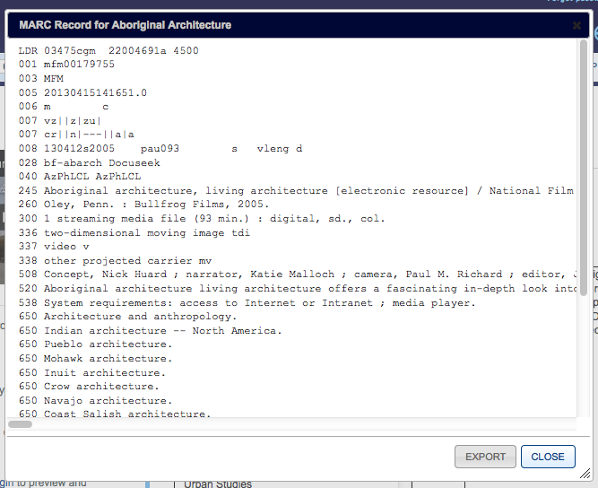
MARC?
Peer Reviewed Social Curation.
@cstahmer

Slide 9
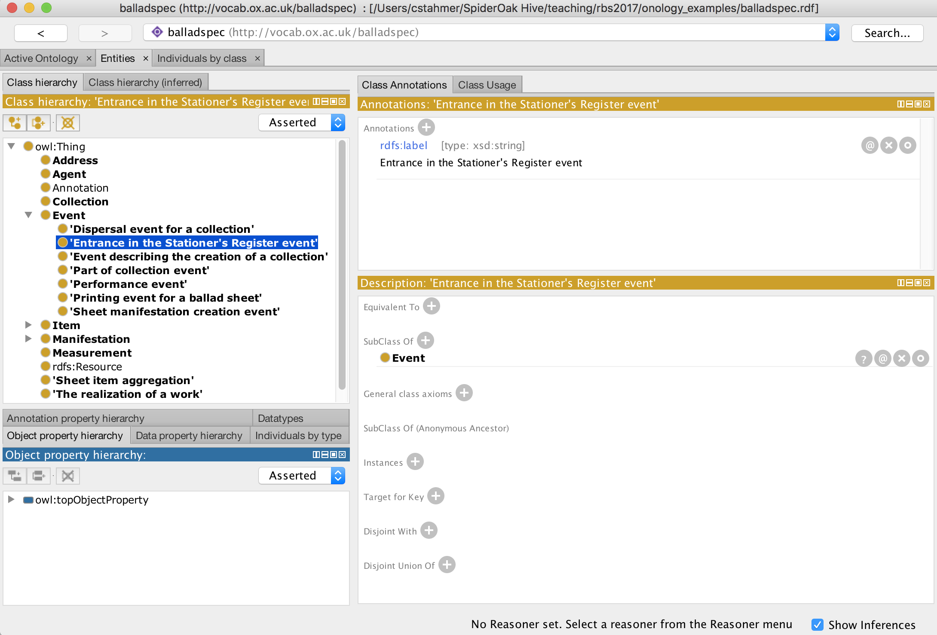
Protégé Ontology Builder
Peer Reviewed Social Curation.
@cstahmer
Notes:
Show protégé and go to notes

Slide 10
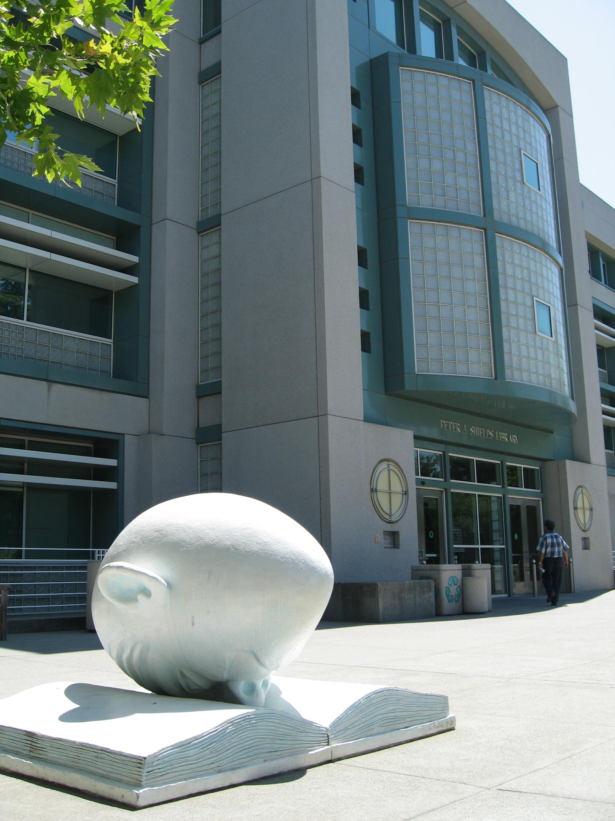

Thank You
Carl G. Stahmer
Director of Digital Scholarship
Associate Director for Humanities
UC Davis Data Science Initiative
www.carlstahmer.com
www.digitalscholarslab.org
@ cstahmer
Programming Concepts
Rare Book School
July, 2017
@cstahmer

