Slide 1




Programming Concepts
Carl G. Stahmer
Director of Data and Digital Scholarship
Associate Director for Humanities
UC Davis Data Science Initiative
www.carlstahmer.com
www.digitalscholarslab.org
@cstahmer
Rare Book School
Digital Approaches to Bibliography and Book History
July 2017

Slide 2
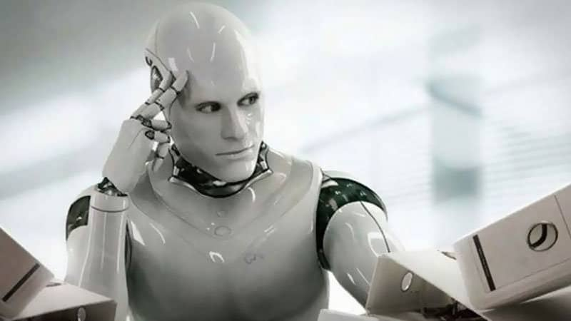
Learn to Think
Like a Machine
@cstahmer
Notes:
The secret to succeeding in this type of work is to stop trying to make the computer think like a computer and instead teach yourself to think like a computer and then imagine the creativity made possible by such a thought process.
When we talk about ’artificial intelligence’ we should be asking, “Whose intelligence?” Maximize the intelligence that the machine has.

Slide 3
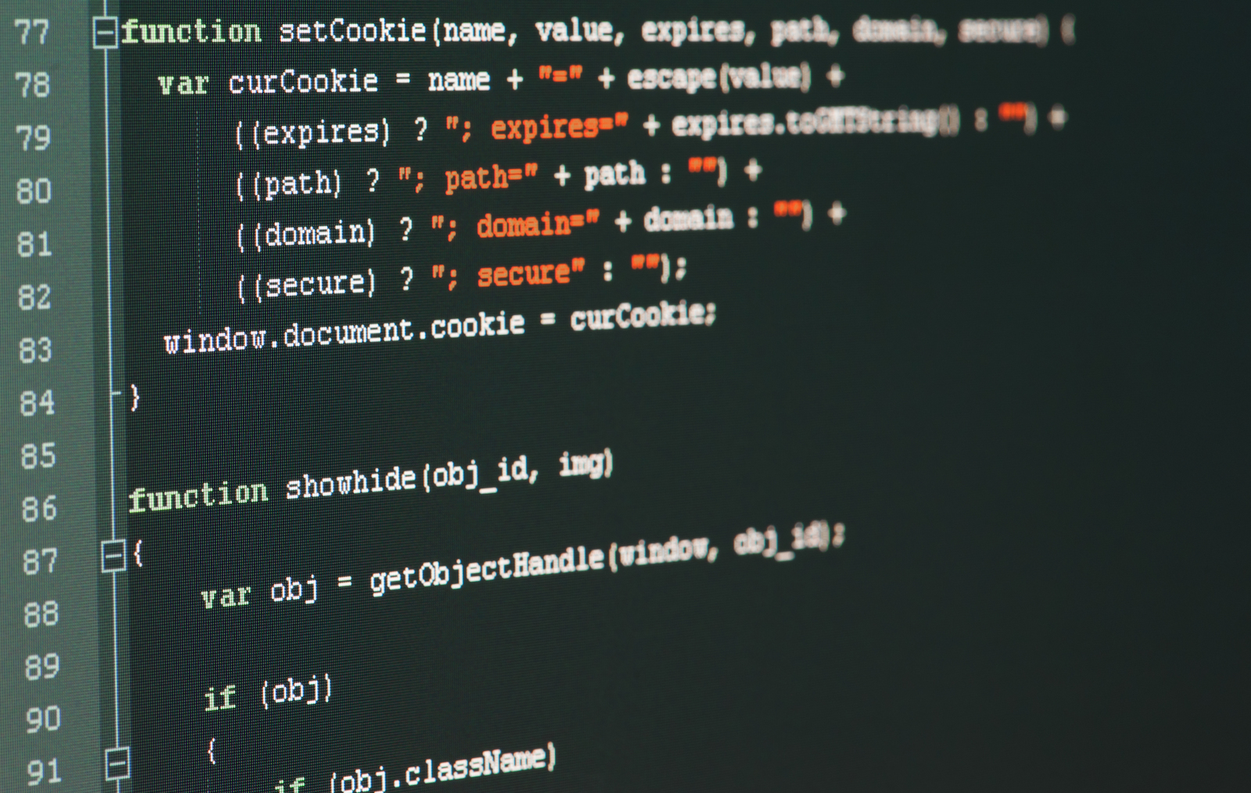
Core Components of all Programming Languages
Variables
Lists / Collections
Data Tables
Matrices
Conditionals / Comparison
Loops
Commands
@cstahmer

Slide 4
Variables and Variable Types
X = 3
Integer / long / double : X = 347
String : X = “A Defence of Poetry”
Boolean : X = true OR X = 1
No Bit Pointer: X = Null
Empty Variable: X = “”
@cstahmer

Slide 5
Variables and Variable Types
X = 3
Integer / long / double : X.int = 347
String : X.str = “A Defence of Poetry”
Boolean : X.bln = true OR X = 1
No Bit Pointer: X.X = Null
Empty Variable: X.X = “”
@cstahmer

Slide 6
Lists and Collections
a, b, c, d, e, f, g, h, I, j, k, l, m, n, o, p, q, r, s, t, u, v, w, x, y, z
Array: A structured list of items of the same basic type
Vector: A sequence of data elements of the same basic type
List: An unstructured collection of items of the same basic type
Table: A collection of items of different types
@cstahmer

Slide 7
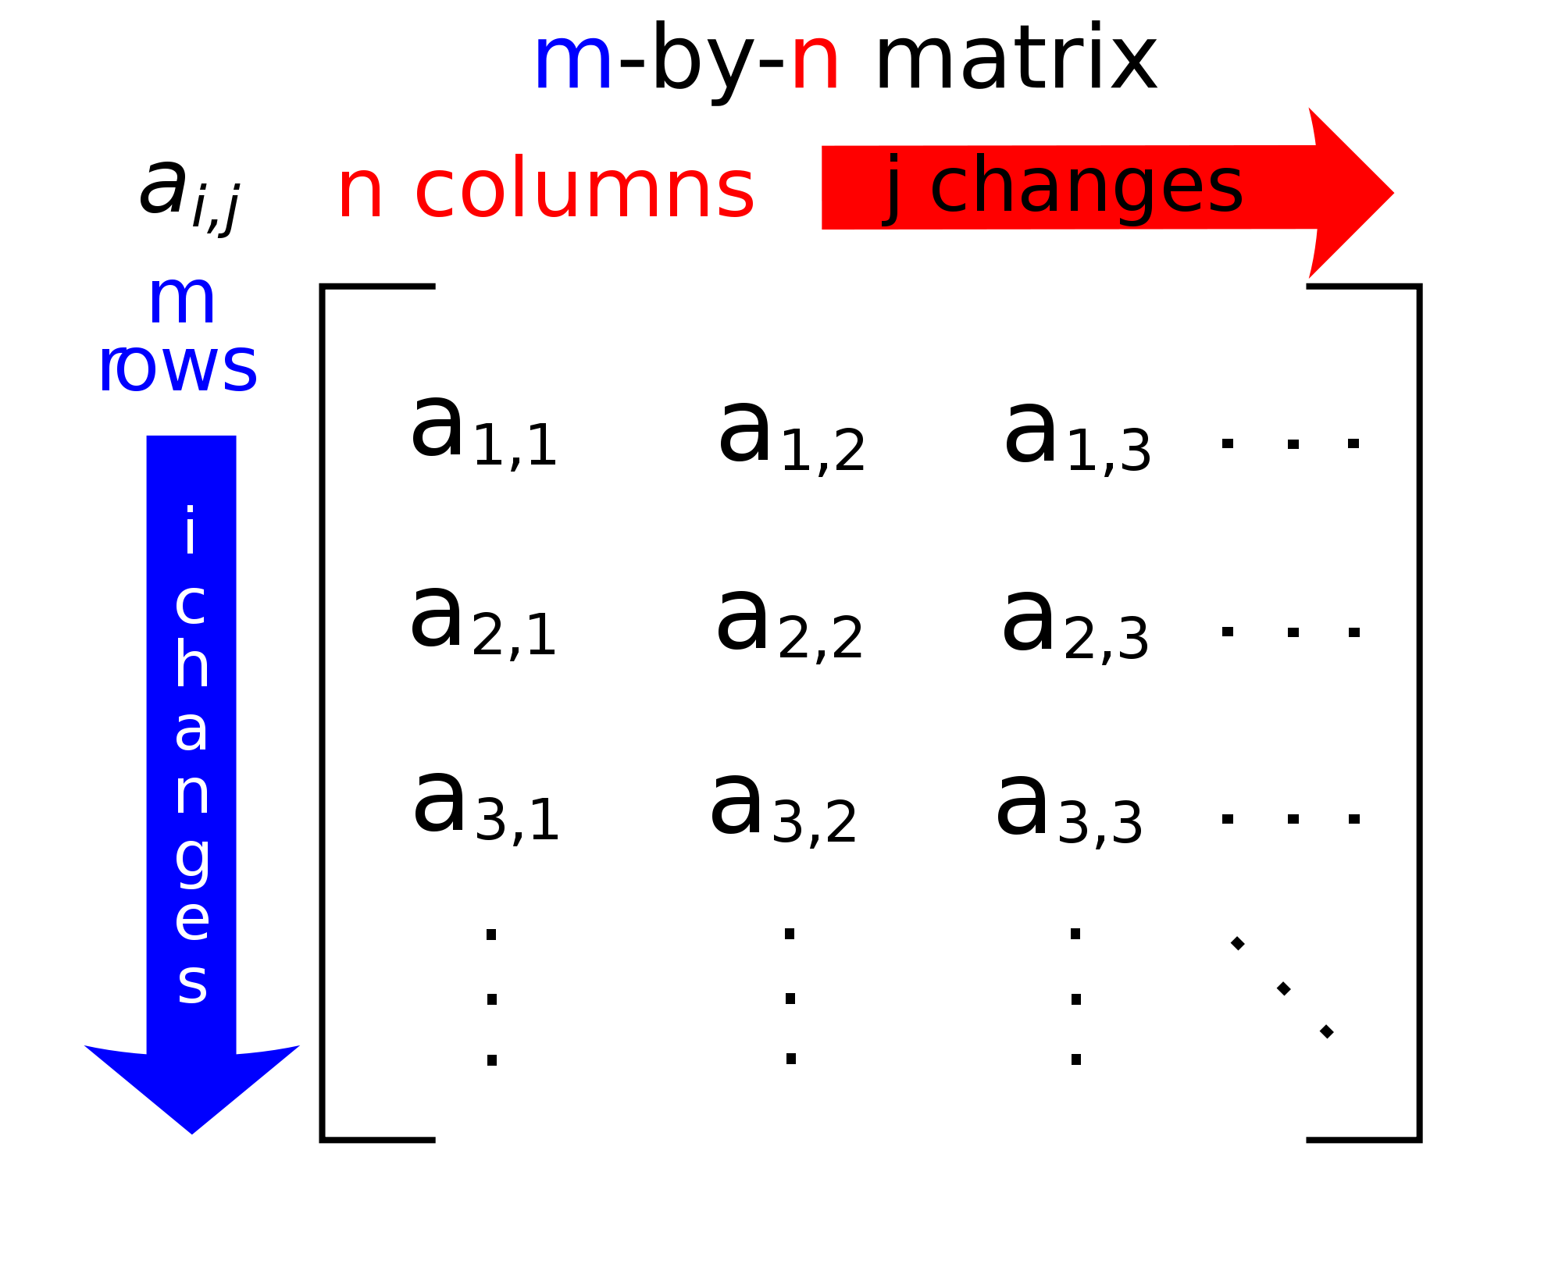
@cstahmer

Slide 8
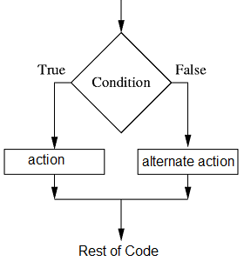
Conditionals
x.int = 37
if (x.Int < 35) {
print (“Too Small”)
} else {
print (“Big Enough”)
}
@cstahmer

Slide 9
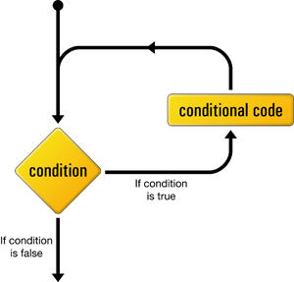
Loops
for (year in (2010,2011,2012,2013,2014) {
print(paste("The year is", year))
}
x.int = 1
while (x.int < 25 ) {
print(paste(”Iteration", x.int))
x.int = x.int + 1
}
x.int = 1
do until (x.int >= 25 ) {
print(paste(”Iteration", x.int))
x.int = x.int + 1
}
@cstahmer

Slide 10
Commands/Methods/Functions
P
Tell your friend to do something.
Exit
Print
Add
Subtract
Divide
Append
Reverse
@cstahmer

Slide 11
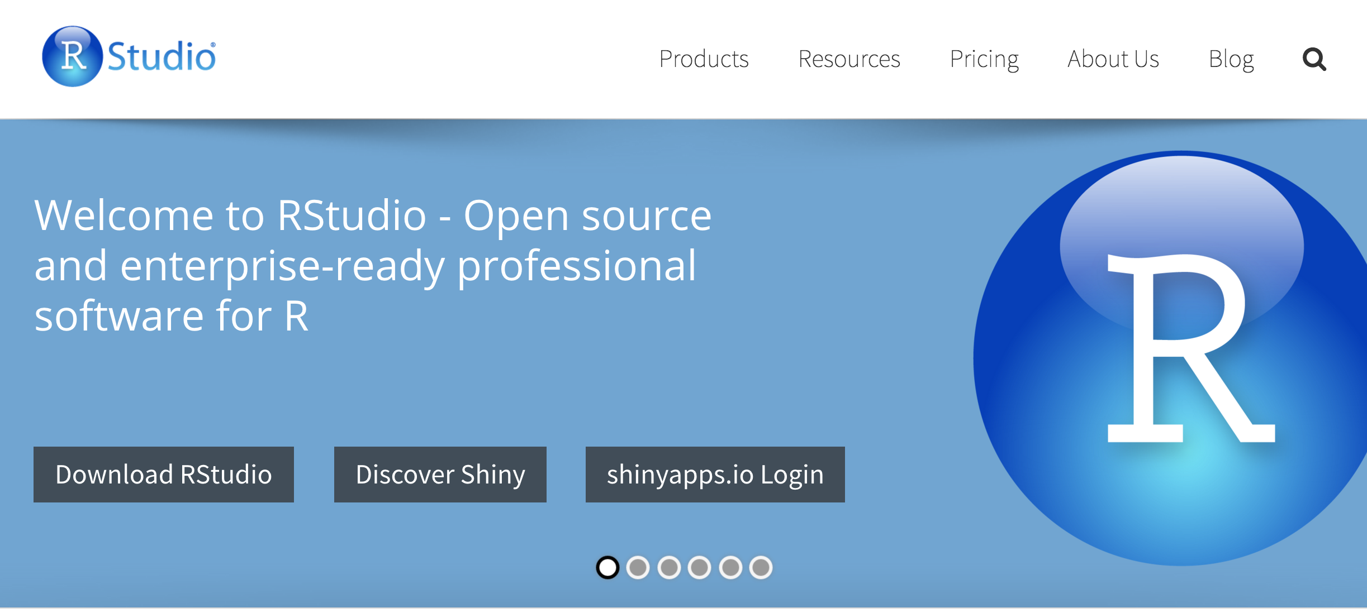
Integrated Development Environment
http://www.rstudio.com
@cstahmer
Notes:
Have everyone launch R Studio

Slide 12
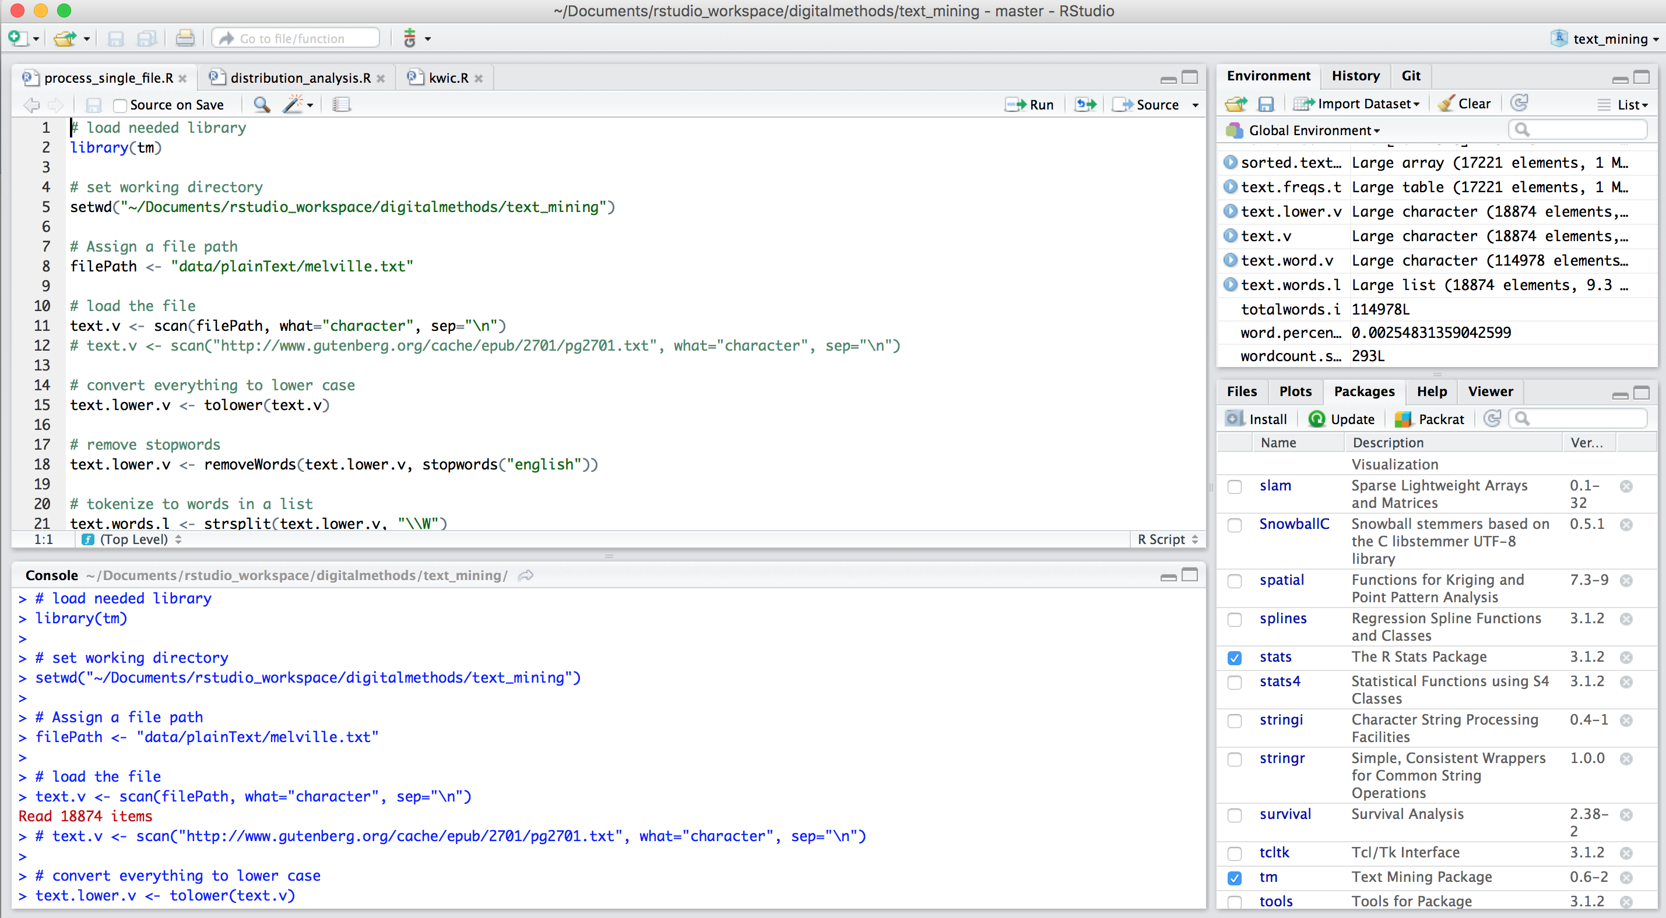
R Interface
https://cran.r-project.org/
@cstahmer
Notes:
Familiarize with interface and then start coding.
See Evernote Outline

Slide 13
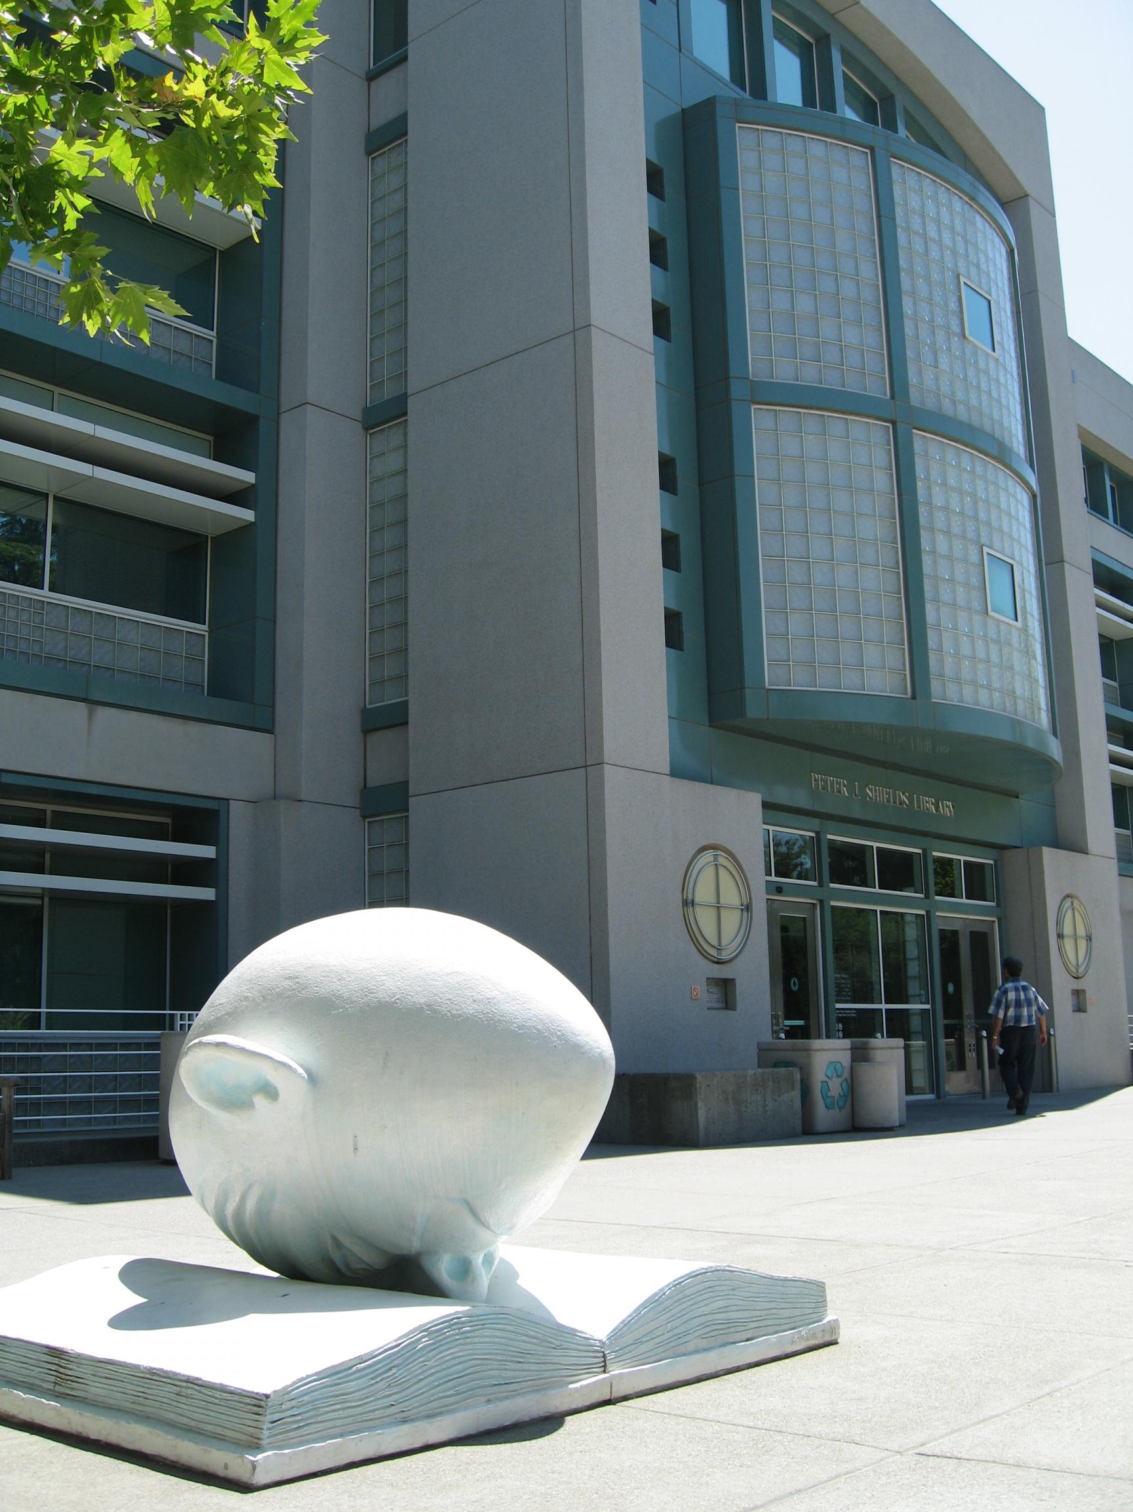

Thank You
Carl G. Stahmer
Director of Digital Scholarship
Associate Director for Humanities
UC Davis Data Science Initiative
www.carlstahmer.com
www.digitalscholarslab.org
@ cstahmer
Programming Concepts
Rare Book School
July, 2017
@cstahmer

