Slide 1
EDA Project on NYC Flight Data
Data Science Foundation Project – UpX Academy
(July’2017)

Slide 2
Group Info
Group Number: 01
Active Contributors:
Chitrabhanu Tamrakar
Deepa Malhotra
Santosh Mahto
Sai Ratna Kashyap Mantri
Siddharth Roy
Sudipta Saha

Slide 3
Project Introduction
Domain: Aviation
Dataset: NYC Flight Dataset ‘2013
This dataset provides records of all flights that took off from New York city in year 2013.
Based on this dataset, we intend to explore underlying pattern in:
Departure delays
Best airports in terms of timely departure
Aircraft speed
On time arrival
Maximum number of flights headed to some particular destination.

Slide 4
Dataset Description
Data Dictionary
Name Description
------------ ---------------------------------------------------------------
year, month, day 2013, month (1-12), Day of the month (1-31)
dep_time, arr_time Departure times, Arrival times in local timezone
sched_dep_time, Scheduled departure/arrival time
sched_arr_time
dep_delay Departure delay, Arrival delay in minutes
arr_delay
carrier Two letter carrier abbreviation
flight Flight number
tailnum Plane tail number
origin, dest Airport codes for origin and destination
air_time Amount of time spent in the air, in minutes.
distance Distance flown, in miles.
hour, minute Scheduled Time of departure broken in to hour and mins.
time_hour Timestamp
Variable Notes
time_hour: Scheduled Departure Slot: Date & Hour
Times are mentioned in HHMM format and in local timezone.
All variables related to departure data, viz. dep_delay, dep_time, origin, carrier are heavily used in our analysis.
Assumptions
Delayed departure (dep_delay > 5 min).
Early departure (dep_delay < -5 min).
On-time departure (dep_delay b/w 5 & -5 min).
Only domestic flights are considered in the dataset.

Slide 5
Business Questions Explored
Related to Departure Delays
How well the departures were facilitated by airports in NYC?
How strong was the impact of traffic on departure delays
How departure delays became characteristic of each carriers.
Was there any connection between departure delays and timing of flights?
Aircraft Speed Analysis
How did carriers select speed of their flight?
What was determinant lever in selecting flight speed?
Was there any connection between speed of flight and seasons of an year?

Slide 6
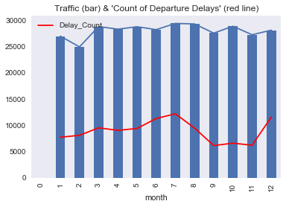
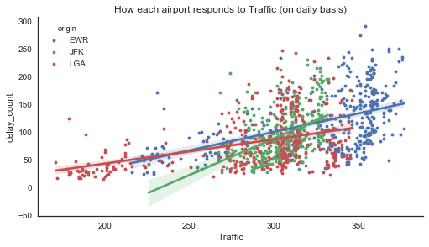
Departure Delays Flight Traffic & its impact on count of delays
Delay pattern throughout the year
Delays across originating airports
Correlation between Traffic & flight delays = 0.39
Impact of traffic on flight delays is not prominent.
July & August are busiest month.
Flight delays are fewer in Sep, Oct & Nov without much reduction in traffic.
Airport Remarks
EWR Mostly highest traffic
LGA Sometimes least traffic
JFK More sensitive to Traffic(steeper slope). Relatively close to capacity.
Several instances of very few delays even with high traffic load.
Both airports react to the traffic in similar way (as slopes are similar)
Traffic is not the only factor for departure delays. Hence, delays can be reduced even in current high traffic.

Slide 7
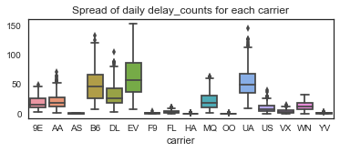
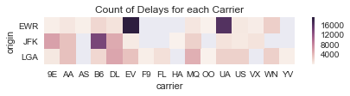
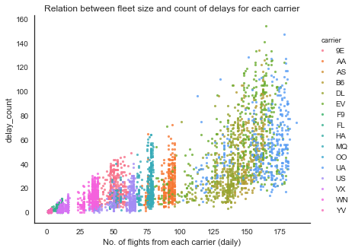
Departure Delays Delays observed by different Carriers
Spread of daily delays for each carrier
Carrier delays are dependent on airport
Number of Delays varies widely for few Carriers.
As many flights a carrier operates, so many delays it can observe.
Every carrier operates different fleet size.
Most delays at origins can be attributed to few carriers.
Different carriers have different fleet sizes, impacting the departure delays that they face.

Slide 8
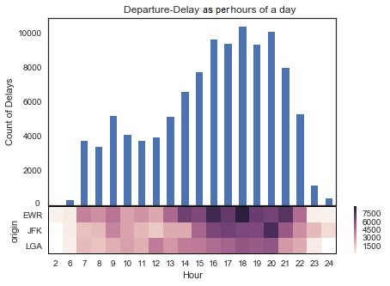
Departure Delays Delay profile throughout the day
Badly impacted hours in a day
Most delays take place between 2 PM & 10 PM.
Delays are minimal during darkest hours of the night (23 PM to 6 AM).
Airport Peak delay hours
EWR 4 PM & 6PM
JFK 8 PM
Delays during morning business hours are relatively under control,
whereas afternoon hours see deterioration due to high traffic probably attributed to personal travels.

Slide 9
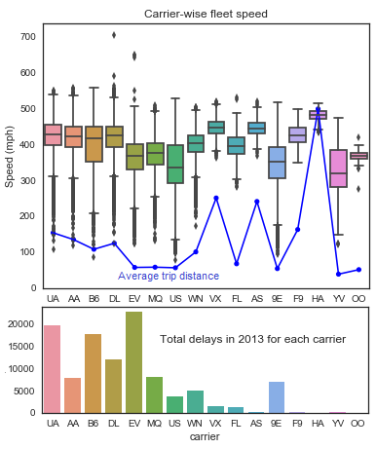
Aircraft Speed Analysis Determinant factor of Speed
Speed, Delays & Trip length
HA : fastest and efficient fleet. Negligible delays. Reliable for longer distance trips.
EV : facing highest delays but using slower fleets.
US : slowest fleet yet handled delays efficiently
High speed fleets normally see low departure delays.
Short distance carriers use slower fleets.
Most of the aircrafts fly with speed less than world’s average passenger jet’s speed (540 MpH), suggests frequent Aircraft maintenance
Trip length (not departure delay) is determinant lever of speed.

Slide 10
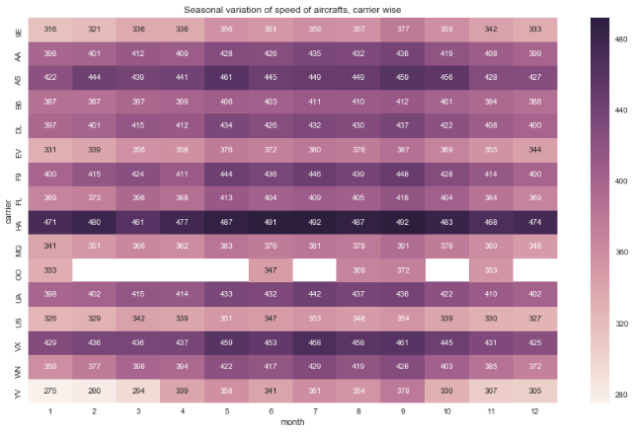
Aircraft Speed Analysis Speed VS Season
During Winters, Aircrafts fly relatively with lower speed. This could be due to low visibility.
OO: operative only before and after of “Spring break” and “Winter holidays”
Season of flight is also a key determinant for Aircraft's speed.

Slide 11
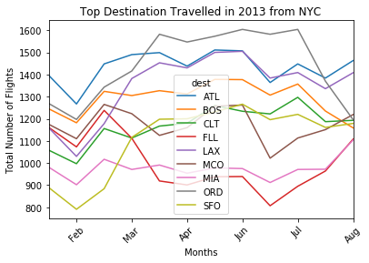
Destination Analysis Top Destinations Travelled in 2013 from NYC
Top 5 Destinations travelled from New York in 2013 are:
Chicago(ORD)
Atlanta(ATL)
Los Angeles(LAX)
Orlando(MCO)
Boston(BOS)
On an average Top Destinations have 4 flights in a day.
Trend shows a peak in June, July(Spring break) and witness a huge dip during February (Winter break)
Reverse trend has been observed for Fort Lauderdal(FLL).

Slide 12
Conclusion
Minimal departure delays are possible even during high airport traffic.
Different carriers have different fleet sizes.
As many flights a carrier operates, so many delays it can observe.
Most delays are observed during afternoon hours.
Length of the trip and Season of flight are prime levers of choosing flight speed.
As expected, Number of flights increase to top destinations before Winter and Spring breaks.

