Slide 1
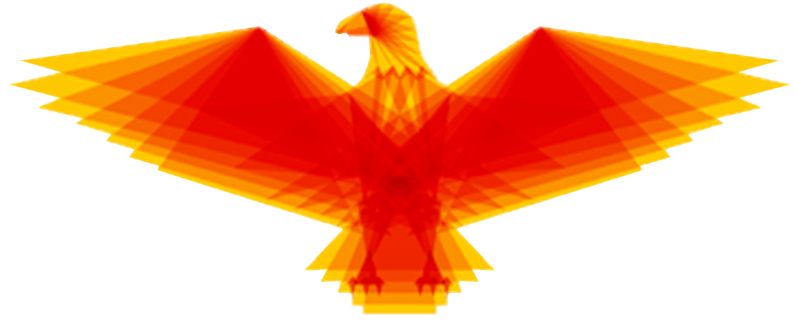


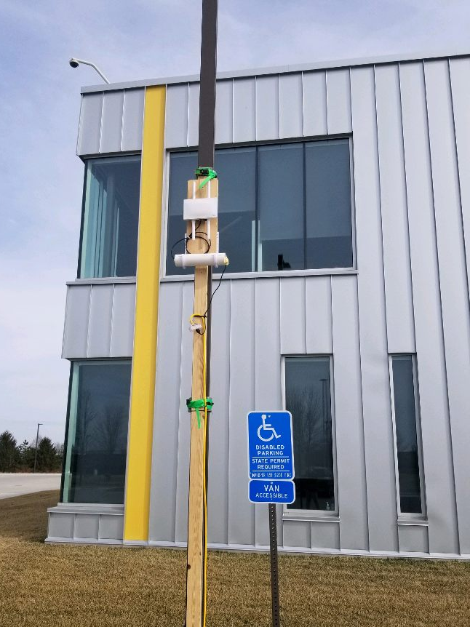
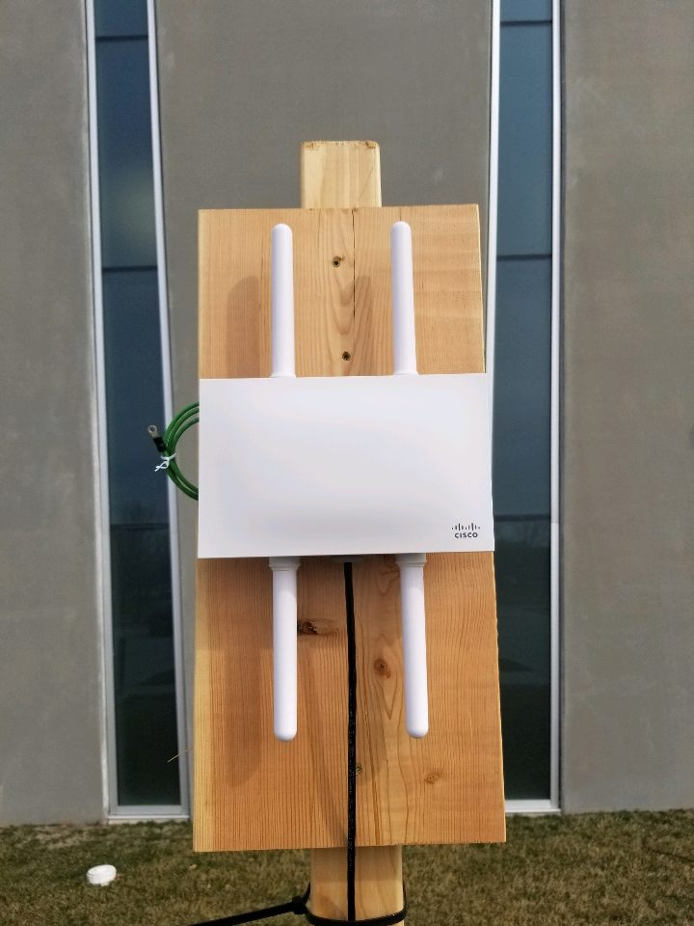
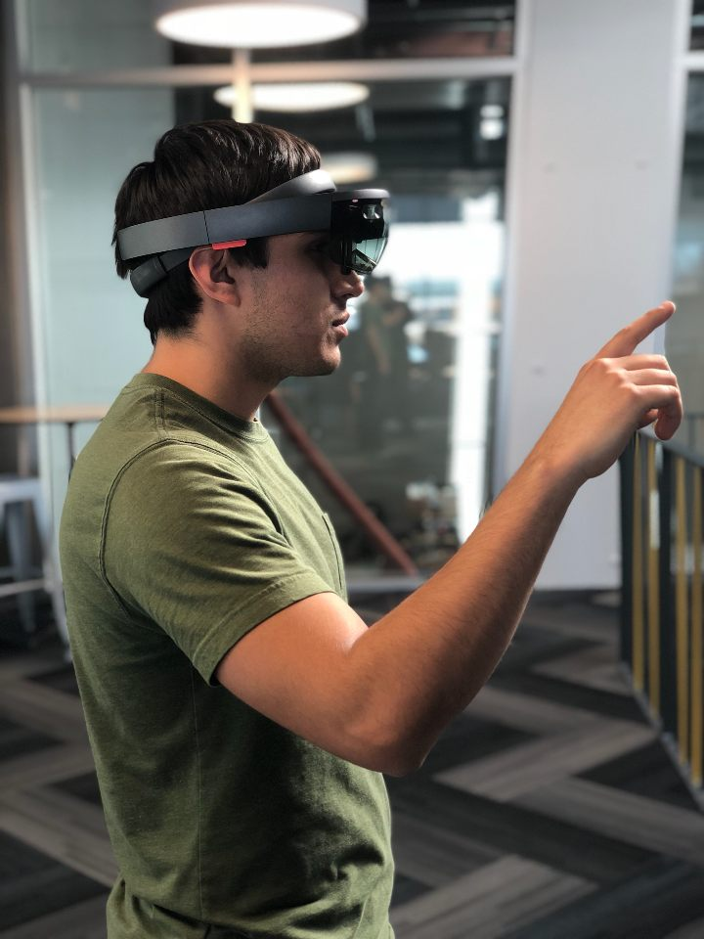
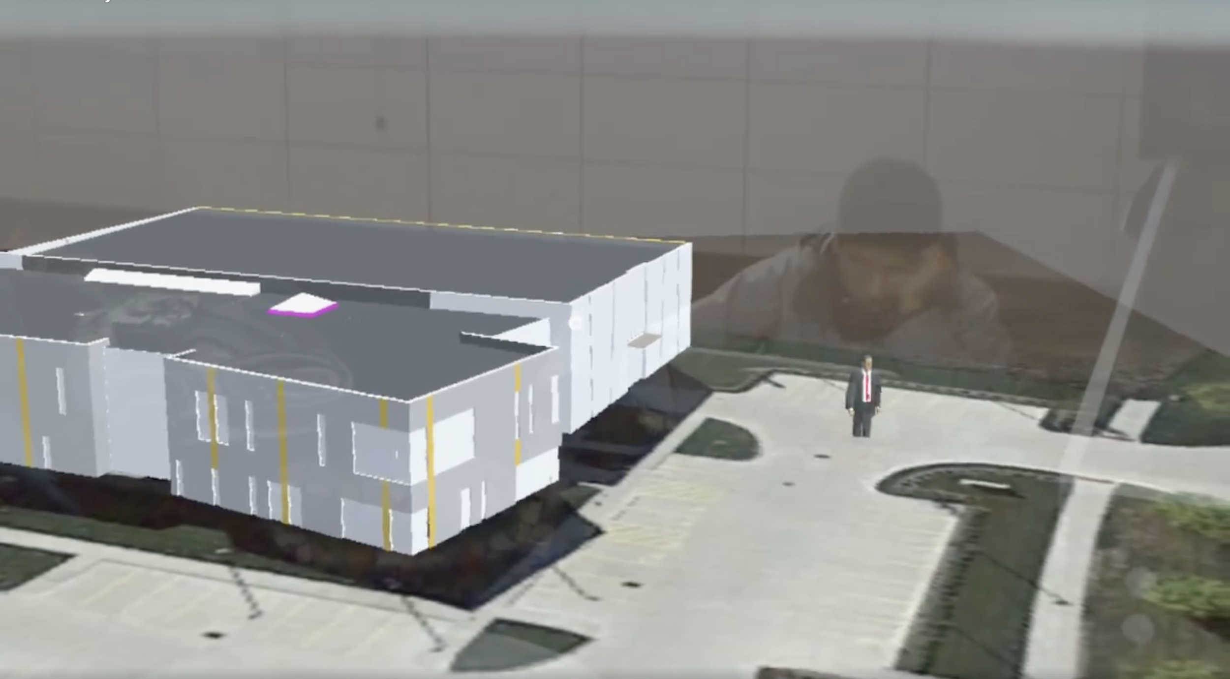
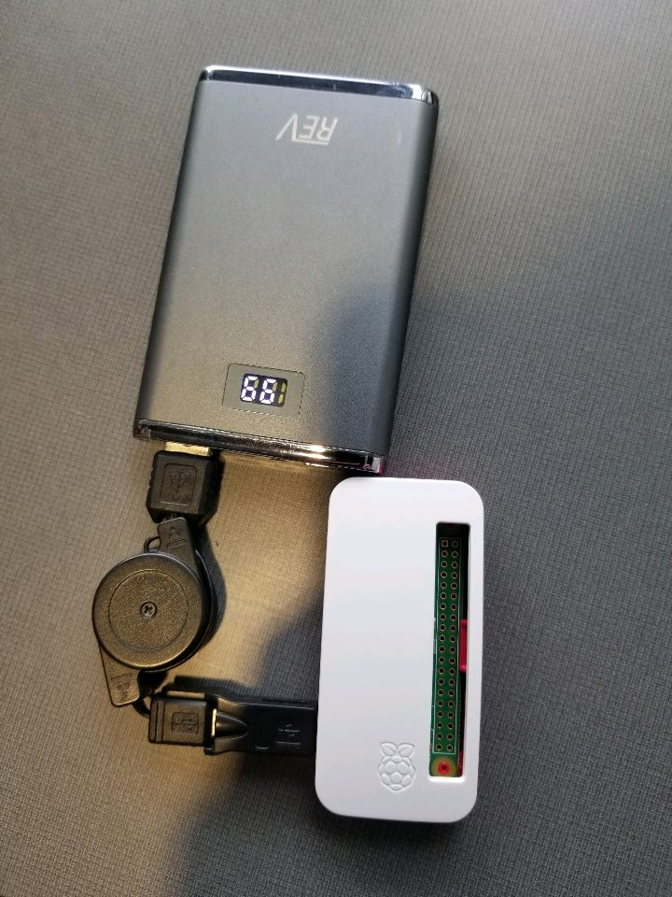
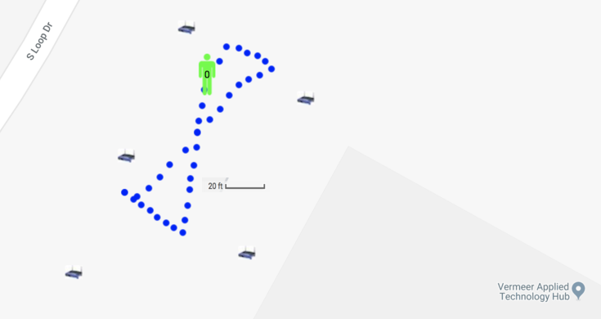
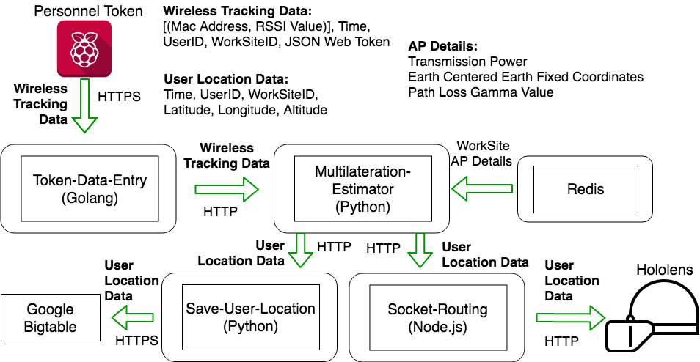
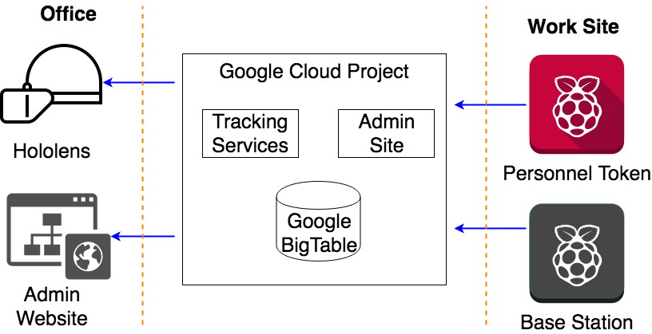
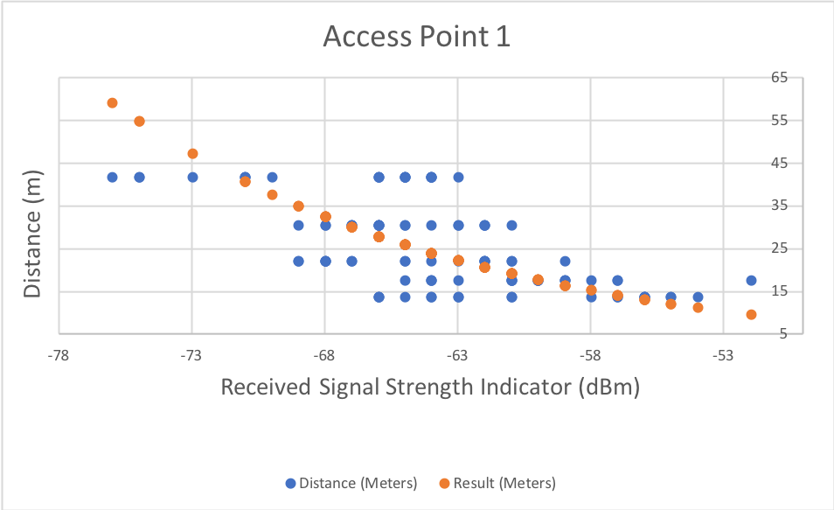
Eagleye: Personnel Tracking in an Augmented Reality Environment
Team Members: Chandler Chockalingam, Victor Da Silva, Josua Gonzales-Neal, Logan Highland, Jason Ramirez, Christopher Stapler
Senior Design May 18-34
Project Goal
System for tracking construction workers in real time
Microsoft HoloLens application showing personnel location at any given time
Small token, which is attached to toolbelt
Communicates with a distributed tracking system that relays data to the HoloLens
Allows supervisors and general contractors to prevent safety incidents
Ensures workers are held accountable for where they are and their job
Design Requirements
Functional Requirements
3-part system: token, services, and HoloLens
System will utilize construction sites’ wifi
Worker will keep token on belt and it will use wireless signal strength data for localization
Admin website
Must store data for future playback
Non-Functional Requirements
Tracking accuracy within 6 meters
Real time tracking
Battery life of token is 10 hours
Token is no larger than iPhone 8
Token will relay readable data to HoloLens
Must be able to track outdoors
Delay must be no longer than 1 second
Engineering Constraints
Budgetary constraint: $5,000
Time constraint: 9 months
Design requirements
Engineering Standards
IEEE 802.11: Specification for implementing wireless local area network (WLAN) computer communication
ISO 21500: Guidance on Project Management
What is Optical Operations?
Provides site management on an industrial scale
Customer: Construction general contractors
Use real-time 3D AR to ensure that the right assets and people are at the right place, at the right time, in a safe way
Test setup at the ISU Startup Factory
Eagleye on the HoloLens
The system’s token: a Raspberry Pi Zero
Simulation Test
System overview diagram
Tracking Services diagram
Results of RSSI to distance test
System Users and Uses
Users
Those who want to ensure that outdoor worksites are running efficiently and safely
Personnel who enter an active construction site
Supervisors monitoring locations
Uses
Monitoring the location of personnel
Ensuring the safety of all employees on site
Aid in location tracking in emergency situations
Technical Approach
System Testing Procedure
Set up access points outside
Pick multiple points to measure in the test area
Measure distance between points and APs
Gather RSSI values from all points
Set up backend services
Plug into multilateration service to get longitude and latitude
Compare with known GPS location
Send information to HoloLens
Compare avatar location with GPS location
Tokens (Data Gather) Raspberry Pi Zero Raspbian Lite (Linux) Ansible GPSD
HoloLens (Frontend) Unity C# MessageWebSockets
Services (Backend) Google Cloud Project Kubernetes Engine (Container Manager) Docker Containers NGINX (HTTPS Proxy) Golang, Python, Node.js, Shell Scripts MongoDB Redis Google Bigtable (Big Data Storage)
Faculty Advisor: Dr. Daji Qiao, Client: Optical Operations LLC
Department of Electrical and Computer Engineering, Iowa State University

