Slide 1

Make-like declarative workflows with R
Christine Stawitz, University of Washington
..with lots of examples/references from Will Landau and Kirill Müller

Slide 2
What is drake?
“workflow manager for data-driven tasks”
– Will Landau
Keeps track of dependencies and only re-runs parts that have changed
..a makefile for R

Slide 3
Why drake?

Slide 4
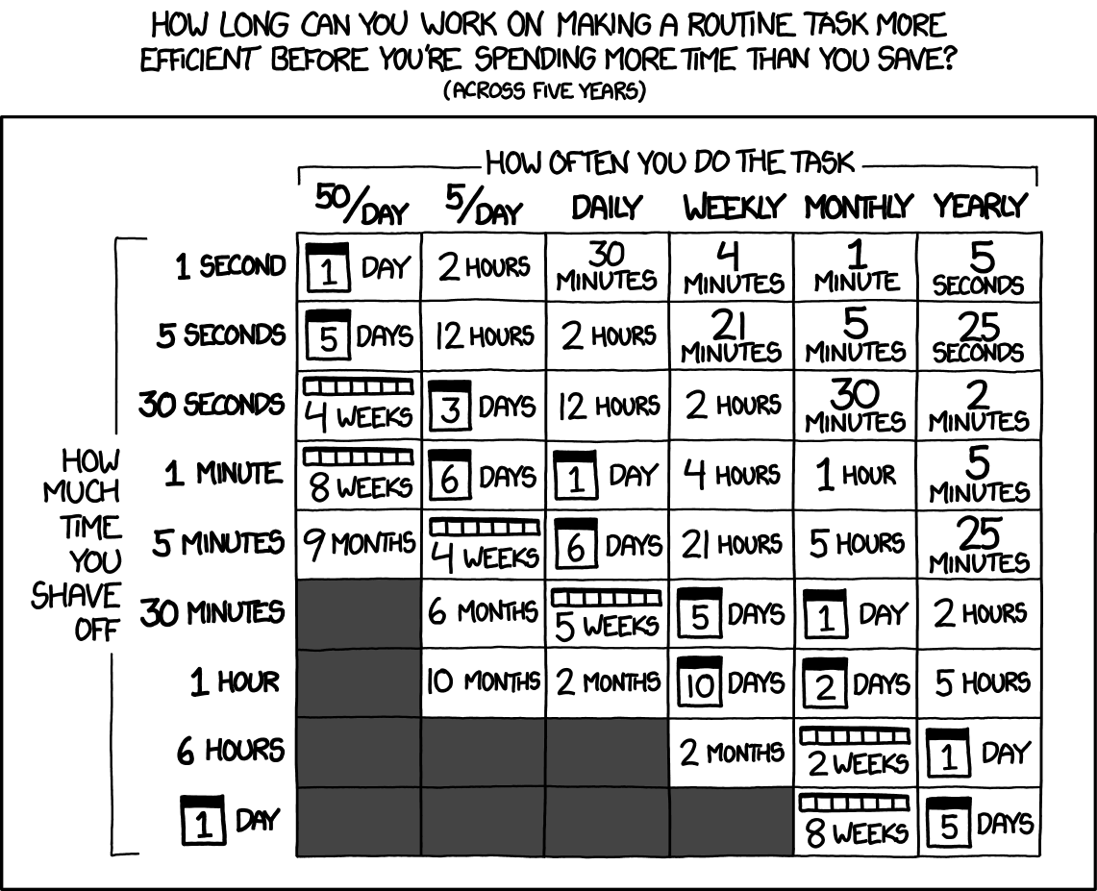
Saves you time
https://xkcd.com/1205/

Slide 5
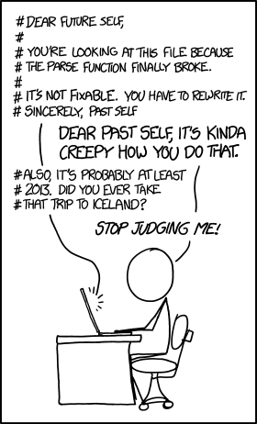
Increases reproducibility
https://xkcd.com/1421/

Slide 6
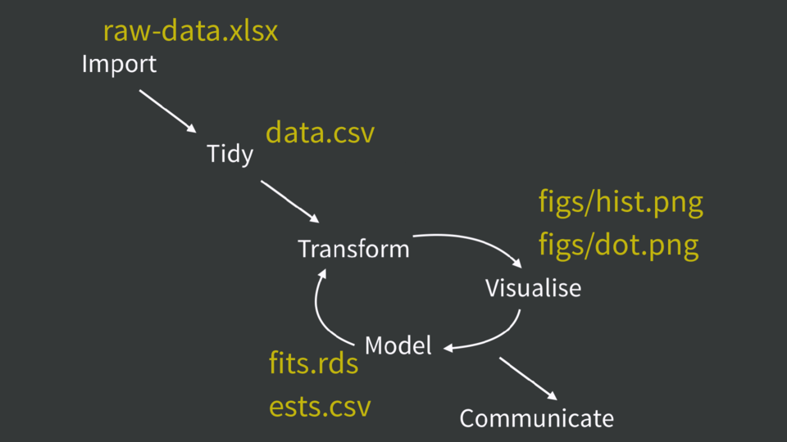
How it works: in a nutshell
Encompass the steps of your analysis in a drake_plan() function
Set triggers for how frequently you want to refresh steps of the plan
Set output to be in a dynamic knitr report
Run make() to do analysis

Slide 7
Key functions

Slide 8
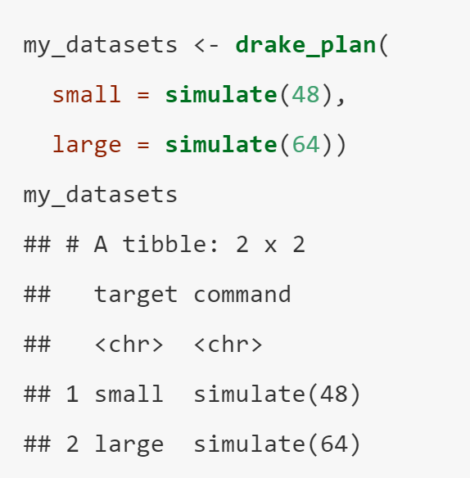
drake_plan()
Create a workflow plan data frame for the plan argument of make().
Arguments:
rows of data frame (targets)
tidy_evaluation (T/F)

Slide 9
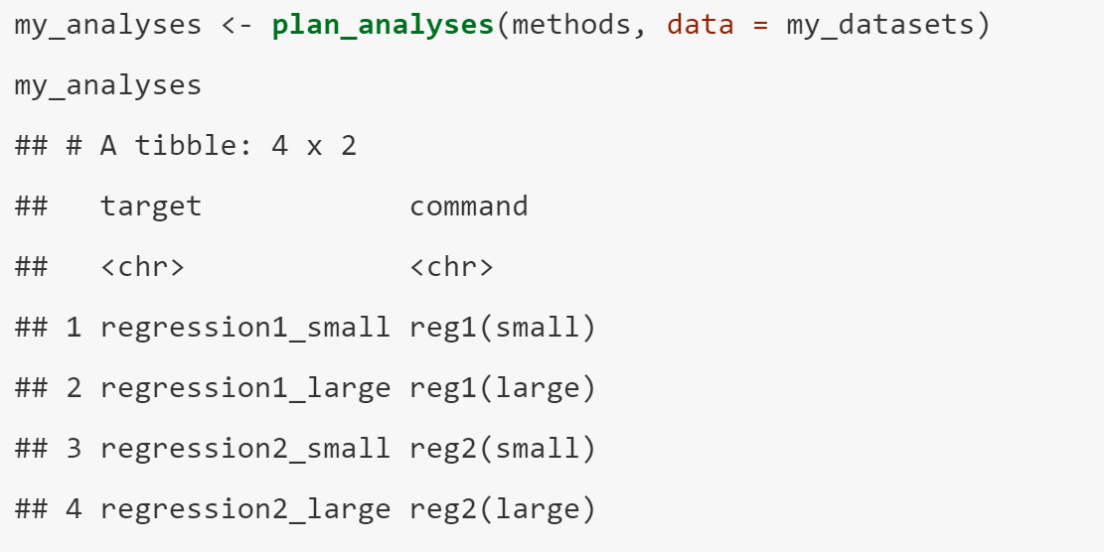
Plan_analyses()
Generate a workflow plan data frame to analyze multiple datasets using multiple methods of analysis.
Arguments:
Data
Methods

Slide 10
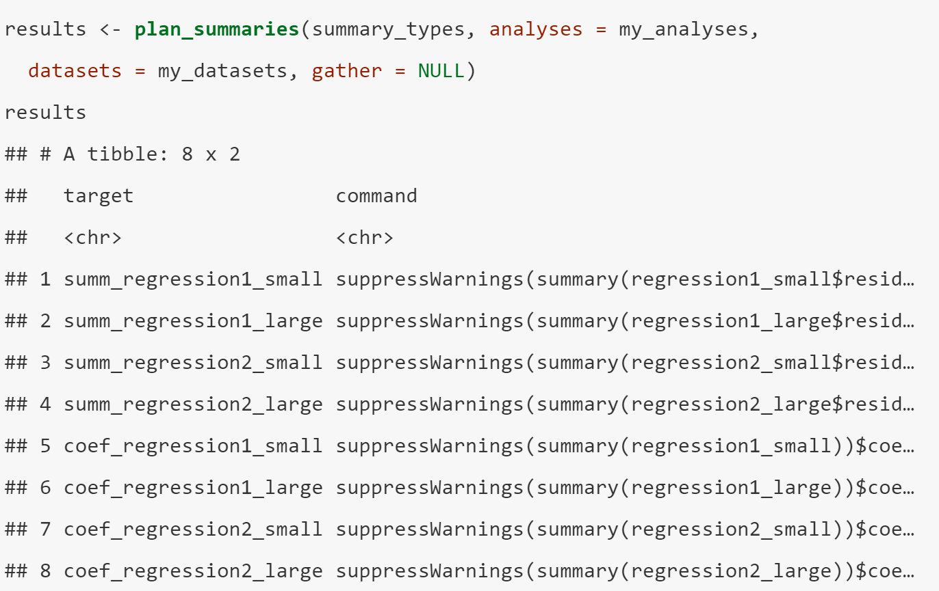
Plan_summaries()
Generate a workflow plan data frame for summarizing multiple analyses of multiple datasets multiple ways
Arguments
Plan
Analyses
Datasets
Gather – brings datasets together

Slide 11
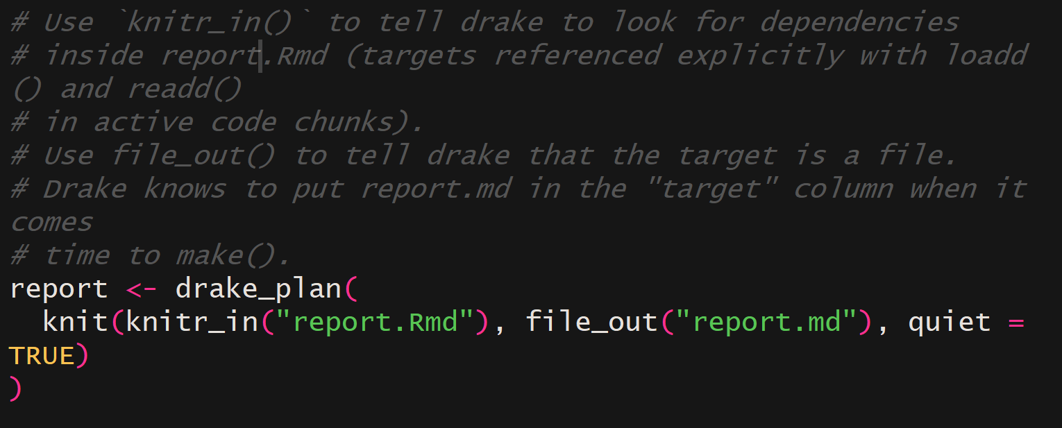
Knitr_in
Declare the knitr/rmarkdown source files of a workflow plan command.

Slide 12
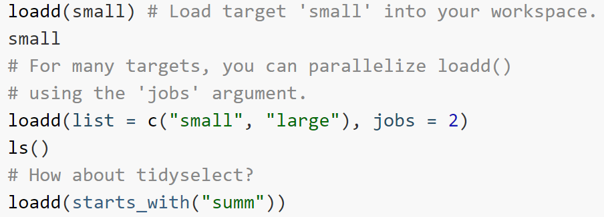
readd() and loadd()
Read or load a built target.

Slide 13
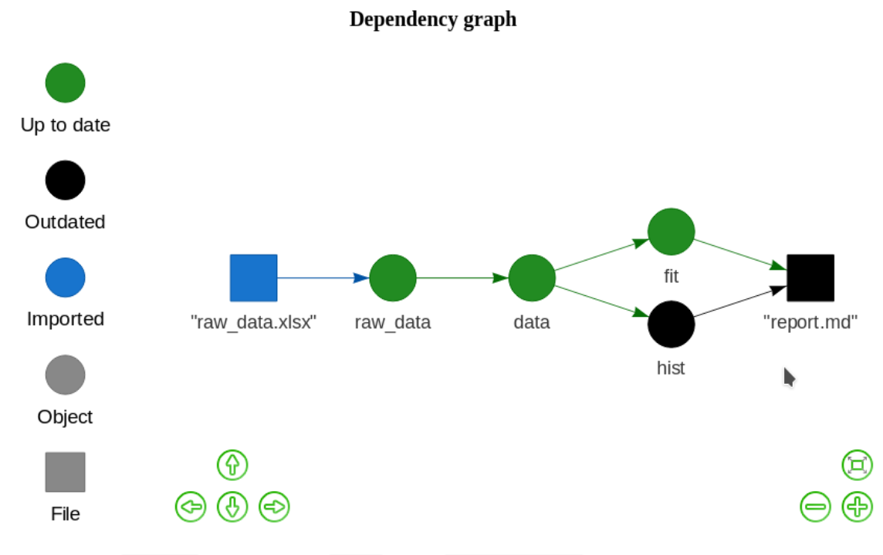
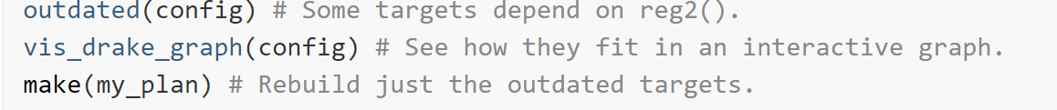
drake_config()
Show an interactive visual network representation of your drake project.

Slide 14
make()
This is the central, most important function of the drake package. It runs all the steps of your workflow in the correct order, skipping any work that is already up to date.
Arguments
Your drake_plan()
Many options governing how the workflow is run
Parallelism
Logging
Dependencies
…

Slide 15
Example #1: main

Slide 16
Main example
drake::drake_example(“main”)
setwd(<“main” directory>)
Open make.R in “main” directory

Slide 17
Example #2: packages

Slide 18
Packages example
drake::drake_example(“packages”)
setwd(<“packages” directory>)
Copy “interactive-tutorial_partsremoved.R” into the “packages” directory
Work through steps in comments

Slide 19
Advanced drake
Impose timeouts and retries when using make()
Tidy evaluation using quasiquotation
Parallelism & high performance computing

Slide 20
References
https://github.com/ropensci/drake
Tutorials:
Kirill Muller’s drake workshop: https://github.com/krlmlr/drake-sib-zurich

