Slide 1

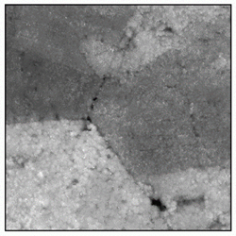
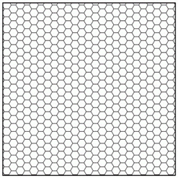
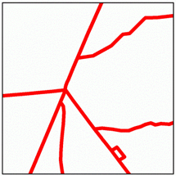
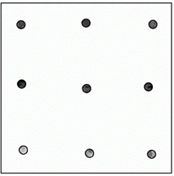
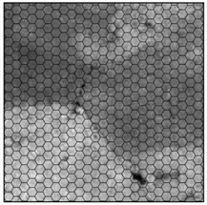
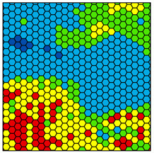
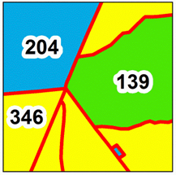
Ground Plots
Remote Sensing Information
Hexagon Cells
Existing Stand Geometries
Coregistrate & derivate
Predictor Variables:
Height, variability, canopy cover & spectral Metrics
Generate wall-to-wall
Predictor Variables
for all Cells
Apply Models for wall-to-wall Mapping
Aggregate Cell Predictions to derive stand-level Estimates
Train predictive Regression Models

