Slide 1
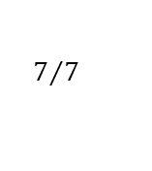
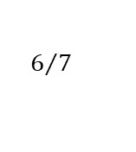
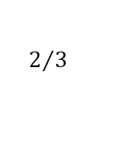
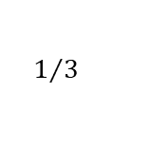
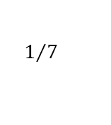
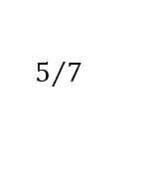
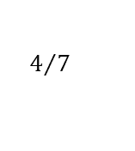
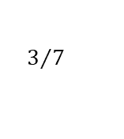
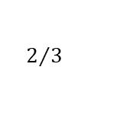
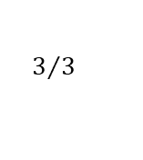
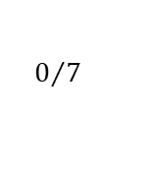
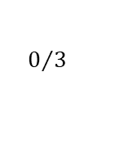
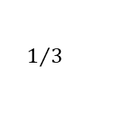
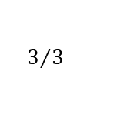
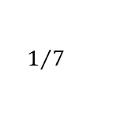
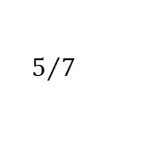
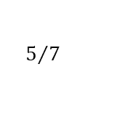
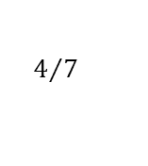
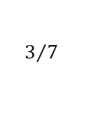
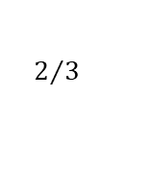
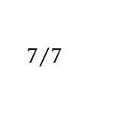
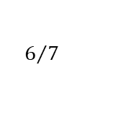
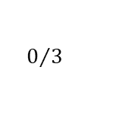

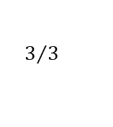
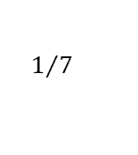
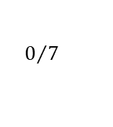
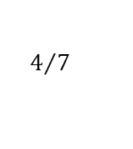
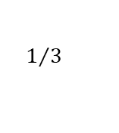
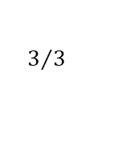
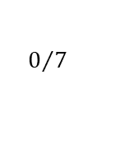
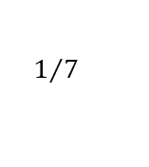
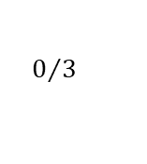
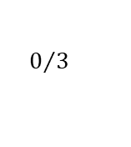
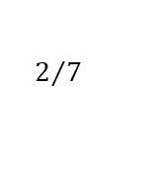
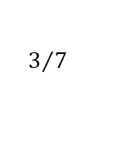
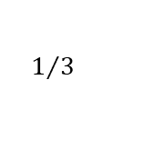
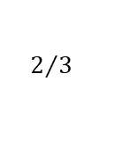
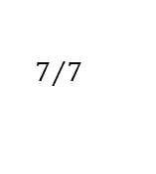
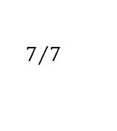
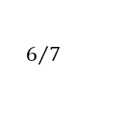
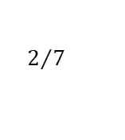
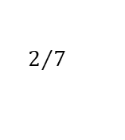
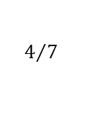
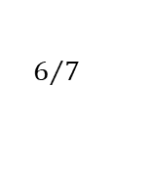
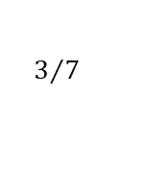
Shock
Long-term average
Time period
-1
0
1
2
3
4
5
6
7
8
9
10
1-year-shock
weath1to3
short-term
(lag 1-3)
LTA
$$3/3$$
$$2/3$$
$$2/3$$
$$2/3$$
$$3/3$$
$$3/3$$
$$3/3$$
$$3/3$$
$$3/3$$
$$3/3$$
$$3/3$$
2018
$$0/3$$
$$1/3$$
$$1/3$$
$$1/3$$
$$3/3$$
$$3/3$$
$$3/3$$
$$3/3$$
$$3/3$$
$$3/3$$
$$3/3$$
weath4to10
long-term
(lag 4-10)
LTA
$$7/7$$
$$7/7$$
$$7/7$$
$$7/7$$
$$6/7$$
$$6/7$$
$$6/7$$
$$6/7$$
$$6/7$$
$$6/7$$
$$6/7$$
2018
$$0/7$$
$$0/7$$
$$0/7$$
$$0/7$$
$$1/7$$
$$1/7$$
$$1/7$$
$$1/7$$
$$1/7$$
$$1/7$$
$$1/7$$
2-year-shock
weath1to3
short-term
(lag 1-3)
LTA
$$3/3$$
$$2/3$$
$$1/3$$
$$1/3$$
$$2/3$$
$$3/3$$
$$3/3$$
$$3/3$$
$$3/3$$
$$3/3$$
$$3/3$$
2018
$$0/3$$
$$1/3$$
$$2/3$$
$$2/3$$
$$1/3$$
$$0/3$$
$$0/3$$
$$0/3$$
$$0/3$$
$$0/3$$
$$0/3$$
weath4to10
long-term
(lag 4-10)
LTA
$$7/7$$
$$7/7$$
$$7/7$$
$$7/7$$
$$6/7$$
$$5/7$$
$$5/7$$
$$5/7$$
$$5/7$$
$$5/7$$
$$5/7$$
2018
$$0/7$$
$$0/7$$
$$0/7$$
$$0/7$$
$$1/7$$
$$2/7$$
$$2/7$$
$$2/7$$
$$2/7$$
$$2/7$$
$$2/7$$
3-year-shock
weath1to3
short-term
(lag 1-3)
LTA
$$3/3$$
$$2/3$$
$$1/3$$
$$0/3$$
$$1/3$$
$$2/3$$
$$3/3$$
$$3/3$$
$$3/3$$
$$3/3$$
$$3/3$$
2018
$$0/3$$
$$1/3$$
$$2/3$$
$$3/3$$
$$2/3$$
$$1/3$$
$$0/3$$
$$0/3$$
$$0/3$$
$$0/3$$
$$0/3$$
weath4to10
long-term
(lag 4-10)
LTA
$$7/7$$
$$7/7$$
$$7/7$$
$$7/7$$
$$6/7$$
$$5/7$$
$$4/7$$
$$4/7$$
$$4/7$$
$$4/7$$
$$4/7$$
2018
$$0/7$$
$$0/7$$
$$0/7$$
$$0/7$$
$$1/7$$
$$2/7$$
$$3/7$$
$$3/7$$
$$3/7$$
$$3/7$$
$$3/7$$

Slide 2
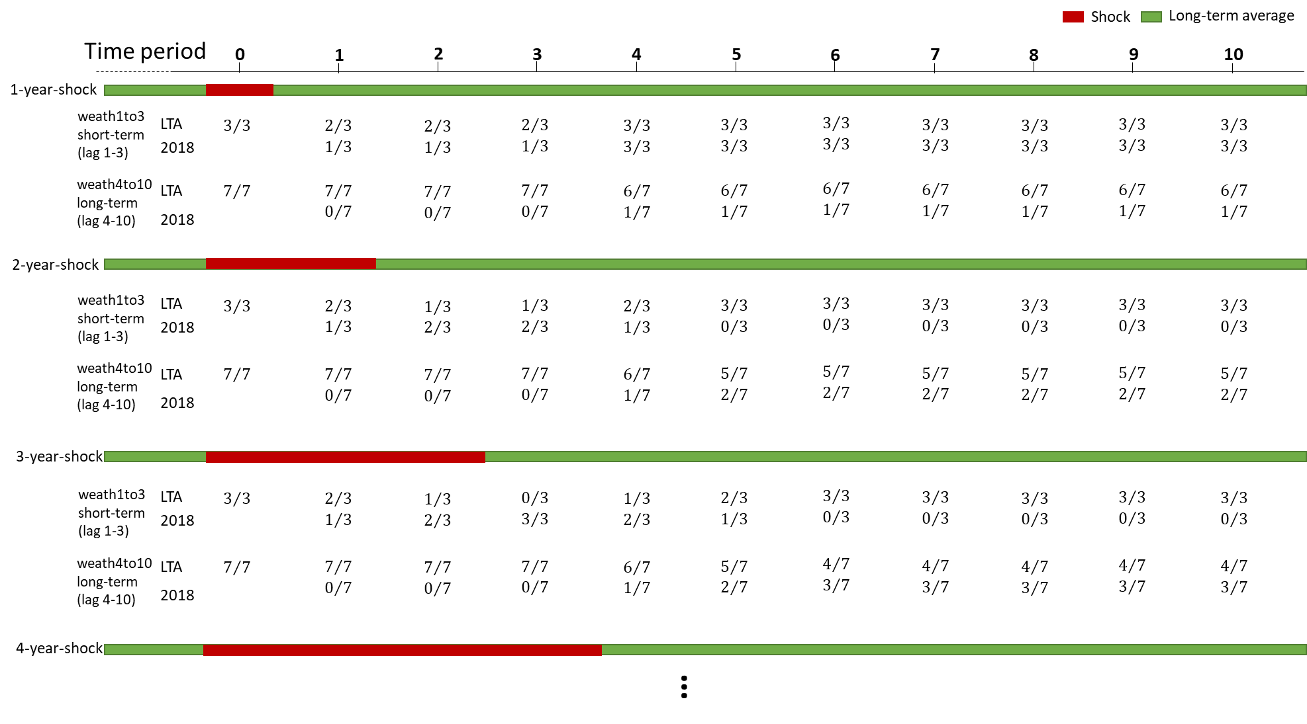

Slide 3
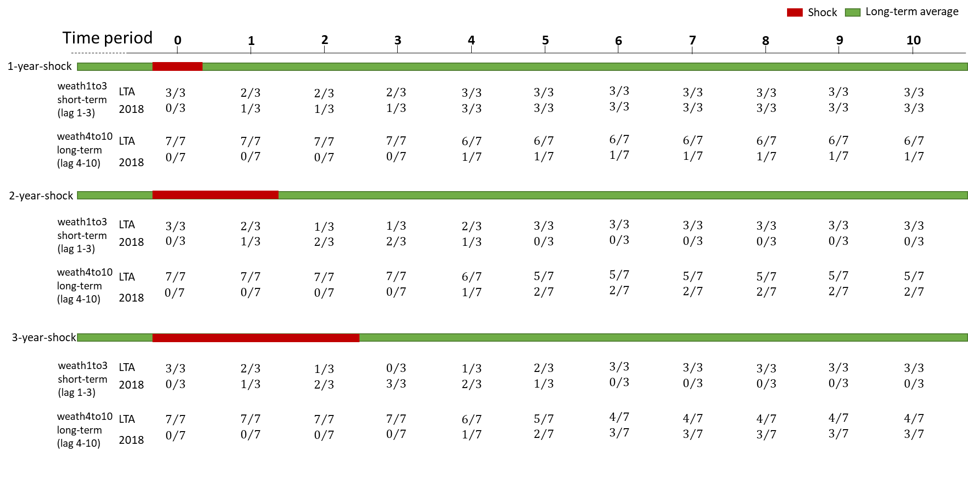

Slide 4
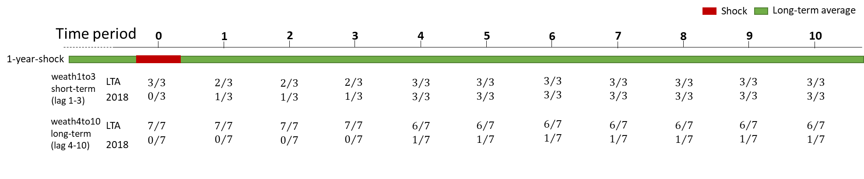
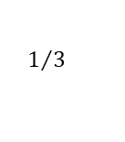
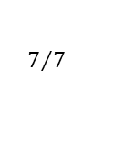
























Shock
Long-term average
Time period
0
1
2
3
4
5
6
7
8
9
10
1-year-shock
weath1to3
short-term
(lag 1-3)
LTA
$$3/3$$
$$2/3$$
$$2/3$$
$$2/3$$
$$3/3$$
$$3/3$$
$$3/3$$
$$3/3$$
$$3/3$$
$$3/3$$
$$3/3$$
2018
$$0/3$$
$$1/3$$
$$1/3$$
$$1/3$$
$$3/3$$
$$3/3$$
$$3/3$$
$$3/3$$
$$3/3$$
$$3/3$$
$$3/3$$
weath4to10
long-term
(lag 4-10)
LTA
$$7/7$$
$$7/7$$
$$7/7$$
$$7/7$$
$$6/7$$
$$6/7$$
$$6/7$$
$$6/7$$
$$6/7$$
$$6/7$$
$$6/7$$
2018
$$0/7$$
$$0/7$$
$$0/7$$
$$0/7$$
$$1/7$$
$$1/7$$
$$1/7$$
$$1/7$$
$$1/7$$
$$1/7$$
$$1/7$$

Slide 5


