Slide 1
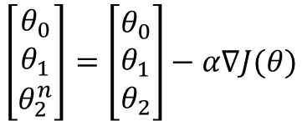






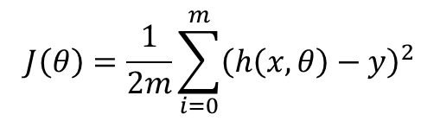
$$θ_{0}$$
$$x_{1}$$
$$θ_{1}$$
Output
Input
$$h\left(x, θ\right)= g\left(θ^{T}x\right)$$
$$θ_{2}$$
$$x_{2}$$
$$\left[\begin{aligned}θ_{0} \\ θ_{1} \\ θ_{2}^{n}\end{aligned}\right]=\left[\begin{aligned}θ_{0} \\ θ_{1} \\ θ_{2}\end{aligned}\right]−α∇J(θ)$$
$$J\left(θ\right)=\frac{1}{2m}\sum_{i=0}^{m}{{\left(h\left(x, θ\right)−y\right)}^{2}}$$

Slide 2


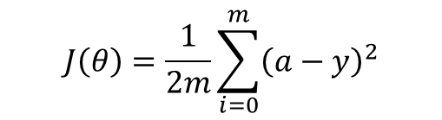













$$θ_{11}^{(1)}$$
$$x_{1}$$
$$g\left(z_{1}^{(1)}\right)$$
$$θ_{11}^{(2)}$$
$$θ_{12}^{(1)}$$
Input
$$g\left(z_{1}^{(2)}\right)$$
$$a^{(2)}$$
Output
$$θ_{21}^{(1)}$$
$$θ_{21}^{(2)}$$
$$x_{2}$$
$$g\left(z_{2}^{(1)}\right)$$
$$θ_{22}^{(1)}$$
$$J\left(θ\right)=\frac{1}{2m}\sum_{i=0}^{m}{{\left(a−y\right)}^{2}}$$
$$\frac{∂J}{∂θ^{l}}=a^{l−1}δ^{l}$$
$$δ^{l}=\left({\left(θ^{l+1}\right)}^{T}δ^{l+1}\right)⊙g^{′}\left(z^{l}\right)$$
$${δ^{L}=∇}_{a}J⊙g^{′}\left(z^{L}\right)$$
$$\frac{∂J}{∂θ_{0}^{l}}=δ^{l}$$

Slide 3
$$θ_{11}^{(1)}$$
$$x_{1}$$
$$g\left(z_{1}^{(1)}\right)$$
$$θ_{11}^{(2)}$$
$$θ_{12}^{(1)}$$
Input
$$g\left(z_{1}^{(2)}\right)$$
$$a^{(2)}$$
Output
$$θ_{21}^{(1)}$$
$$θ_{21}^{(2)}$$
$$x_{2}$$
$$g\left(z_{2}^{(1)}\right)$$
$$θ_{22}^{(1)}$$

Slide 4





$$x_{1}$$
$$x_{2}$$
Input
$$a^{L}$$
Output
$$x_{3}$$
$$x_{4}$$

Slide 5





$$x_{1}$$
$$x_{2}$$
Input
$$a^{L}$$
Output
$$x_{3}$$
$$x_{4}$$

Slide 6
$$x_{1}$$
$$x_{2}$$
Input
$$a^{L}$$
Output
$$x_{3}$$
$$x_{4}$$

Slide 7
$$x_{1}$$
$$x_{2}$$
Input
$$a^{L}$$
Output
$$x_{3}$$
$$x_{4}$$

Slide 8





$$x_{1}$$
$$θ_{1}$$
$$y$$
$$θ_{2}$$
$$x_{2}$$

Slide 9





$$x_{1}$$
$$θ_{12}^{(1)}$$
Input
$$a^{(2)}$$
Output
$$θ_{21}^{(2)}$$
$${g(θ}_{21}^{\left(2\right)}g(z+Δz))$$
$$x_{2}$$
$$θ_{22}^{(1)}$$
$$θ_{21}^{\left(2\right)}g(z+Δz)$$
$$z+Δz$$

