Slide 1
The Effects of Health and Wellness on the Presence of Sleep Disorders
An approach to predicting sleep disorders using machine learning
Ceara Stewart | IST707 | 9/16/2023

Slide 2
Contents
Introduction
Data and its Source
Literature Review
Data Exploration and Data Cleaning
Output and Analysis
Conclusion
Sources

Slide 3
Introduction
Aims to utilize machine learning models to predict if patients have or do not have a sleeping disorder based on general health and well-being data.
Machine learning models used:
K-Means
EM
Decision Trees
Random Forest
Goal is to create models with high accuracy that utilize training data of patient health and well-being and their associated sleeping disorder or lack of to predict if test data of patient health and well-being can be associated with having or not having a sleep disorder.

Slide 4
Data and its Source
Training Data
Test Data
“Sleep Health and Lifestyle Dataset” from Kaggle
Made up of 13 attributes:
Person ID
Gender
Age
Occupation
Sleep Duration
Quality of Sleep
Physical activity Level
Stress Level
BMI Category
Blood Pressure
Heart Rate
Daily Steps
Sleep Disorder
Self-collected data from colleagues, friends, and family.
Was collected completely anonymously and has all the same variables as the data set from Kaggle
Sleep disorder variable for every participant is listed as “unknown”

Slide 5
Literature Review
“Machine Learning Approach for anxiety and sleep disorders analysis during COVID-19 lockdown”, written by Anbarasi, Jawahar, Cherian and Shreenidhi
Sought to investigate the different symptoms and side effects that people suffer from in connection to their sleep patterns and uses machine learning to predict the possible relationships that exist between COVID-19 and sleep patterns and disorders.
Random Forest
K-Means
Results of the K-mean clustering present that anxiety score does play an effect on whether the participants were classified as either having or not having a sleeping disorder, while sleep quality clustering had less of an effect.

Slide 6
Data Exploration and Data Cleaning
Person ID column was ignored in all models run as it has no effect on any other column and is just an identification column for the participants.
k-Means
To look at how the test data with the unknown sleep disorders compares to how the training data is clustered, a combined dataset was created.
Three clusters
500 iterations
set seed of 10
Euclidean distance
EM
Set seed of 10
Started with 100 iterations
Decision Trees
J48
Tuning parameters:
“BinarySplit”
“unpruned”
“ConfidenceFactor”
“minNumObj”
Random Forest
Does not necessarily need to be discretized before running a model
Tuning parameters:
numTrees
numIterations

Slide 7
Output and Analysis: k-Means
The cluster mode selected was “Classes to cluster evaluation” and the sleep disorder column was selected.
When comparing the sleep disorder attribute to different health and lifestyle columns using the visualization feature in Weka, you can see how the unknown sleep disorder classification compares to the known sleep disorder classifications.
Sleep disorder classification versus quality of sleep scores
Cluster 2 mainly belongs in the “none” sleep disorder category and is associated with quality of sleep scores of 6 and 7.
Participants falling within Cluster 3 mainly fall between sleep apnea and insomnia.
Cluster 1 mainly belongs in the “none” sleep disorder category with quality of sleep scores mainly belonging to 8 or 9.
Unknown sleep disorder:
Six out of twenty participants are in cluster 3.
Three belong to cluster 1.
Eleven were placed in cluster 2.
It can be assumed that
Two participants can be classified as having sleep apnea.
One being classified as having insomnia.
Seven being classified as either having sleep apnea or insomnia.
Ten being classified as having no sleep disorder.

Slide 8
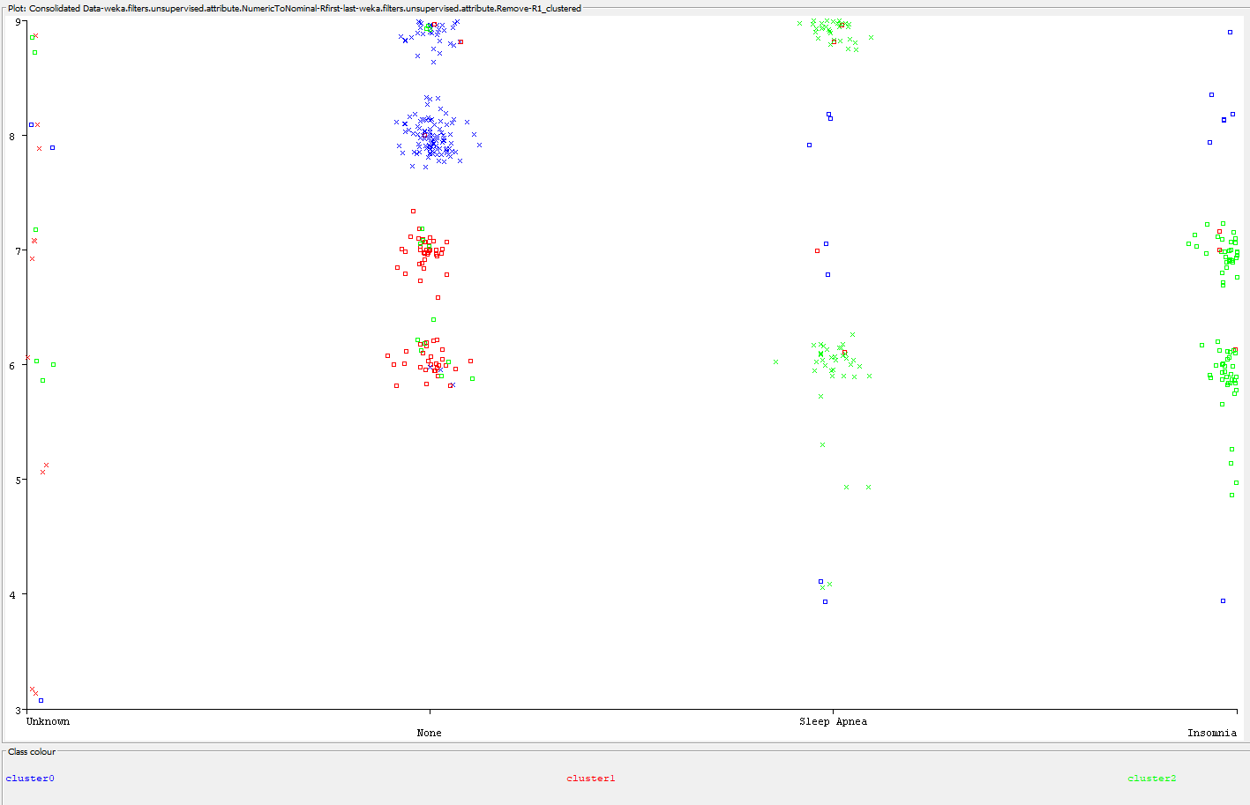
k-Means Visualization of Sleep Disorder versus Quality of Sleep

Slide 9
Output and Analysis: EM
The expectation maximization algorithm focuses on using log-likelihoods to determine the distribution of the latent variables.
Points belonging to cluster 2, which is the main cluster split between sleep apnea and insomnia, are all located at higher heart rate values.
When comparing each sleep disorder category against different variables
The “none” category I mainly made up of clusters 1 and 3.
The sleep categories of “insomnia” and “sleep apnea” are mainly composed of points from cluster 2.
Looking at sleep disorder vs heart rate
For “none”, no points are found above a heart rate of 77
For “sleep apnea” and “insomnia” have multiple points above a heart rate of 77.
For the “unknown” sleep disorder, there are 12 points belonging to cluster 1, 6 points belonging to cluster 2, and 2 points belonging to cluster 3.
Possibly indicate a connection to increased heart rate to the patient having a sleep disorder.
Can assume 8 “unknown” participants having a heart rate above 77 could either have sleep insomnia or sleep apnea.
This closely aligns with what was found using the k-Means algorithm as that algorithm assumes 10 “unknown” participants have either sleep apnea or insomnia.

Slide 10
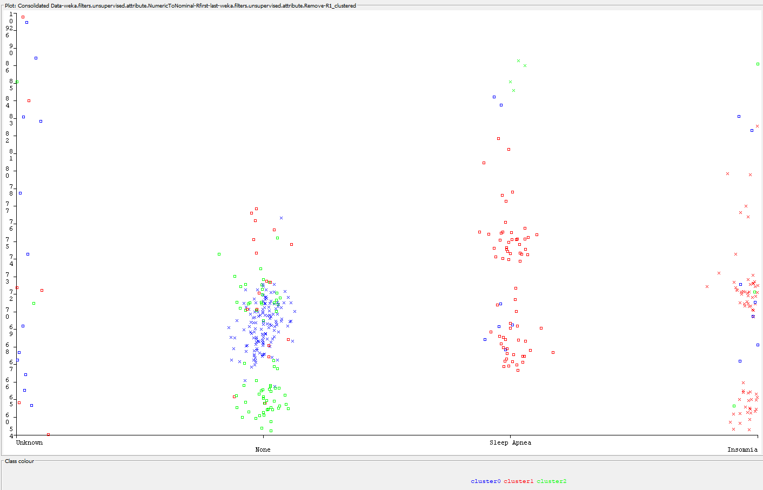
EM Visualization of Sleep Disorder versus Heart Rate

Slide 11
Output and Analysis: Decision Trees
The most accurate decision tree had
“confidenceFactor” at 0.25
“minNumObj” at 1
“unpruned” parameter to “True”
Decision tree with an accuracy of 93.3155%
The decision tree visual was used on the test data to predict the presence or lack of a sleep disorder from the 20 participants data.
Eleven out of twenty participants were classified as having no sleeping disorder.
Two were classified having insomnia.
Seven were classified as having sleep apnea.

Slide 12
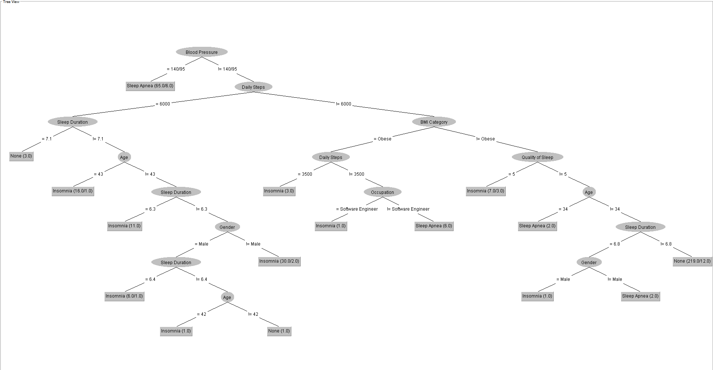
Decision Tree Visualization of most Accurate Tree

Slide 13
Output and Analysis: Random Forest
Changing the number of iterations had no effect on the model accuracy.
The best random forest model has a number of iterations of 10, as decreasing the number of iterations ensures that the model is not overfitting the data as this would be a problem when running the same model on the test dataset.
Accuracy produced was 93.3155%.
Confusion matrix results
For sleep disorder equals none
TP = 210
TN = 144
FP = 11
FN = 9
For the sleep disorder equal to sleep apnea
TP = 70
TN = 289
FP = 7
FN = 8
For sleep disorder equal to insomnia
TP = 69
TN = 290
FP = 7
FN = 8

Slide 14
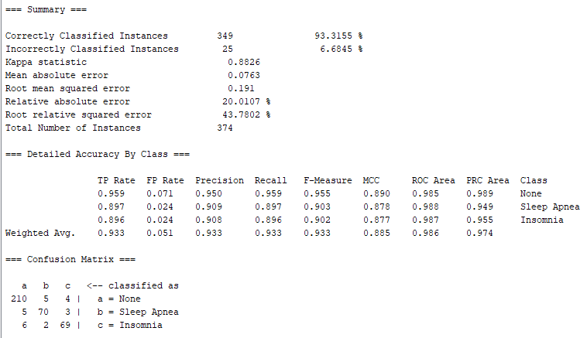

Slide 15
Conclusion
Each of these four different machine learning models have similar results when classifying which of twenty participants with an unknown sleep disorder have sleep apnea, insomnia, or no sleep disorder.
Out of the four models, random forests were the best model for this data set.
Had one of the highest accuracies.
Outputs and are less sensitive to overfitting compared to decision trees.
k-Means are sensitive to outliers
EM is sensitive to initialization
Decision trees are prone to overfitting without proper tuning.

Slide 16
Sources
https://www.kaggle.com/datasets/uom190346a/sleep-health-and-lifestyle-dataset
https://link.springer.com/article/10.1007/s12553-022-00674-7#Sec6

Slide 17
Thank You 1

