Slide 1
Group 4 – Final Project
Cristobal Gavaldon
Ceara Stewart
Kristan Rodriguez

Slide 2
AGENDA
Final Data Sets
Initial Cleaning
Descriptive Statistics & Graphics
Joining Airline Delays and Weather Data
Regression Analysis
Neural Networks
ARIMA

Slide 3
Airline Delays & Weather
Can we predict whether a flight delayed based on weather.

Slide 4
Final Datasets
Airport delay data came from the Bureau of Transportation Statistics and January 2019 to November of 2023 data was used.
Airport locations with their latitude and longitude was pulled from the OCHA Services HDX website.
These datasets were joined so that for each year, each airport also listed its coordinates and elevation metrics.
Weather data was pulled from the National Centers for Environmental Information, and monthly average precipitation and temperature values for each state were pulled.

Slide 5

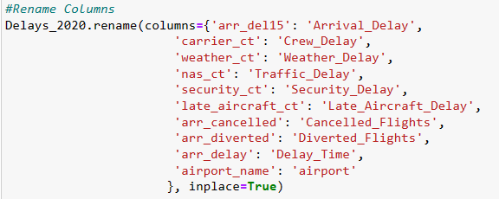

Initial Data Cleaning
Involved removing "unecessary" columns
Renaming Columns
Cleaning values within columns to drop symbols and words.

Slide 6

Initial Graphics and Descriptive Statistics
Mean delay for Weather was highest in 2023.
Mean for Cancelled Flights was highest in 2020.
2020 flight cancellations are possible biases/outliers caused by COVID-19 and not necessarily weather.
The highest percentage of flights delayed due to weather was 1.668% of flights for 2021.
Involved:
Running descriptive statistics
Averaging weather delay for each airport
Mapping weather delays for each year
Counting number of weather delays for each carrier

Slide 7
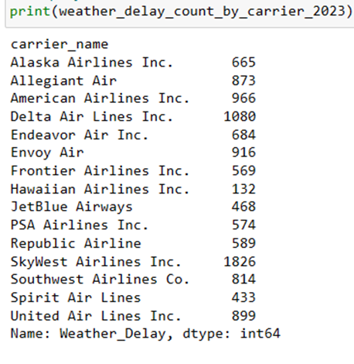
For each year, SkyWest airlines inc. Had the highest count of delays due to weather

Slide 8
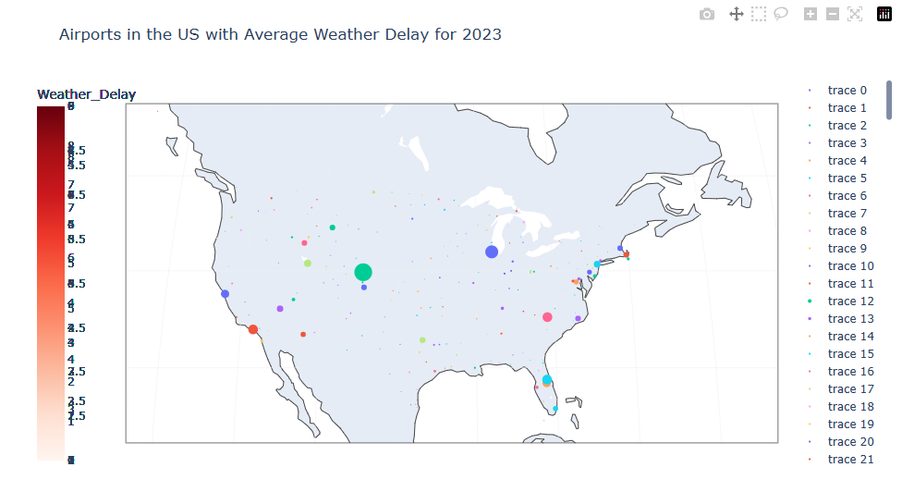
Graphics for Average Weather Delays for Each Airport

Slide 9
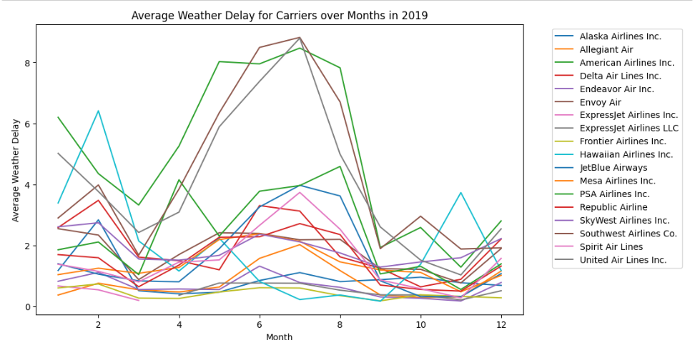
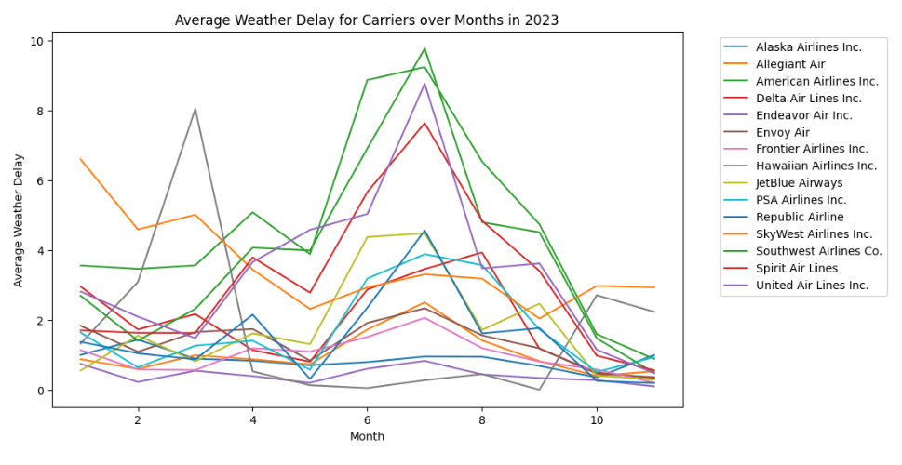
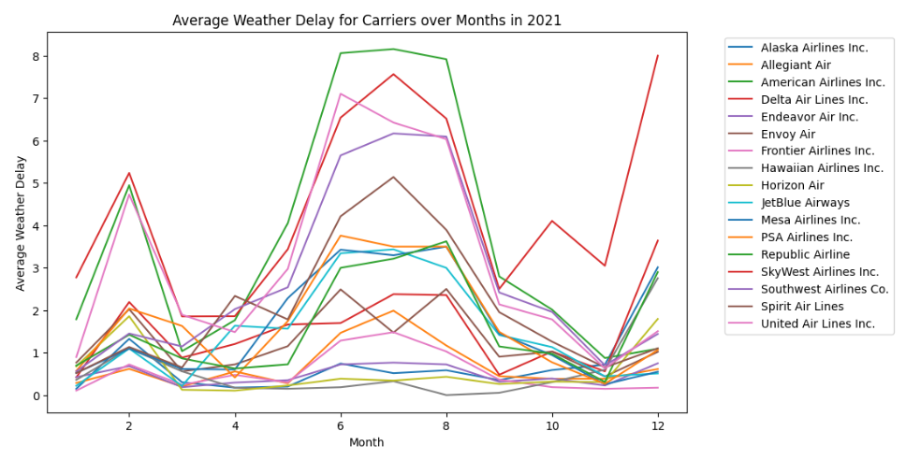
Initial Forecasting Graphics

Slide 10
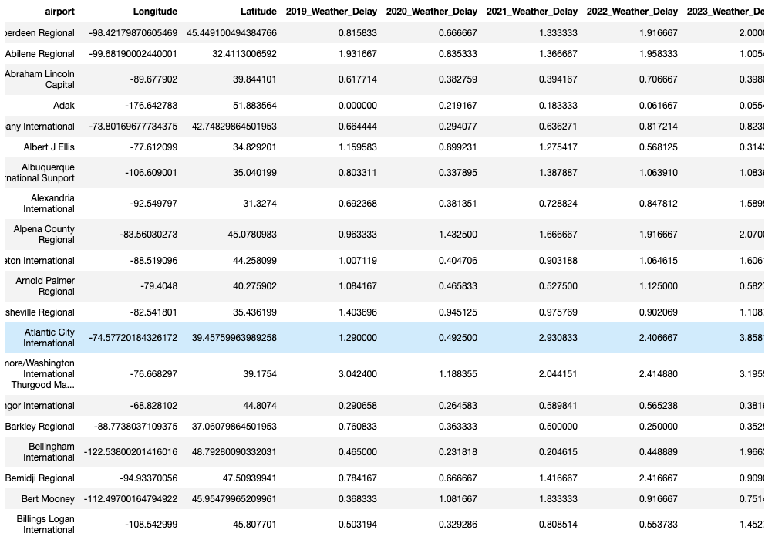
2019-2023 Average Weather delays by airport

Slide 11
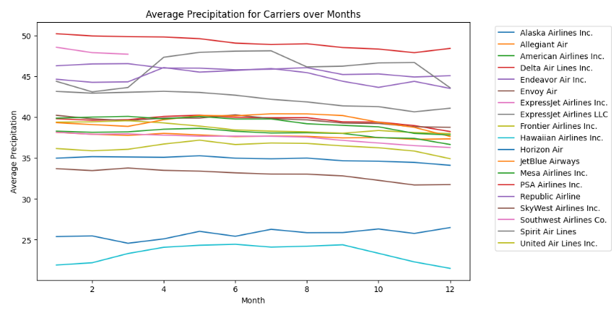
Precipitation by carrier: Averaging precipitation by month

Slide 12

Regression
Y Variable:
Weather Delay Binary Variable
Involved:
Splitting the data into training and testing sets
Creating and fitting the linear regression
Predict Y based on test X
Calculate Mean Squared Error
Print Coefficients and Intercept
Adding constant term to the independent variables
Fitting the linear regression model and printing summary
X Variables:
Year
Month
Latitude
Longitude
Elevation
Precipitation
Temperature

Slide 13
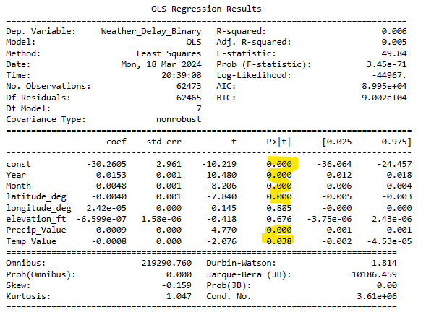


Slide 14

Decision Tree
Involved:
Using same X and Y variables as the regression
Splitting the data into training and testing sets
Creating and fitting the decision tree model
Making predictions for Y based on Test X
Find the best parameters for the model
Fit the data to the decision tree and print the tree

Slide 15
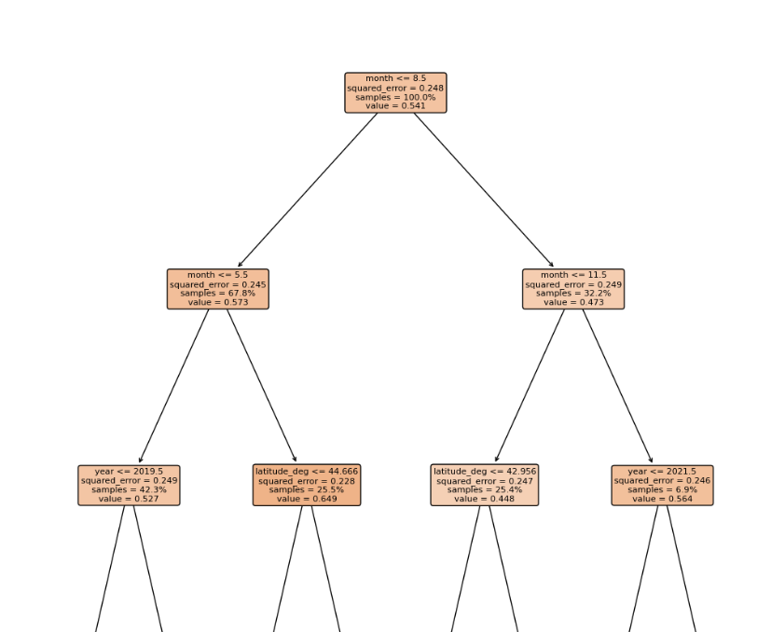

Slide 16
ARIMA
Testing for Stationary or Non-Stationary data
Replacing finite values with NaN and replacing NaN values with 0
Produce ADF Statistic
Use Auto-Arima to find best order
Visualizing Time Series for current data
Print Autocorrelation and Partial Autocorrelation functions
Train ARIMA on detrended data
Forecast weather delays for December 2023 to December 2024
Run a seasonal ARIMA

Slide 17
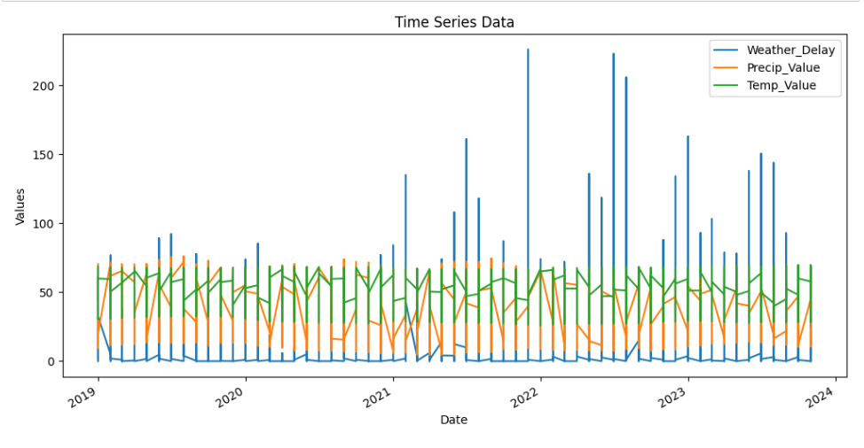
Time Series data

Slide 18

TESTING FOR STATIONARY
P-value is less than 0.05 so time series data is stationary.

Slide 19
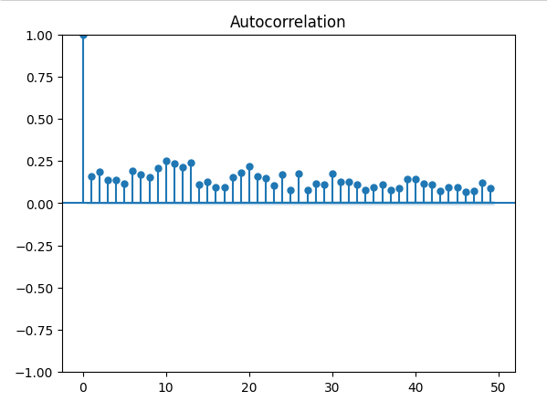
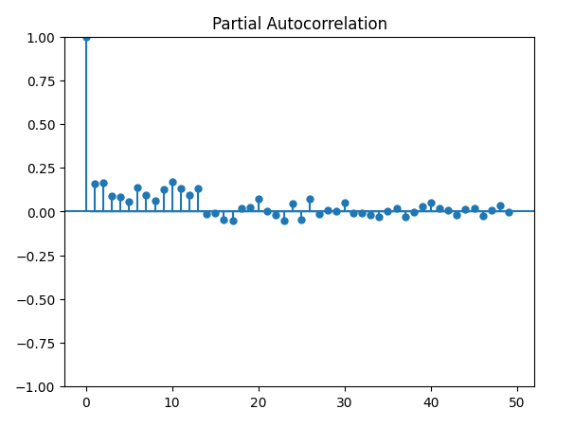
Plotting ACF and PACF
Helps identify the presence of seasonality.
Significant spikes or patterns in the plot indicate the presence of serial correlation in the data.
Calculates correlation between two variables while controlling for the values of set of other variables.
Representation of partial correlations coefficients against different lags.

Slide 20
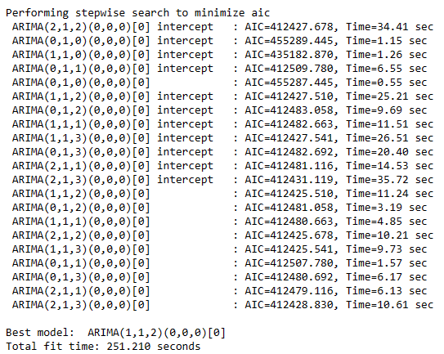
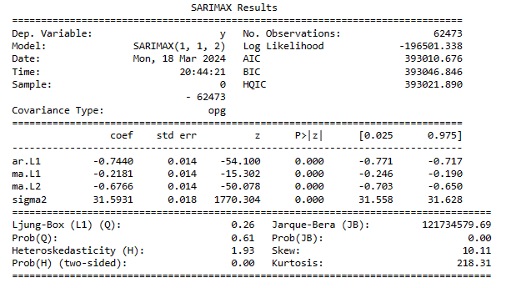

Auto Arima
We ran Auto ARIMA to find the optimal order/lag that has the lowest AIC.

Slide 21
Chose to Run a Subset of the data
Looking at American Airlines flights at Denver International Airport in Colorado

Slide 22
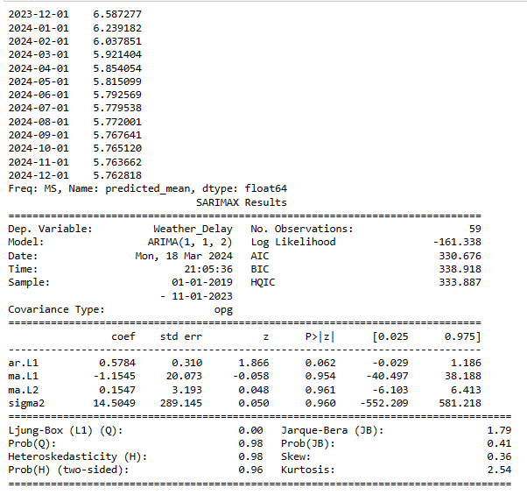
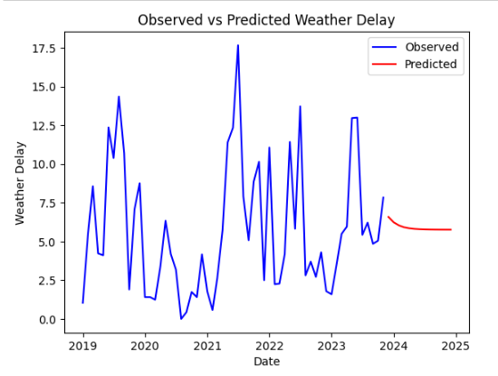
Initial ARIMA Run

Slide 23
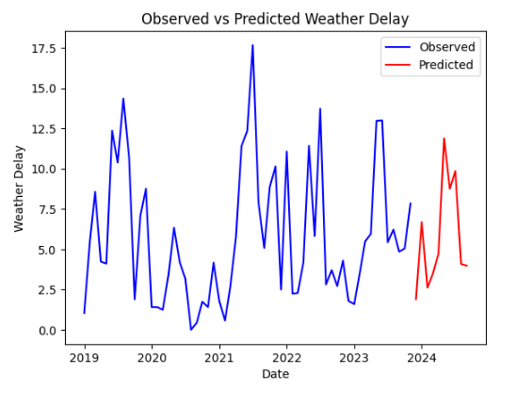
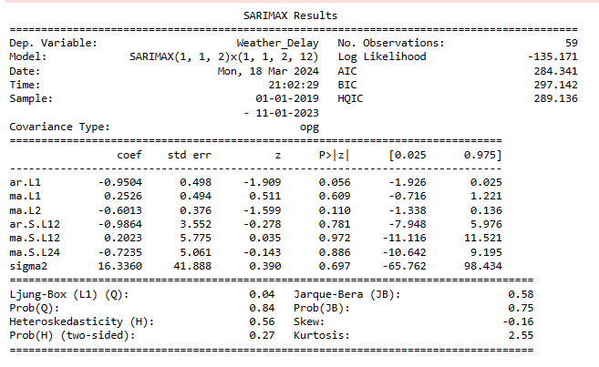
Seasonal "SARIMAX" Run

Slide 24
Conclusion
Our regression model did allow us to predict weather delays for flights, but the model had a low R-squared and our low MSE suggests that the data was overfitted.
Our decision tree model produced a higher MSE than the regression model, but the node splits and selected features do make logical sense for predicting what values predict a weather delay
Our initial ARIMA produced an extremely low Ljung-Box statistic while our seasonal ARIMA did produce a higher Ljung-Box statistic but still not something above 0.05.
If we continued this project into the future, we would like to produce a regression model with not only a low MSE but a high R-squared.
We would also like to tune the decision tree model to see if we can obtain a smaller MSE.
And we would like to run the ARIMA model on all data and not just a subset as well as work to increase the Ljung-Box statistic to 0.05 or higher.

