Slide 1
Group 3 Final Project
Ceara Stewart, Blake Casey, Cristobal Gavaldon

Slide 2
Agenda
Introduction + Charter
High-Level Dimensional Model
Detailed Dimensional Model
SSIS Demo and Star Schema
Summary and Recommendations

Slide 3


Introduction

Slide 4
Project Charter
Business Requirements
Optimize the sales and order fulfillment process by implementing an integrated inventory management system with real-time updates and automated order processing.
Business processes
Fudgemart (FM) Sales
Fudgeflix (FF) Billing
FM & FF overall revenue
fm_products product_id join to fm_order_details product_id * fm_order_details order_qty < - > ab_billed_amount from ff_account_billing
Fudgemart reviews
FM & FF order fulfillment with
at_queue_date from ff_account_titles < - > order_date from fm_orders
at_shipped_date from ff_account_titles < - > shipped_date from fm_orders
lag time

Slide 5
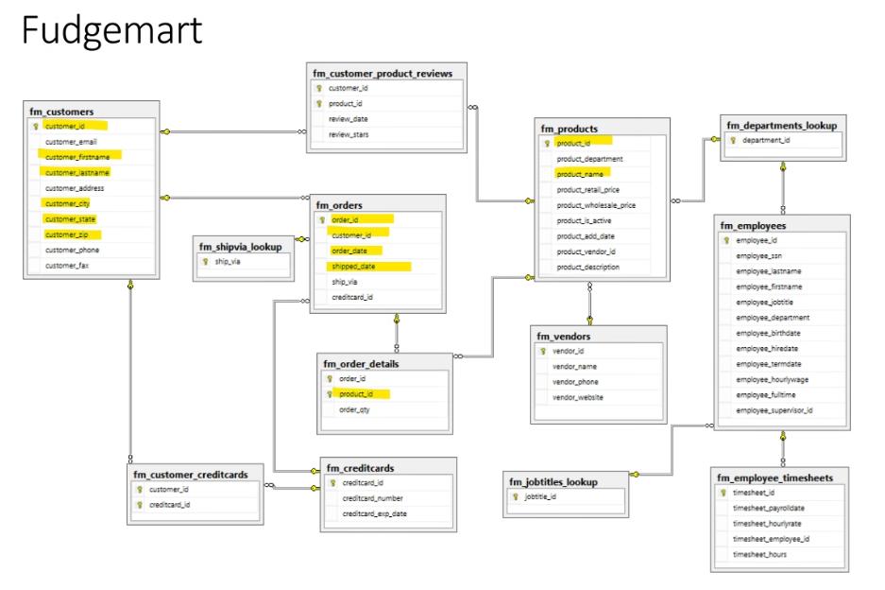

Slide 6
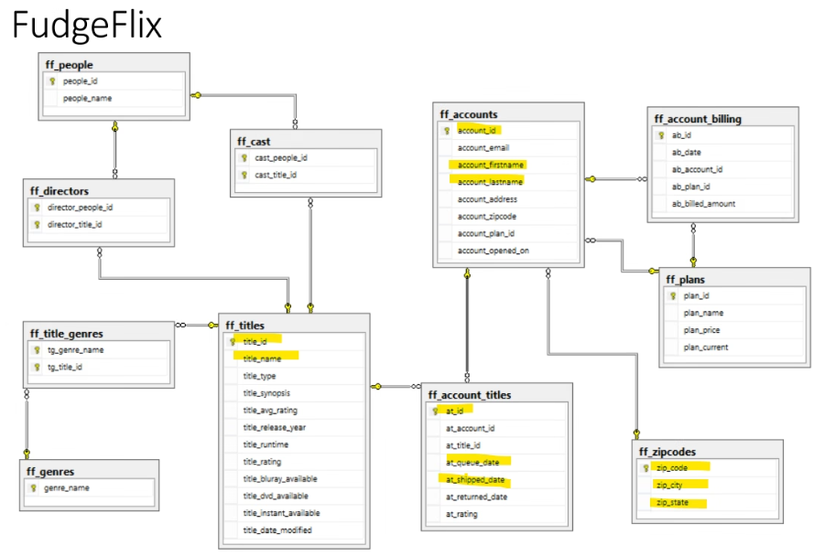

Slide 7
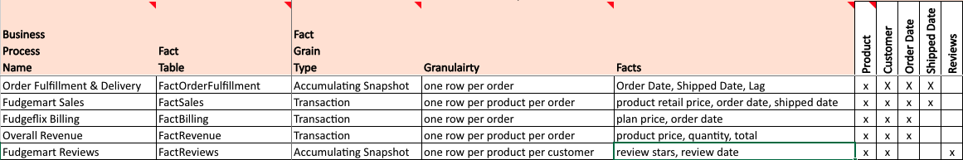
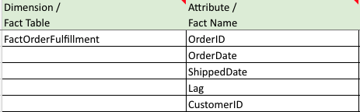
High-Level Dimensional Model
Chosen Business Process: Order Fullfillment & Delivery

Slide 8
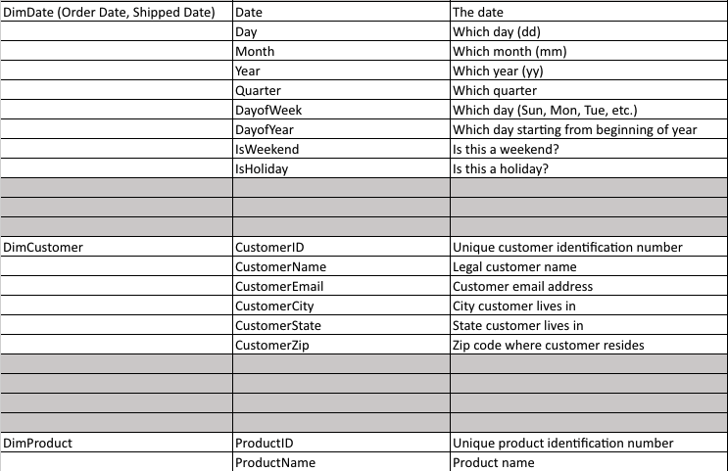
Used Dimensions
High-Level Dimensional Model

Slide 9
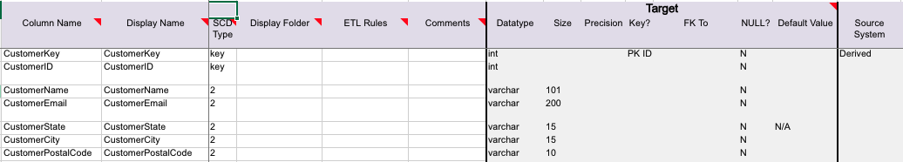
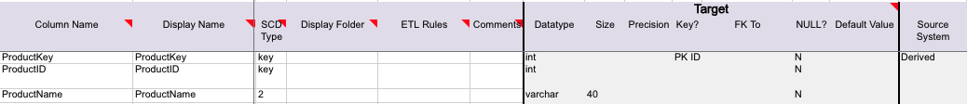
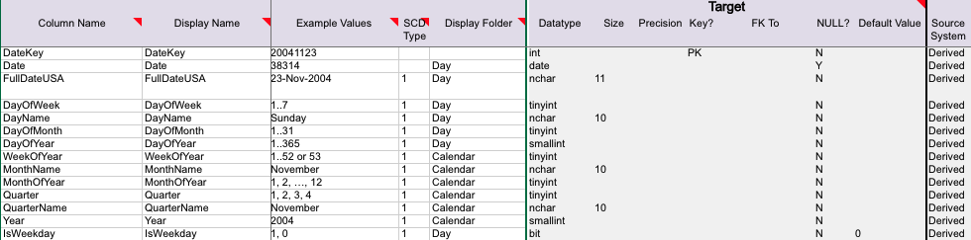
Detailed Dimensional Model
Used Dimensions
DimCustomer =
DimProduct =
DimDate =

Slide 10
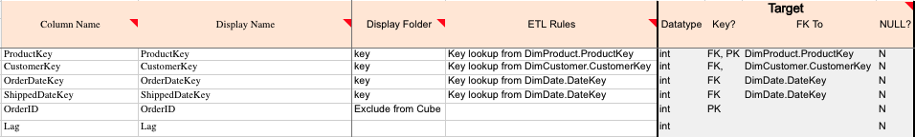
Detailed Dimensional Model
Order Fullfillment Fact Table

Slide 11
SSIS Demo

Slide 12
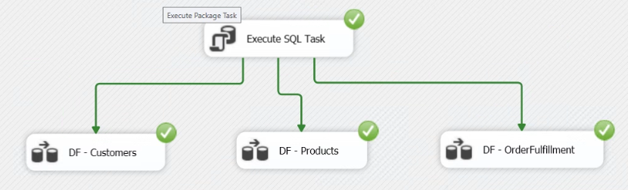
Staging

Slide 13
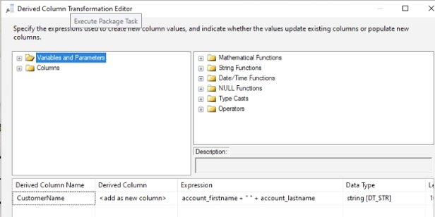
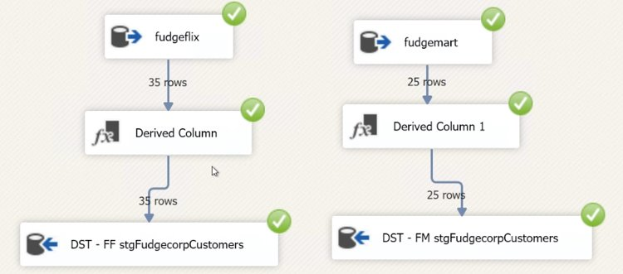
Staging: Customers

Slide 14
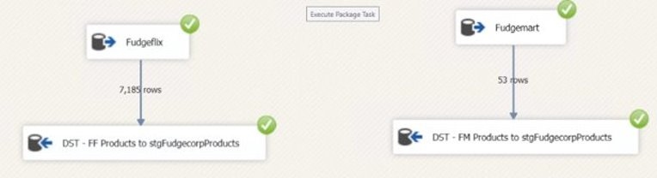
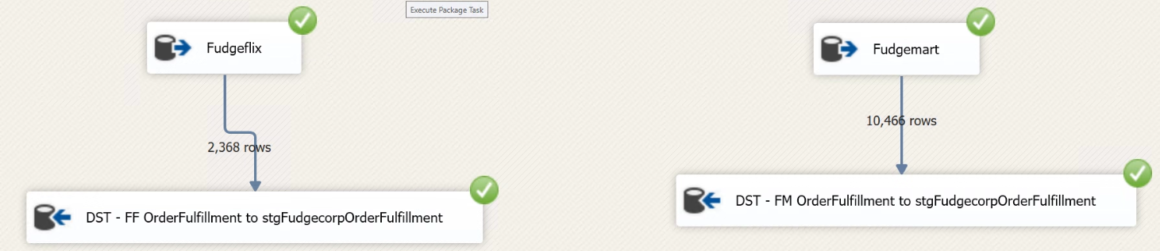
Staging: Products
Staging: Order Fulfillment

Slide 15
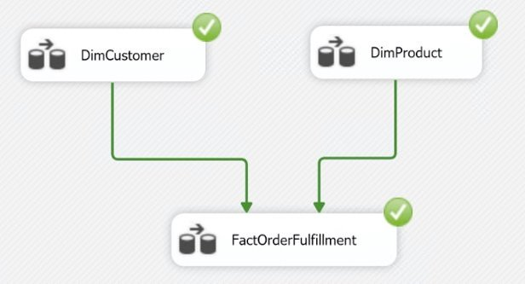
Data Warehouse

Slide 16
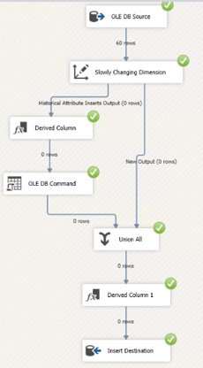
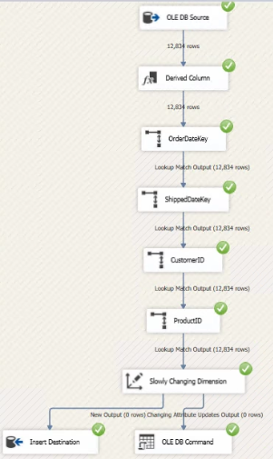

Slide 17
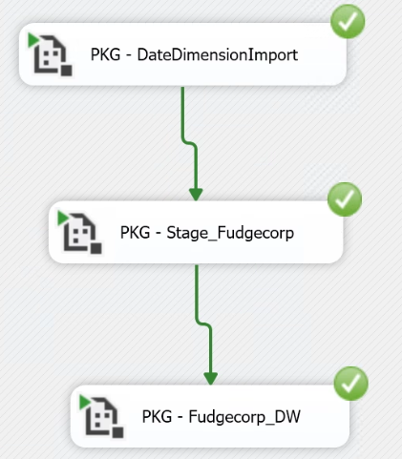
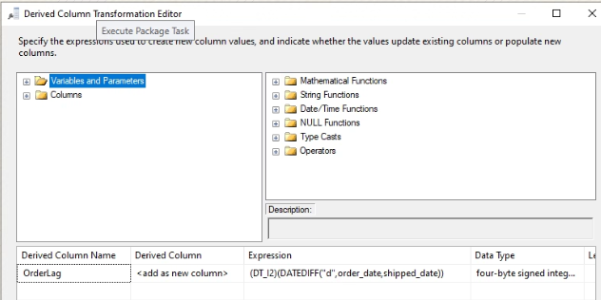

Slide 18
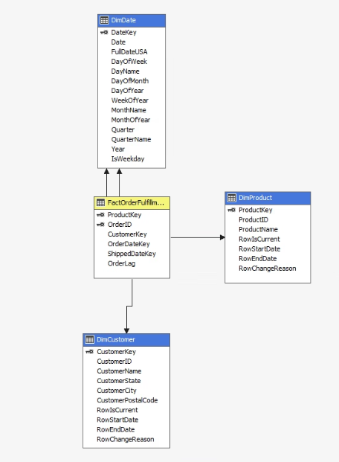
Star Schema

Slide 19
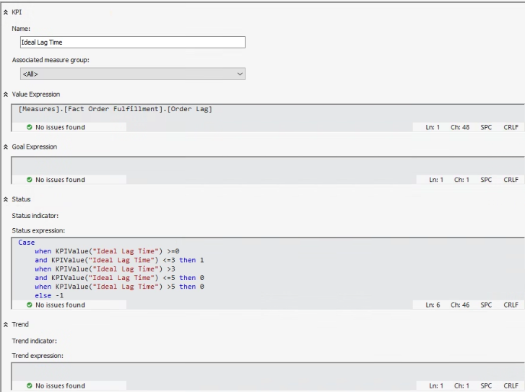
KPI: Ideal Lag Time

Slide 20
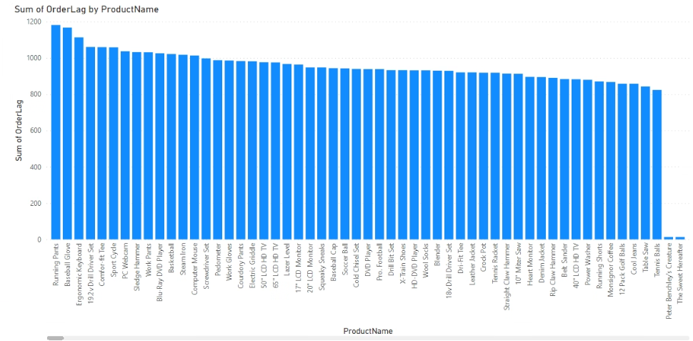

Slide 21
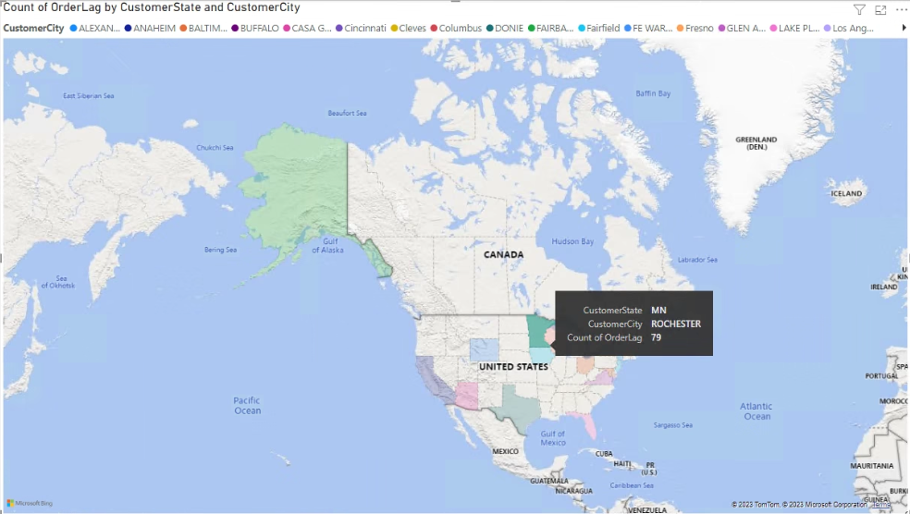

Slide 22
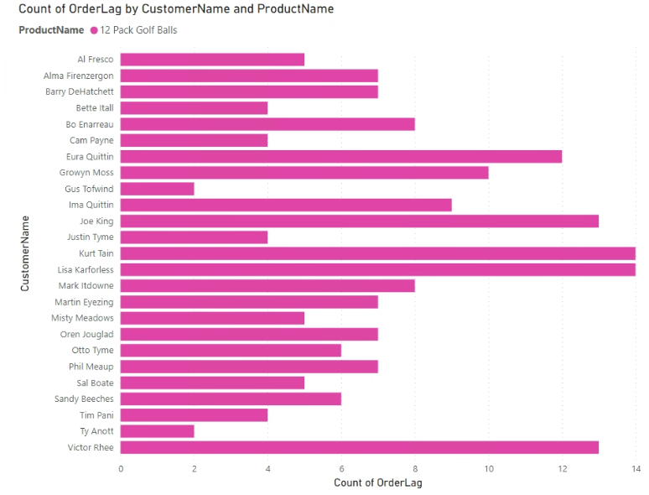

Slide 23
Recommendations
Double check your source SQL joins from Fudgemart and Fudgeflix
Change the data types for derived columns to ensure correct linkage
Ensure to pull the correct product_id from Fudgeflix

