Slide 1


Lab Assignment

Slide 2
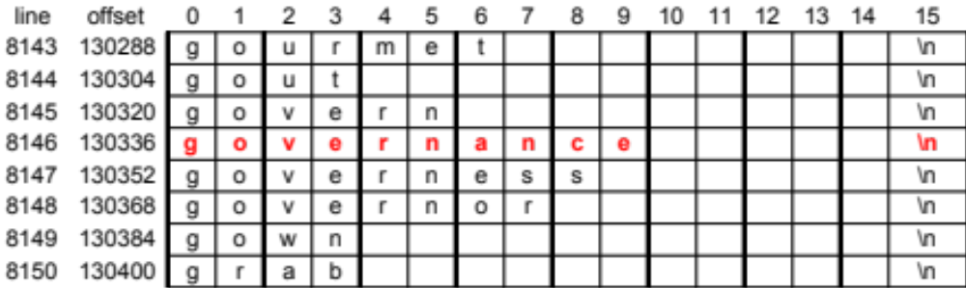
Help Users Spell Correctly
% ok governence
no
% ok governance
yes
Search online dictionary.
Print "yes" or "no" if argv[1] found or not found
Report error if no argument supplied.
Details:
  The online dictionary is /cs_Share/class/cs360/lib/webster
  Format is 1 word/line
  Lines are in ascending sorted order
  Each line is 16 characters long
  Use binary search (how?)
Files to submit:
  ok.c (complete program)
how test?

Slide 3
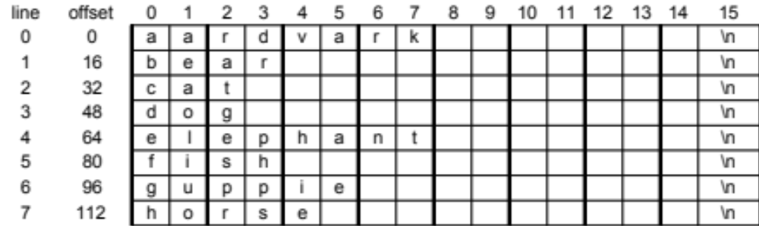
Example Operation
Assume the online dictionary has this content:
(this file at /cs_Share/class/cs360/lab/io/tiny)
% ok dog
# word wanted="dog "
# search range: bottom=0, top=8
# middle=4, word have="elephant "
# test: want < have
# search range: bottom=0, top=4
# middle=2, word have="cat "
# test: want > have
# search range: bottom=3, top=4
# middle=3, word have="dog "
# test: want = have
yes
Here is a sample run of my version with debugging turned on:

Slide 4
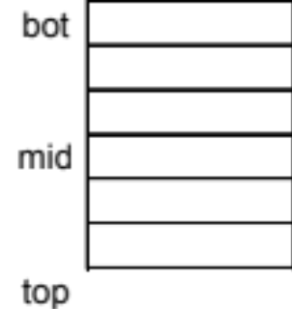
"OK" Program Design
Plan:
  Use binary search via lseek and read
Variables:
  want: the word we are testing
  have: word read from the dictionary
  bot & top: line numbers
  that define the search range
Logic for main routine:
  exit if command line not correct
  set word = argv[1], set fd by opening dictionary; exit if can't open the dictionary
  call ok (fd, word) to check the word; print "yes" or "no" per returned value
Logic for subroutine: int ok (int fd, char *word)
  prepare 'want' and 'have' variables per above format
  set bot to 0 and top to last line number + 1 (use lseek)
  repeat:
    if search range empty (bot >= top), return 0
    set mid = (bot+top)/2; read that line into 'have' (don't read newline)
    compare 'want' vs. 'have' (using strcmp)
    if they are equal, return 1
    if 'want' smaller than 'have', set top = mid; otherwise, set bot = mid+1
both are padded with blanks and terminated
with a \0 like this (note there is NO newline):
lines remaining to be searched are those with line numbers n such that bot <= n < top

