Slide 1
How Computers Work
Lecture 3
A Direct Execution RISC Processor:
The Unpipelined BETA

Slide 2



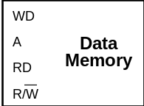
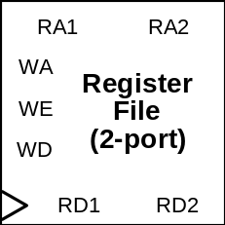

What you can do with very little:
Each instruction class can be implemented using a few simple components.
Components:

Slide 3
Review: β Model of Computation
Fetch/Execute
Loop:
Processor State
Instruction Memory
PC
• Fetch <PC>
• PC ← <pc> + 1
• Execute fetched instruction
• Repeat!
r0
r1
32 bits
(4 bytes)
r2
32 bits
next instr
r31
always 0

Slide 4
Review: BETA Instructions
Two 32-bit Instruction Formats:
OPCODE
Ra
Unused
Rb
Rc
OPCODE
Ra
16 bit Constant
Rc

Slide 5
Review: β ALU Operations
What the machine sees (32-bit instruction word):
SIMILARLY FOR:
• SUB, SUBC
• (optional)
MUL, MULC
DIV, DIVC
BITWISE LOGIC:
• AND, ANDC
• OR, ORC
• XOR, XORC
SHIFTS:
• SHL, SHR, SAR
(shift left, right;
shift arith right)
COMPARES
CMPEQ, CMPLT, CMPLE
OPCODE
Ra
Unused
Rb
Rc
What we prefer to see: symbolic ASSEMBLY LANGUAGE
ADD(ra, rb, rc) rc ← <ra> + <rb>
“Add the contents of ra to the contents of
rb; store the result in rc”
Alternative instruction format:
OPCODE
Ra
16 bit Constant
Rc
ADDC(ra, const, rc) rc ← <ra> + sext(const)
“Add the contents of ra to const; store the result in rc”

Slide 6
A Descending Data Flow View of the Beta
PC
Q
Operate class: Rc <- <Ra> op <Rb>
RA1
Memory
RD1
XADDR
BRZ(R31,XADDR,XP)
ISEL
0
1
31:26
25:21
20:5
9:5
4:0
OPCODE
RA
C
RB
RC
+1
0
1
OPCODE
Register File
RA1
RD1
Register File
RA2
RD2
SEXT
ASEL
0
1
2
1
0
BSEL
A
ALU
B
ALUFN
A op B
Z
RA2
Memory
RD2
PCSEL
0
1
0
1
2
WDSEL
D
PC
WD
Memory
WA
WD
Register File
WA
RC
WE
WEMEM
WE
WERF

Slide 7
Combinational Read Port on Memory
Address
A
Memory
Q
<Address>

Slide 8
Data Register
Works like a camera
  D = image
  Q = picture
  E = On/Off Switch
  clock = shutter release button
D
Q
E
Clock

Slide 9
D Register w/ Enable
D
Q
E
clk
clk
clk
Q
Q
D
D
E
E

Slide 10
2-Port Register File
(independent Read addresses)
RA
A
RA1
RA2
RD
<A>
Write Address
5
WA
CLK
Register
Write Enable
WE
File
(2-port)
WE
Write Data
32
WD
CLK
WA
A
RD1
RD2
Note:
<R31> Always
ZERO!
WD
new <A>
32
32
(Independent Read Data)
What if (say) WA=RA1???
  RD1 reads value from last cycle!
Notes:
OLD <RA1>

Slide 11
Selector (a.k.a. Multiplexor / MUX)
Output Q is selected to be 1 of N inputs
N is a power of 2
K select inputs, K = log2(n)
May be ganged to select one W-bit word out of N multi-bit words
D_{N-1}
D₂
D₁
D₀
D_{N-1}
D₂
D₁
D₀
. . .
. . .
W
S
S
K
K
W
Q = D_{s}
Q = D_{s}

Slide 12
A Descending Data Flow View of the Beta
PC
Q
Operate class: Rc <- <Ra> op <Rb>
RA1
Memory
RD1
XADDR
BRZ(R31,XADDR,XP)
ISEL
0
1
31:26
25:21
20:5
9:5
4:0
OPCODE
RA
C
RB
RC
+1
0
1
OPCODE
Register File
RA1
RD1
Register File
RA2
RD2
SEXT
ASEL
0
1
2
1
0
BSEL
A
ALU
B
ALUFN
A op B
Z
RA2
Memory
RD2
PCSEL
0
1
0
1
2
WDSEL
D
PC
WD
Memory
WA
WD
Register File
WA
RC
WE
WEMEM
WE
WERF

Slide 13
A Descending Data Flow View of the Beta
PC
Q
Operate class: Rc <- <Ra> op C
RA1
Memory
RD1
XADDR
BRZ(R31,XADDR,XP)
ISEL
0
1
31:26
25:21
20:5
9:5
4:0
OPCODE
RA
C
RB
RC
+1
0
1
OPCODE
Register File
RA1
RD1
Register File
RA2
RD2
SEXT
ASEL
0
1
2
1
0
BSEL
A
ALU
B
ALUFN
A op B
Z
RA2
Memory
RD2
PCSEL
0
1
0
1
2
WDSEL
D
PC
WD
Memory
WA
WD
Register File
WA
RC
WE
WEMEM
WE
WERF

Slide 14
Review: β Branches
Conditional: rc = <PC>+1; then
  BRNZ(ra, label, rc) if <ra> nonzero then
  PC <- <PC> + displacement
  BRZ(ra, label, rc) if <ra> zero then
  PC <- <PC> + displacement
Unconditional: rc = <PC>+1; then
  BRZ(r31, label, rc) PC <- <PC> + displacement
Indirect: rc = <PC>+1; then
  JMP(ra, rc) PC <- <ra>
Note: “displacement” is coded as a CONSTANT in a field of the instruction!

Slide 15
A Descending Data Flow View of the Beta
PC
Q
Rc <- <PC>+1; if <Ra>=0 then PC <- <PC>+C
RA1
Memory
RD1
XADDR
BRZ(R31,XADDR,XP)
ISEL
0
1
31:26
25:21
20:5
9:5
4:0
OPCODE
RA
C
RB
RC
+1
0
1
OPCODE
Register File
RA1
RD1
Register File
RA2
RD2
SEXT
ASEL
0
1
2
1
0
BSEL
A
ALU
B
ALUFN
A op B
Z
RA2
Memory
RD2
PCSEL
0
1
0
1
2
WDSEL
D
PC
WD
Memory
WA
WD
Register File
WA
RC
WE
WEMEM
WE
WERF

Slide 16
A Descending Data Flow View of the Beta
PC
Q
JMP:
Rc <- <PC>+1; PC <- <Ra> + C
RA1
Memory
RD1
XADDR
BRZ(R31,XADDR,XP)
ISEL
0
1
31:26
25:21
20:5
9:5
4:0
OPCODE
RA
C
RB
RC
+1
0
1
OPCODE
Register File
RA1
RD1
Register File
RA2
RD2
SEXT
ASEL
0
1
2
1
0
BSEL
A
ALU
B
ALUFN
A op B
Z
RA2
Memory
RD2
PCSEL
0
1
0
1
2
WDSEL
D
PC
WD
Memory
WA
WD
Register File
WA
RC
WE
WEMEM
WE
WERF

Slide 17
Review: β Loads & Stores
LD(ra, C, rc) rc ← < Mem[<ra> + sext(C)] >
Old
New
ST(rc, C, ra) Mem[<ra> + sext(C)] ← <rc>
ST(ra, C, rc) Mem[<rc> + sext(C)] ← <ra>

Slide 18
Straightening Out Store
Old Format: ST(Rc, C, Ra)
  Mem[<Ra> + C] <- <Rc>
  ST(R1, 2, R3) means Mem[<R3> + 2] <- <R1>
New Format: ST(Ra, C, Rc)
  Mem[<Rc> + C] <- <Ra>
  ST(R1, 2, R3) means Mem[<R3> + 2] <- <R1>
Both versions of Store work “from left to right” in assembly language.
Difference is only in the binary encoding of the instruction, and the hardware implementation’s decoding of the binary encoding.

Slide 19
A Descending Data Flow View of the Beta
PC
Q
LD:
Rc <- Mem[<Ra>+C]
RA1
Memory
RD1
XADDR
BRZ(R31,XADDR,XP)
ISEL
0
1
31:26
25:21
20:5
9:5
4:0
OPCODE
RA
C
RB
RC
+1
0
1
OPCODE
Register File
RA1
RD1
Register File
RA2
RD2
SEXT
ASEL
0
1
2
1
0
BSEL
A
ALU
B
ALUFN
A op B
Z
RA2
Memory
RD2
PCSEL
0
1
0
1
2
WDSEL
D
PC
WD
Memory
WA
WD
Register File
WA
RC
WE
WEMEM
WE
WERF

Slide 20
A Descending Data Flow View of the Beta
PC
Q
ST:
Mem[<Rc>+C] <- <Ra>
RA1
Memory
RD1
XADDR
BRZ(R31,XADDR,XP)
ISEL
0
1
31:26
25:21
20:5
9:5
4:0
OPCODE
RA
C
RB
RC
+1
0
1
OPCODE
Register File
RA1
RD1
Register File
RA2
RD2
SEXT
ASEL
0
1
2
1
0
BSEL
A
ALU
B
ALUFN
A op B
Z
RA2
Memory
RD2
PCSEL
0
1
0
1
2
WDSEL
D
PC
WD
Memory
WA
WD
Register File
WA
RC
WE
WEMEM
WE
WERF

Slide 21
LDR
Load Relative
Used for loading large (32 bit) constants with data from the instruction stream.
Depends on the fact data and instruction memory are ports of one main memory.
Use: LDR (label, Rc)
RTL Description: Rc <- <Mem[<NextPC> + Offset]>
Note that Ra is ignored, Offset is calculated from label
…
  LDR (label, R1)
  BR (label + 1)
label: 123456789
  …

Slide 22
A Descending Data Flow View of the Beta
PC
Q
LDR:
Rc <- Mem[<PC>+1+C]
RA1
Memory
RD1
XADDR
BRZ(R31,XADDR,XP)
ISEL
0
1
31:26
25:21
20:5
9:5
4:0
OPCODE
RA
C
RB
RC
+1
0
1
OPCODE
Register File
RA1
RD1
Register File
RA2
RD2
SEXT
ASEL
0
1
2
1
0
BSEL
A
ALU
B
ALUFN
A op B
Z
RA2
Memory
RD2
PCSEL
0
1
0
1
2
WDSEL
D
PC
WD
Memory
WA
WD
Register File
WA
RC
WE
WEMEM
WE
WERF

Slide 23
Control Logic Truth Table
We can specify it via a table of the form ...
Control Logic Inputs:
OPCODE
OP
OPC
LD
ST
BRZ
BRNZ
JMP
LDR
(Illegal)
Z
0
1
0
1
Control Logic Outputs:
PCSEL
RA2SEL
ASEL
BSEL
WDSEL
ALUFN
Wr
WERF
WASEL
YOU should be able to fill in this table!
Notes:
Project: Define control logic.
“Left to the reader”, mostly...
How to go about it?

Slide 24
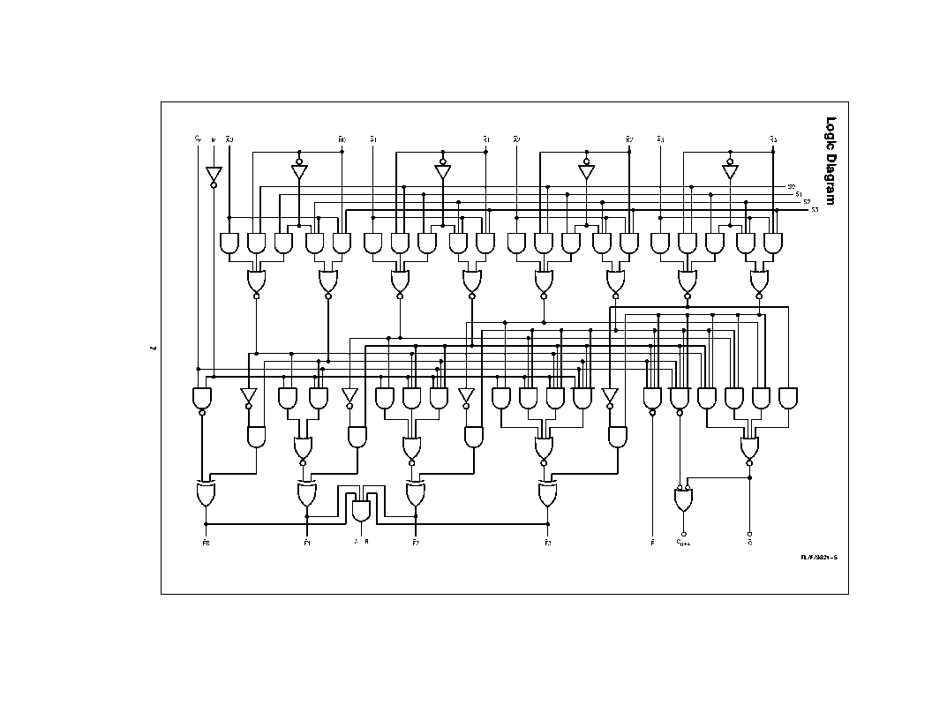
Next Time - How to Add

