Slide 1
How Computers Work
Lecture 4
Computer Arithmetic

Slide 2
A Descending Data Flow View of the Beta
PC
Q
Operate class: Rc <- <Ra> op <Rb>
RA1
Memory
RD1
XADDR
BRZ(R31,XADDR,XP)
ISEL
0
1
31:26
25:21
20:5
9:5
4:0
OPCODE
RA
C
RB
RC
+1
0
1
OPCODE
Register File
RA1
RD1
Register File
RA2
RD2
SEXT
ASEL
0
1
2
1
0
BSEL
A
ALU
B
ALUFN
A op B
Z
RA2
Memory
RD2
PCSEL
0
1
0
1
2
WDSEL
D
PC
WD
Memory
WA
WD
Register File
WA
RC
WE
WEMEM
WE
WERF

Slide 3
What are we going to learn today?
How to build the Arithmetic/Logical Unit
  Integer adder and multiplier architectures
  Time/Space/Cost Trade-offs

Slide 4
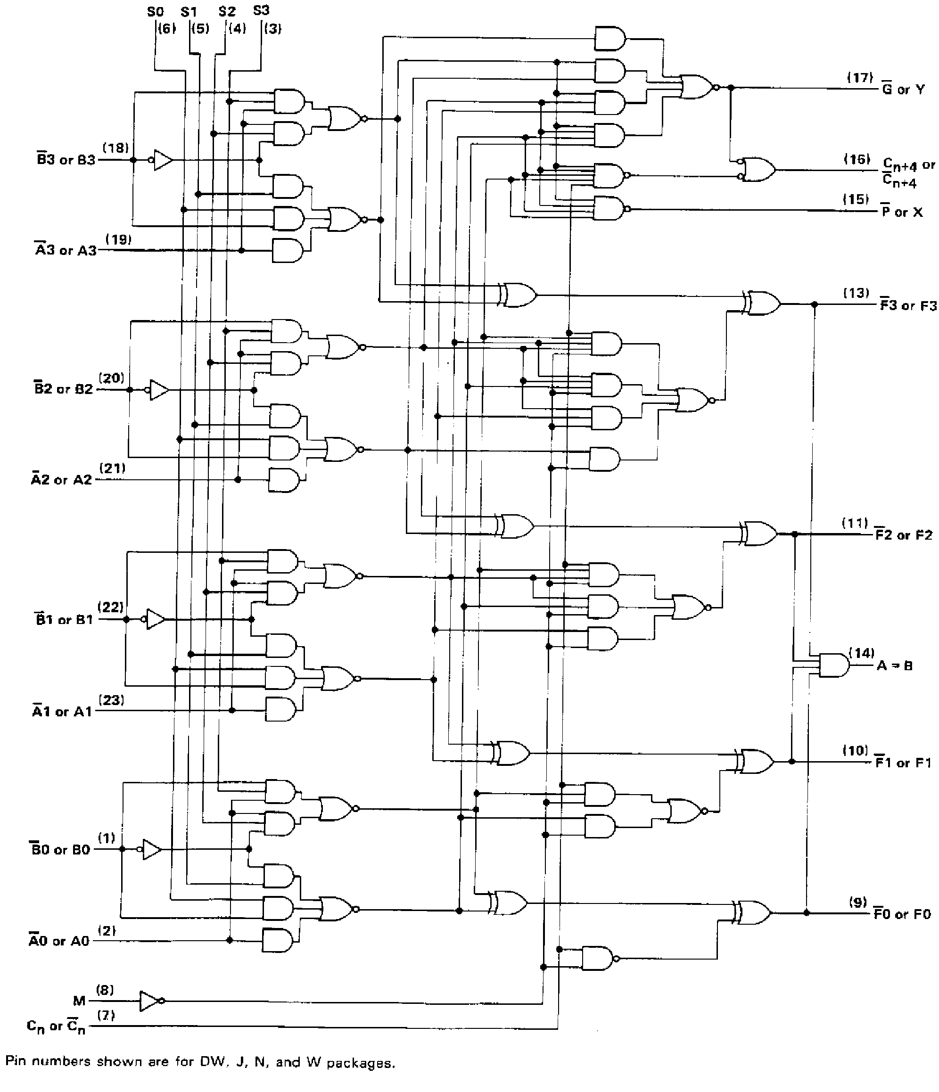
The 74181 ALU

Slide 5
A Wild and Crazy Idea:
Arithmetic / Logic Unit is describable by a table:
  ergo, we can implement it with a memory:
32
A
B
32
32
ALUFN
Bad Idea, because:
2 ^{~70} is a large number of rows!
A few

Slide 6
A 1 Bit Full Adder
C_{i}
0
0
0
0
1
1
1
1
A
0
0
1
1
0
0
1
1
B
0
1
0
1
0
1
0
1
S
0
1
1
0
1
0
0
1
C_{o}
0
0
0
1
0
1
1
1
  • Generates 1 sum bit, carry
  • Can be cascaded to N bits
A
B
C_{o}
FA
C_{i}
S

Slide 7
Ripple-carry N-bit adder:
FA
FA
FA
FA
Problem: It’s Slow!

Slide 8
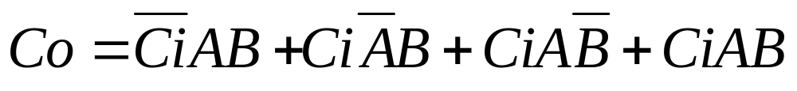
What is Co as a function of Ci, A, B ?
C_{i}
0
0
0
0
1
1
1
1
A
0
0
1
1
0
0
1
1
B
0
1
0
1
0
1
0
1
S
0
1
1
0
1
0
0
1
C_{o}
0
0
0
1
0
1
1
1

Slide 9
But What is Co really ?
C_{i}
0
0
0
0
1
1
1
1
A
0
0
1
1
0
0
1
1
B
0
1
0
1
0
1
0
1
S
0
1
1
0
1
0
0
1
C_{o}
0
0
0
1
0
1
1
1
Co = 1 if 2 or more inputs are 1 !

Slide 10
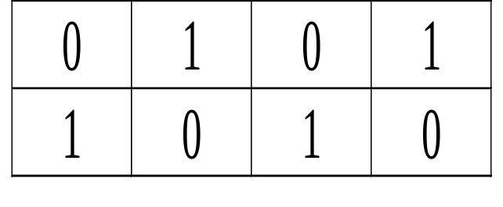
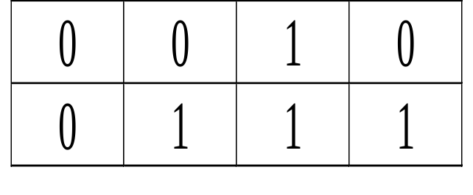
How can we build simplified logic?
Example: Full Adder : K-Map
A
C_{i}
0
0
0
0
1
1
1
1
A
0
0
1
1
0
0
1
1
B
0
1
0
1
0
1
0
1
S
0
1
1
0
1
0
0
1
C_{o}
0
0
0
1
0
1
1
1
S:
C_{i}
B
A
C_{o}:
C_{i}
B

Slide 11
The Karnaugh Map
Characteristics:
1: Unit-Distance Input Labels
2: Wrap-Around

Slide 12
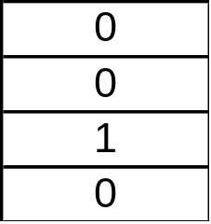
AND
A
Q
B
Q
A
B
Notes:
NOR
1
0
0
0

Slide 13
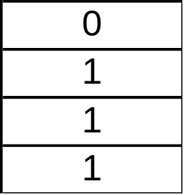
OR
A
Q
B
Q
A
B
Notes:
NOR
1
0
0
0

Slide 14
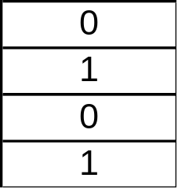
XOR
A
Q
B
Q
A
B
Notes:
NOR
1
0
0
0

Slide 15
Q: What is Cout?
A
C_{i}
B

Slide 16
Q: What is Cout?
A
C_{i}
B
A: (A and Ci) or (A and B) or (B and Ci)
A: (A Ci) + (A B) + (B Ci)
A: A Ci + A B + B Ci

Slide 17
How about S ?
C_{i}
0
0
0
0
1
1
1
1
A
0
0
1
1
0
0
1
1
B
0
1
0
1
0
1
0
1
S
0
1
1
0
1
0
0
1
A
C_{i}
B

Slide 18
Parity
A
B
S
Ci

Slide 19
Tree Structure
A
1
A
2
A
3
A
4
A
N
N-input TREE has O(log(n)) levels...
Signal propagation takes O(log(n)) gate delays.
O(n) gates.

Slide 20
An Idea !
Speed things up by doing as much work as possible on A & B Inputs before the carry arrives:
?
?

Slide 21
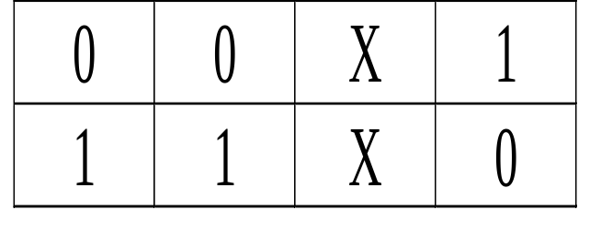
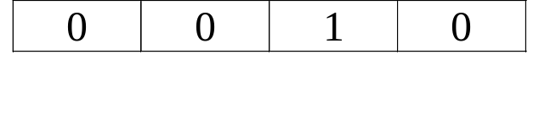
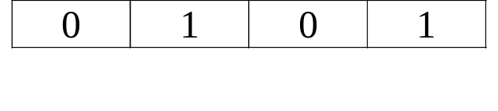
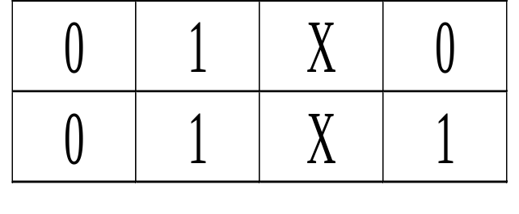
Generate and Propagate
G
(35)
A
S:
C_{i}
G:
B
P
A
G
(36)
P:
C_{o}:
B
C_{i}
P

Slide 22
Implementation of C_{o}
A
B
G = A B
P = A xor B
G
P
Cout = G + P Cin
Cout
Cin

Slide 23
Implementation of S
G = A B
P = A xor B
G
P
S = P xor Cin
Cin
S

Slide 24
Yet Another Idea !
Carry Look-Ahead

Slide 25
The 74181 ALU

Slide 26
How Fast Can an Adder Get ?
Input Sensitivity Analysis: Ultimately, some bits of the answer are dependent on all bits of the inputs.
Given an infinite number of bounded fan-in gates, what is the minimum growth of t_{pd} vs. the number of inputs (n)?
  Answer: O(log(n))

Slide 27
Any more tricks to go faster?
What about changing the Encoding of the inputs (i.e. base 4 !!!!!!!)
  O(log(n)) limitation still there, but converting to a higher radix, doing the computation, then going back to binary CAN be faster than doing it naively in binary.
How about analog computing?
  Works, but watch out for noise.
How about parallel computing?
  Works, but watch out for cost.
How about pipelined computing?
  Q: What’s a pipelined computer?
    A: You’re going to find out real soon.

Slide 28
Summary
Today’s Lecture:
  How to build the Arithmetic/Logical Unit
  Time/Space/Cost Trade-offs
Recitation
  K-maps and sum-of-products form
  Multipliers

