Slide 1
How Computers Work
Lecture 7
Under the Hood of Synchronous Finite State Machines

Slide 2
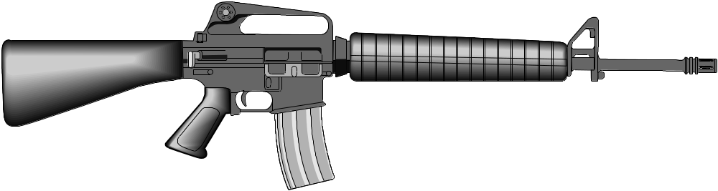
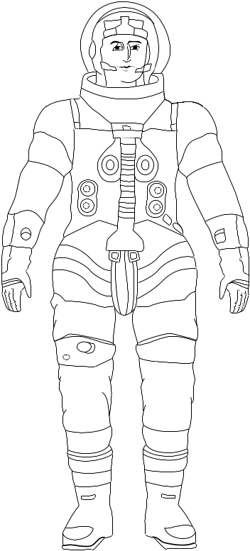
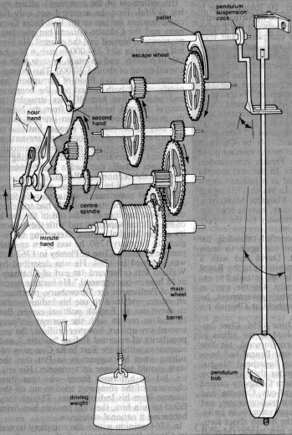
What do these have in common?
D
Q
CLK

Slide 3
The Selector
A
Truth Table
S Q
0 A
1 B
0
Q
B
1
S
No bubble, so positive logic
(H = 1 , L = 0)

Slide 4
The Selector’s K-Map
B
Truth Table
S Q
0 A
1 B
AB
S
00
01
11
10
0
0
1
1
0
1
0
0
1
1
S
A

Slide 5
Selector’s K-Map
B
AB
S
00
01
11
10
P2
A
0
0
0
0
1
1
B
1
1
0
1
1
0
S
S
P1
A

Slide 6
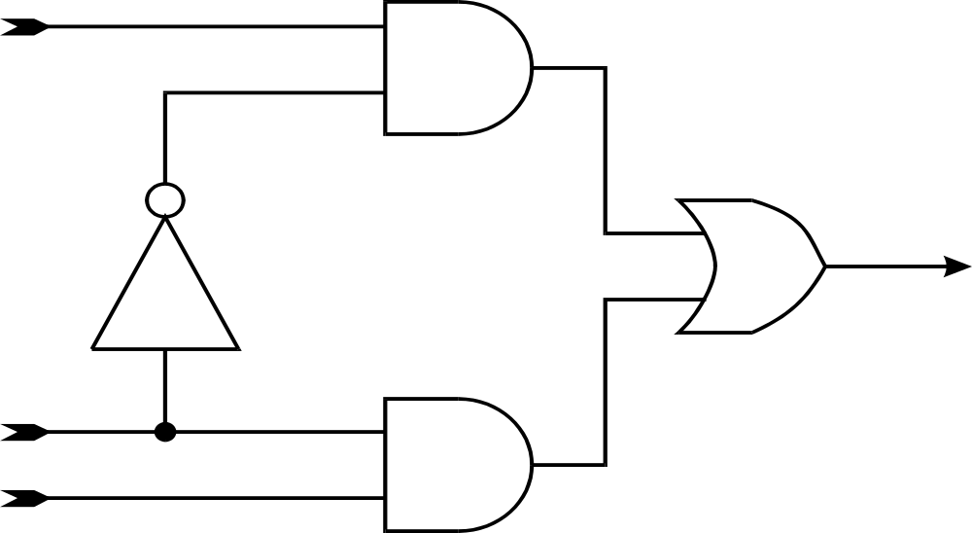
Review: The Selector’s Minimum
SOP Implementation
A
P2
Q
S
B
P1

Slide 7
The Trouble with Transitions
Suppose: A = B = 1 (H)
S:
P1
P2
Q

Slide 8
Hazards
Static Hazards:
  Output Enters Forbidden Zone Unnecessarily
  1-Hazards
  0-Hazards
Dynamic Hazards:
  Output Enters Same Valid Zone Again after Entering Opposite Valid Zone
  0-1 Hazards
  1-0 Hazards

Slide 9
What You Should Expect
H
Q
H
S
S
T pd max
Q
T cd = t pd min

Slide 10
What Hazard-Free Means
H
Q
H
S
S
Q

Slide 11
Fundamental Mode
SIC (Single Input Change) rule
Only 1 Input Bit Can Change “At a Time”
> Tw

Slide 12
Fixing the Selector’s 1-Hazard with a redundant product term
B
AB
A
S
00
01
11
10
0
0
0
1
1
1
0
1
1
0
S
S
A
B

Slide 13
Rules for Fixing Hazards in SIC SOP situations
Avoid using X and X in a single product term
  This insures product terms have no SIC hazards
    prevents all dynamic hazards and static 0-hazards
Cover all adjacent 1 cells in K-map with at least 1 product term
  This insures at least 1 product term remains steadily high during SIC
    prevents static 1-hazards
Remember - This Only Applies for SIC !!!

Slide 14

A First Taste of Asynchronous
(Fundamental Mode)
State Machines
Yea!
MUX Implementation
of the Transparent Latch
D
0
Q
G
D
1
Q
G

Slide 15
State Diagram of D-Latch
G D
G + D
0
1
G + D
G D
D
Q
G

Slide 16
Definition:
Fundamental Mode
Finite State Machine (FSM)
Finite # of States
Output = f(State, Input)
  May just be f(State)
State Transitions occur asynchronously due to asynchronous (no clock) input level changes.

Slide 17
Architecture of
Fundamental Mode FSM
IN
OUT
C.L.
STATE

Slide 18
Fundamental Mode
SIC (Single Input Change) rule
Only 1 Input Bit Can Change “At a Time”
> Tw

Slide 19
SIC Conditions for the
Transparent Latch
D
G
Hold time
Th = ________________
Setup time
Ts = ____________________

Slide 20
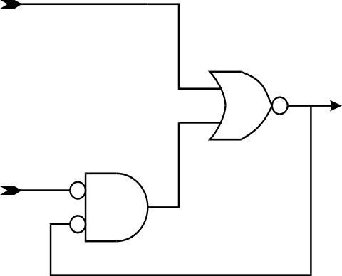
The Set-Reset (SR) Flip-Flop
S
R
SR
Q
00
01
11
10
Q
0H
0H
0H
1L
1L
R
1L
1L
0H
1L
1L
Q
S
S
S
0
1
S + R
R S

Slide 21
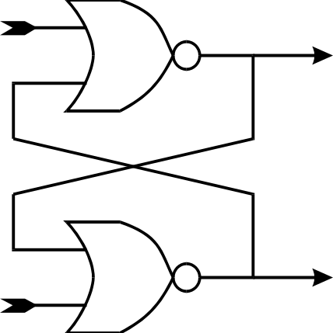
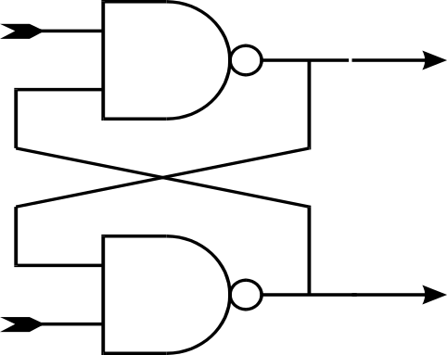
Dual Forms of SR Flops
S
S
Q
Q
Q
R
Q
R
Note : Q is true inverse of Q only when S R = 0

Slide 22
Simple Rules for 2-State Fundamental Mode State Machines
SIC Assumption
No Free-Running Oscillators
Logic Is Hazard-Free
Set
Set
0
1
Reset
Reset

Slide 23
More Complex Fundamental Mode FSMs
> 2 States possible, with somewhat more complex rules
Good behavior for non-SIC also possible, with somewhat more complex rules
Only Certain Hazards are Important
For More Information, read:
  The Essence of Logic Circuits, by Stephen H. Unger, Prentice-Hall, 1989.

Slide 24
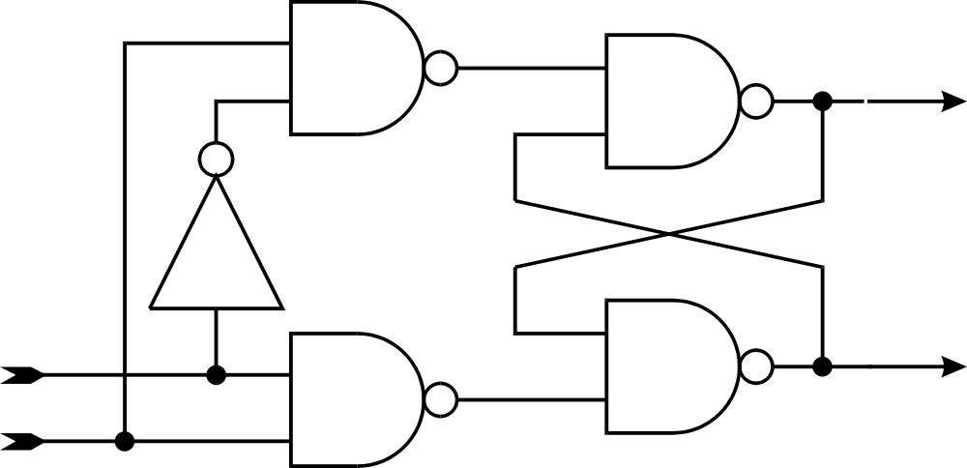
Building a Latch from an SR Flop
R
_Q
_____
D
S
Q
_____
G

Slide 25
The Edge-Triggered Flip-Flop
(also called D-FF or Register)
CLK
D
Q
D
CLK
Q

Slide 26

Building an Edge Triggered FF out of 2 Latches
D
D
Q
D
Q
Q
G
G
CLK
H
CLK=_________
L
CLK=_________

Slide 27
Edge-Triggered F-F Timing
D
CLK
Hold Time
Th = ________________
Setup Time
Ts = ____________________

Slide 28
A Pneumatic Flip-Flop

Slide 29
A Mechanical Flip-Flop
Clock Escapement

Slide 30
Another Example of a Flip-Flop
1 Sear - lets hammer fall when trigger is pulled.
2 Hammer hits firing pin, pin dents primer, ignites gunpowder, propels bullet.
3 Gas from burning gunpowder opens bolt, ejects case, pulls hammer back
4 Disconnector - holds hammer back
Semi-Automatic : until trigger is released
Fully-Automatic : until bolt fully closes

