Slide 1
How Computers Work
Lecture 8
Asynchronous State Machines and Metastability

Slide 2
Review:
Edge-Triggered Timing Constraints
Edge Triggered Flip-Flop
1
clk
in
out
3
4
C.L.
current state
current
state
next
state
5
6
Q
D
next state
1 3
3 5
Tcd_{C-Q} < t____
Tpd_{C-Q} > t____
Tcd_{C.L.} < t____
Tpd_{C.L.} > t____
1 4
4 6
clk
Thold
_________________ < Tcd_{C-Q} + Tcd_{C.L.}

Slide 3
Maximum Frequency
clk
in
out
C.L.
current state
current
state
next
state
Q
D
next state
clk
Tpd c-q + Tpd cl + Tsetup
Clock Period > ___________

Slide 4
Skew
D
Q
C.L.
D
Q
clk1
clk2
Thold + Tskew
Tcd c-q + tcd cl
_______________________< _______________________________
Tpd c-q + Tpd cl + Tsetup + Tskew
Clock Period > _______________________________

Slide 5
What we will cover today:
The Trouble with Asynchronous Inputs
in
D
Q
D
Q
out
current
state
next
state
clk
clk
Q
D
clk

Slide 6
A Synchronizer as Arbiter
D
Q
clock
clock
D
D
Q
Q

Slide 7
What Happens Now?
CLOCK
Ts
Th
D
Nothing
Flip-Flop Specification Says:______________________

Slide 8
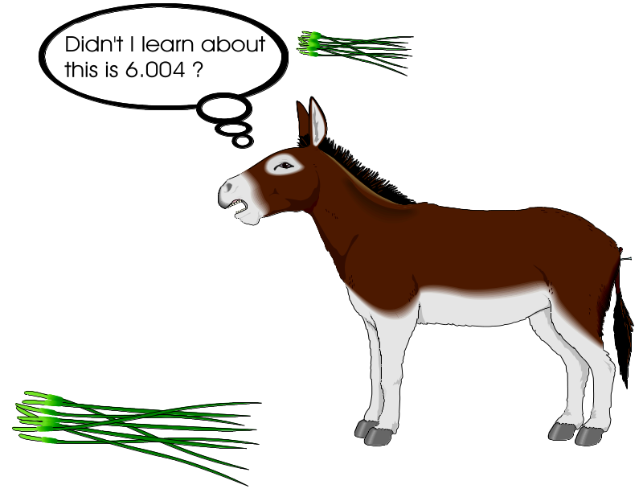
Buridan’s Ass
Buridan, Jean
Buridan, Jean (1300-58), French Scholastic philosopher, who held a theory of determinism, contending
that the will must choose the greater good. Born in Bethune, he was educated at the University of Paris,
where he studied with the English Scholastic philosopher William of Ockham. After his studies were
completed, he was appointed professor of philosophy, and later rector, at the same university. Buridan is
traditionally but probably incorrectly associated with a philosophical dilemma of moral choice called
"Buridan's ass." In the problem an ass starves to death between two alluring bundles of hay because it
does not have the will to decide which one to eat.

Slide 9
The Game Show Arbiter
A
B
Arbiter
A wins B Wins

Slide 10
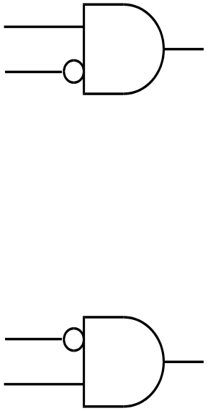
A Simpler Arbiter
A
A wins
B wins
B

Slide 11
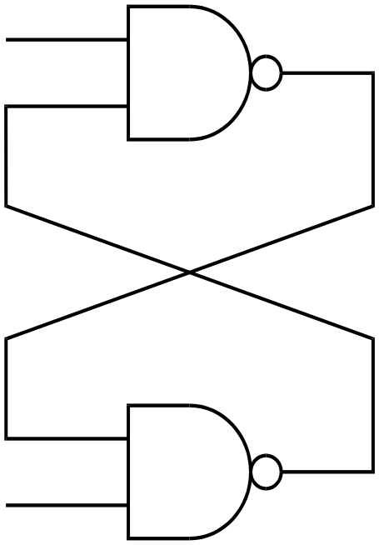
With Both Inputs High
H
H

Slide 12
Static Metastability
Vin
Vout
R
Vin
Vout
A
i
C
Vout = Vin
Vout > Vin
Vout
Vout < Vin
Vin

Slide 13
Static Metastability:
Inverted Pendulum Analogy
Potential Energy
(mgh)
m
h
angle
left
up
right

Slide 14
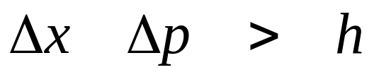
What does Heisenberg Say ?

Slide 15
What if we relax accuracy?
Who Won
0
Ta - Tb
Arbiter output perfectly correct if | Ta - Tb | > Tmargin
if | Ta - Tb | <= Tmargin, output can be RANDOM

Slide 16
The Remarkable Fact
The perfect arbiter:
  T_{margin} and T_{pd} finite and constant
  Correct Ouput if | T_{a} - T_{b} | > T_{margin}
  Any Output if | T_{a} - T_{b} | <= T_{margin}
  Answer valid and stable after T_{pd}
    IT IS IMPOSSIBLE TO BUILD ! ! ! !

Slide 17
Dynamic Metastability
(More Stupid Classroom Tricks)

Slide 18
Lecture Demonstration Circuit
delay
D
Q
delay
To Scope

Slide 19
Is It Possible to Build This?
Answer:
__________
A
B
The
Asynchronous
Arbiter:
Yes
Winner
Done

Slide 20
Practical Metastability
Async.
Inputs
FSM
Clock

Slide 21
A Simple Model of Static Metstability
Assume Vout = A Vin (i.e. not saturated)
i =
Vin(t) =
R
Vin
Vout
(A - 1) Vin / R
A
i
C
Vout
1
E ^{t (A - 1) / ( R C )}
Vin
-1

Slide 22
Evolution of Vout
Vout
1
time
-1

Slide 23
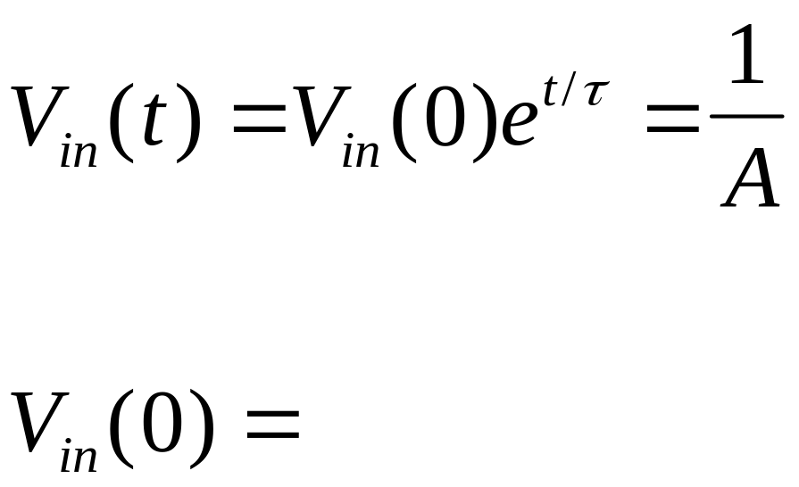
How Small must Vin(0) be to make time to saturation take longer than time t?
1/(A e ^{t/tau}) = e ^{-t/tau} / A

Slide 24
If Vin(0) is uniformly distributed:
Vin
p _{metastable} (t) = __________________________
1/(A e ^{t/tau}) = e ^{-t/tau} / A
But if Vin is in linear rise/fall a certain fraction
(p _{transition}) of the time:
Vin
p _{metastable} (t) = __________________________
p _{transition} /(A e ^{t/tau}) = (p _{transition} / A) e ^{-t/tau}

Slide 25
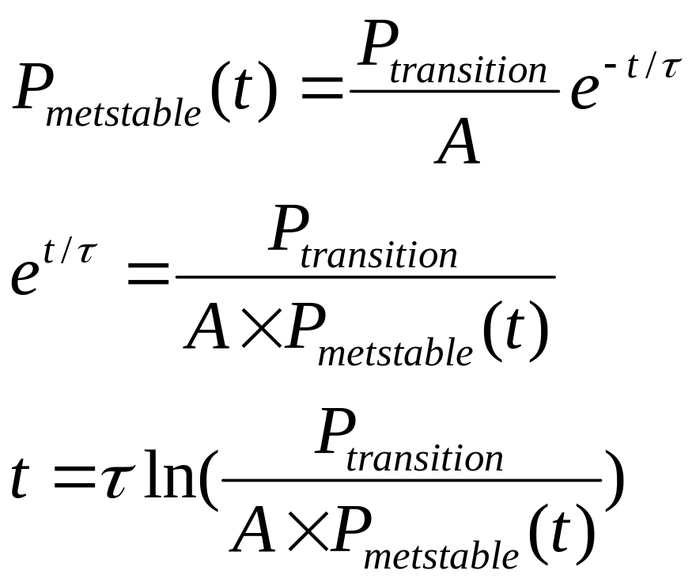
How much time do we need to achieve a certain p_{metastable}?

Slide 26
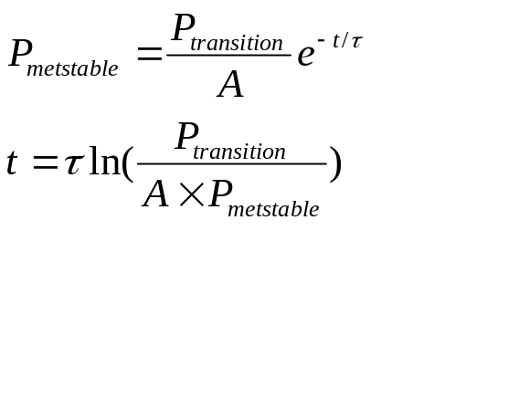
Example:
How Long for 1 failure / year?
100 MHz Clock (t = 10 ns)
p_{transition} = 0.1
A = 10
τ = 1 ns
P_{metstable} = 1 / (100MHz . 1 year)
= 1 / (10⁸ x π x 10 ⁷ ) = π x 10 ⁻¹⁶
t = 10 ⁻⁹ ln( 0.1 / (10 x π x 10 ⁻¹⁶ ) ) = about 31 ns
How about 10 years instead of 1?
t = (10^-9)ln(pi x 10^(-15)) = 33ns

Slide 27
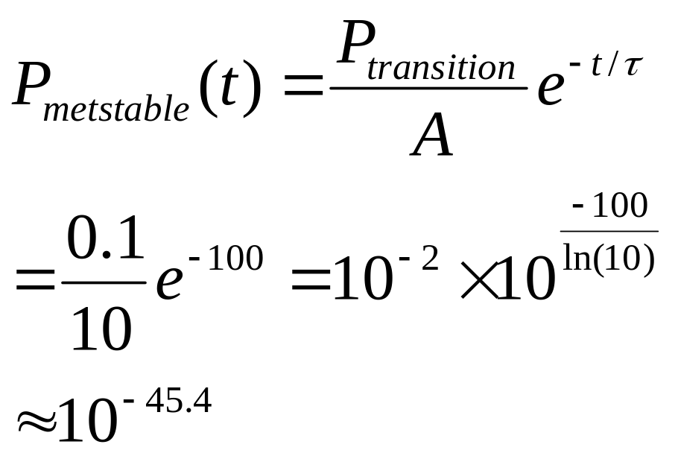
How often will failures occur if we wait 100 ns?
At 100 MHz, this is about 1 failure every 10³⁰ YEARS!
Age of Hominids:
Age of Earth:
Age of Universe:
10 ⁷
10 ⁹
10 ¹⁰

Slide 28
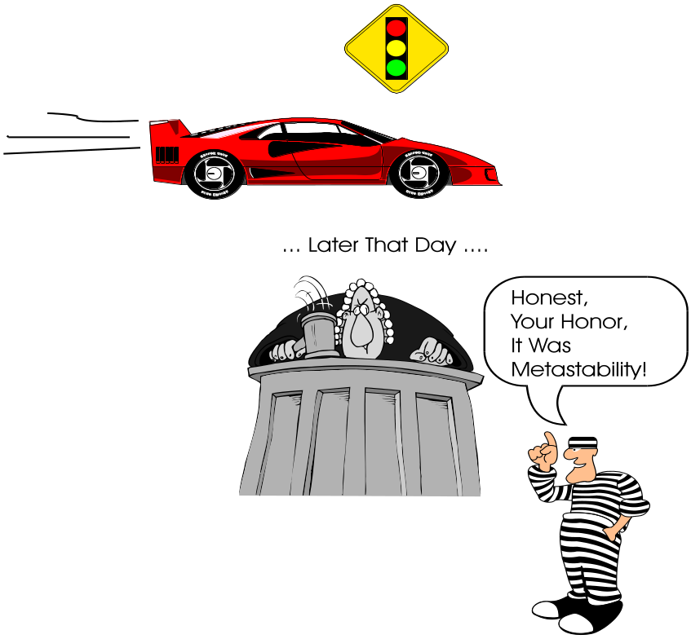
Is this a Good Excuse
For Cruising a Light?
You get 10 ³⁰ Years!

Slide 29
What did we Learn Today?
If we violate setup or hold times, a flip-flop can give a random digital output.
If we violate setup or hold times, we can’t bound the propagation delay of a flip-flop.
Metastability usually causes strange outputs, but flip-flops are sold that have valid, stable, outputs while internal nodes are metastable. They can still change their minds when coming out of metastability.
In practice, we can choose a propagation time that will have a forever stable output “most” of the time.
If we wait long enough (typ. 10-100 ns) “most of the time” is almost all of the time.
We can easily detect when settling happens, but we can’t say how long it will take.

