Slide 1

How Computers Work
Lecture 9
The Static Discipline + Regular Logic
The Statistical Nature of the Universe, and how we make computers work despite it.

Slide 2
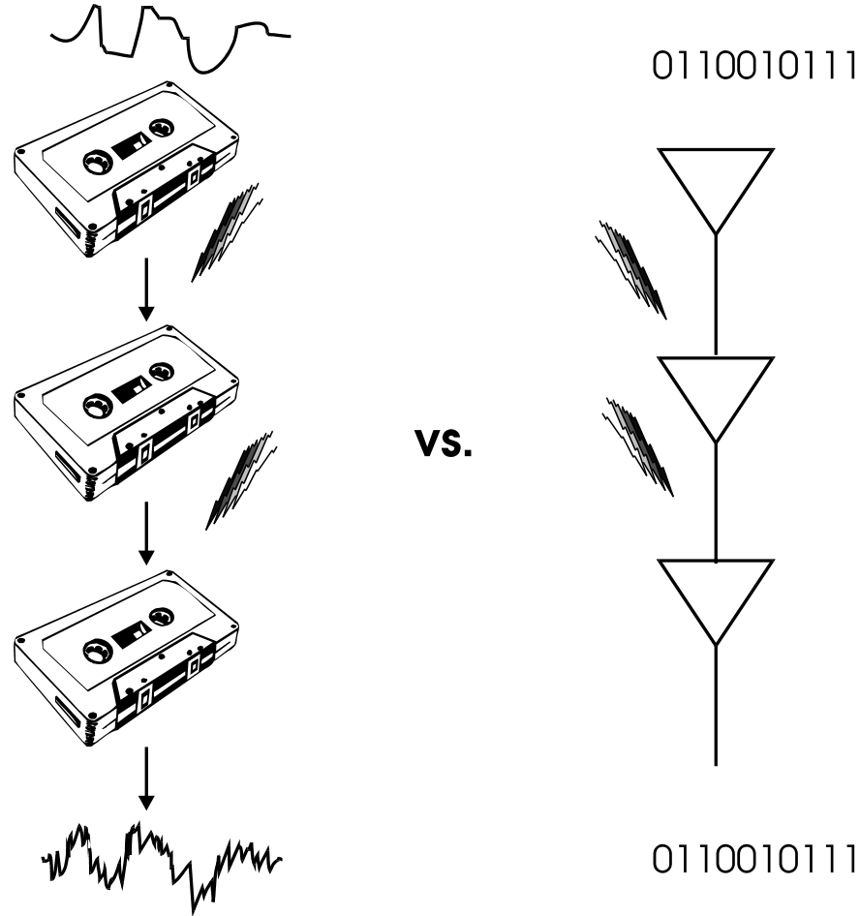
Analog vs. Digital Noise Tolerance

Slide 3
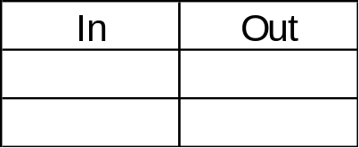
CMOS Inverter
In
Out
Notes:
NOR
1
0
0
0

Slide 4
MOS (“Metal” Oxide Semiconductor)
Transistors
P Channel
H
G
S
D
L
H
N Channel
G
S
D
L
Notes:
NOR
1
0
0
0

Slide 5
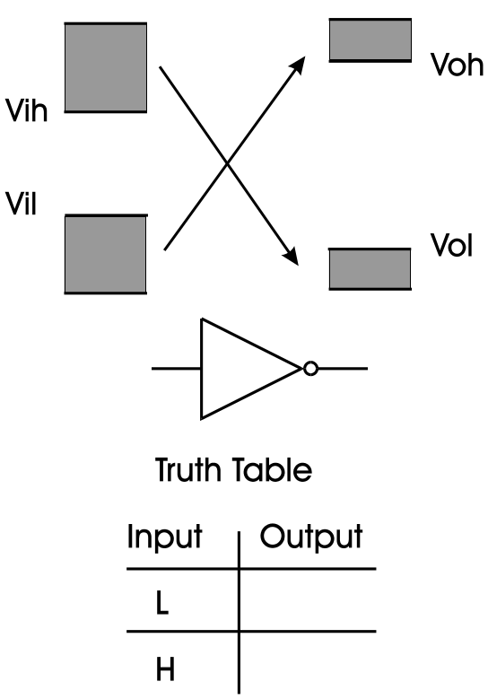
Inverter
H
L

Slide 6
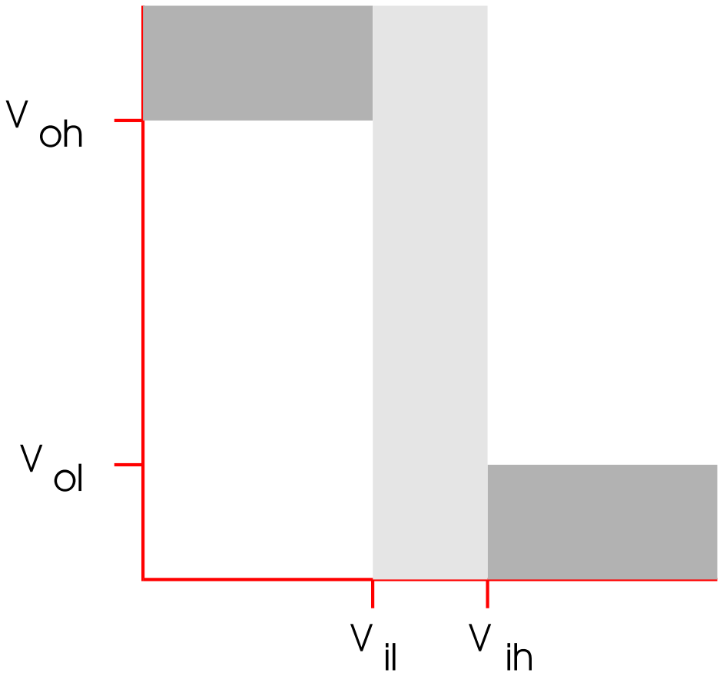
Inverter

Slide 7
CMOS Buffer
In
Out
L
H
H
L
Notes:
NOR
1
0
0
0

Slide 8
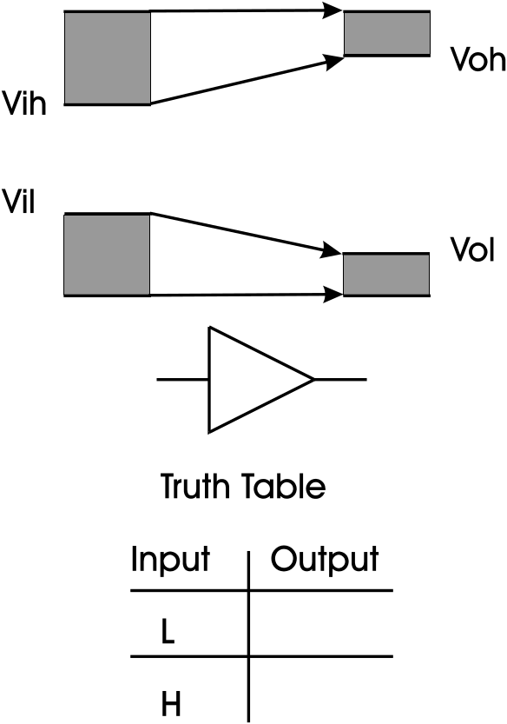
Buffer
L
H

Slide 9
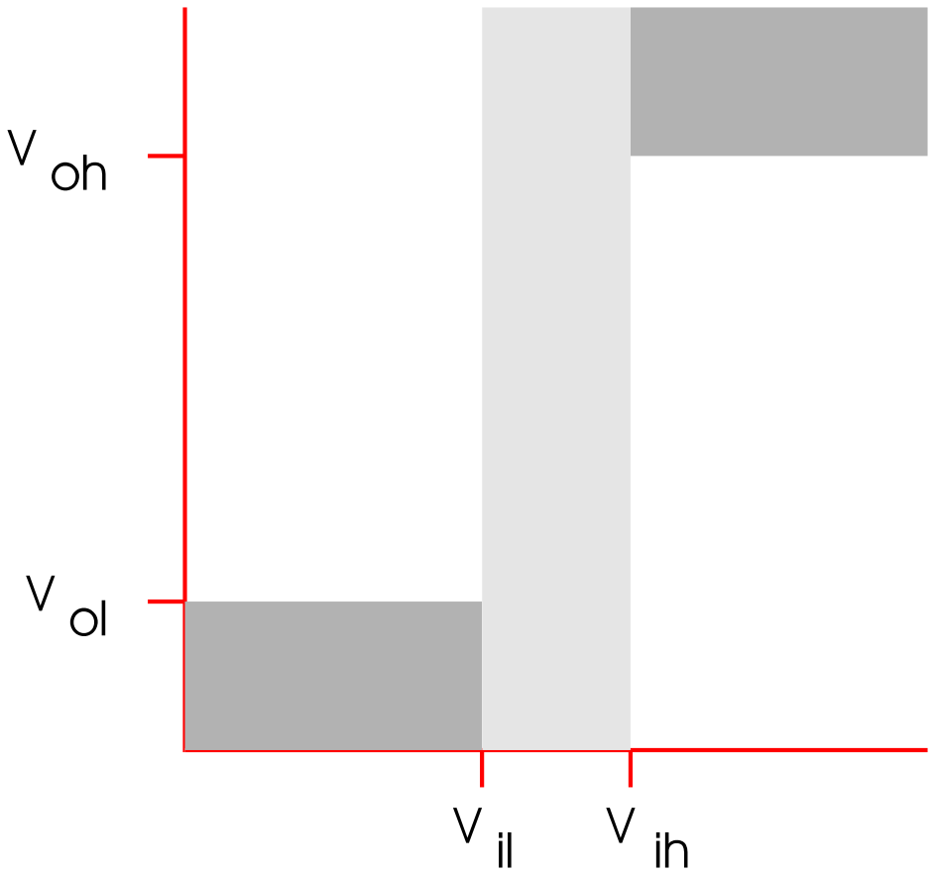
Buffer

Slide 10
The Digital Abstraction Part 1:
The Static Discipline
V_{ol}
V_{oh}
Tx
Noise
Rx
V_{il}
V_{ih}

Slide 11
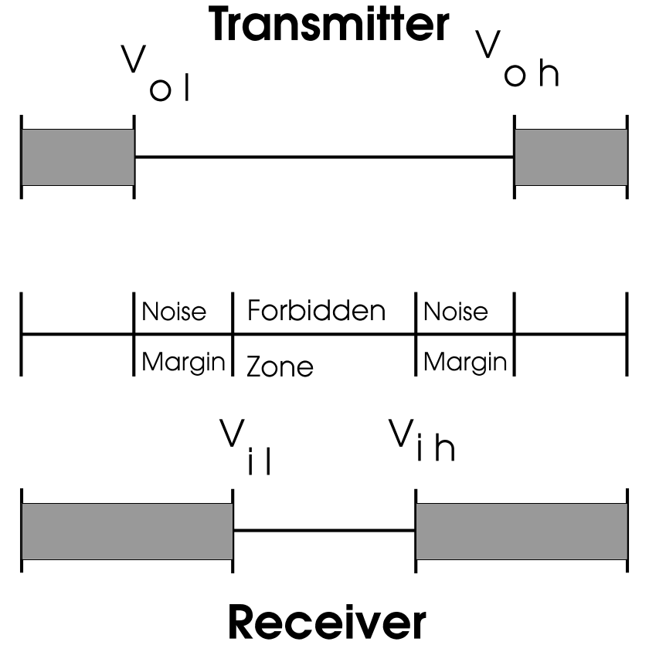
Noise Margins and the Forbidden Zone
Data
Flow

Slide 12
Consequences of the
Static Discipline
Transfer Curve of a single input, single output device:
= Disallowed
V_{oh}
Device Must
have
_______________
and be
_______________
Out
Gain
V_{ol}
V_{il}
V_{ih}
Non-Linear
In

Slide 13
Recall that the probability of asynchronous arbitration metastability after a finite Tpd is non-zero
So What about the Static Discipline?
  A: It, like many abstractions you learn about in computer design is really a probabilistic one.
  Parts fail too.
    Reliability typically follows a “bathtub” curve
  If the probability of the static discipline failing is much less than the probability of any part failing, we can basically ignore the problem.

Slide 14
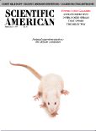
Other things in life are probabilistic too...
In the February ‘97 issue of Scientific American, Richard E. Crandall, MIT Ph.D. Course 8 ‘73, chief scientist at NeXT,
writes in “The Challenge of Large Numbers” :
1) The age of the universe is about _________________ years.
2) It would take a bird, pecking randomly on a keyboard, about
10 ^{3,000,000} years to write “The Hound of the Baskervilles”
3) A full beer can, sitting on a level, steady table, will spontaneously topple due to quantum fluctuations about once every 10 ¹⁰³³ years.
4) The probability of a mouse living on the surface of the sun for a week is about 1 in 10 ¹⁰⁴².
5) The probability of you suddenly dematerializing on earth, materializing on Mars, then re-materializing on earth is about 1 in 10 ¹⁰⁵¹.
10^10

Slide 15
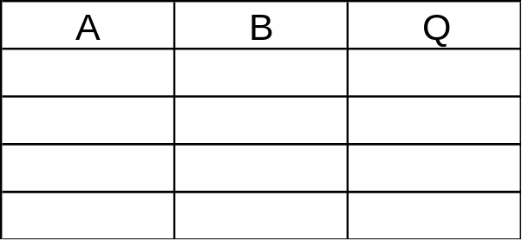
CMOS NOR
B
A
Q
L
L
H
L
H
L
H
L
L
H
H
L
Notes:
NOR
1
0
0
0

Slide 16
CMOS NAND
B
Q
A
L
L
H
L
H
H
H
L
H
H
H
L
Notes:
NOR
1
0
0
0

Slide 17
A Systematic Approach
The ROM
Q₀
Q₁
k SELECT inputs
N = 2^{k} OUTPUTs.
Selected Q_{j} HIGH
All other Q_{j} LOW
Q_{N-1}
k

Slide 18
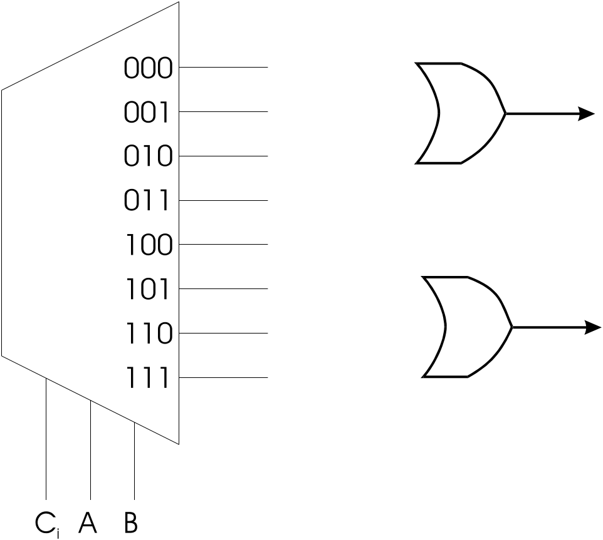
Lookup Table Implementation
(1-Dimensional ROM)
C_{i}
0
0
0
0
1
1
1
1
A
0
0
1
1
0
0
1
1
B
0
1
0
1
0
1
0
1
S
0
1
1
0
1
0
0
1
C_{o}
0
0
0
1
0
1
1
1

Slide 19
NMOS NOR
A
B
C
Q

Slide 20
The Expandable Wire-NOR
Pulldown Notation:
HIGH horiz. input
causes vertical output LOW
Passive Pullup makes vertical line HIGH by default

Slide 21
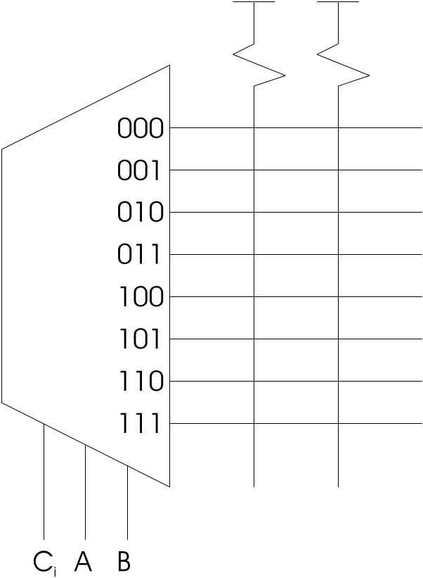
ROM Architecture
C_{o} = ABC_{i} + ABC_{i} + ABC_{i} + ABC_{i}

Slide 22
General PLA Architecture
AND Plane OR Plane

Slide 23
NMOS AND
?
A
B
Q

Slide 24
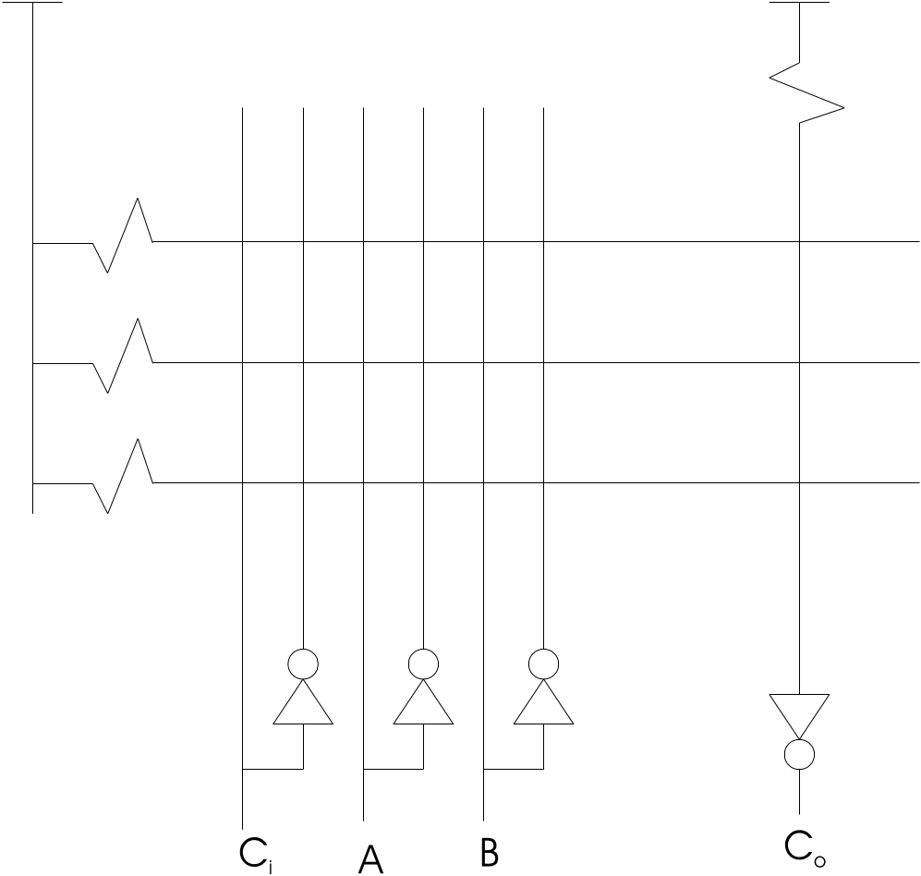
PLA Implementation of Co
= AB + BC_{i} + AC_{i}

Slide 25
PALS
PLA with fixed OR plane
Usually contain memory devices as well

Slide 26
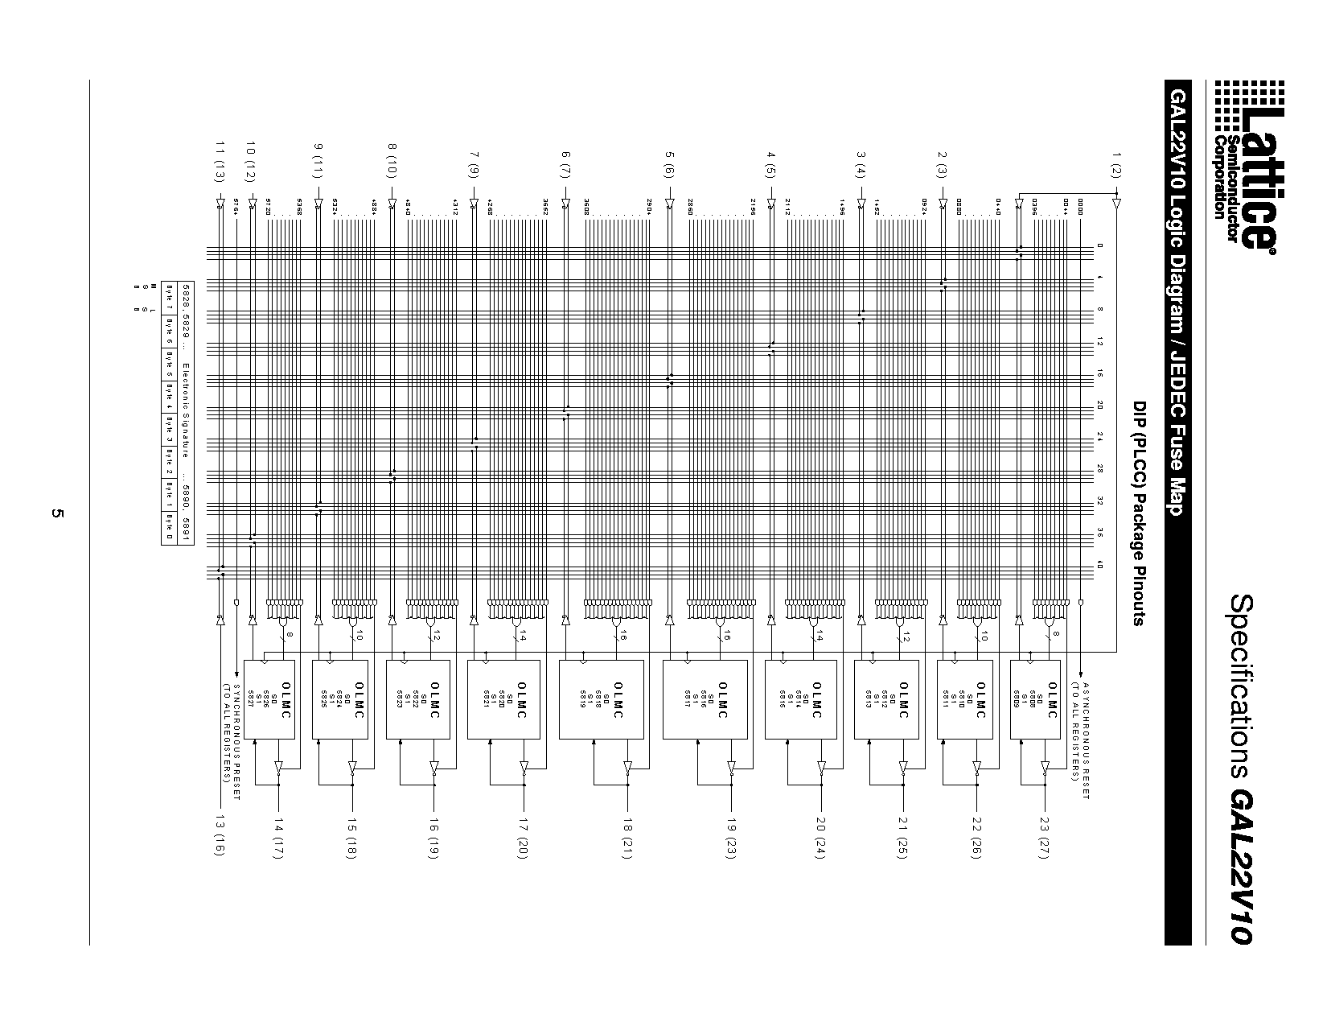
22V10 PAL

Slide 27
Tree Structure
A
1
A
2
A
3
A
4
A
N
N-input TREE has O(log (n)) levels...
Signal propagation takes O(log (n)) gate delays.
O(n) gates.

Slide 28
FPGAs
Recognition that PLA 2-Level Architecture is poor match to many functions
Network of many small programmable logic elements
  ROMs
  PLAs
  Gates
Programmable Interconnection Network

Slide 29
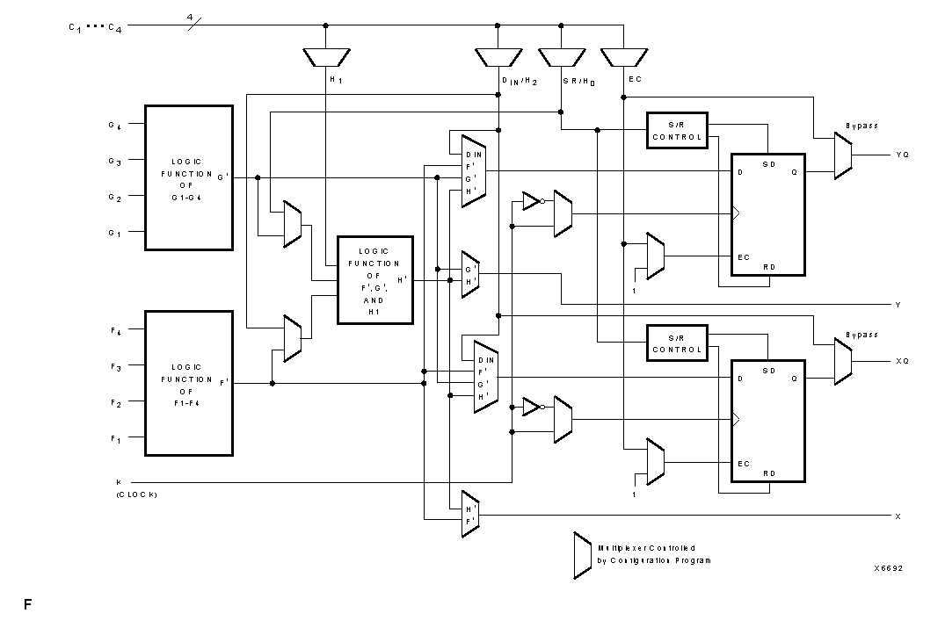
Xilinx 4000 FPGA CLB

Slide 30
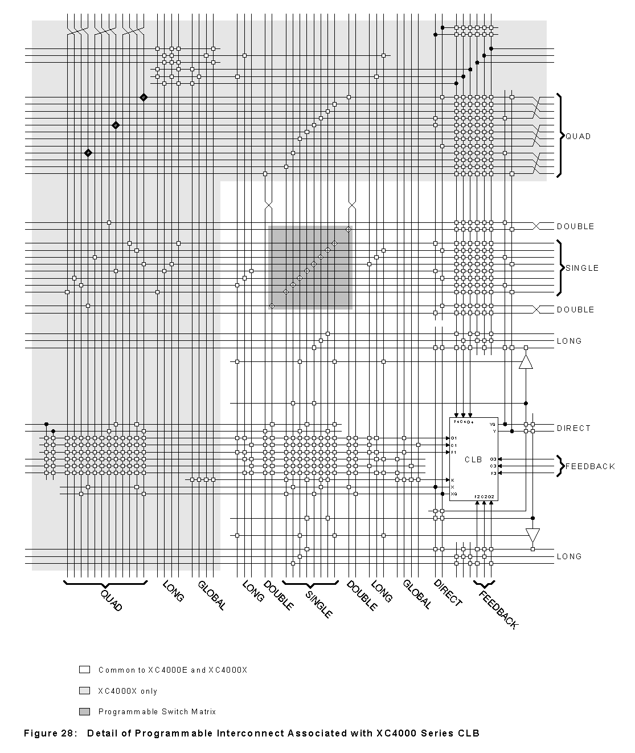
FPGA Interconnect per CLB

Slide 31
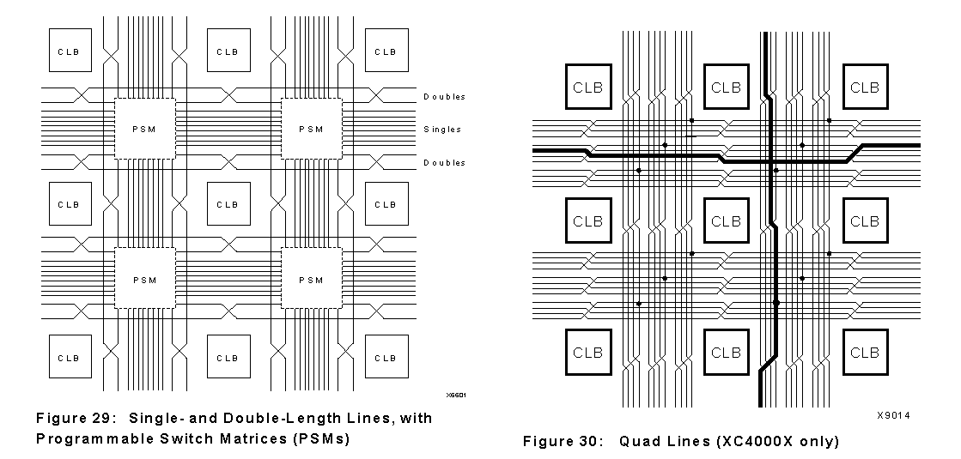
FPGA Interconnect Matrix

