Slide 1
How Computer Work
Lecture 10
Introduction to the Physics of
Communication

Slide 2
The Digital Abstraction Part 1:
The Static Discipline
V_{ol}
V_{oh}
Tx
Noise
Rx
V_{il}
V_{ih}

Slide 3

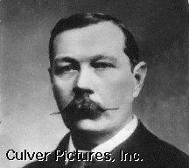
What is Information?
Information Resolves ______________
Uncertainty

Slide 4

How do we measure information?
Error-Free data resolving 1 of 2 equally likely possibilities =
________________ of information.
1 bit

Slide 5

How much information now?
3 independent coins yield ___________ of information
# of possibilities = ___________
3 bits
8

Slide 6
How about N coins ?
........................
N independent coins yield
# bits = ___________________________
# of possibilities = ___________
N
2^{N}

Slide 7
What about Crooked Coins?
P_{tail} = .25
P_{head} = .75
# Bits = -
Σ
p_{i} log₂ p_{i}
(about .81 bits for this example)

Slide 8
How Much Information ?
. . . 00000000000000000000000000000 . . .
None (on average)

Slide 9
How Much Information Now ?
. . . 0 1 0 1 0 1 0 1 0 1 0 1 0 1 0 1 0 1 0 1 . . .
. . . 0 1 0 1 0 1 0 1 0 1 0 1 0 1 0 1 0 1 0 1 . . .
Predictor
None (on average)

Slide 10
How About English?
6.JQ4 ij a vondurfhl co8rse wibh sjart sthdenjs.
If every English letter had maximum uncertainty, average information / letter would be _________
Actually, English has only ______ bits of information per letter if last 8 characters are used as a predictor.
English actually has _______ bit / character if even more info is used for prediction.
log₂(26)
2
1

Slide 11
Data Compression
Lot’s O’ Redundant Bits
Encoder
Fewer Redundant Bits
Decoder
Lot’s O’ Redundant Bits

Slide 12
An Interesting Consequence:
A Data Stream containing the most possible information possible (i.e. the least redundancy) has the statistics of ___________________ !!!!!
Random Noise

Slide 13
Digital Error Correction
Original Message
Encoder
Original Message + Redundant Bits
Corrector
Original Message

Slide 14
How do we encode digital information in an analog world?
Once upon a time, there were these aliens interested in bringing back to their planet the entire library of congress ...

Slide 15
The Effect of “Analog” Noise
01101110
01101110

Slide 16
Max. Channel Capacity for Uniform, Bounded Amplitude Noise
P
Tx
Noise
Rx
N
Max # Error-Free Symbols = ________________
Max # Bits / Symbol = _____________________
P/N
log₂(P/N)

Slide 17
Max. Channel Capacity for
Uniform, Bounded Amplitude Noise (cont)
P = Range of Transmitter’s Signal Space
N = Peak-Peak Width of Noise
W = Bandwidth in # Symbols / Sec
C = Channel Capacity = Max. # of Error-Free Bits/Sec
C =
____________________________
W log₂(P/N)
Note: This formula is slightly different for Gaussian noise.

Slide 18
Further Reading on Information Theory
The Mathematical Theory of Communication,
Claude E. Shannon and Warren Weaver, 1972, 1949.
Coding and Information Theory, Richard Hamming,
Second Edition, 1986, 1980.

Slide 19



The mythical equipotential wire

Slide 20
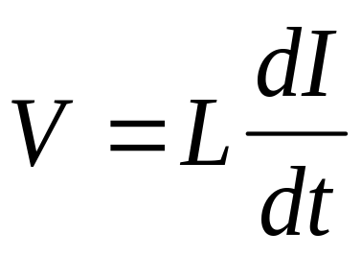
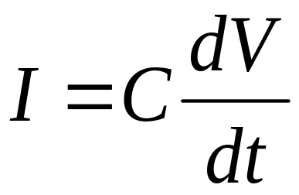
But every wire has parasitics:
-
+
+
-

Slide 21
Why do wires act like transmission lines?
...
...
Signals take time to propagate
Propagating Signals must have energy
Inductance and Capacitance Stores Energy
Without termination, energy reaching the end of a transmission
line has nowhere to go - so it
_________________________
Echoes

Slide 22

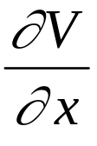


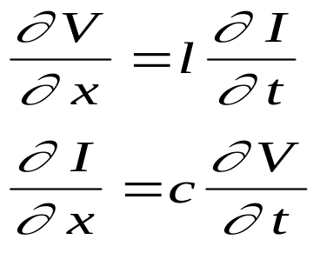
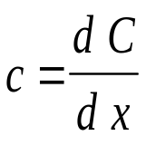

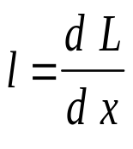
Fundamental Equations of Lossless Transmission Lines
-
+
...
...

Slide 23
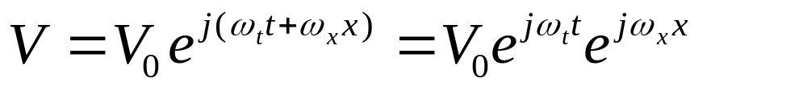
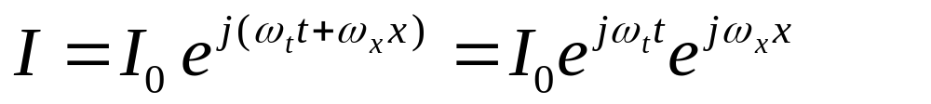

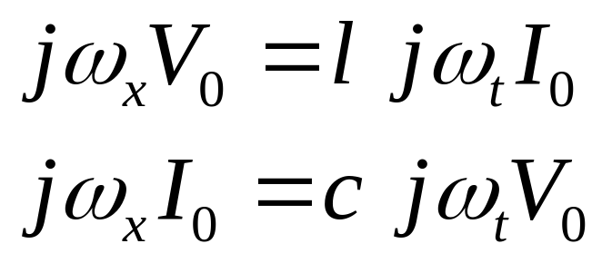
Transmission Line Math
Lets try a sinusoidal solution for V and I:

Slide 24
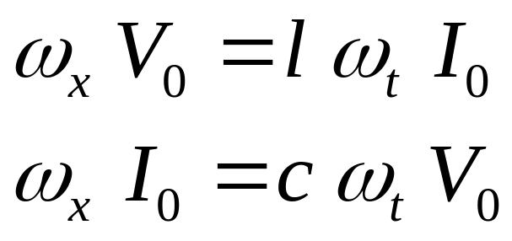
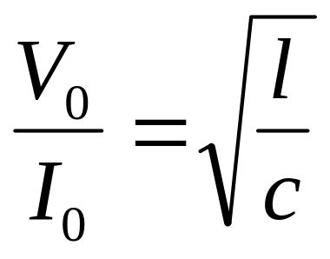
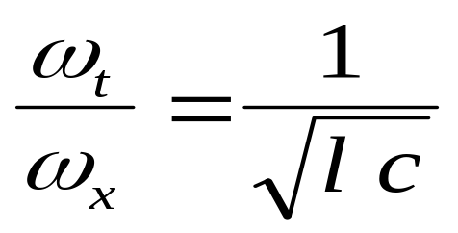
Transmission Line Algebra
Propagation Velocity
Characteristic Impedence

Slide 25
Parallel Termination

Slide 26
Series Termination

Slide 27
Series or Parallel ?
Series:
  No Static Power Dissipation
  Only One Output Point
  Slower Slew Rate if Output is Capacitively Loaded
Parallel:
  Static Power Dissipation
  Many Output Points
  Faster Slew Rate if Output is Capacitively Loaded
Fancier Parallel Methods:
  AC Coupled - Parallel w/o static dissipation
  Diode Termination - “Automatic” impedance matching

Slide 28
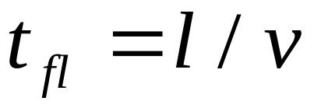
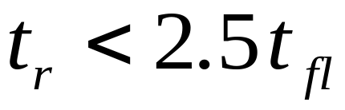
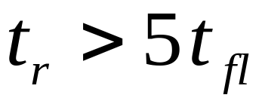
When is a wire a transmission line?
Rule of Thumb:
Transmission Line
Equipotential Line

Slide 29

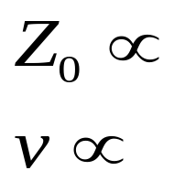
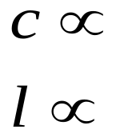
Making Transmission Lines
On Circuit Boards
Insulating Dielectric
Copper Trace
w
t
h
Voltage Plane
h / (w sqrt(ε _{r} ) )
ε _{r} w/h
1/sqrt(ε _{r} )
h/w

Slide 30
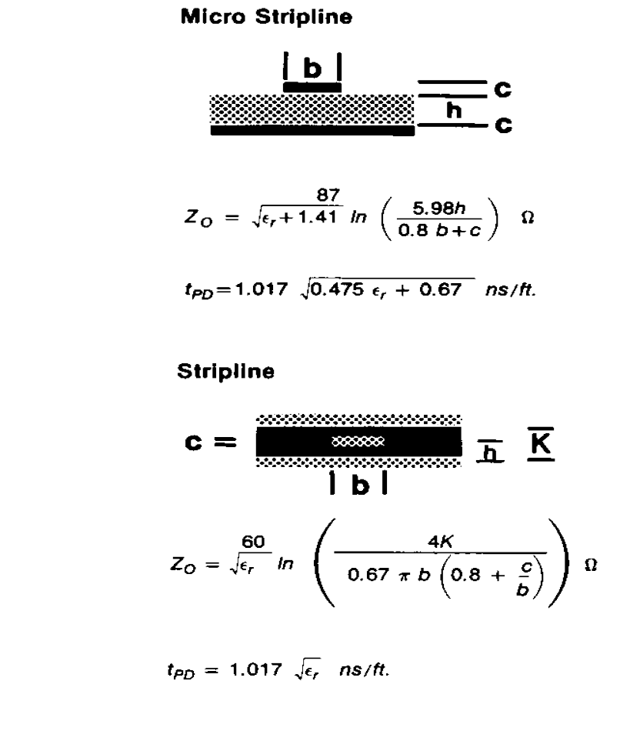
Actual Formulas

Slide 31
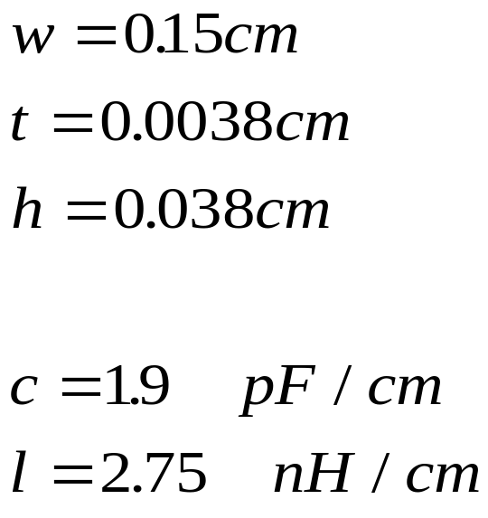
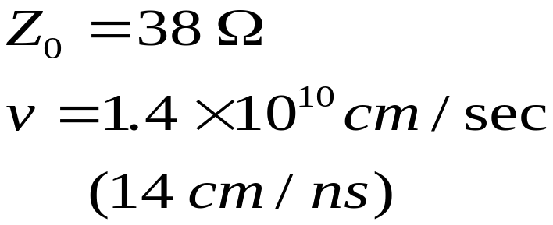
A Typical Circuit Board
1 Ounce Copper
G-10 Fiberglass-Epoxy

