Slide 1
How Computers Work
Lecture 11
Introduction to the Physics of Computation

Slide 2
Recall the essence of data transmission:
Q: What form does information take during transmission?
A: _____________
Energy
Notes:
Energy

Slide 3
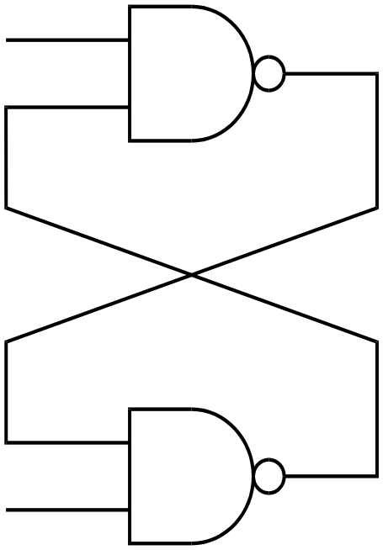
Recall the SR Flop in the Store State
H
H

Slide 4
Is this an adequate way to explain storage of a bit?
A:_______________
No
Vout = Vin
Vout > Vin
Vin
Vout
Vout
Vout < Vin
Vin

Slide 5
Where is the bit really stored?
In the capacitors

Slide 6
A little exercise:
In a world of Rs, Ls, Cs, and Memory-less gain elements, only the _______ and ________ store energy, so memory can only reside in them.
These elements inevitably cause delay.
Memory Requires ___________
Delay, Energy, and State (Memory) are intimately coupled.
Ls
Cs
Delay

Slide 7
(Linear) Capacitor Energetics
Q: How much energy does a capacitor charged to voltage V store?
  A: _________________
Q: If I charge an originally discharged capacitor to a voltage V through a resistor, how much energy is dissipated in the resistor?
  A:__________________
Q: How much total energy is lost charging (to V) and discharging a capacitor?
A:________________
(1/2) C V²
V
R
(1/2) C V²
C
C V²

Slide 8
Power Loss in the CMOS Inverter
Power is lost due to:
1)______________
2)______________
3)______________
Leakage
In
Q
Shoot-Through
Capacitive Charge/Discharge
Notes:
NOR

Slide 9
Quantitative Power Loss in CMOS
Leakage:
  __________________
Crossover (Shoot-Through):
  __________________
Capacitive: Constant Energy / Cycle, ergo:
  __________________ Frequency
Insignificant
Small if Rise/Fall times are fast
Power is proportional to

Slide 10
How do we minimize power loss?
G
S
D
Q: Does changing the on-resistance help? A:____________
Q: Does making the channel length shorter help? A:_______
Q: Does lowering the voltage help?A:_____________
No
Yes - C goes down
Yes

Slide 11
But do MOS transistors turn on enough at low voltages?
Side View
G
In
Q
S
D
A: ____________ as long as you doctor the channel a bit, thus
lowering the turn-on threshold.
Yes

Slide 12
How about speed?
V
R
Unlike power dissipation, lowering
R does lower Tpd.
Q: How do we lower R?
A: Make FET channel _________
Q: Does making the FET channel
wider help?
A:________ because it raises C while
lowering R.
C
Side View
G
Shorter
S
D
Top View
No

Slide 13
What about the gate oxide thickness?
Q: If it takes a fixed E-field strength to turn on the transistor,
what effect does changing the gate oxide thickness have?
A: An n times thicker gate oxide takes roughly ___ times more
voltage to make the same E-field strength, but has roughly _____
times the capacitance as before. Thus, thicker oxides are a net
__________.
Ergo: Gate oxides are made as ________ as possible, given
reliability constraints.
n
1/n
loss
thin

Slide 14
Other ways of lowering power consumption:
Re-Code data for fewer transitions.
Re-design architectures for fewer transition in “average case” performance.
Power-Down (i.e. selectively clock) parts of a machine that aren’t needed now.
Consider radical ideas like “reversible computing”.

Slide 15
Reversible Computing?
Q1: How little energy can be used to represent a bit?
Q2: Is there a minimum energy is takes to do computation?
Intuitive (in this case, wrong) answers:
A1: It can take arbitrarily little energy to represent a bit
A2: Computation must consume power

Slide 16
The smallest energy system we know that can represent a bit:
Heat Source/Sink
at T
1 particle of gas exists in a 2-piston iso-thermal cylinder at temperature T.
Q: What is the kinetic energy of the particle?
A:______________________
T

Slide 17
Q: Does it take energy to slowly compress the gas to the left side?
Heat Source/Sink
at T
A: ___________
Q: Is the kinetic energy of the particle any different?
A:__________________
Yes
No

Slide 18
Then why did it take energy?
Heat Source/Sink
at T
A: Because the particle was bouncing against the piston
Q: Where did this energy go?
A1: Into the heat sink
A2: Into information!

Slide 19
How many bits of information have we created?
Heat Source/Sink
at T
1
A:___________
Q: How much energy did this take:
A: log_{e}(2) k T

Slide 20
Can we get this energy back?
Heat Source/Sink
at T
Yes
A:___________!!!!!! IF WE DO IT SLOWLY!!!!!

Slide 21
Summary:
Slow (i.e. reversible) thermodynamic processes can recover the energy put into creating a bit.
Fast (i.e. irreversible) processes loose part of this energy.
We can recover an arbitrarily high fraction of the energy put in by going slowly enough.
There’s nothing special about the isothermal heat sink - adiabatic (insulated) cylinders work too, it’s the speed that’s important.

Slide 22
But that’s bit storage. How about computing?
A: Computing is nothing more than creating bits whose value is determined by examining other bits.
Examination of bits is energetically free. It is their creation and destruction that is tied to energy.
When destroying a bit, we can do so reversibly (i.e. slowly) or irreversibly (i.e. fast).

Slide 23
A typical CMOS Inverter
Has fixed power supply rails.
Is driven as fast as possible.
Operates non-reversibly.
Throws away its bit energy
In
Q

Slide 24
But there’s another way:
Reversible Computing:
  To Create a bit:
    Start with two power supply rails at the same voltage.
    Connect the parasitic capacitance to the appropriate power supply rail.
    Slowly separate the power supply rail voltages, raising one and lowering the other.
  To (reversibly) destroy a bit:
    Start with two power supply rails separated by some voltage.
    Connect the (already charged) parasitic capacitance to the appropriate rail.
    Slowly bring the power supply rails together.
    Except for (arbitrarily small) resistive losses, the power supply can recover all of the energy!

Slide 25
An example: Younis and Knight’s SCRL
= Clock Lines
Out
In

Slide 26
An interesting consequence:
We must remember the value of a bit in order to recover it’s
energy, so every computation must be reversed after it is done.
Thus: For any computation (e.g. AND) that destroys input
information, we must remember enough input variables
to be able to UNDO or REVERSE the computation, and recover
the energy that would be otherwise lost due to the DESTRUCTION
OF BITS.
This is sometimes practical and sometimes not. By being clever
and only throwing away bits when it is very inconvenient to
remember them, we can make reversible computation practical.

Slide 27
Reversible Computing?
Some real answers
Q1: How little energy can be used to represent a bit?
Q2: Is there a minimum energy is takes to do computation?
Real answers:
A1: k T log_{e}(2) is the minimum energy to reliably store a bit
CMOS gates typically use 10⁸ kT per bit
RNA duplication typically uses 100 kT per bit
A2: Computation does NOT need to consume power, as long as it is done reversibly (i.e. slowly enough, and without destroying information)
Related Trivia : The awake human brain consumes approximately 40 Watts of power.

Slide 28
To Learn More Read:
Feynman Lectures on Computation
http://www.ai.mit.edu/people/tk/lowpower/crl.ps
http://www.ai.mit.edu/people/tk/lowpower/low94.ps
“Thermodynamics of Computation - A Review” Charles H. Bennett, International Journal of Theoretical Physics 21, 905(1982)

