Slide 1
How Computers Work
Lecture 13
Details of the Pipelined Beta

Slide 2
Review: 1-Stage Beta (Top-Down View)
With st(ra,C,rc) : Mem[C+<rc>] <- <ra>
PC
Q
RA1
Memory
RD1
XADDR
JMP(R31,XADDR,XP)
ISEL
0
1
31:26
25:21
20:5
9:5
4:0
OPCODE
RA
C
RB
RC
+1
0
1
OPCODE
Register File
RA1
RD1
Register File
RA2
RD2
SEXT
ASEL
0
1
2
1
0
BSEL
A
ALU
B
ALUFN
A op B
Z
RA2
Memory
RD2
PCSEL
0
1
0
1
2
WDSEL
D
PC
WD
Memory
WA
WD
Register File
WA
RC
WE
WEMEM
WE
WERF

Slide 3
Review: Pipeline Stages
GOAL: Maintain (nearly) 1.0 CPI, but increase clock speed.
APPROACH: structure processor as 4-stage pipeline:
  Instruction Fetch stage: Maintains PC, fetches one instruction per cycle and passes it to
  Register File stage: Reads source operands from register file, passes them to
  ALU stage: Performs indicated operation, passes result to
  Write-Back stage: writes result back into register file.
IF
RF
WHAT OTHER information do we have to pass down the pipeline?
ALU
WB
Notes:
Four “major” datapath subsystems:
- Instr Memory
- Register File
- ALU
- Data Memory
Suggests a 4-stage pipe.
PC, INST

Slide 4
Sketch of 4-Stage Pipeline
Instruction
Fetch
IF
instruction
Register
File
CL
RF
(read)
instruction
A
B
ALU
CL
ALU
Write
Back
instruction
Y
CL
instruction
RF
(write)
NEED ALSO:
  <PC> - for Branch/JMP instrs!
Lets make it real....
Notes:
PIPELINE SKETCH...
4 CL Instruction Exec Time
1 Instr/CL Exec RATE
Short combinational paths, hence faster clock.
Need also
- Instruction (or parts of it) to drive control logic
- <PC>, for BR/JMP instructions!
(recall, they load old PC into destination register)
BR & JMP
To make it real, need to add some detail...

Slide 5
PC
Q
RA1
Memory
RD1
XADDR
IF
JMP(R31,XADDR,XP)
ISEL
0
1
31:26
25:21
20:5
9:5
4:0
OPCODE
RA
C
RB
RC
RF
+1
0
1
OPCODE
Register File
RA1
RD1
Register File
RA2
RD2
SEXT
ASEL
0
1
2
1
0
BSEL
ALU
A
ALU
B
ALUFN
A op B
Z
WB
RA2
Memory
RD2
PCSEL
0
1
0
1
2
WDSEL
D
PC
WD
Memory
WA
WD
Register File
WA
RC
WE
WEMEM
WE
WERF

Slide 6
Pipeline Hazards
PROBLEM:
  Contents of a register WRITTEN by instruction k is READ by instruction k+1... before its stored in RF! EG:
      ADD(r1, r2, r3)
      CMPLEC(r3, 100, r0)
  fails since CMPLEC sees “stale” <r3>.
R3 Written
ADD(r1,r2,r3) | IF | RF | ALU | WB
CMPLEC(r3,100,r0) |  | IF | RF | ALU | WB
R3 Read
Time
Notes:
Return to 2nd problem...
... called a PIPELINE HAZARD.
Suppose there’s communication between consecutive instrs?
ADD writes R3
CMP reads R3

Slide 7
R3 Written
ADD(r1,r2,r3) | IF | RF | ALU | WB
CMPLEC(r3,100,r0) |  | IF | RF | ALU | WB
 |  |  | IF | RF | ALU | WB
CMPLEC(r3,100,r0) |  |  |  | IF | RF | ALU | WB
R3 Read
SOLUTIONS:
  1. “Program around it”.
    ... document weirdo semantics, declare it a software problem.
      - Breaks sequential semantics!
      - Costs code efficiency.
EXAMPLE: Rewrite
ADD(r1, r2, r3)
CMPLEC(r3, 100, r0)
MULC(r1, 100, r4)
SUB(r1, r2, r5)
ADD(r1, r2, r3)
MULC(r1, 100, r4)
SUB(r1, r2, r5)
CMPLEC(r3, 100, r0)
as
HOW OFTEN can we do this?
Notes:
Can renegotiate the contract...
BUT IT COSTS! Compilers can fill
1 delay slot: fill 75%
2 delay slots: fill 25%

Slide 8
SOLUTIONS:
  2. Stall the pipeline.
    Freeze IF, RF stages for 2 cycles,
    inserting NOPs into ALU IR...
R3 Written
ADD(r1,r2,r3) | IF | RF | ALU | WB
NOP |  | IF | RF | ALU | WB
NOP |  |  | IF | RF | ALU | WB
CMPLEC(r3,100,r0) |  |  |  | IF | RF | ALU | WB
R3 Read
DRAWBACK: SLOW
Notes:
PIPELINE STALL:
HOLD current IF, RF state;
ADVANCE ALU, WB state (putting in NOPs or annulled instrs!)
PERFORMANCE!

Slide 9
SOLUTIONS:
  3. Bypass Paths.
    Add extra data paths & control logic to re-route data in problem cases.
<R1>+<R2> Produced
<R0> Produced
<R0> About to be Written Back
ADD(r1,r2,r3) | IF | RF | ALU | WB
CMPLEC(r3,100,r0) |  | IF | RF | ALU | WB
BT(r0,LOOP) |  |  | IF | RF | ALU | WB
XOR(r0,r0,r3) |  |  |  | IF | RF | ALU | WB
<R1>+<R2> Used
<R0> Used
<R0> Used
Notes:
MOST AMBITIOUS SOLN:
Fix the problem.
OBSERVATION: The new data exists in our data paths; its just not where we’re looking.
APPROACH: Add new paths, control logic.
HOW MANY DO WE NEED?
(ans: 4)

Slide 10
PC
Q
Hardware Implementation of Bypass Paths
RA1
Memory
RD1
XADDR
IF
JMP(R31,XADDR,XP)
ISEL
0
1
31:26
25:21
20:5
9:5
4:0
OPCODE
RA
C
RB
RC
RF
+1
0
1
OPCODE
Register File
RA1
RD1
Register File
RA2
RD2
SEXT
ASEL
0
1
2
1
0
BSEL
ALU
A
ALU
B
ALUFN
A op B
Z
WB
RA2
Memory
RD2
PCSEL
0
1
0
1
2
WDSEL
D
PC
WD
Memory
WA
WD
Register File
WA
RC
WE
WEMEM
WE
WERF

Slide 11
Bypass Paths - I
RF
IR
RA1
RA2
CMPLEC(r3,100,r0)
Register
RD1
File
RD2
ALU
A
B
IR
ADD(r1,r2,r3)
A
B
ALU
Y
WB
WB
IR
Y
WA
WD
Register
File
WE
Notes:
Case 1:
• instr i writes r3
• instr i+1 uses <r3> as 2nd source operand
New data is at ALU OUTPUT; must route it to B input reg
LOGIC will select this path under proper circumstances
(NB: RDest is Rc for operate instrs)
BUG! Won’t work for BR/JMP/LD

Slide 12
PC
Q
Hardware Implementation of Bypass Paths
RA1
Memory
RD1
XADDR
IF
JMP(R31,XADDR,XP)
ISEL
0
1
31:26
25:21
20:5
9:5
4:0
OPCODE
RA
C
RB
RC
RF
+1
0
1
OPCODE
Register File
RA1
RD1
Register File
RA2
RD2
SEXT
ASEL
0
1
2
1
0
BSEL
ALU
A
ALU
B
ALUFN
A op B
Z
WB
RA2
Memory
RD2
PCSEL
0
1
0
1
2
WDSEL
D
PC
WD
Memory
WA
WD
Register File
WA
RC
WE
WEMEM
WE
WERF

Slide 13
Bypass Paths - II
RF
IR
ADD(r1, r2, r3)
RA1
RA2
Register
RD1
File
RD2
ALU
A
B
IR
A
ALU
B
Y
WB
WB
IR
Y
XOR(r3, r4, r2)
WA
WD
Register
File
WE
Notes:
Case 2:
• instr i writes r3
• instr i+2 uses <r3> as 2nd source operand
New data is at RF write data input; must route it to B input reg
LOGIC will select this path under proper circumstances
(NB: RDest is Rc for operate instrs)

Slide 14
PC
Q
PC Bypassing
RA1
Memory
RD1
XADDR
IF
JMP(R31,XADDR,XP)
ISEL
0
1
31:26
25:21
20:5
9:5
4:0
+1
OPCODE
RA
C
RB
RC
RF
+1
0
1
OPCODE
Register File
RA1
RD1
Register File
RA2
RD2
SEXT
ASEL
0
1
2
1
0
BSEL
ALU
A
ALU
B
ALUFN
A op B
Z
WB
RA2
Memory
RD2
PCSEL
0
1
0
1
2
WDSEL
D
PC
WD
Memory
WA
WD
Register File
WA
RC
WE
WEMEM
WE
WERF

Slide 15
BRANCH DELAY SLOTS
PROBLEM: One (or more) following instructions have been pre-fetched by the time a branch is taken.
POSSIBLE SOLUTIONS:
  1. “Program around it”. Either
    1a. Follow each BR with 2 NOP instructions; or
    1b. Make your compiler clever enough to move USEFUL instructions following branches.
  2. Make pipeline “annul” instructions following branches which are taken, eg by disabling
    WERF and WEMEM and PCSEL.
Notes:
NOP
NOP = ADD(r31, r31, r31)
WERF
R/W-
PCSEL

Slide 16
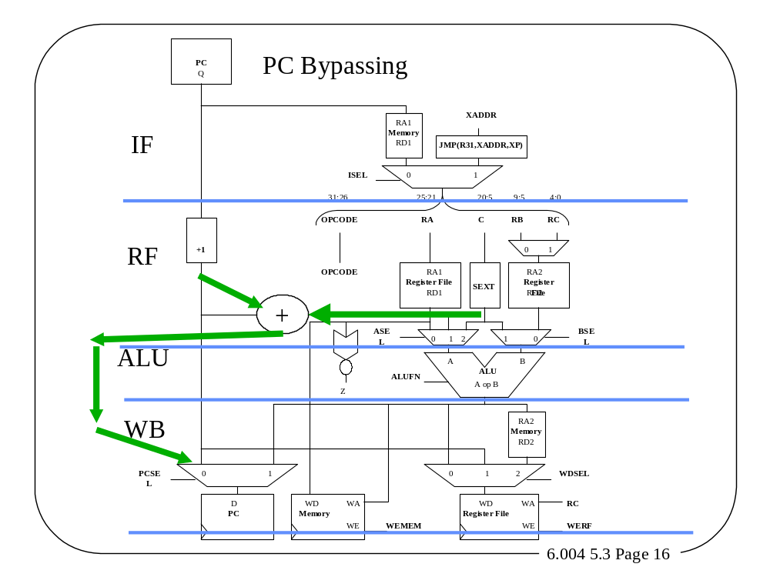
Can we shorten the number of delay slots? A: Yes (by 1)

Slide 17
Load Delays
Consider LOADS:
  Can we fix all these
  problems using our
  previous bypass
  paths?
LD(r1, 0, r4)
ADD(r1, r4, r5)
XOR(r3, r4, r6)
ANSWER: No – only 1 (XOR) !
For a LD instruction fetched during clock i,
data isn’t returned from memory until late
into cycle i + 3 !
LD Data Available
LD(r1, 0, r4) | IF | RF | ALU | WB
ADD(r1, r4, r5) |  | IF | RF | ALU | WB
XOR(r3, r4, r6) |  |  | IF | RF | ALU | WB
R4 Needed
R4 Needed
Notes:
i+3
NO - ADD conflict!
SIMILAR Problems with LD...
BUT data isn’t around as early!
2 hazards in this example: can both be fixed using bypasses?

Slide 18
PC
Q
LD Data Bypass
RA1
Memory
RD1
XADDR
IF
JMP(R31,XADDR,XP)
ISEL
0
1
31:26
25:21
20:5
9:5
4:0
OPCODE
RA
C
RB
RC
RF
+1
0
1
OPCODE
Register File
RA1
RD1
Register File
RA2
RD2
SEXT
ASEL
0
1
2
1
0
BSEL
ALU
A
ALU
B
ALUFN
A op B
Z
WB
RA2
Memory
RD2
PCSEL
0
1
0
1
2
WDSEL
D
PC
WD
Memory
WA
WD
Register File
WA
RC
WE
WEMEM
WE
WERF

Slide 19
Load Delays - II
Load Timing
Problems:
LD(r1, 0, r4)
ADD(r1, r4, r5)
XOR(r3, r4, r6)
Problem 1
Problem 2
Can relegate both problems to Compiler.
Alternatively, fix Problem 2 using
  Bypass Paths
  and fix Problem 1 using
  NOPs / Stalls
Notes:
BYPASSES
STALLS
Can bypass one load delay, skipping the RF access cycle.
Other load delay is more fundamental... it results from the slowness of big memories.

Slide 20
Load Problems - III
But, but, what about FASTER processors?
  FACT: Processors will become fast relative to memories!
  Do we just lengthen the cycle time?
ALTERNATIVE: Longer pipelines.
  1. Add “MEMORY WAIT” stages between START of read operation & return of data.
  2. Build pipelined memories, so that multiple (say, N) memory transactions can be in progress at once.
  3. (Optional). Stall pipeline when the N limit is exceeded.
4-Stage pipeline requires 1 instruction’s delay.
5-Stage pipeline requires 2 instruction’s delay.
Notes:
1
2
PROBLEM: Memory access time is O(log size), at best.
(One can argue that its worse! We’ll see next week).
Are we up the creek, as processors get faster?
Try lengthening the pipeline...

Slide 21
PC
Q
5 Stage Pipeline
RA1
Memory
RD1
XADDR
IF
JMP(R31,XADDR,XP)
ISEL
0
1
31:26
25:21
20:5
9:5
4:0
OPCODE
RA
C
RB
RC
RF
+1
0
1
OPCODE
Register File
RA1
RD1
Register File
RA2
RD2
SEXT
ASEL
0
1
2
1
0
BSEL
ALU
A
ALU
B
ALUFN
A op B
Z
MEM RD
RA2
Memory
RD2
PCSEL
0
1
0
1
2
WDSEL
WB
D
PC
WD
Memory
WA
WD
Register File
WA
RC
WE
WEMEM
WE
WERF

Slide 22
The Long Pipeline Fantasy are there any limits?
Suppose memory access time is 80 ns, clock speed is 2 ns.
Might include 40 MEMORY-WAIT stages in pipeline:
44-Stage Pipeline:
IF
RF
ALU
40 Stages
of memory
waiting...
MEM
COMPLICATIONS?
WB
BNE(...)
...
...
...
LD(..., r1)
...
...
...
ADD(r1, ...)
Lots of
delay
Slots
(possibly bypassed)
Lots of
cycles of
pipeline
stalls
Notes:
1
40

Slide 23
What Have We Learned Today?
Pipelining improves throughput by lowering clock period
Pipelining cannot improve latency
Data Hazards can be fixed with
  Re-Programming, NOPs, Bypass Paths
Branch Hazards can be fixed with
  Re-Programming, NOPs, Annulment
Memory Hazards can be fixed with
  Re-Programming, NOPs, (1) Bypass Path
As in Karate, balance is important … too much pipelining is BAD

Slide 24
Next Time:
Implicit Multiple Issue
Automatic Out-of-Order Execution

