Slide 1
Applied Probability Lecture 5
Tina Kapur
tkapur@ai.mit.edu

Slide 2
Review Timeline/Administrivia
Friday: vocabulary, Matlab
Monday: start medical segmentation project
Tuesday: complete project
Wednesday: 10am exam
Lecture: 10am-11am, Lab: 11am-12:30pm
Homework (matlab programs):
  PS 4: due 10am Monday
  PS 5(project): due 12:30pm Tuesday

Slide 3
Review Friday: Vocabulary
Random variable
Discrete vs. continuous random variable
PDF
Uniform PDF
Gaussian PDF
Bayes rule / Conditional probability
Marginal Probability

Slide 4
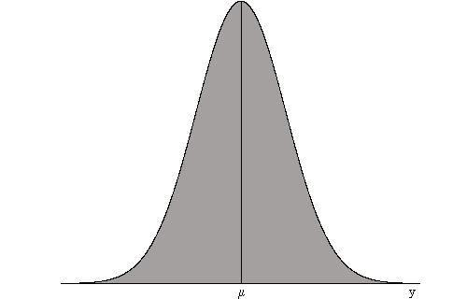
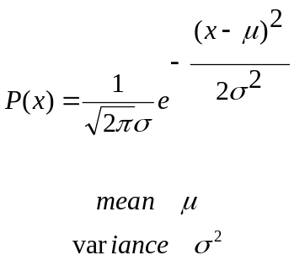
Gaussian PDF

Slide 5
Objective
Probabilistic Segmentation of MRI images.

Slide 6
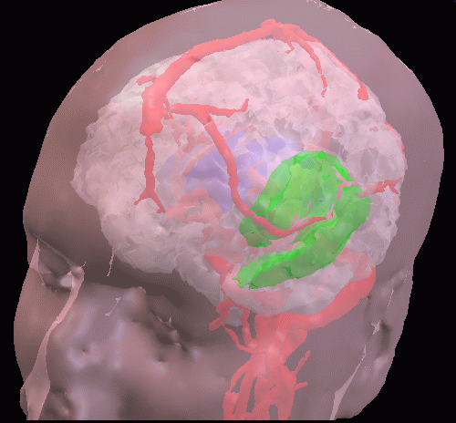
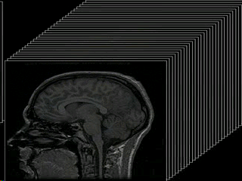
Objective
Probabilistic Segmentation of MRI images.

Slide 7
Today and Tomorrow
Lecture: Bayesian Segmentation of MRI
  Inputs and outputs
  Mechanics
Lab/Recitation: Implementation using Matlab.

Slide 8
Bayesian Segmentation of MRI: Inputs and Outputs

Slide 9
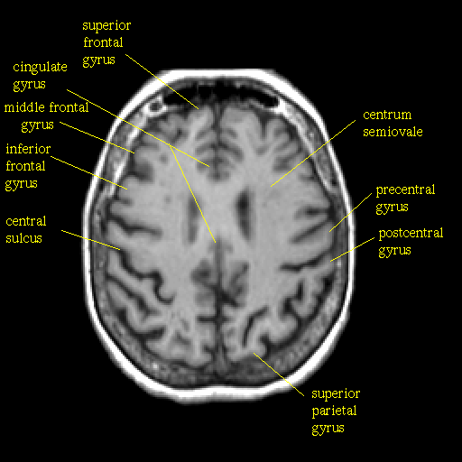
Bayesian Segmentation of MRI: Inputs and Outputs
Input: 256x256 MRI image

Slide 10
Bayesian Segmentation of MRI: Inputs and Outputs
Input: 256x256 MRI image
Given knowledge base
  # classes 3: WM (1), GM (2), CSF(3)
  Training data (manual segmentations)

Slide 11
Bayesian Segmentation of MRI: Inputs and Outputs
Input: 256x256 MRI image
Given knowledge base
  # classes 3: WM (1), GM (2), CSF(3)
  Training data (manual segmentations)
Output: segmented image with labels 1,2,3.

Slide 12
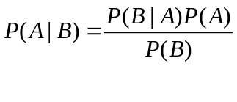
Bayes Rule for Segmentation

Slide 13
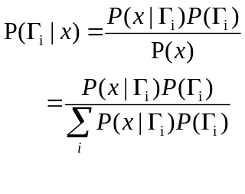
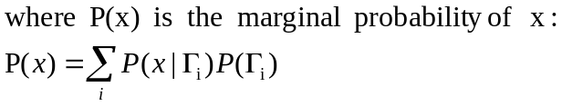
Bayes Rule for Segmentation
In MRI Segmentation:

Slide 14
Bayes Rule for Segmentation
In MRI Segmentation:
What is P(x|Γ)? P(Γ)? P(Γ| x)?

Slide 15
Bayesian Segmentation of MRI: Mechanics
Create class-conditional Gaussian density models from training data

Slide 16
Bayesian Segmentation of MRI: Mechanics
Create class-conditional Gaussian density models from training data
Use Uniform priors on the classes

Slide 17
Bayesian Segmentation of MRI: Mechanics
Create class-conditional Gaussian density models from training data
Use Uniform priors on the classes
Use Bayes rule to compute Posterior probabilities for each class

Slide 18
Bayesian Segmentation of MRI: Mechanics
Create class-conditional Gaussian density models from training data
Use Uniform priors on the classes
Use Bayes rule to compute Posterior probabilities for each class
Assign label of M-A-P class => segmentation

Slide 19
Recitation/Lab
Start MRI Segmentation Lab

