Slide 1
Applied Probability
Course Lecturer
Rajeev Surati Ph.D.
Tina Kapur Ph.D.

Slide 2
Agenda
Purpose of Course with Motivating Examples
Go Over Outline of course and Grading Policy
Algebra of Events and start on conditional Probability

Slide 3
Purpose of Course
Focus has been on solving Deterministic Computational Problems
This course is about how to deal with solving real world problems that involve uncertainty
4 motivating examples on why its worth studying

Slide 4
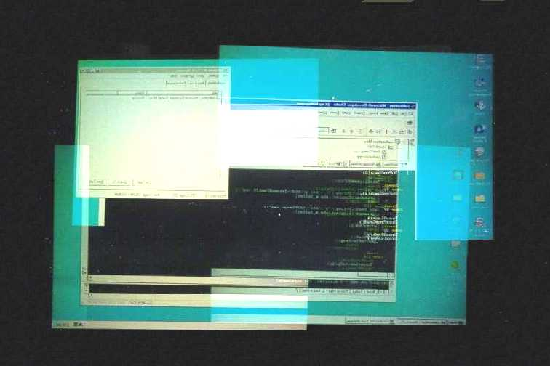
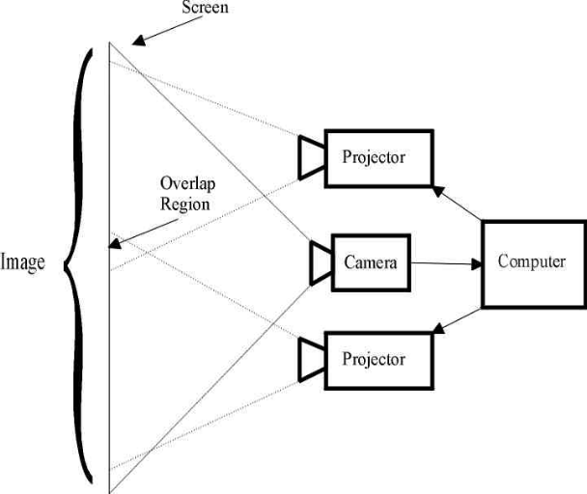

1st Example: Seamless Video Wall

Slide 5
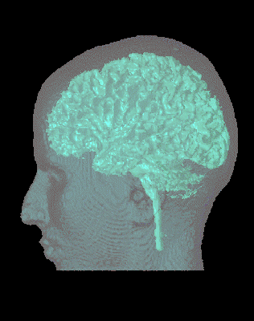
Brain Cancer Image Segmentation
Image segmentation based on probabilistic methods can be used in invasive surgery applications. Tina is an expert on this and has made some problem set to let you try your own hand at it.

Slide 6
Instant Messaging
What do you do when someone asks you to show that the system you have built is scalable and robust?
Network Modeling: Poisson Processes, Queueing Theory

Slide 7
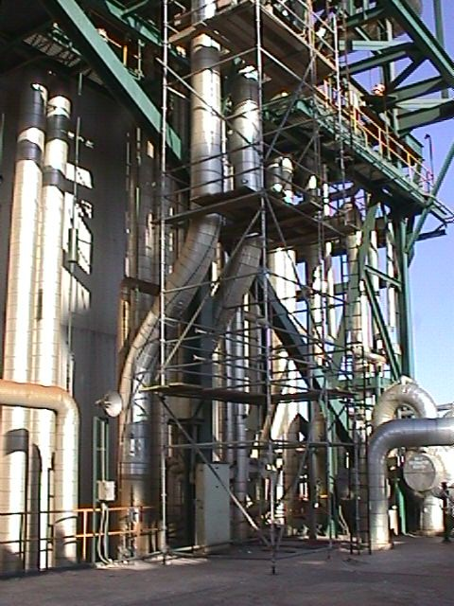
Power Plant Steam Pipe Failure

Slide 8
Course Info
Monday: Algebra of Events, Conditional Probabability
Tuesday: Conditional continued, Bayes Theorem
Thursday: Random Variables
Friday: Gaussian Random Variables
Monday: ML Estimation
Tuesday: MLE Segmentation
Wednesday: Exam
Thursday: Exam Results
Friday: Ravi Sundaram: Former Head of Mapping Group at Akamai

Slide 9
Grading
6 Problem Sets, 1 Final Exam
75% Problems Sets, 25% Exam

Slide 10
Algebra of Events
A
B
Events are collections of points or areas in a space.
C
The collection of all points in the entire space is called U , the universal set or the universal event.

Slide 11
Alebra of Events Continued
Event A’, the complement of event A, is the collection of all points in the universal set which are not included in event A. The null set φ contains no points and is the complement of the universal set.
A
A’
The intersection of two events A and B is the collection of all points which are contained both in A and B notated AB.
B
A

Slide 12
Algebra of Events continued…
The union of two events A and B is the collection of all points which are either in A or in B or in both. For the union of events A and b we shall use the notation A + B
A
B
Two events A and B are Equal if every point in U which is in A is also in B and every point of U not in A’ is alson in B’; rather A includes B and B includes A.

Slide 13
7 Axioms of Algebra of Events
A + B = B + A Commutative Law
A + (B + C) = (A + B) + C Associative Law
A(B+C) = AB + AC Distributive Law
(A’)’ = A
(AB)’ = A’ + B’ DeMorgan’s Law
AA’ = φ
AU = A

Slide 14
Some Derivable Relations
A + A = A
A + AB = A
A + A’B = A + B
A + A’ = U
A + U = U
A Φ = Φ

Slide 15
Mutually Exclusive and Collectively Exhaustive
B
A set of events are mutually exclusive if the set of events do not intersect
A
A set of events are collectively exhaustive if the sum up to U
e.g. A + B + C = U
C
A
B

Slide 16
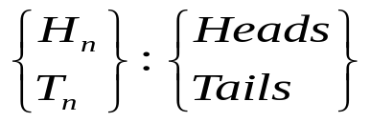





Sample Spaces
Sample Space:The finest-grain mutually exclusive, collectively exhaustive listing of all possible outcomes of a model of an experiment.
Sequential Sample Space
Event on the nth toss of the coin.
Is finest grain event type for two tosses
Is coarser grain event for two tosses

Slide 17
3 Axioms of Probability Measure
Measure of events in a sample space
For Any Event A, P(A) >= 0
P(U) = 1 (Normalization)
If AB = φ, then P(A+B) = P(A) + P(B)
From this and the prior Axioms one can determine the probability measure of an event by simply summing up all the measures for each of the finest grain events that the event consists of.

Slide 18
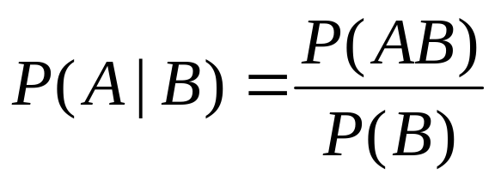
Conditional Probability; an intuitive Taste
A
B

