Slide 1
Applied Probability Lecture 2
Rajeev Surati

Slide 2
Agenda
Independence
Bayes Theorem
Introduction to Probability Mass Functions

Slide 3
Independence
Simply put P(A|B) = P(A)
This implies that P(AB)=P(A|B)P(B)=P(A) P(B)
Interpretation in Event space:
A
B

Slide 4

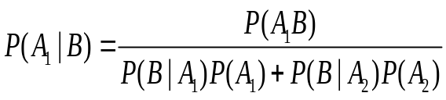






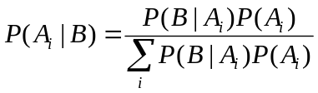

Bayes Theorem
Sample Space Interpretation
Generalized

Slide 5
Steroids(quick review)
Manufacturer says steroid test is 99% accurate(*). If news reports that an athlete tests positive, are we so certain that he/she is taking steroids
99% accurate if steroids are present, 15% false positives; finally assuming 10% of all athletes take steroids.

Slide 6
Monty Hall
Three doors(A,B,C) behind one is a krispy kreme doughnut
Rajeev selects say door A. Monty, who knows where the donut is, opens say door b which is empty(as he perpetrated) and offers to let Rajeev switch. What should Rajeev do.

Slide 7
Explanations
1 Probability behind P(A|He Knew )is 1/3, P(B|He knew) is 0 therefore P(C| He knew) = ??
Bayesian method
Take experiment to Limit

Slide 8

Random Variables
Before this we talked about “Probabilities” of events and sets of events where in many cases we hand selected the set of fine grain events that made up an event whose probability we were seeking. Now we move onto another more interesting way to group this point: using a function to ascribe values to every point in a sample space (discrete or continuous)
One example might be the number of heads r in 3 tosses of a coin.

Slide 9


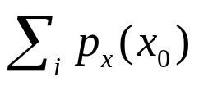

Probability Mass Function
probability that the experimental value of a random variable x obtained on a performance of the experiment is equal to
same story value of pmf. Can extend up to more dimensions which then allows for conditional pmfs

Slide 10
Expected Values
E(x) given a p.m.f. provides some sense of the center of mass of the pmf.
Variance is another measure that provides some mesure of the distribution of a pmf/pdf around its expected value.

