Slide 1
Applied Probability Lecture 3
Rajeev Surati

Slide 2
Agenda
Statistics
PMFs
  Conditional PMFs
  Examples
  More on Expectations
PDFs
  Introduction
  Cumalative Density Functions
  Expectations, variances

Slide 3
Statistics
If the number of citizens in a city goes up should the electric load go up?

Slide 4
Statistics
Statistically I can show that in Tucson Arizona the electric load goes up when the number of people goes down when people leave at the end of the winter
Does that mean that people leaving caused the rise?
The missing variable is temperature

Slide 5
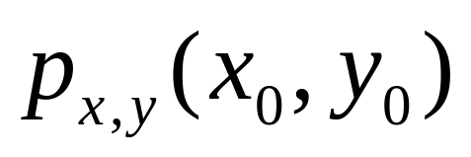
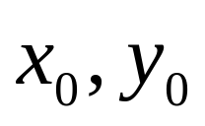
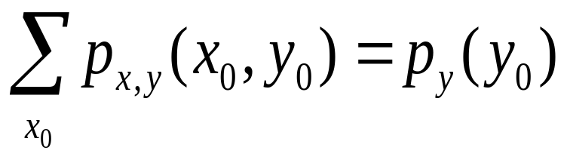
Probability Mass Functions
Consider which equals probability that the values of x,y are and is often called the compound p.m.f.
and vis a vis.

Slide 6
An example
Show the pmf for p(r,h) of three coin flips, where length of longest run r and # of heads h
Show that you can derive a distribution
Expected value and variance of r

Slide 7
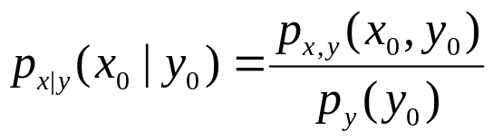

Conditional PMF
and independence
Implies for all x and y
Example: derive PMFs

Slide 8
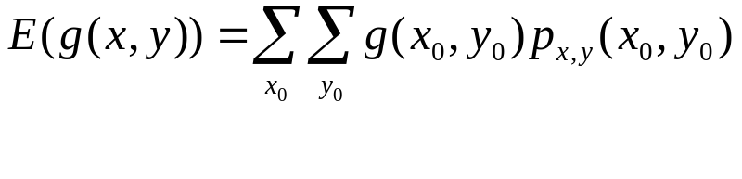
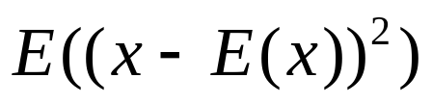
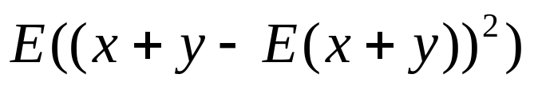
Expectations continued
Expectation of g(x,y)
Compute E(x+y)
Compute

Slide 9
One last PMF Example
Bernoulli Trial 1 if heads, 0 if tails
Compute expected value and variance
Compute expected value and variance of the sum of n such bernoulli trials

Slide 10
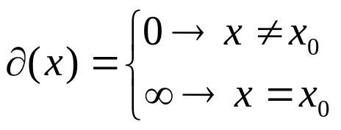
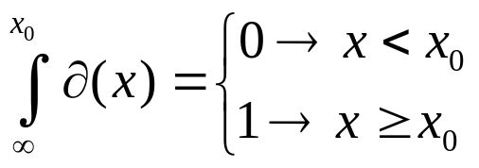
Probability Density Function
Here we are dealing with describing a set of points over a continuous range. Since the number of points is infinite we discuss densitiies rather than “masses” or rather PMFs are just PDFs with impulse functions at each discrete point in the PMF domain.

Slide 11
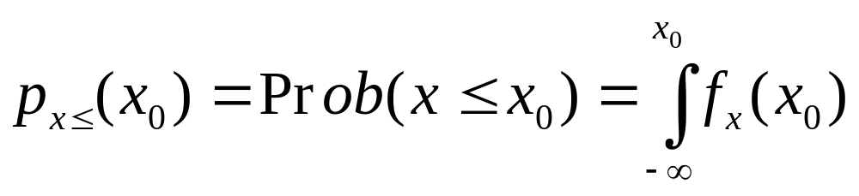
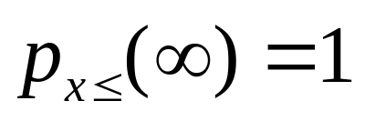
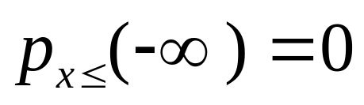
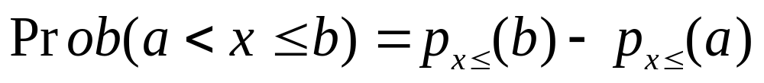
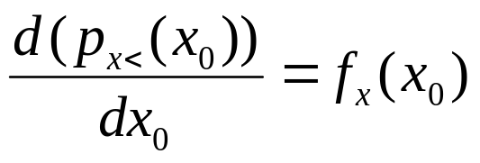
Same old set of rules except…

Slide 12
Some Example Events
X<= 2
1 <= x <= 10

Slide 13
An Example
Exponential pdf

