Slide 1
Applied Probability Lecture 4
Tina Kapur
tkapur@ai.mit.edu

Slide 2
Objective
Use Probability to create a software solution to a real-world problem.

Slide 3
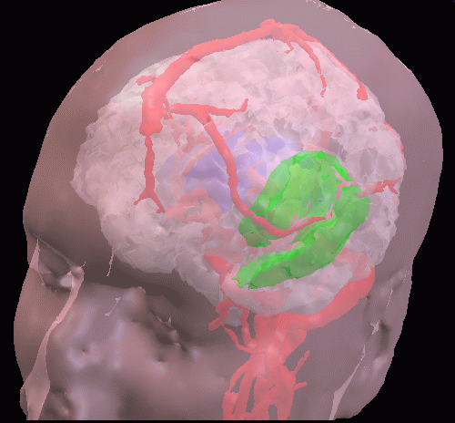
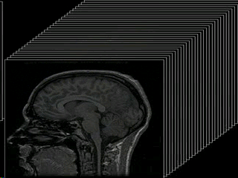
Objective
Use Probability to create a software solution to a real-world problem.

Slide 4
Timeline/Administrivia
Friday: vocabulary, Matlab
Monday: start medical segmentation project
Tuesday: complete project
Wednesday: 10am exam
Lecture: 10am-11am, Lab: 11am-12:30pm
Homework (matlab programs):
  PS 4: due 10am Monday
  PS 5: due 12:30pm Tuesday

Slide 5
Vocabulary
Random variable
Discrete vs. continuous random variable
PDF
Uniform PDF
Gaussian PDF
Bayes rule / Conditional probability
Marginal Probability

Slide 6
Random Variable

Slide 7
Random Variable
Function defined on the domain of an experiment

Slide 8
Example r.v.
Experiment: 2 coin tosses
  Sample space:
  Random variable:

Slide 9
Example r.v.
Experiment: 2 coin tosses
  Sample space: HH, HT, TT, TH
  Random variable: h number of heads in run

Slide 10
Discrete vs. Continuous R. V.

Slide 11
Discrete vs. Continuous R. V.
Domain

Slide 12
PDF

Slide 13
PDF
Function that associates probability values with events in sample space.

Slide 14
PDF
Function that associates probability values with events in sample space.
Two characteristics of a PDF:

Slide 15
PDF
Function that associates probability values with events in sample space.
Two characteristics of a PDF:
  Mean or Expected value
  Variance

Slide 16
Uniform PDF

Slide 17
Uniform PDF
p(x)
E(x) =
σ²(x) =
?
0
a
x

Slide 18
Gaussian PDF

Slide 19
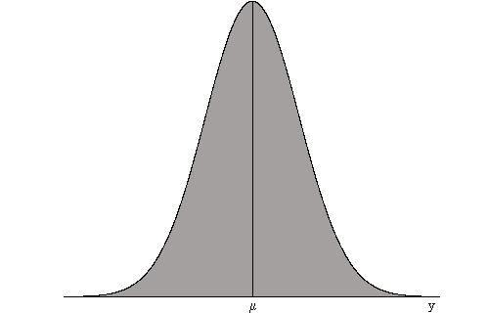
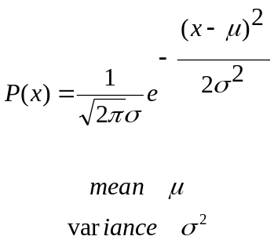
Gaussian PDF

Slide 20
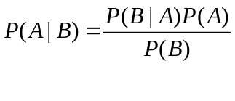


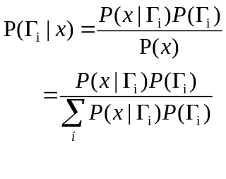
Bayes Rule Revisited

Slide 21
Recitation/Lab
Install Matlab
Start Problem Set 1

