Slide 1
CIS234a – t1 ranking System java application

Slide 2
Agenda
Stories Completed
Overview
Approach
Challenges / Lessons Learned

Slide 3
Stories Completed
N-item Sort
Foundation stories
Admin Set-up
User Taking Test
Elected Side Stories
Basic Result Reporting
Progress Meter
Custom Comparison with Images
User Tracking

Slide 4
Overview
Admin Test Setup
Add / Delete Existing Database Items (e.g. words or phrases)
Add / Remove Test Items
Associate New or Existing Database Images to Existing Items
Display Progress Meter During the User Test
View Test Results

Slide 5
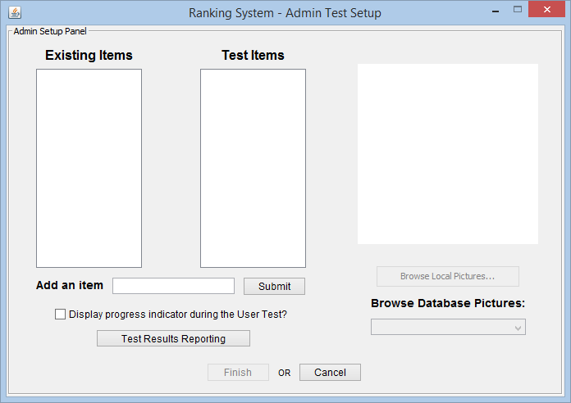
Overview

Slide 6
Approach

Slide 7
Challenges / Lessons Learned

Slide 8
Overview

