Slide 1
CIS234a – t1 ranking System java application

Slide 2
Overview
Completed Functionality
Functional Overview
Approach
Challenges / Lessons Learned

Slide 3
Completed Functionality
Base Functionality
Admin Set-up
User Taking Test
Side Stories
Basic Result Reporting
Progress Meter
Custom Comparison with Images
User Tracking

Slide 4
Functional Overview - Login
New user registration
Login by username
Username credentials determine access role

Slide 5
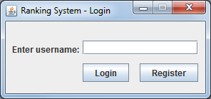
Overview – Login Screen

Slide 6
Functional Overview – Admin Test Setup
Manage Existing Database Items (e.g. words or phrases)
Manage Test Items
Associate Images to Existing Items
Display Progress Meter During the User Test
View Test Results

Slide 7
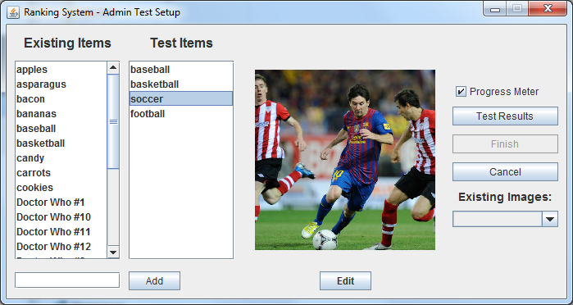
Overview – Admin Test Setup Screen

Slide 8
Functional Overview – User Take Test
Compare defined test in groups of two
Selected Left, Right, or Unsure
View Progress Meter During the User Test

Slide 9
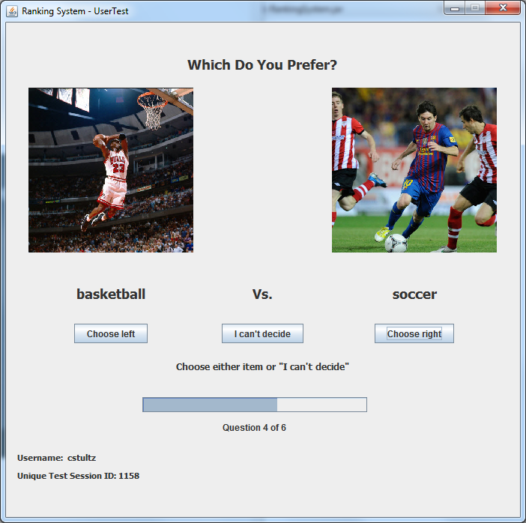
Overview User Test Screen

Slide 10
Functional Overview – Test Results Reporting
View results of users for data gathering
Select User, then TestID and Date, and View Results
View Progress Meter During the User Test

Slide 11
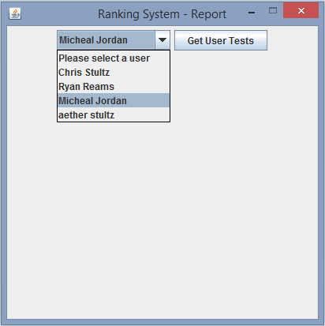
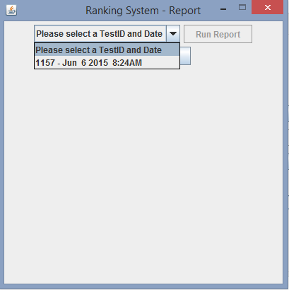
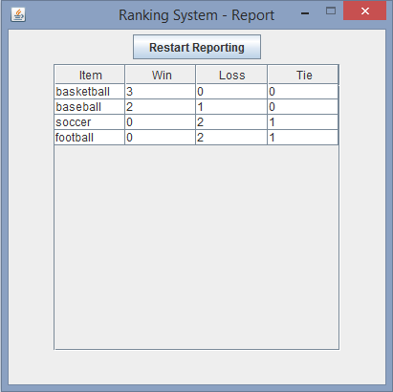
Overview – Test Results Reporting

Slide 12
Approach
Get familiar with the Eclipse IDE
Design the database
Setup the class models
Get familiar with the MVC design pattern
Divide up the stories in the sprint
Start coding

Slide 13
Challenges / Lessons Learned
Constant Check-ins
GitHub – Revision Control
Proper MVC coding
Eclipse IDE
Assumptions

