Slide 1
CIS234a – t1 ranking System java application

Slide 2
Agenda
Stories Completed
Approach
Overview
Challenges / Lessons Learned

Slide 3
Stories Completed
Foundation Stories
Admin Test Setup
User Test
Side Stories
User Tracking
Comparison With Images
Progress Meter
Test Results Reporting

Slide 4
Approach
Design The Database
Design The Classes
Divide Up The Work For The Sprint
Start Coding

Slide 5
Overview - Login
New User Registration
Login By Username
User Credentials Determine Access Role
Admin
User

Slide 6
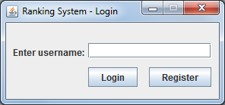
Overview - Login Screen

Slide 7
Overview - Admin Test Setup
Manage Existing Database Items (E.G. Words Or Phrases)
Associate Images To Existing Items
Manage Test Items
Toggle Progress Meter
View Completed Test Results

Slide 8
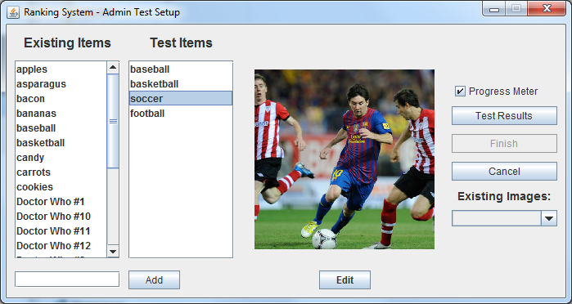
Overview - Admin Test Setup Screen

Slide 9
Overview - User Test
User Assigned A Unique Test Session ID
Compares Items In Groups Of Two
User Selects One, The Other, Or I Can’t Decide
Progress Meter Shown/Hidden

Slide 10
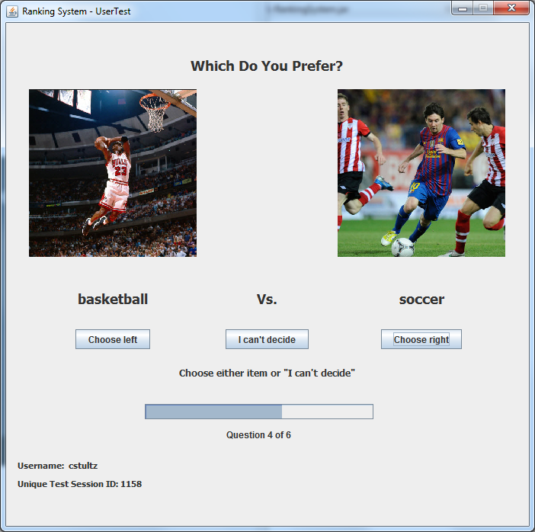
Overview - User Test Screen

Slide 11
Overview - Test Results Reporting
Found By User and Unique Test Session ID
Item Ranking Order
Win 1 Point
Loss -1 Point
Tie 0 Points

Slide 12
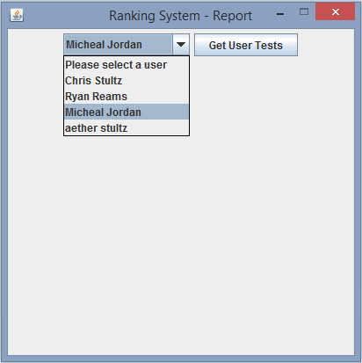
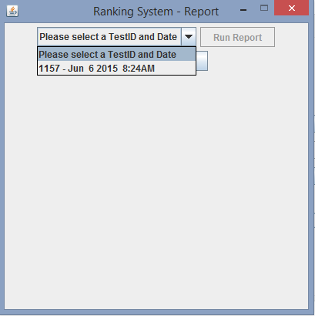
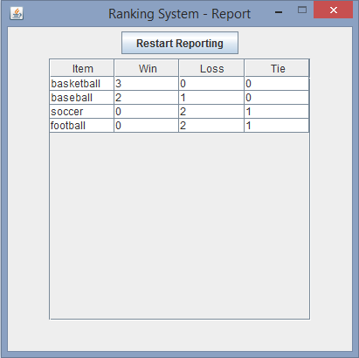
Overview - Test Results Reporting

Slide 13
Challenges / Lessons Learned
Constant Check-ins
GitHub – Revision Control
Proper MVC coding
Eclipse IDE
Assumptions

Slide 14
QUESTIONS?

