Slide 2
CIS234a – t1 ranking System java application

Slide 3
Agenda
Stories Completed
Approach
Overview
Demo
Lessons Learned

Slide 4
Stories Completed
Foundation Stories
Admin Test Setup
User Test
Side Stories
User Tracking
Comparison With Images
Progress Meter
Test Results Reporting

Slide 5
Approach
Design The Database
Design The Classes
Divide Up The Work For The Sprint
Start Coding

Slide 6
Overview - Login
New User Registration
Login By Username
User Credentials Determine Access Role
Admin
User

Slide 7
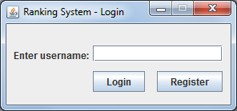
Overview - Login Screen

Slide 8
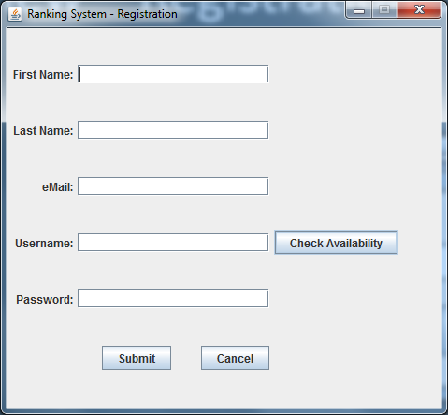
Overview – Registration Screen

Slide 9
Overview - Admin Test Setup
Manage Existing Database Items (E.G. Words Or Phrases)
Associate Images To Existing Items
Manage Test Items
Toggle Progress Meter
View Completed Test Results

Slide 10
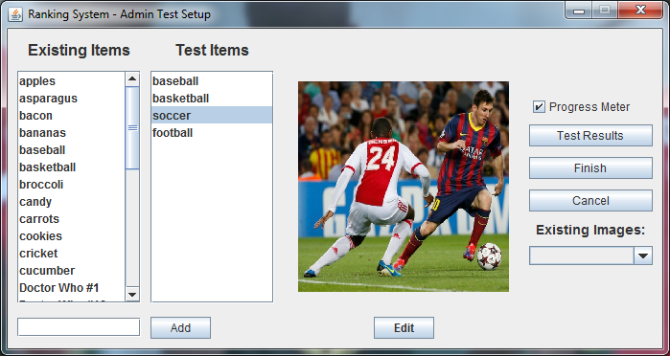
Overview - Admin Test Setup Screen

Slide 11
Overview - User Test
Assigns User A Unique Test Session ID
Compares Items In Groups Of Two
User Selects One, The Other, Or I Can’t Decide
Progress Meter Shown/Hidden

Slide 12
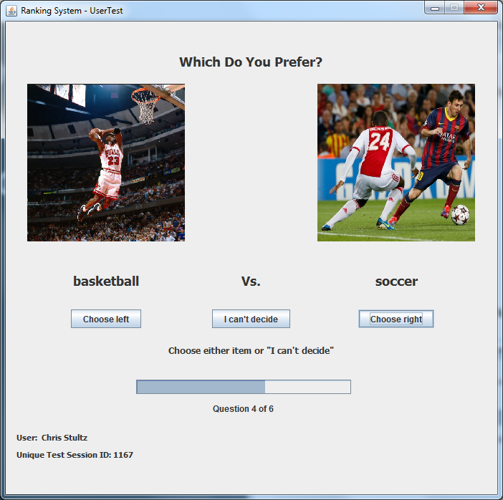
Overview - User Test Screen

Slide 13
Overview - Test Results Reporting
View results of users for data gathering
Select User, then Test ID and Date, and View Results
View Progress Meter During the User Test

Slide 14
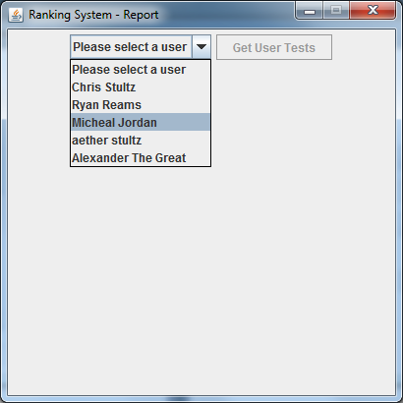
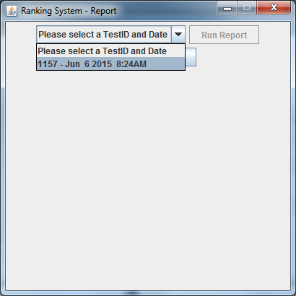
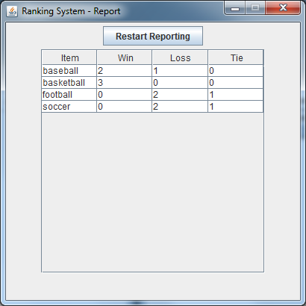
Overview - Test Results Reporting

Slide 15
Application Demo

Slide 16
Lessons Learned
Knowledge Sharing
Work Flow Interruption
Revision Control
Assumptions

Slide 17
QUESTIONS?

