Slide 1
CIS 234a – t1 Presentation
A technical review of Ranking System Java application

Slide 2
Presentation – What To Expect
Team Review
t1 Ranking System Review
Stories Completed
Implementation Overview
Implementation Approach
Software Demo
Ranking System Lessons Learned

Slide 3
Team Review
t1 Members
Chris Stultz
John Loranger
Ryan Reams
Josh Eads

Slide 4
Stories Completed
Selected Stories
Foundation Stories
N-item-sort – Admin Set-up
N-item-sort – User Taking Test
Additional Functionality
Progress Meter
Basic Result Reporting

Slide 5
Overview
What does it do?
Why was it written?

Slide 6
Overview
What does it do?
The Ranking system is a GUI Application
Lists of Questions
Question shows two items

Slide 7
Overview
Why was it written?
Set of 'Stories’
Story is a user scenario
Students choose stories

Slide 8
Overview
Administration Story
Creation of items to appear on test
User can see what items added thus far
User can add to items existing before app launch

Slide 9
Overview
Taking Test Story
Sequence of questions
Question: Choose between two items
Answers: Left, Right, Cannot Decide

Slide 10
Overview
Progress Meter
On the Taking Test Screen
Displays a progress bar graphic

Slide 11
Overview
Report View
In the admin login
Display basic reporting results from each user

Slide 12
Approach
Learn the software
Setup the repo
Setup the database diagram
Implement the database
Setup the class diagram
Implement the class diagram
Connect to the database

Slide 13
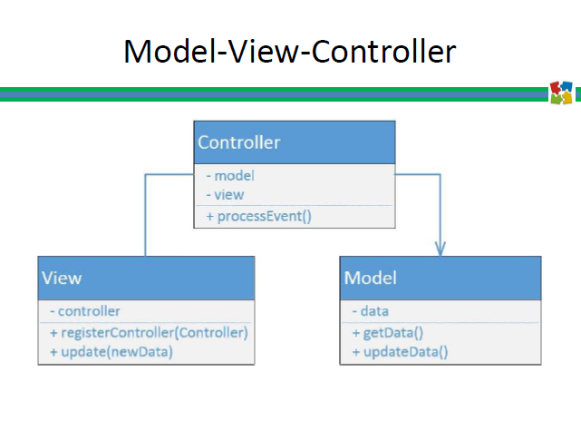
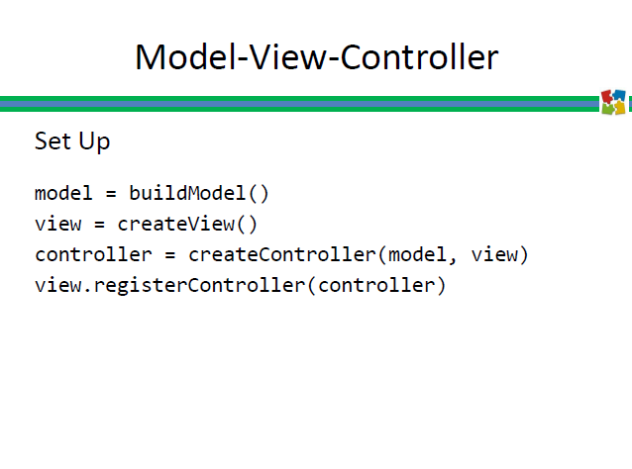
Approach

Slide 14
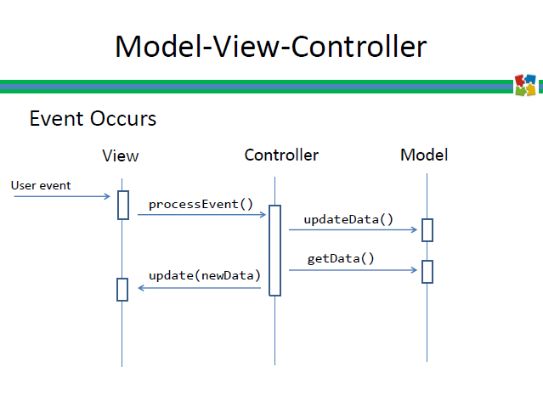
Approach

Slide 15
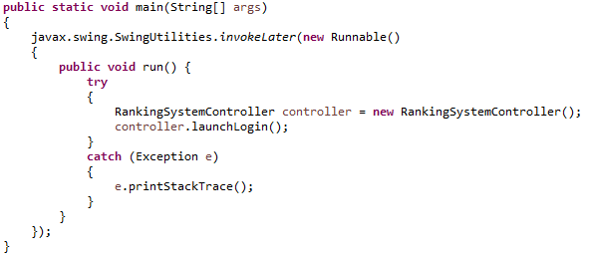
Approach
Main.java

Slide 16
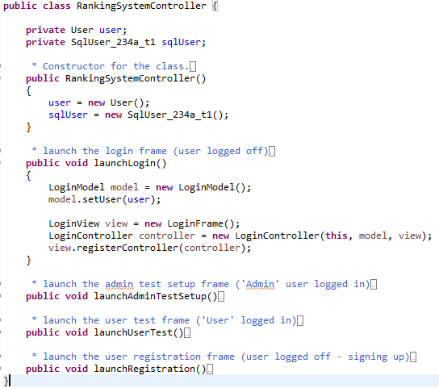
Approach
Parent – RankingSystemController

Slide 17
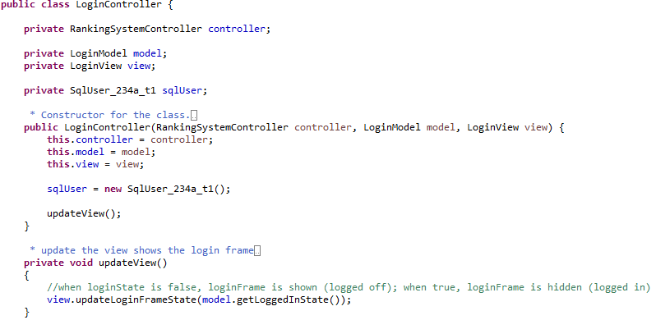
Approach
Child - LoginController

Slide 18
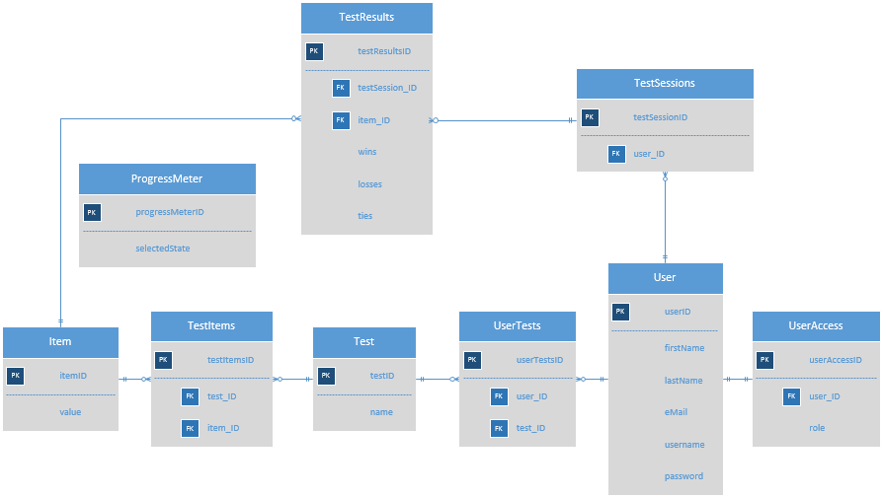
Approach
UML – Database Diagram

Slide 19
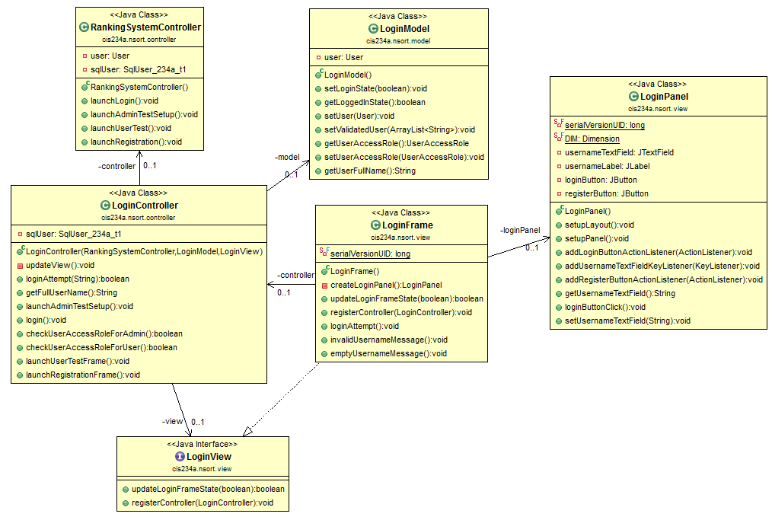
Approach
UML – Class Diagram

Slide 20
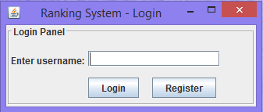
Software Demo

Slide 21
Lessons Learned
Constant Check-ins
GitHub – Revision Control
Proper MVC coding
Eclipse IDE
Assumption Making

Slide 22
Questions?

