Slide 1
Rosy's Wizards 465
Rose Ordway
CS-465-001: Multimodal Interaction for 3D User Interfaces

Slide 2
About the Project
The objective of this project is to create a VR spell-based casting system that utilizes gestures and controller inputs.
These control systems will be compared to determine which is the most effective and user-friendly.
Meta Quest 3 hand-tracking technology
Creating a engaging environment was high priority

Slide 3
Building The Prototype
Classroom Design
Spellcasting Effects
Dialogue and Narrative

Slide 4
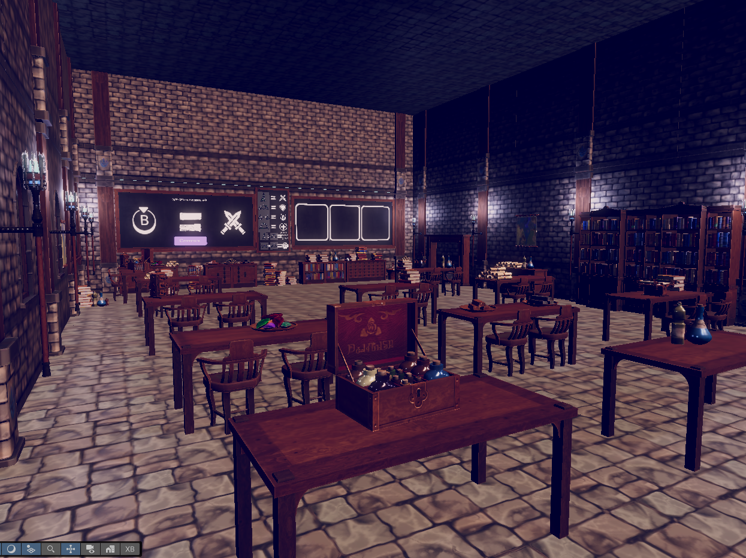
Classroom Design
Used assets from Dungeon Set - Wizard Laboratory by DuoDraconis
Iterated over a lot of ideas
Terrain?
Town

Slide 5
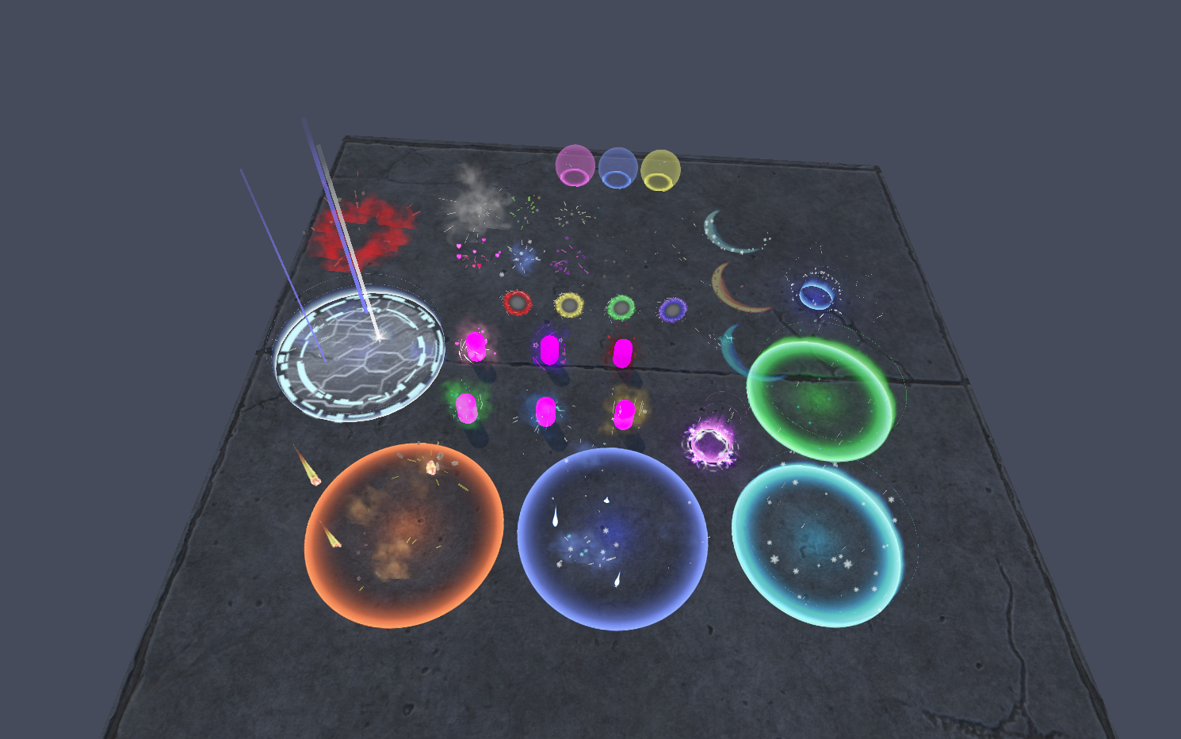
Creating Magical Effects
Used assets from Magic Effects FREE
– Hovl Studio

Slide 6
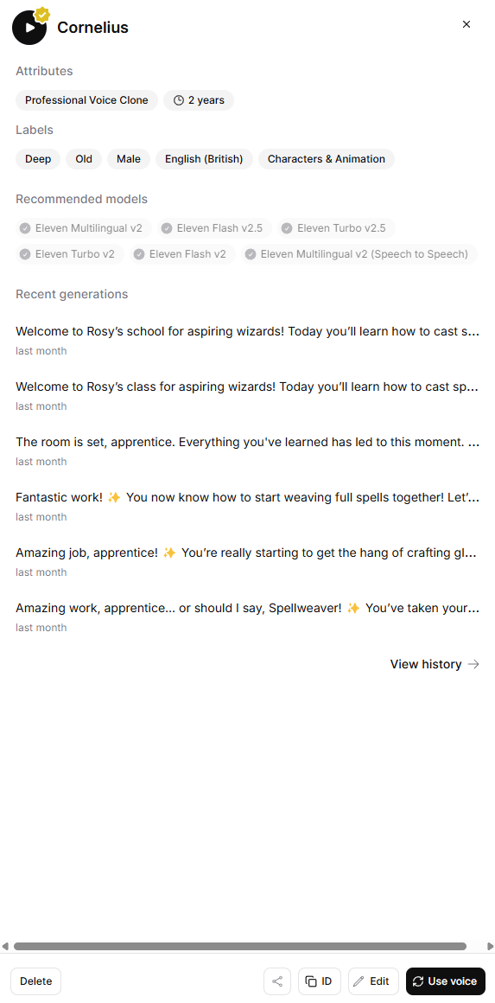
Dialogue and Narrative
Wrote the narrative myself
Voice was done using AI voice generation in elevenlabs.io

Slide 7






Basic Spell System
Four basic glyphs: 🛡️ Defense, ⚔️ Attack, ❤️ Healing, ✨ Buff
Two connector glyphs: ⛓️ Link, 🪢 Weave
Create glyphs using three gestures or inputs
Examples: A, B, A (controller), Peace, Rocker, Fist (gesture)

Slide 8
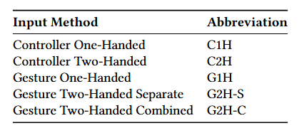
Systems Overview
The project uses multimodal interactions to cast spells

Slide 9
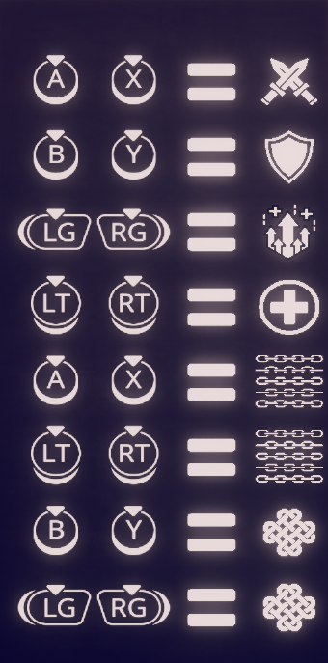
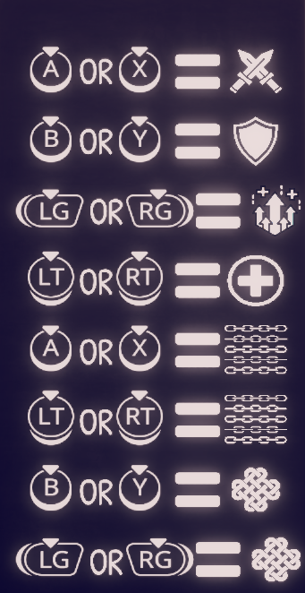
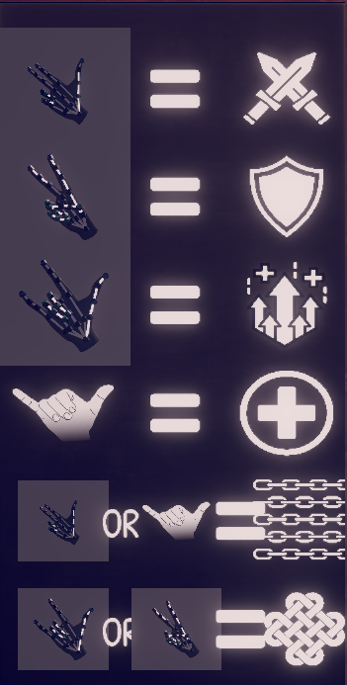
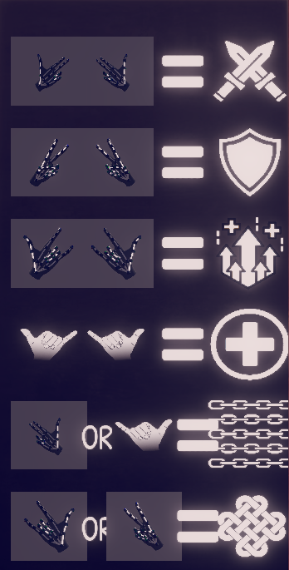
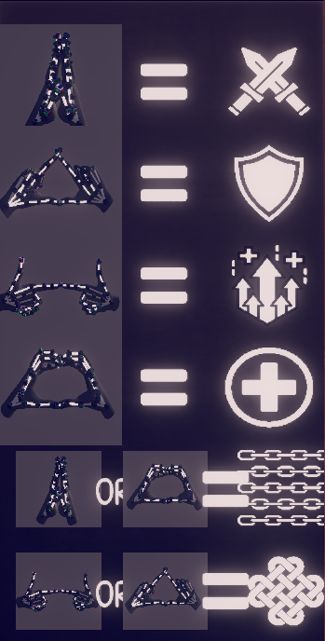
Control Types
Each control type has a different way of creating glyphs
The control schemes were shown to the user throughout their playthrough

Slide 10
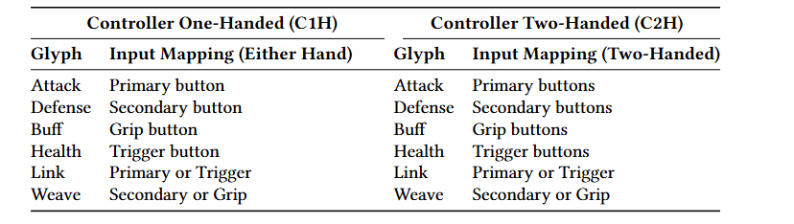
Controllers
Controllers uses the button inputs to create glyphs
C1H uses either hand to press the correct button for a glyph
C2H uses both hands to press the correct button on both controller

Slide 11
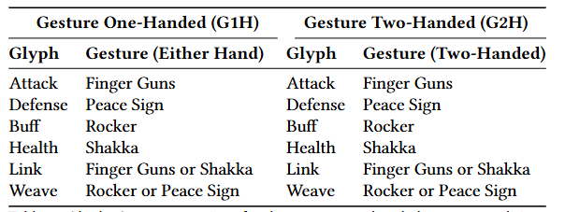
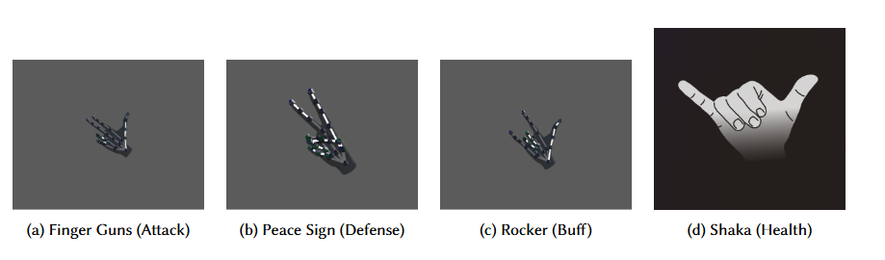
Gestures
G1H uses either hand to create a single gesture
G2H uses both hands to both doing the same gesture

Slide 12
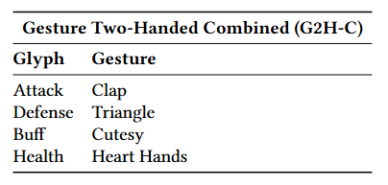
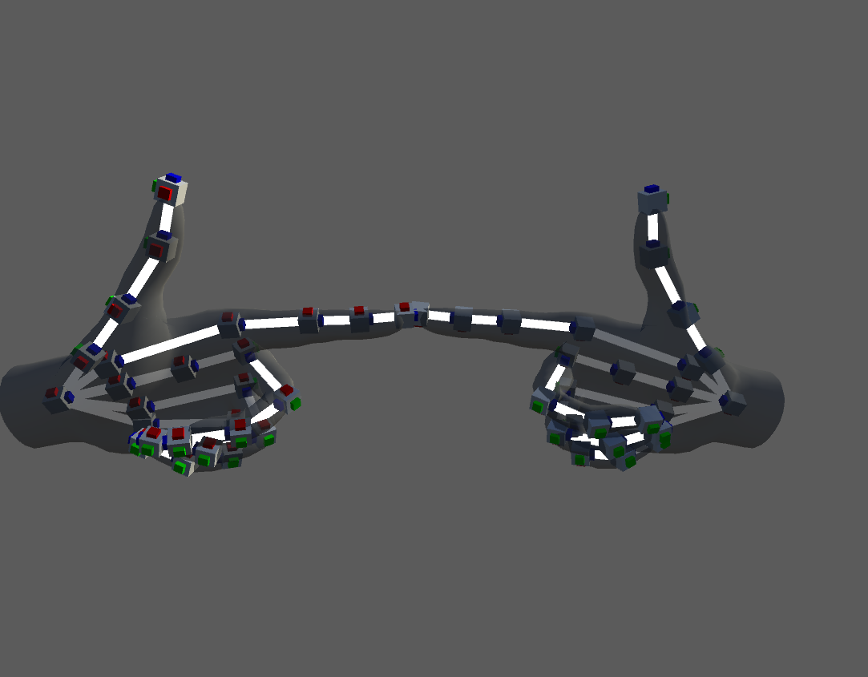
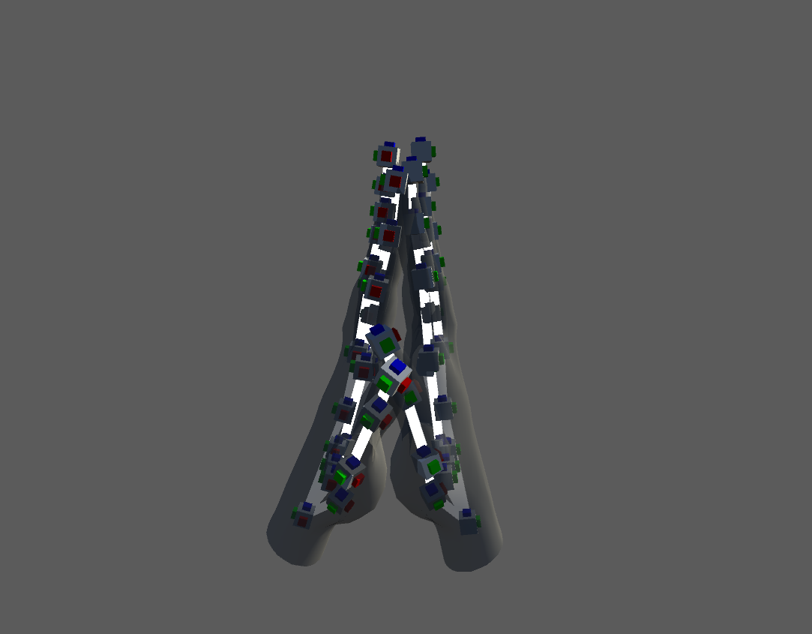
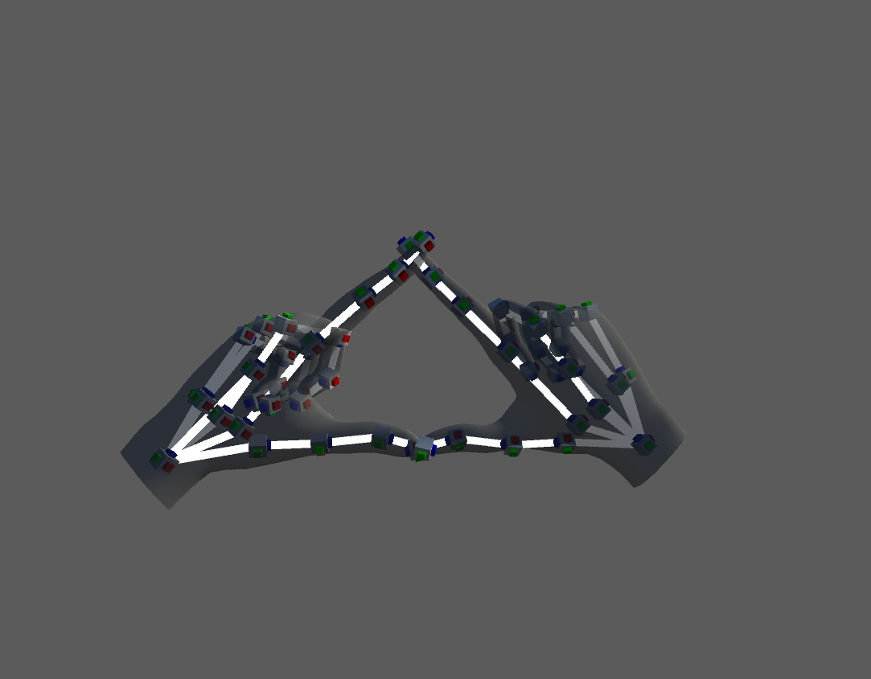
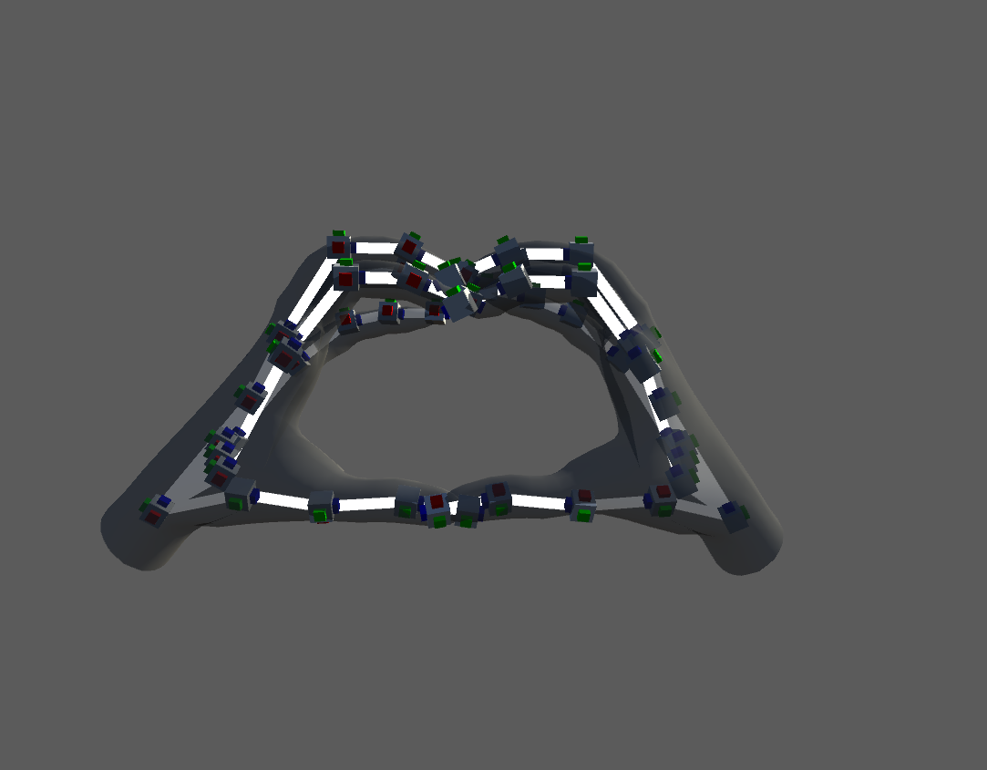
Combined Gestures
G2H-C uses both hands to create one symbol therefore creating a glyph

Slide 13
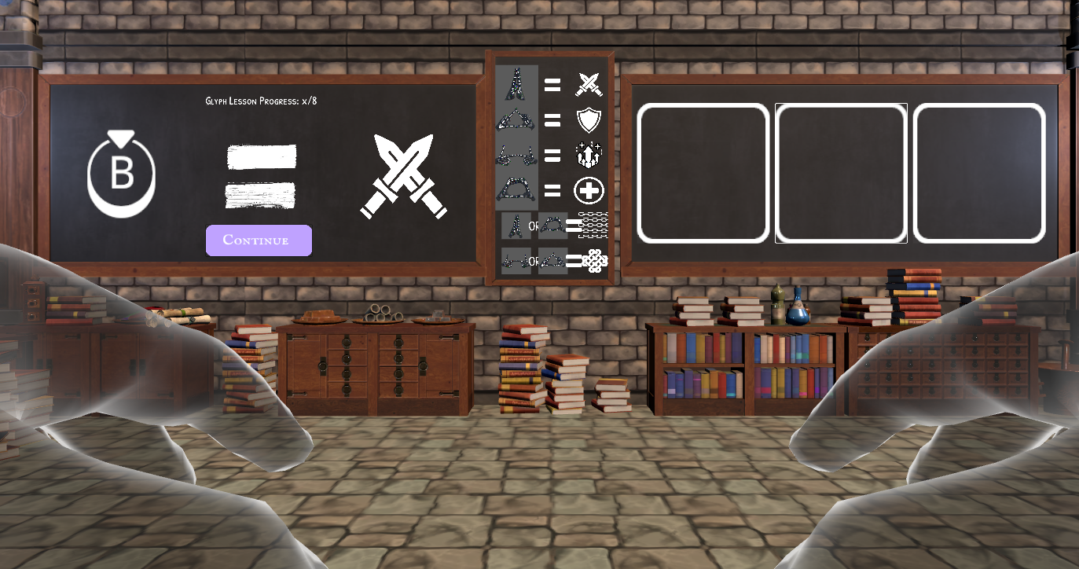
Gameplay Flow
In-game chalkboard layout
Left (Teacher Board)
Showing the target glyph sequence and progress indicator.
Center (Control Set Board)
listing the current glyph–input assignments.
Right (Student Board)
Where the user’s inputs appear with immediate green/red feedback.

Slide 14
Objectives & Lessons
Tutorial: learn which button or gesture produces each glyph
Glyph Lesson. Participants combine glyphs to form spells. 8 spells are needed to pass.
Spell Lesson. Participants cast 16 spells with real-time visual feedback (spell effects and environmental changes) to simulate the final trial

Slide 15
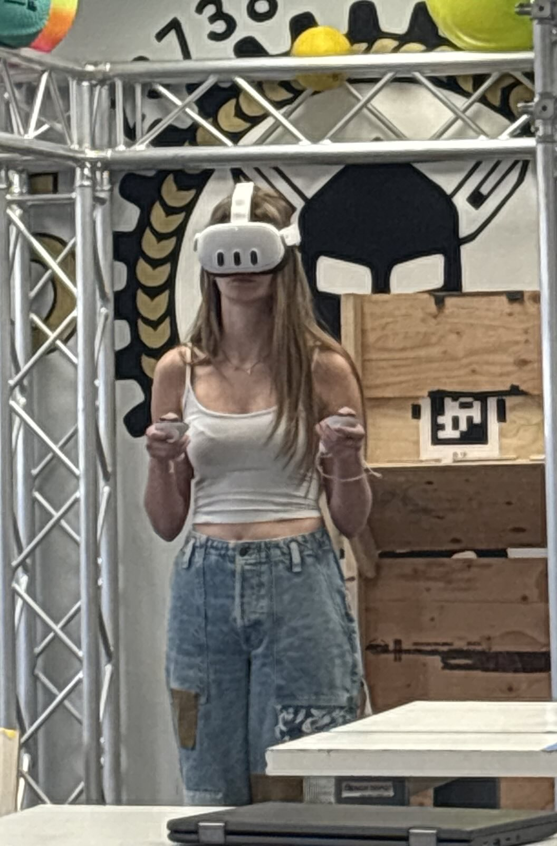
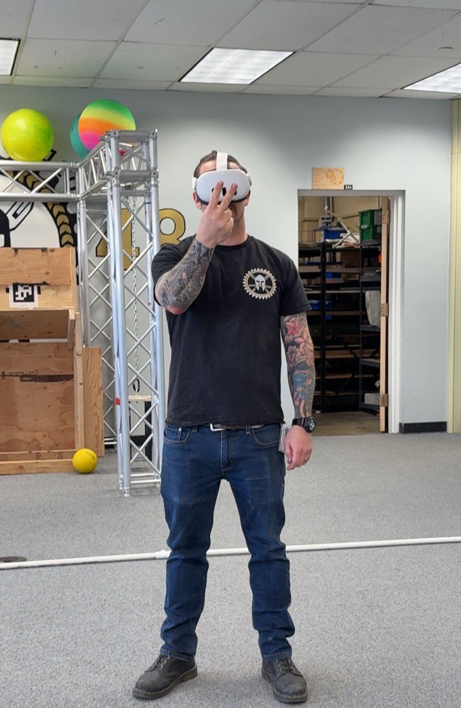
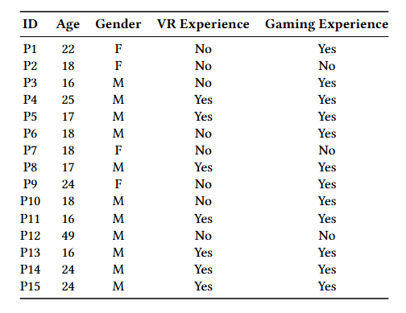
Experiment
15 participants
Ages 16 to 49
4 women and 11 men
M = 21.46,
Mdn = 18
Participants had varying degrees of experience with VR and gaming

Slide 16
Results
Measurements were taken for three different factors
Time
Average input time
Lesson completion time
Accuracy
User preference

Slide 17
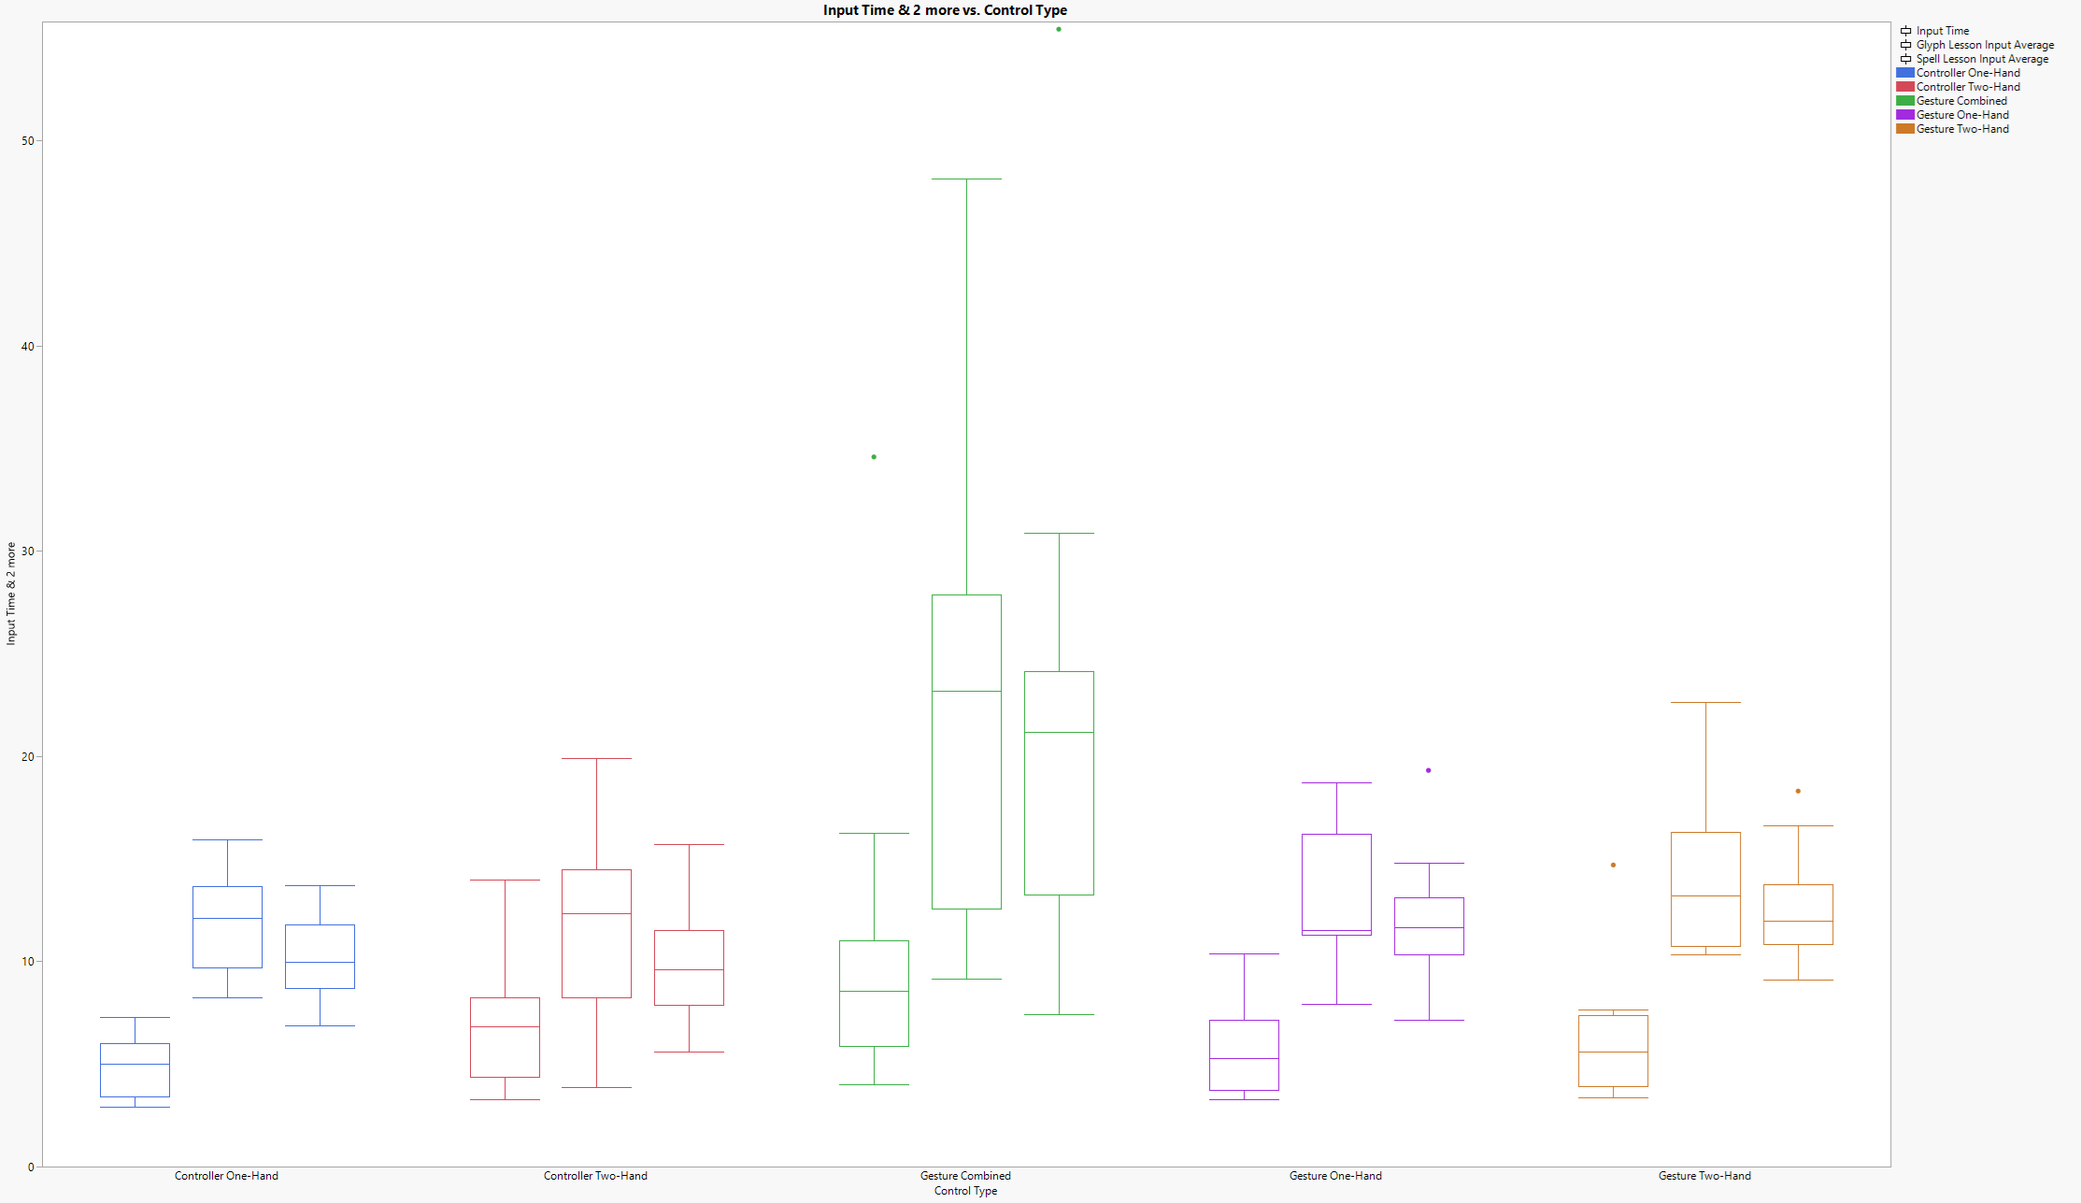
Average Input Time
Tutorial Input Average
Glyph Lesson Input Average
Spell Lesson Input Average
Slowest: Gesture Two-Handed Combined
Less Present in the Tutorial Lesson
All other control types are in the normal range of each other

Slide 18
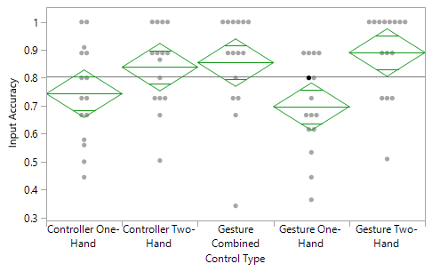
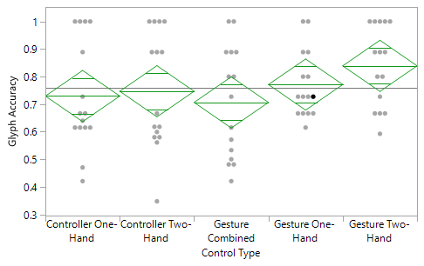
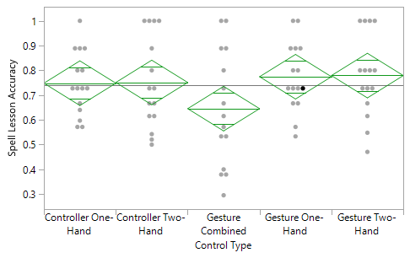
Accuracy
Tutorial Input Accuracy
Glyph Lesson Accuracy
Gesture One-Hand was significantly less accurate in the tutorial
During the other lessons, it became more accurate
Over spell and glyph lessons, gestures were slightly more accurate
Gesture Two-Hand Combined was accurate to learn, but hard to reproduce over the lessons.
Spell Lesson Input Accuracy

Slide 19
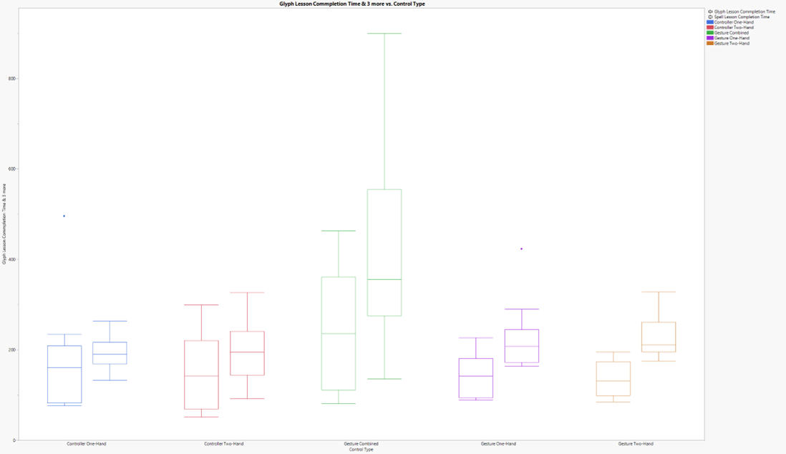
Completion Time
Glyph Lesson (Left)
Spell Lesson (Right)
Slowest: Gesture Two-Handed Combined
All other control types are in the normal range of each other
Lines up with the data found in Average Input Time

Slide 20
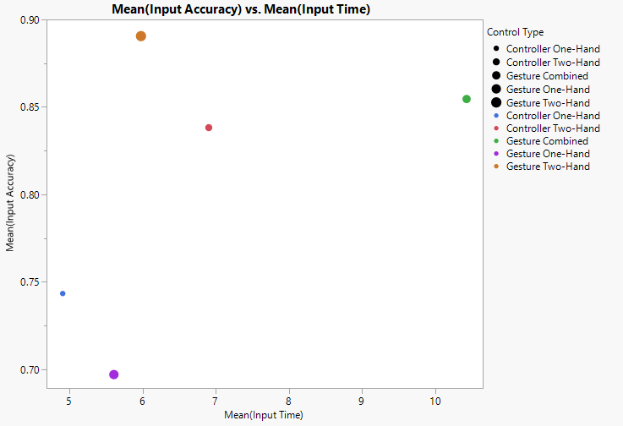
Accuracy vs. Input Time
Controller One-Hand (Blue)
Inaccurate
Very Fast
Controller Two-Hand (Red)
Slightly Accurate
Moderate Input Speed
Gesture One-Hand (Purple)
Very Inaccurate
Fast
Gesture Two-Hand (Orange)
Very Accurate
Fast
Gesture Combined (Green)
Accurate
Very Slow
Gesture Two-Hand was the most efficient, looking at accuracy vs time

Slide 21
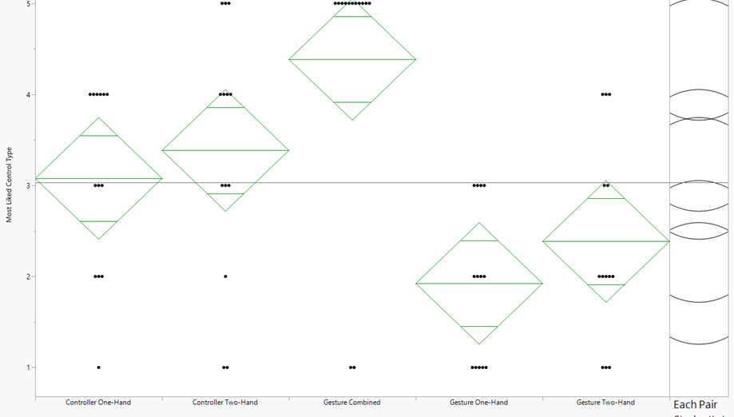
User Preference
Participants did not like G2H-C
Participants preferred gestures to controllers
Participants preferred one hand over two

Slide 22
Conclusions
Most Efficient Control Type
Gesture two-handed
Participant Preferred Control Type
Gesture one-handed
Less accurate than its two-handed counterpart
G2H-C was almost universally disliked

Slide 23
What I Learned
Better Utilize Unity
How multimodal devices change interaction with the experience
Coding and Project skills

