Slide 1
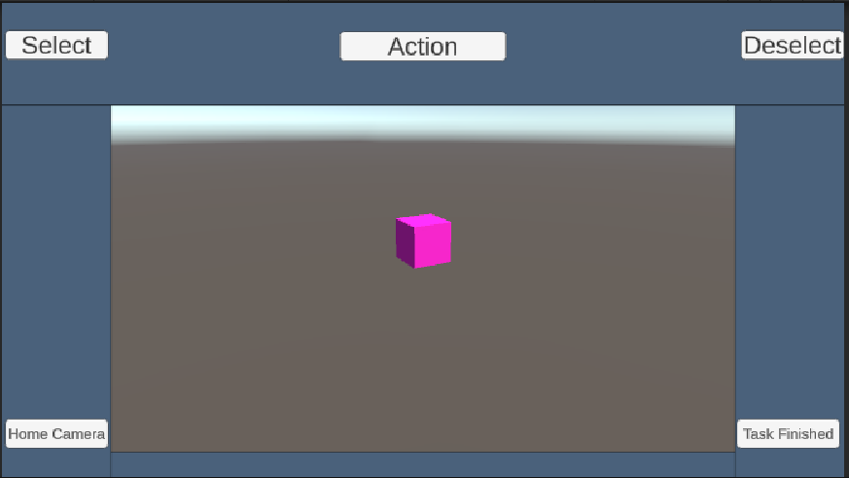
Task 1.1
Create a pink cube

Slide 2
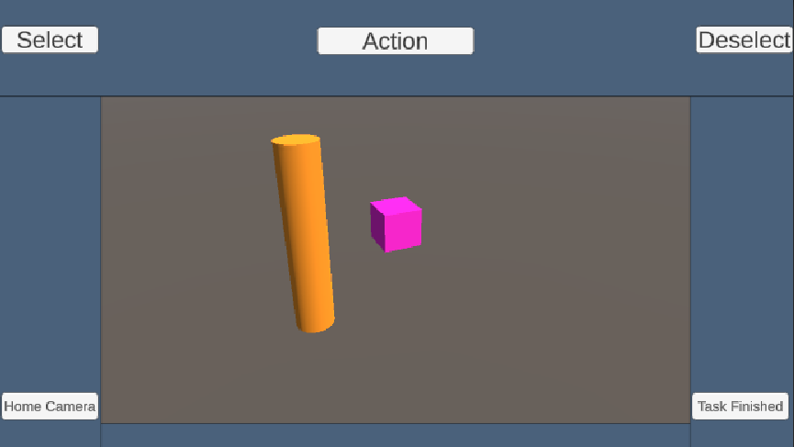
Task 1.2
Create a long, thin, orange cylinder.

Slide 3
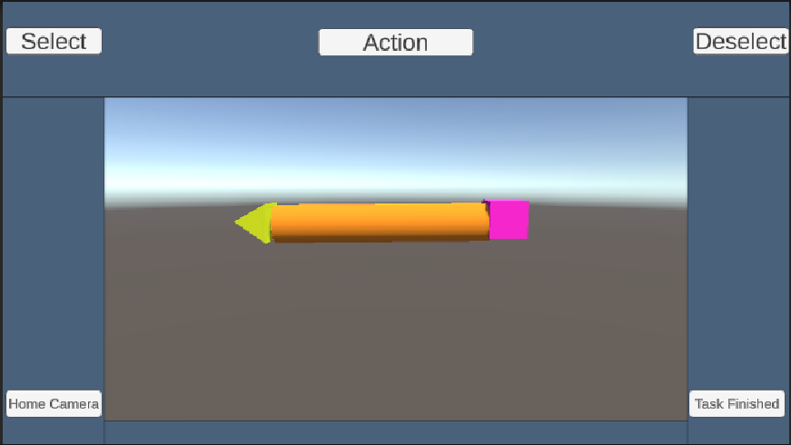
Task 1.3
Create a yellow pyramid and position all three objects to make the appearance of a pencil

Slide 4
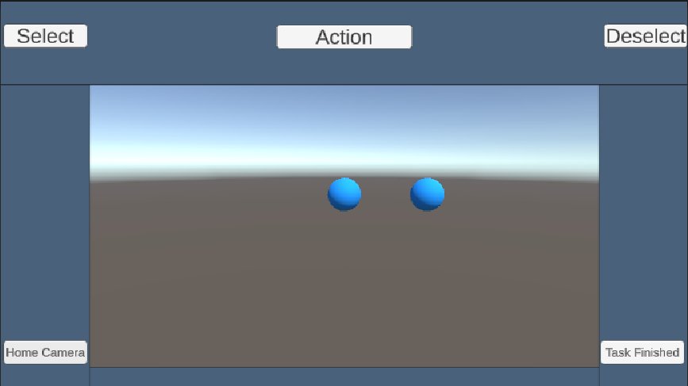
Task 2.1
Create two blue spheres that do not overlap or intersect

Slide 5
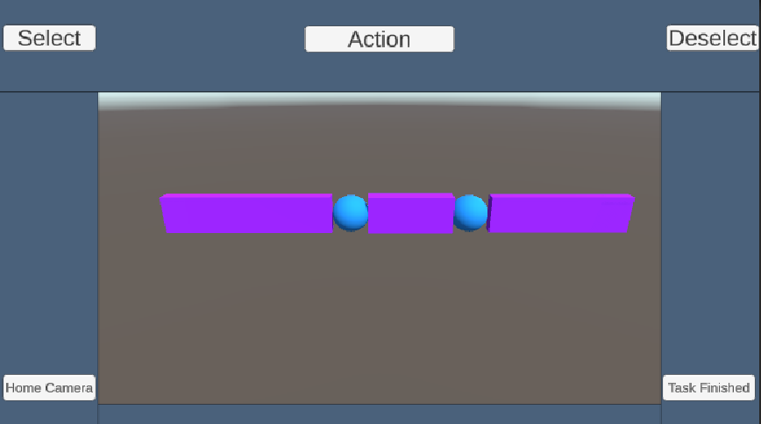
Task 2.2
Create three cubes, stretch them into long thin rectangular prisms, and color them purple, position them so the two spheres connect all shapes in a line.

Slide 6
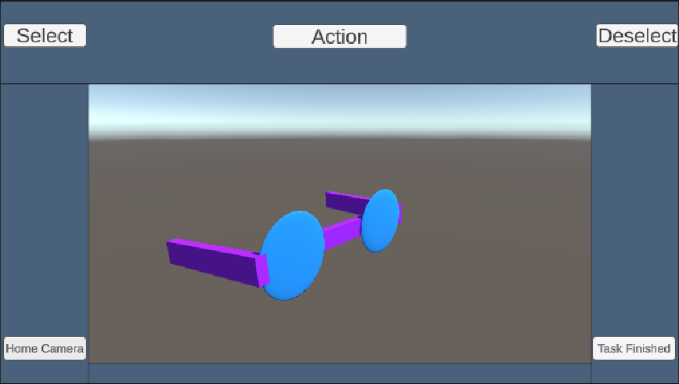
Task 2.3
Flatten the spheres and rotate the prisms to make the appearance of glasses. Shape may overlap some.

Slide 7
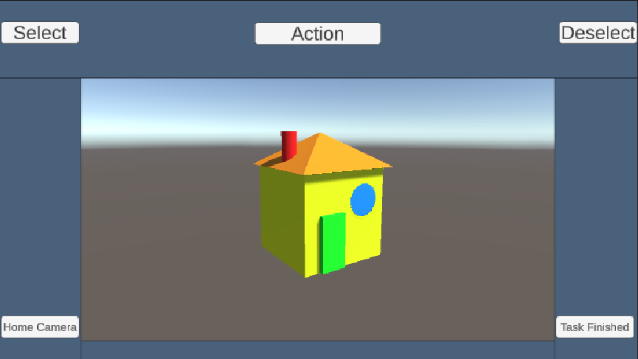
Task 3.1
Build a simple house with a roof, a chimney, a window, and a door. Each shape used must be a different color.

