Slide 1
Merging and aggregating data using SQL
Robin Donatello
2-19-19
Data Science Initiative Seminar Workshop

Slide 2
What is SQL, and how do you pronounce it?
SQL = Structured Query Language
Pronounced either “S”, “Q”, “L”, or “sequel”
Standard language for managing relational databases (RDBMS)
Often slightly different dialects
e.g. to select the first row (‘limit 1” vs “where rownum=1”)
Oracle, Postgres, SQL Server, MySQL, MS Access
Can be called in stand alone programs
MySQL, DB Browser for SQLite, SQLite3
Or used in many other programs
R (directly, or secretly via dplyr), Python, SAS
This presentation demonstrates SQL using R.

Slide 3
Why use SQL?
Data too large to fit on your computer
Centralized data repositories (data warehouse, data lake) for a whole organization
Efficient memory usage
Privacy/security - aggregate on the server and only download results
SQL is a declarative programming language (Go do this thing, but I don’t care how you actually go do it)

Slide 4
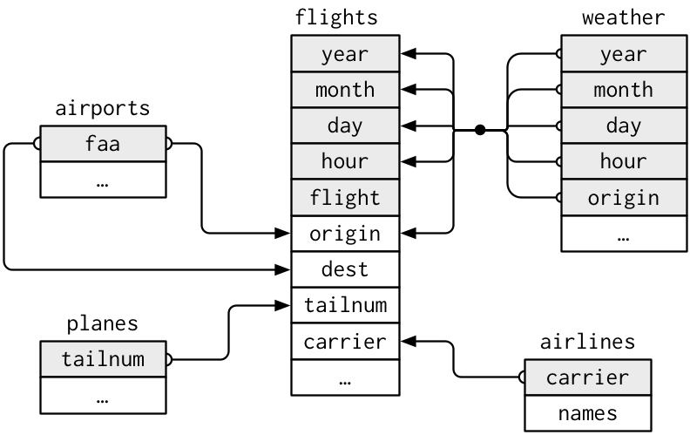
Relational Database Structure
Data on flights out of 3 airports in NYC during 2013
A collection of data tables, connected to each other by common variables, or keys.
Each table describes different unit of observation.
flights: day/time of flight, where it came from and went to, tail number of flight, carrier etc.
weather: hourly precipitation, wind speed & direction, visability, pressure, humidity...
airport: airport name, faa code, lat/long
planes: tailnumber, year, type, model, number of engines, number of seats, engine type..

Slide 5
Follow Along!
R studio cloud setup for you
http://bit.ly/dsi_cloud
Click “Intro_SQL” to make your own copy the project to in workspace
Packages:
nycflights13 (contains data)
sqldf

Slide 6


See data table characteristics without loading entire data set (R code).
dim(flights)
names(flights)
names(planes)
names(weather)

Slide 7
Querying Data using SQL Syntax
SELECT column1, column2....columnN FROM table_name WHERE CONDITION
GROUP BY column_name HAVING (arithmetic function condition);
A * is used as a wild card for column selection
Let’s look at executing these statements one at a time
Within R, we write SQL queries inside the sqldf() function.

Slide 8
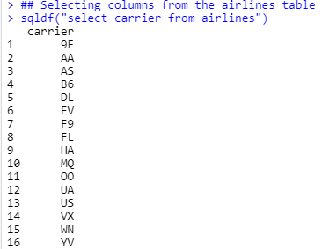
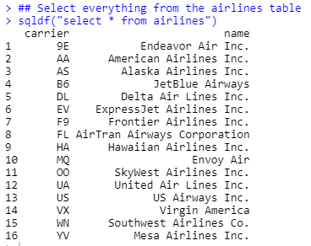

Selecting rows and columns

Slide 9
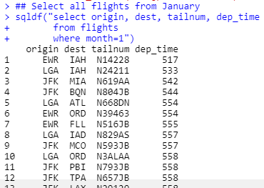
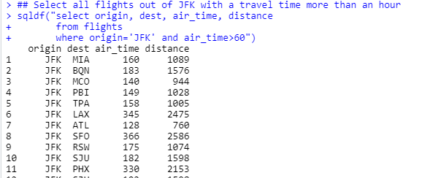
Subsetting data to only return some rows
The line breaks in the SQL code are stylistic, not syntax driven.
Easier to read.

Slide 10
Your turn: Exploring how bad travel delays are around the holidays
Write the SQL code to pick out the following variables from the flights data set, but only keep observations during the month of December: day, origin, dest, dep_delay, arr_delay, carrier.
Use the following R code to save this result as a new table called dec_flights.
dec_flights <- sqldf(“WRITE SQL CODE HERE“)

Slide 11
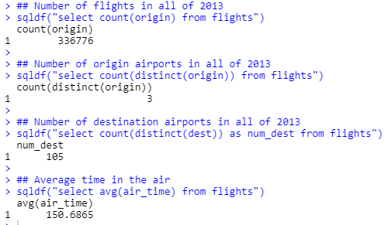
Generating summary values
Using the variable origin here was arbitrary since i’m counting all rows
Some dialects of SQL use unique instead of distinct.
Newly created variables can be saved with meaningful variable names
Finding the correct summary function (avg, not average, not mean) typically is a result of Googling (for me)

Slide 12
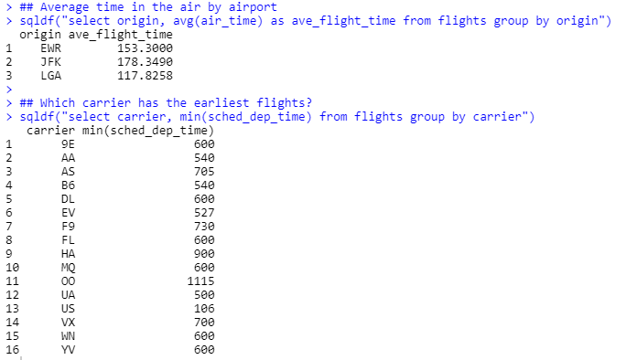
Grouped summary statistics
Don’t forget to specifically select the grouping variable name if you want to keep it attached to the resulting summary statistic

Slide 13
Your Turn: Holiday Travel Delays
Using the dec_flights table that you created a moment ago, calculate the average, and maximum daily departure delays. Save this as dec_delays.

Slide 14
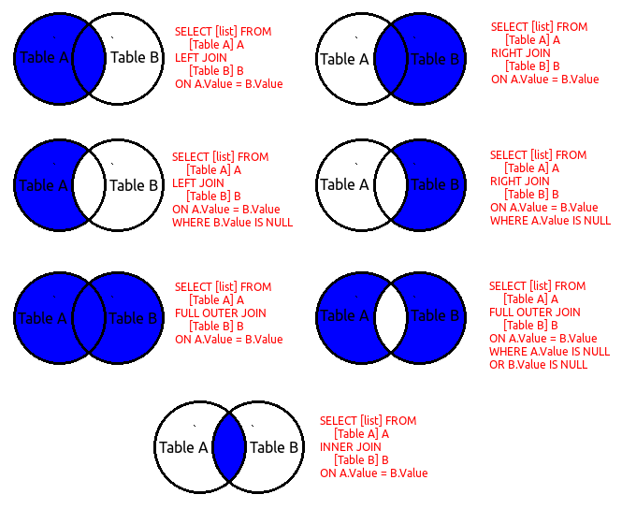
Joining Data from Multiple Tables
Blue shaded areas are the regions of interest that you want to KEEP
Tables to join must have the same key values, but they do NOT have to have the same variable name!
Select [list] from A inner join B on A.ID=B.Subj_ID
Note of caution on mixing inner and outer joins https://weblogs.sqlteam.com/jeffs/2007/10/11/mixing-inner-outer-joins-sql/
Full join is the same as full outer join

Slide 15
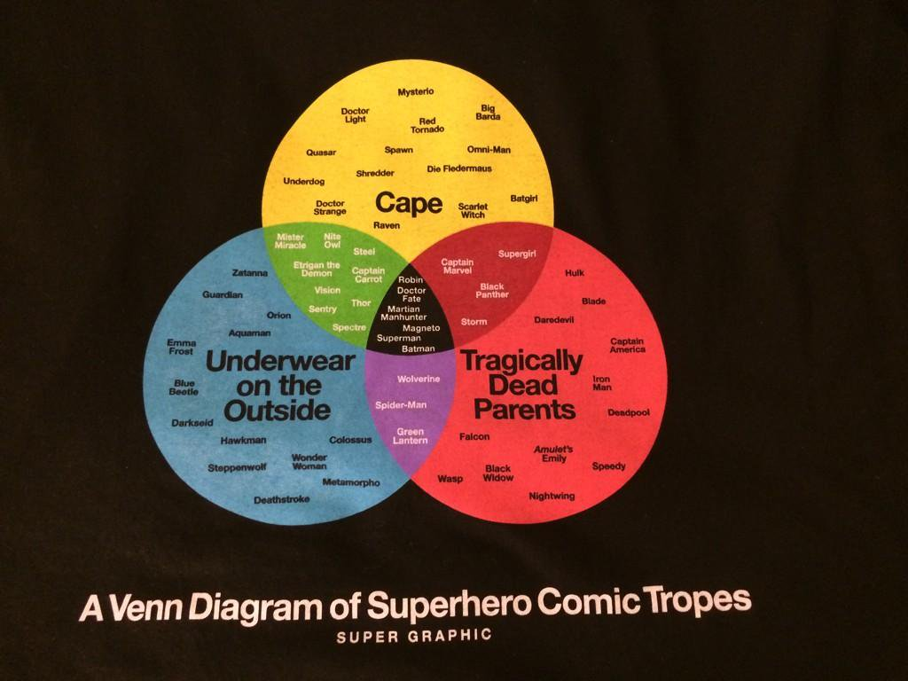
Superhero Venn
Diagrams
Each circle is a table
Each superhero is a row in the table
Bold font is the key characteristic (and table name)
What would the result be of and inner join between underwear on outside and a cape? (select * from underwear inner join cape)
What about a left join of tragically dead parents onto cape? (select * from tragic left join cape)
Notes:
So this is what it’s like when worlds collide…. https://twitter.com/maro254/status/492935405272985600
I need this shirt.

Slide 16
Keys
Variables used to connect a pair of tables are called keys.
A Key is a variable that uniquely identifies an observation.
What is the key for the planes table? For weather?
How would you connect the planes table to the weather weather? (Hint: You have to use a third table)

Slide 17

Joining data on the plane, to the flights table
Tail numbers are used to uniquely identify aircraft.
The variable tailnum is the key to link the planes table, and the flights table.

Slide 18
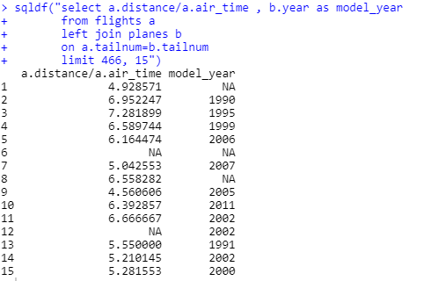
Are newer planes faster?
Join the year the plane was made to the flight
1:many join as there is only 1 plane per row in the planes data set, but the same plane (tailnum) shows up many times in the flights data set.
Dynamically creating a new variable speed as distance/air_time
Just showing 15 rows starting at line 466 to demonstrate what happens when there are no matches.

Slide 19
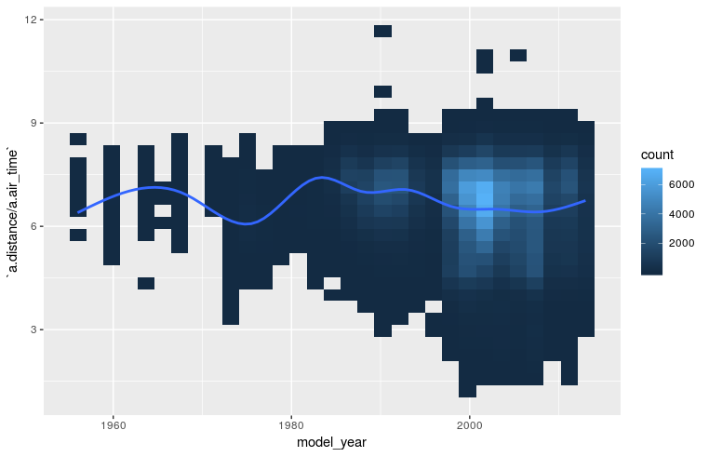
Are newer planes faster? Not really
Note: Had to use stat_bin2d here because there are 336,776 observations in this data set, which results in a very pixel-dense plot.

Slide 20
Your Turn: Travel delays due to weather?
Calculate the average daily precipitation from the weather data set, and left_join it onto the dec_delays data set on date.
Create a plot to see if precipitation is correlated with departure delays.

Slide 21
Ready to learn more?
https://www.w3schools.com/sql/default.asp
https://github.com/ggrothendieck/sqldf
https://www.tutorialspoint.com/sql/sql-quick-guide.htm
http://jasdumas.com/tech-short-papers/sqldf_tutorial.html
http://swcarpentry.github.io/sql-novice-survey/

