Slide 1


P2
Dream Team
Simon Nardos, Mike Popesh, Colin Kitten, Darien Cupit, and Adan Soto

Slide 2
Agenda
Introduction
User Stories and Epics
Game Logic/Board/Setup
Decisions and Scrum Ceremonies
Game Demo

Slide 3
User Stories
The Platform will Enforce the Rules of the Game (User Story 11)
(A) List Rules of the Game
(B) Validate Moves Before Execution
(C) Each Move Checks for Goal (Winning) State
(D) Switch Turns After Each Move
Users can Create a Game (User Story 5)
(A) I want a playable Game
(B) Game should run locally
(C) Can play against another player

Slide 4
Acceptance Criteria
As a user I want the platform to Enforce the Rules of the Game
Game rules are clearly stated and easily accessible
No invalid move will be executed by default
For win conditions the user is clearly notified and the game is over
No user is allowed to make more than 1 move before the opponent does
As a user I want to be able to create a game
Ability to launch a game
Game can be played by 2 players locally
Game can be played to completion

Slide 5
Epics Related to Stories
Game Logic Implementation (User Story 11)
Game Board Implementation (User Story 5)
Game Setup (User Story 11)

Slide 6
Game Logic Implementation Tasks
Piece validation
Move validation
Win Condition validation
Update board after move

Slide 7
Game Board Implementation Tasks
Setup ClientGame class
Game Board UI
Make Game Board Interactive

Slide 8
Game Setup Tasks
Create Server Skeleton Code
Create Client Skeleton Code
Developer Notes for setting up Project in Eclipse
Server Implementation

Slide 9
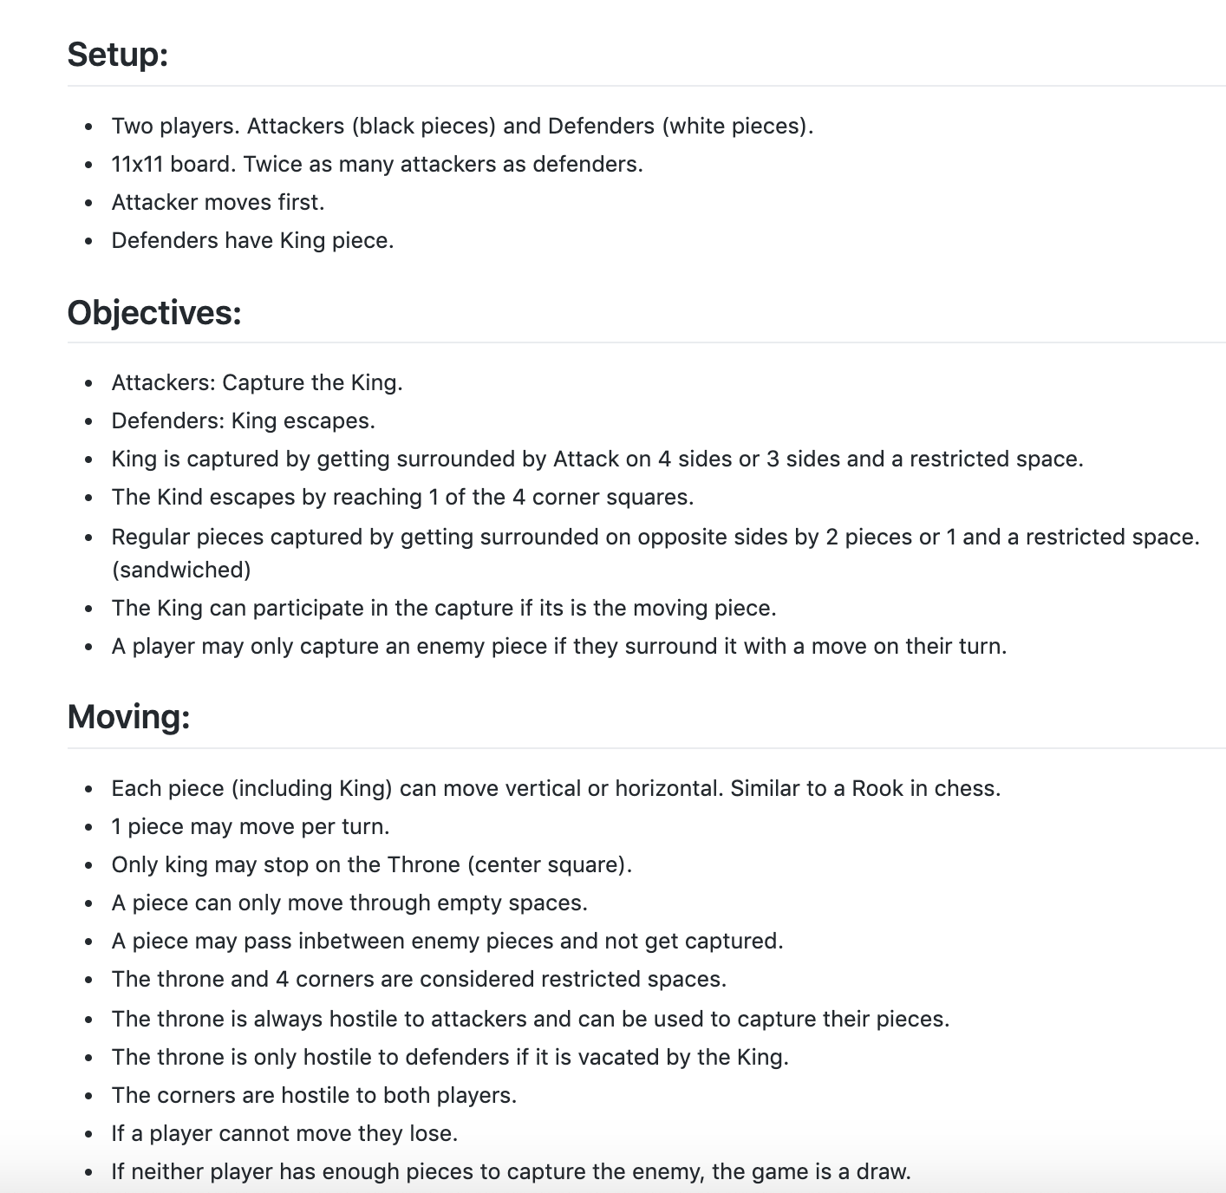

Slide 10
Process/Product Decisions Made
Focused mainly on the client code
Game runs locally
Imported JavaSwing for the GUIs
JUnit Tests

Slide 11
Scrum Ceremonies
-10/14: Problems setting up Maven
-10/16: Light Meeting with A2 looming
-10/23: Started working on powerpoint and modifying diagram
-10/28: Discussed changes to code and meeting time to practice presentation
-10/30: Practice presentation run through
-10/1: Sprint 1 review, initial Planning
-10/2: PO Meeting, Tasks definition and breakdown
-10/7: Code Setup JUnit Setup
-10/9: Problems creating java class in project discussed

Slide 12
Updated UML Diagram
Next Slide

Slide 13
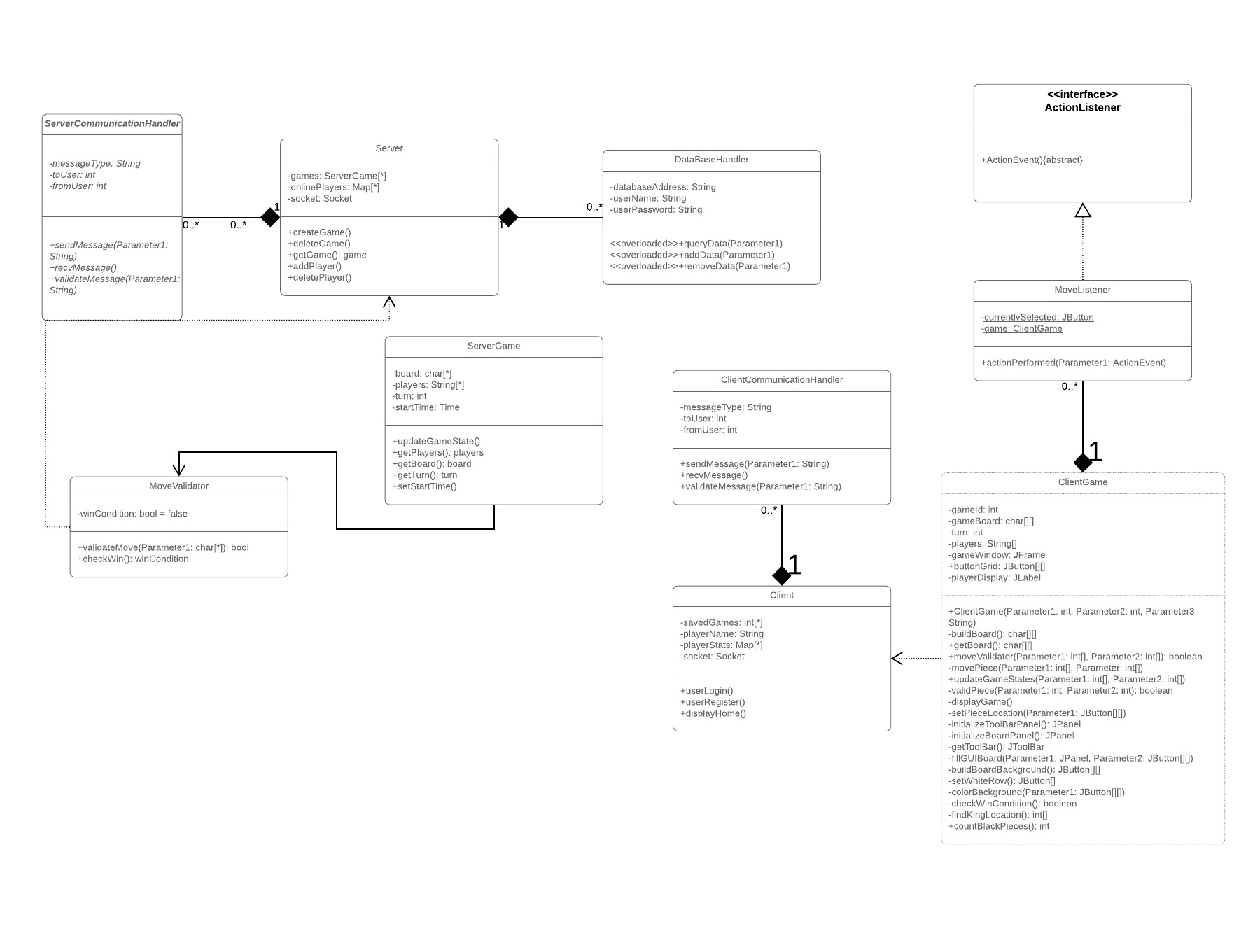

Slide 14
Retrospective
What went well?
Team problem solving/working together
Task Estimates (time required) were accurate
What could be improved?
More work assigned at beginning of sprint
Leave more time for testing at end of the sprint
Create finer-grained tasks

Slide 15
Retrospective Continued
What will we improve for next sprint?
Spend more time on task planning/creation
Achieve consistent task completion rate throughout the sprint
Continuous Integration (Travis C.I. & Code Climate)

