Slide 1


970 Dream Team
P3
Simon Nardos, Mike Popesh, Colin Kitten, Darien Cupit, and Adan Soto

Slide 2
Agenda
Introduction
Game Description
Project Development
Design Decisions
Design Patterns
Game Demo
Lessons Learned

Slide 3
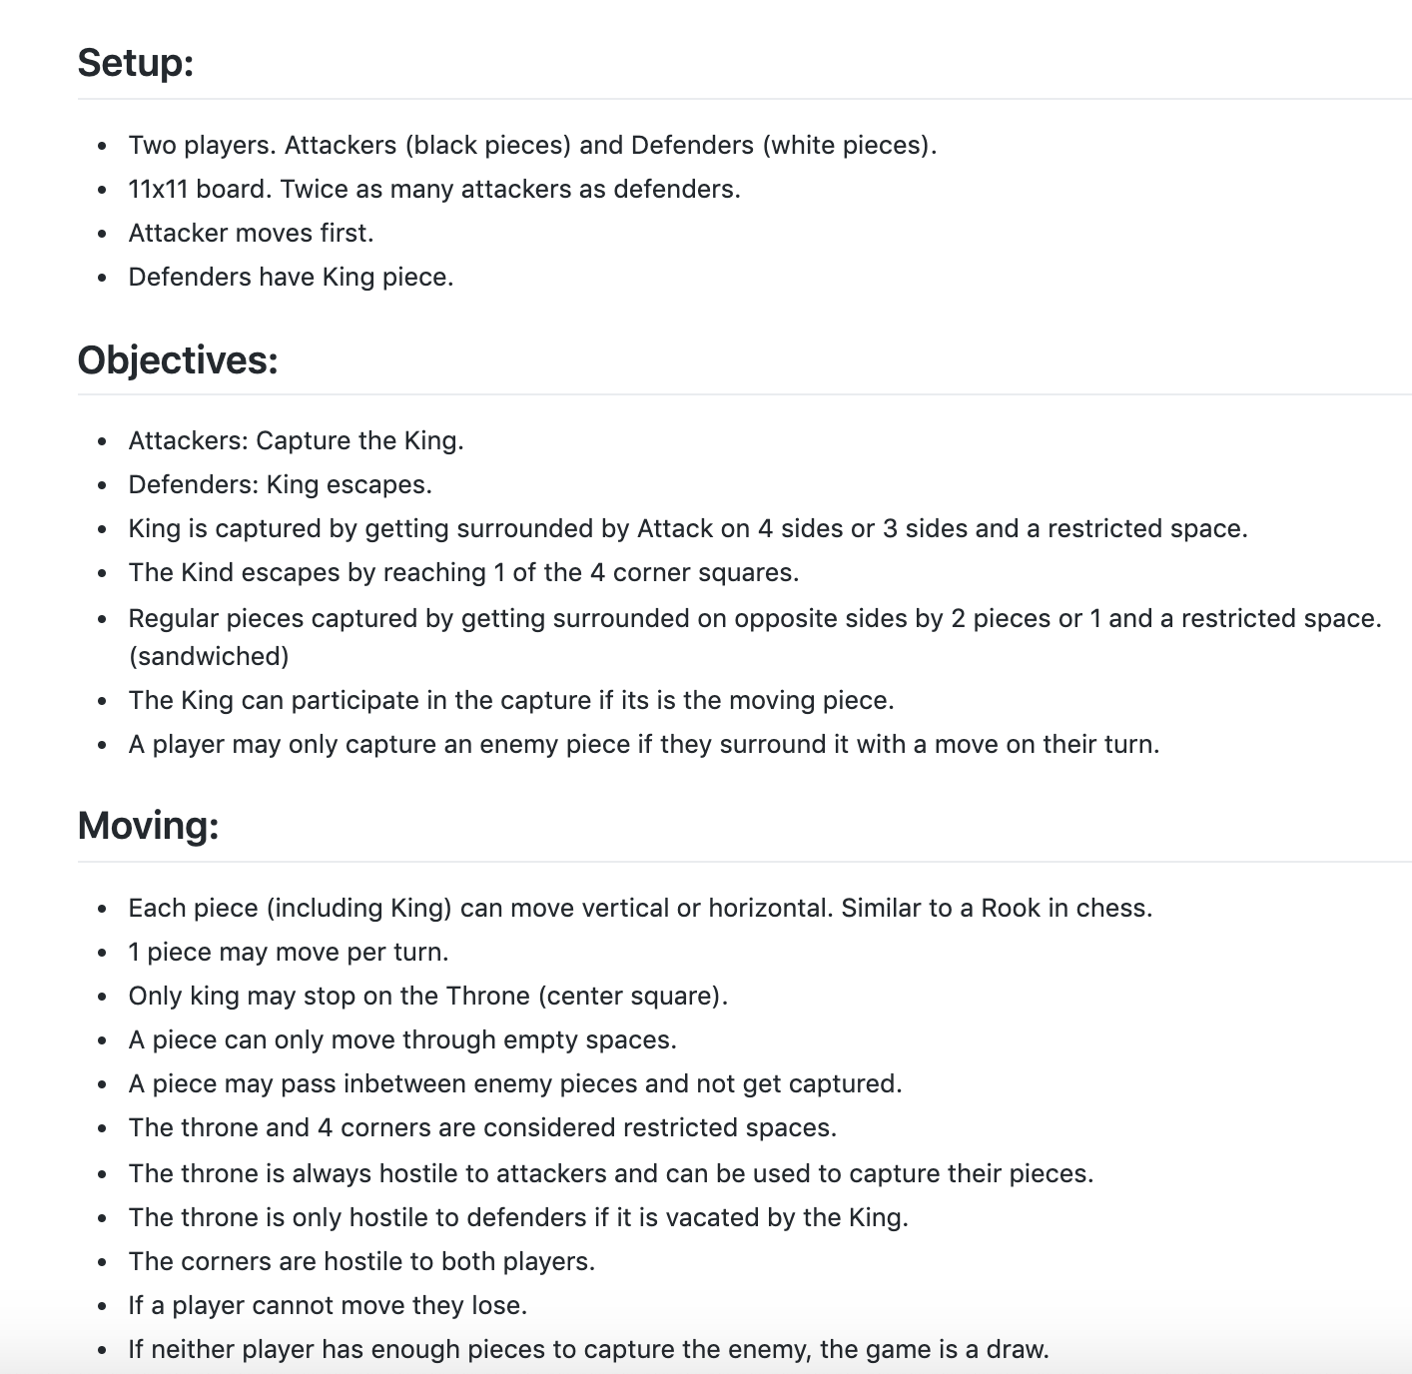

Slide 4
User Stories and Acceptance Criteria

Slide 5
User Stories
Users Can Register an Account (User Story 1)
(A) 1 email for each account
(B) No duplicate emails or account names
(C) 2 password inputs for account creation
(D) Enter nickname, password, email
(E) Password must be at least 8 characters
Users Can Login to an Existing Account (User Story 2)
(A) Enter credentials to login to existing account
(B) Display error message on login screen if failed
(C) Username/password is retrieved

Slide 6
User Stories
Users Can Invite Others to Play (User Story 6)
(A) Can invite players logged into game
(B) Click name produces send invite/cancel invite
(C) Timeout period for invites
Users Can Play Multiple Games Simultaneously (User Story 7)
(A) Each new game pops out into a new window

Slide 7
User Stories
Users Can Play a Game Online (User Story 8)
(A) Clients connect to game server
(B) Standardized frames used to communicate actions
Users Can Quit the Game at any TIme (User Story 10)
(A) Save, quit/forfeit options
(B) Forfeit does not save game state
(C) Send message based on type of abandonment

Slide 8
Tasks and Challenges

Slide 9
Login/Register
Add UI for account registration
Create client communication handler
SQL database setup
Add to database table
Account/Password creation check

Slide 10
Users Can Play a Game Online
Client connects to game server
Implement server communication handler
Handle registration and login requests from the client

Slide 11
Users Can Invite Others to Play
Handle invites inside of Server Communications Handler
Handle invites inside of the Client

Slide 12
Users Can Play Multiple Games Simultaneously
Ensure each new game uses separate sockets

Slide 13
Review

Slide 14
Process/Product Decisions Made
Focused on client and server communication
Game is able to be played across a network
Imported JavaSwing for the GUIs
JUnit Tests
mySQL
Maven

Slide 15
Scrum Ceremonies
-12/2: Progress Report after Break
-12/4: Wrap up code with Presentation/end of semester coming quickly
-12/7: Started working on powerpoint
-12/8: Presentation Practice and reflection on whole semester
-11/11: Sprint 2 review, initial Planning
-11/13: PO Meeting, Tasks definition and breakdown
-11/20: Server Setup
-11/25: Fall Break, Finish Setting up Server

Slide 16
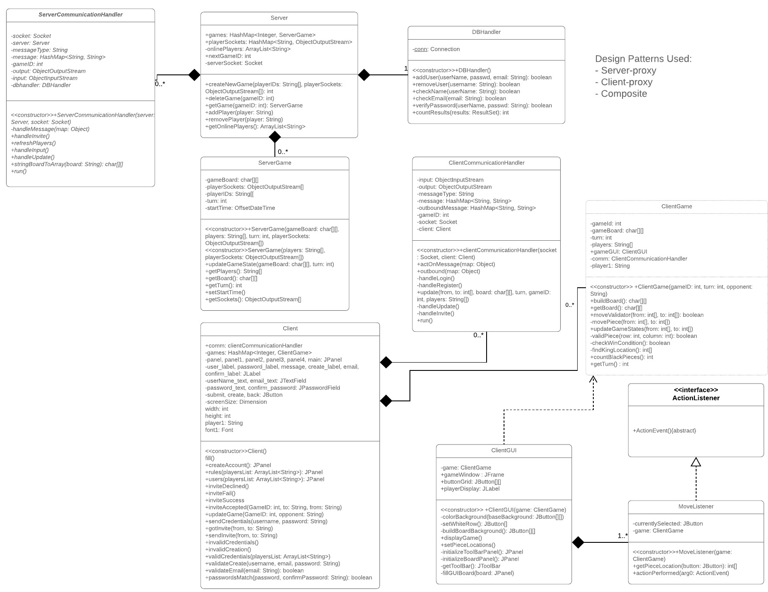
UML Diagram

Slide 17
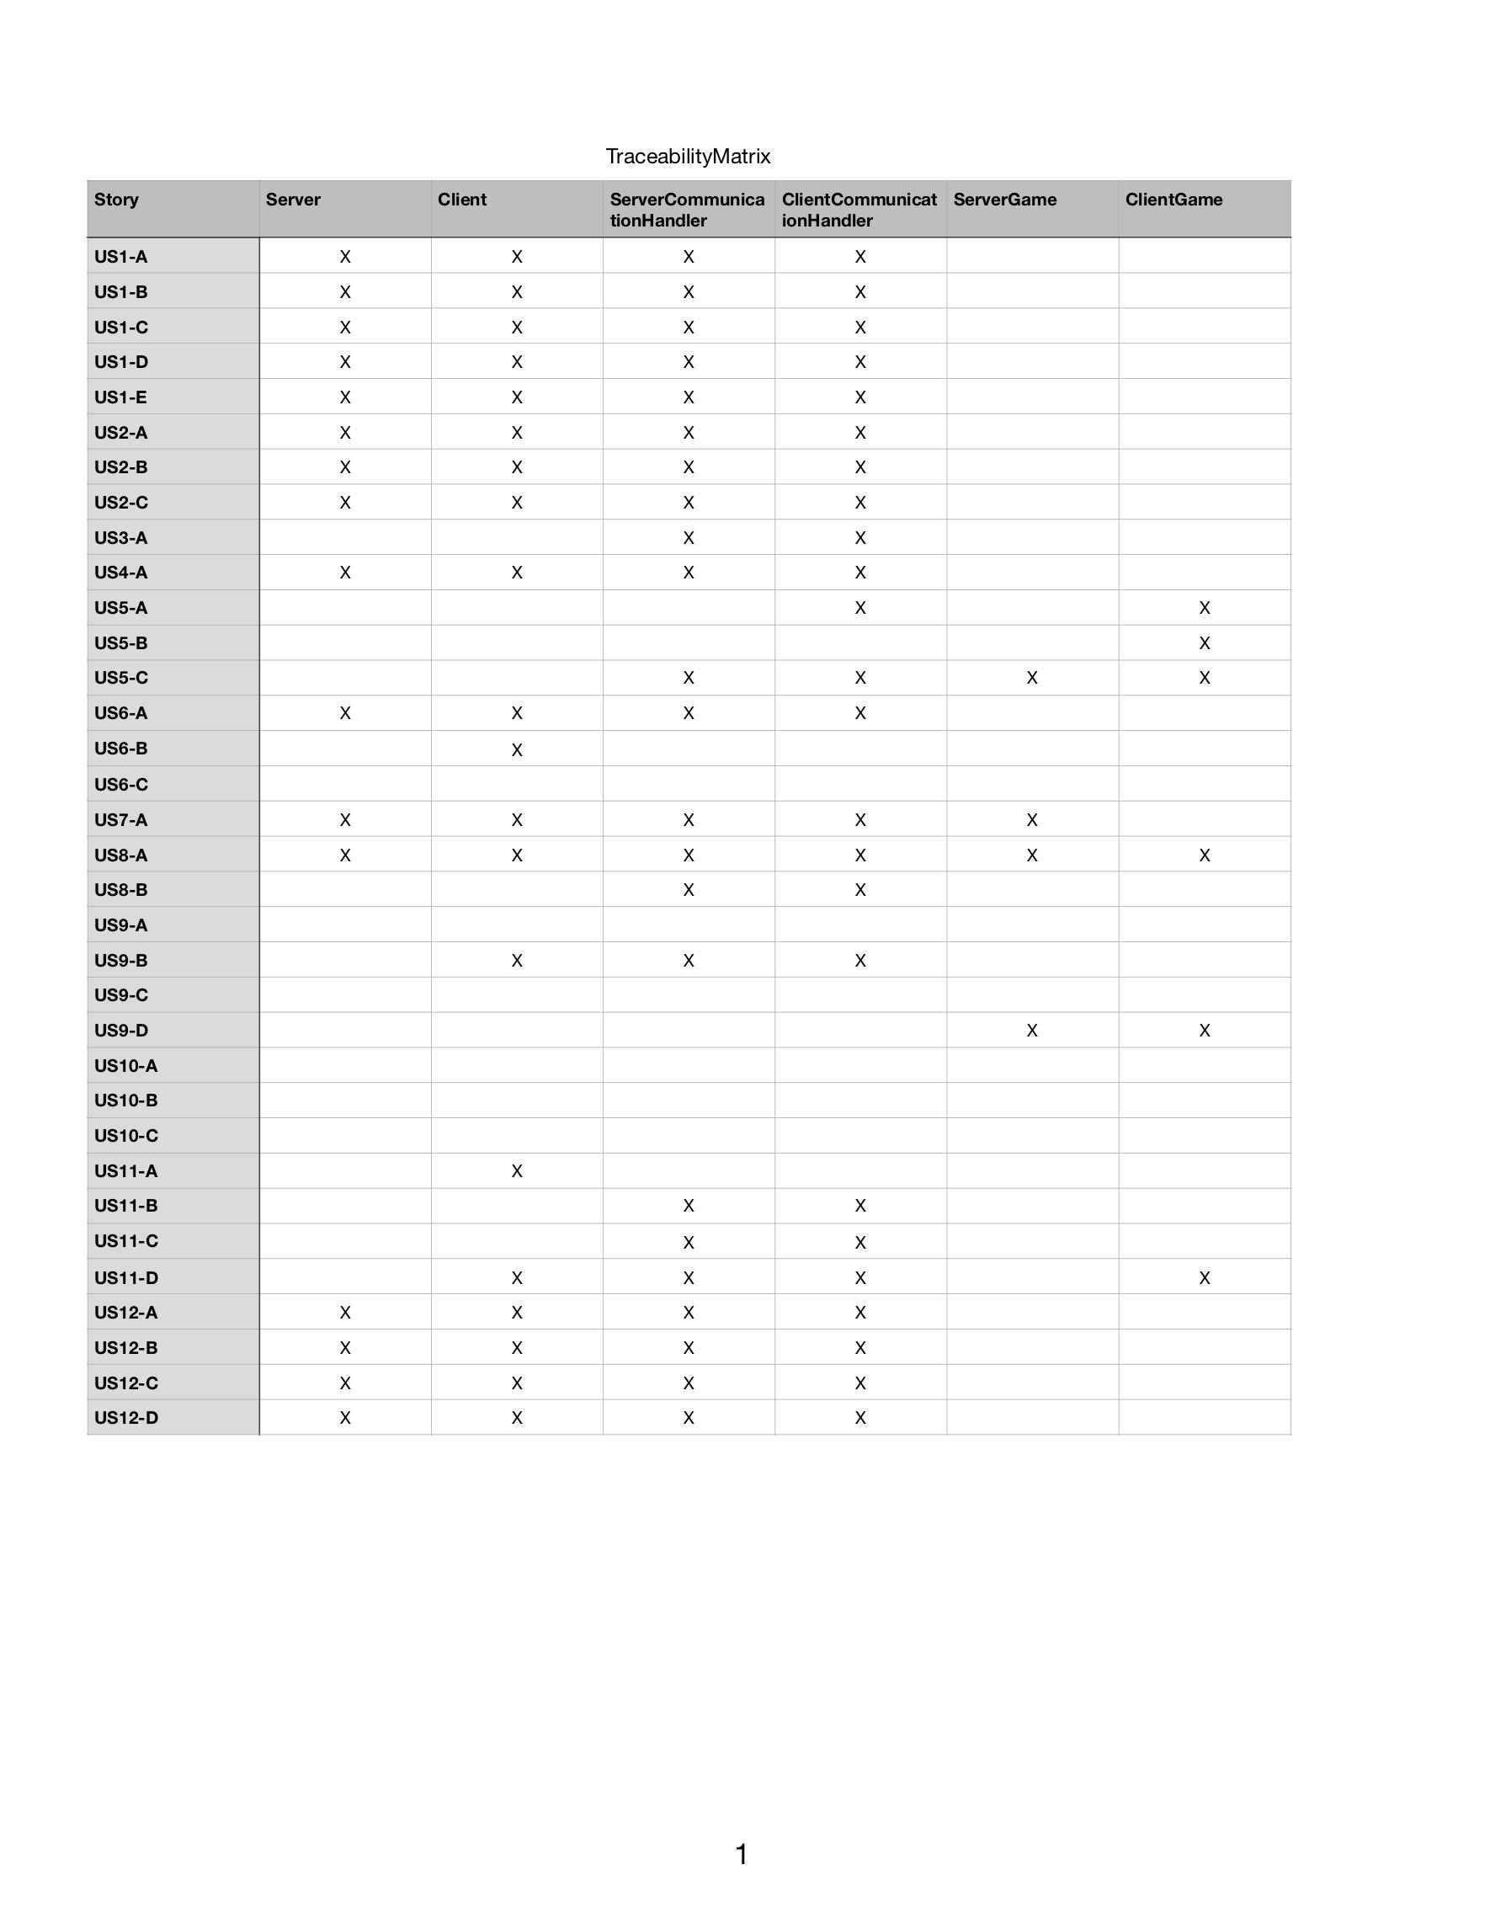
Matrix

Slide 18
Retrospective
What went well?
Team problem solving/working together
Task Estimates (time required) were accurate
What could be improved?
More work assigned at beginning of sprint
Leave more time for refactoring and testing code

Slide 19
Retrospective Continued
What will we improve for future Sprints in life?
Spend more time on task planning/creation
Achieve consistent task completion rate throughout the sprint
Greater emphasis on refactoring code

