Slide 1
Earthquake Data Analysis
Team Members:
Kishan Mistry
Keyuri Gajjar
Daxesh Mehra

Slide 2
Agenda
To analyze the available earthquake data over past 100 years
To determine whether a given location is prone to earthquake or not.

Slide 3
Hypothesis
The data received to analyze data, to determine
1) earthquake occurred in a particular location, over the span of years.
2) magnitude of earthquakes occurred at a particular location.

Slide 4
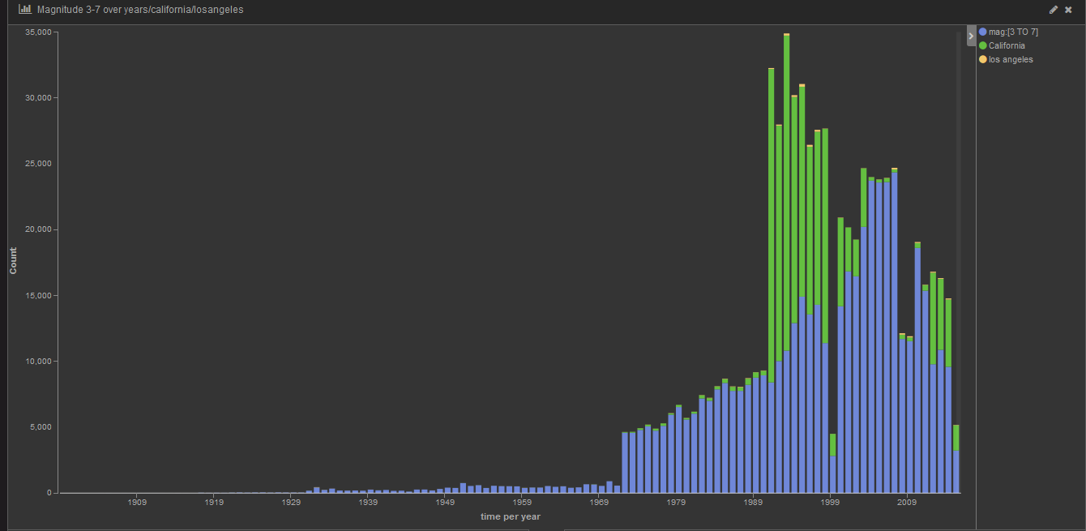
Assumptions
Fig:1
Earthquake Occurrence all over the years

Slide 5
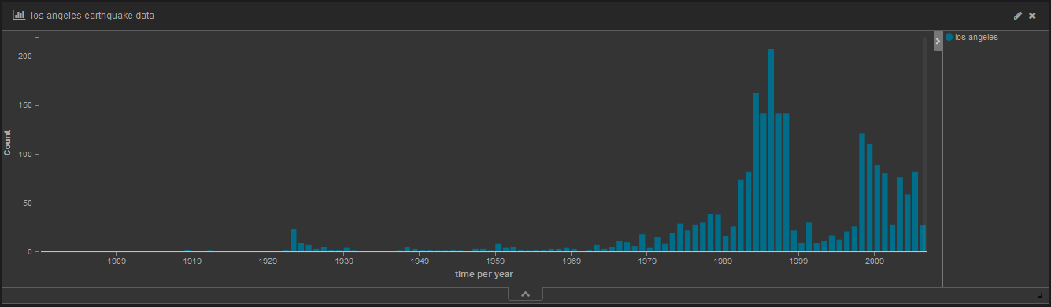
Fig:2
Earthquake Occurrence in Los Angeles

Slide 6
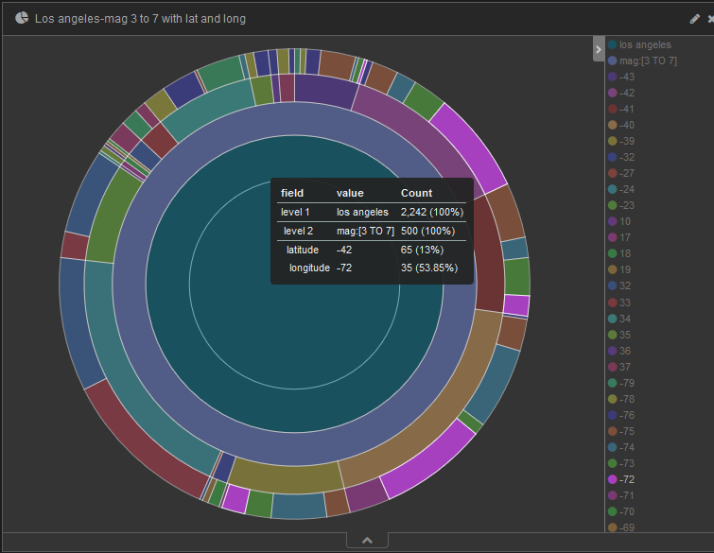
Fig: 3
Earthquake Occurrence in Los Angeles, along with latitude and longitude

Slide 7
Data & Tools
ElasticSearch & Kibana
For Visualization
Pie Charts
Bar Graph
Cannot map latitude and longitude

Slide 8
Future Analysis
Need more data.
Handle the latitude and longitude, may be through geo-points.
Goal to be achieved:
Given a location, we can predict whether it is more likely to receive an occurrence of earthquake in near future.

Slide 9
THANK YOU

