Slide 1
Overview
In one day:
24 million transactions processed by Walmart
100 TB of data uploaded to Facebook
175 million tweets on Twitter
……….
How to store, query and process these data efficiently?
Notes:
30s

Slide 2
Overview
The problems with Relational Database:
Overhead for complex select, update, delete operations
Select: Joining too many tables to create a huge size table.
Update: Each update affects many other tables.
Delete: Must guarantee the consistency of data.
Not well-supported the mix of unstructured data.
Not well-scaling with very large size of data.
NoSQL is a good solution to deal with these problems.
Notes:
https://infocus.emc.com/april_reeve/big-data-and-nosql-the-problem-with-relational-databases/
1min

Slide 3
Overview
What is NoSQL:
NoSQL = Non SQL or Not only SQL
Wikipedia’s definition:
A NoSQL database provides a mechanism for storage and retrieval of data that is modeled in means other than the tabular relations used in relational databases.

Slide 4















In Production
http://www.mongodb.org/about/production-deployments/
Notes:
2009: Initial release
At now: version 2.2.3

Slide 5








NoSQL
Key-value
Graph database
Document-oriented
Column family
Notes:
Huge quantity of data => Distributed systems => expensive joins =>
New fields, new demands (graphs) =>
Different data strucutres:
Simplier or more specific

Slide 6
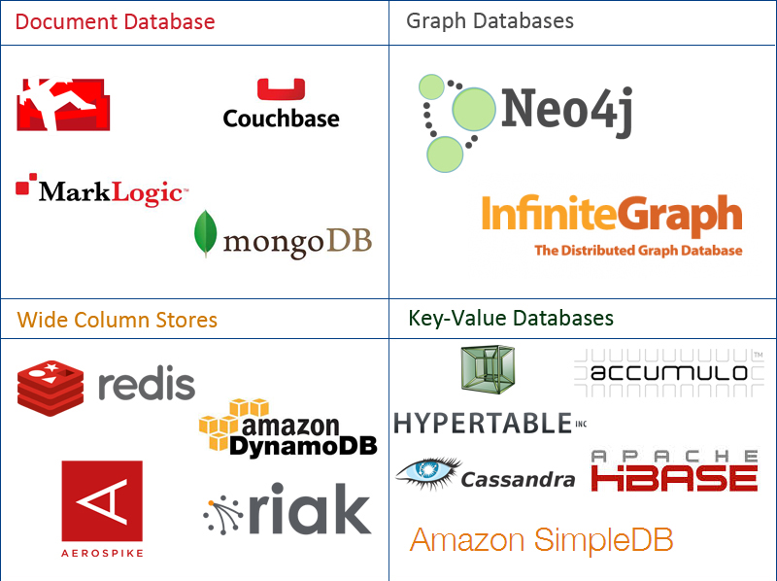
Overview – NoSQL Family
Data stored in 4 types:
Document
Graph
Key-value
Wide-column
Notes:
https://www.mongodb.com/nosql-explained http://aryannava.com/2014/04/06/nosql-databases-family/

Slide 7
Overview – MongoDB
MongoDB is:
An open source and document-oriented database.
Data is stored in JSON-like documents.
Designed with both scalability and developer agility.
Dynamic schemas.
Notes:
What is dynamic schemas?

Slide 8
Installation
Download and install suitable package for each platform [Windows, Linux, Mac OSX, Solaris]
Create a folder e.g. C:\mongodb
Go to bin of installation folder.
Type following command: mongod --dbpath=C:/mongodb
Run another command: mongo.exe
The mongodb server is running.

Slide 9
Document store
RDBMS |  | MongoDB
Database |  | Database
Table, View |  | Collection
Row |  | Document (JSON, BSON)
Column |  | Field
Index |  | Index
Join |  | Embedded Document
Foreign Key |  | Reference
Partition |  | Shard
Notes:
Javascript

Slide 10
Document store
RDBMS |  | MongoDB
Database |  | Database
Table, View |  | Collection
Row |  | Document (JSON, BSON)
Column |  | Field
Index |  | Index
Join |  | Embedded Document
Foreign Key |  | Reference
Partition |  | Shard
> db.user.findOne({age:39})
{
"_id" : ObjectId("5114e0bd42…"),
"first" : "John",
"last" : "Doe",
"age" : 39,
"interests" : [
"Reading",
"Mountain Biking ]
"favorites": {
"color": "Blue",
"sport": "Soccer"}
}
Notes:
Flexible schema
Javascript

Slide 11
SQL vs MongoDB
SQL Terms/Concepts | MongoDB Terms/Concepts
database | database
table | collection
row | document
column | field
index | index
table joins (e.g. select queries) | embedded documents and linking
Primary keys | _id field is always the primary key
Aggregation (e.g. group by) | aggregation pipeline
Notes:
What is the index in MongoDB
Embedded documents and linking??
Aggregation pipeline??
http://docs.mongodb.org/manual/core/data-model-design/

Slide 12
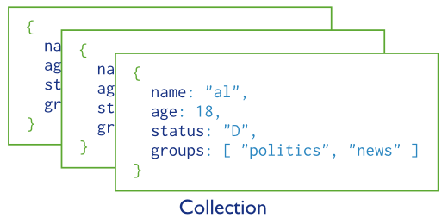
MongoDB Data Model
A collection includes documents.
Notes:
The schema is very flexible. Documents in each collection can have different structures.

Slide 13
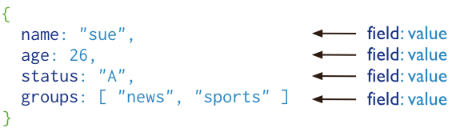
MongoDB Data Model
Structure of a JSON-document:
The value of field:
Native data types
Arrays
Other documents
Notes:
The schema is very flexible. Documents in each collection can have different structures.

Slide 14
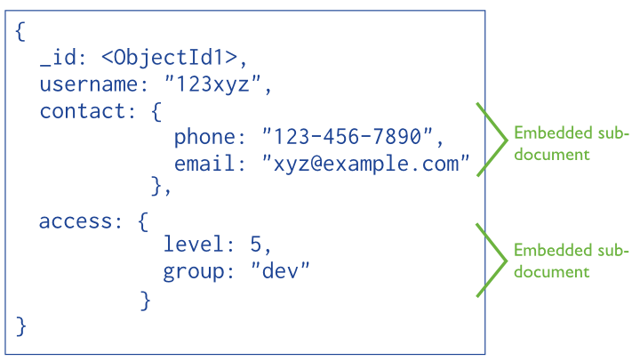
MongoDB Data Model
Embedded documents:
The primary key
Notes:
With embedded documents, we do not need complicated join table.
Why objectId1 – a hex string

Slide 15
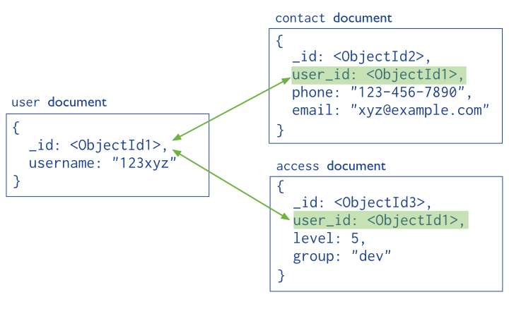
MongoDB Data Model
Reference documents or linking documents
Notes:
With embedded documents, we do not need complicated join table.
Why objectId1 – a hex string

Slide 16
CRUD
Create
db.collection.insert( <document> )
db.collection.save( <document> )
db.collection.update( <query>, <update>, { upsert: true } )
Read
db.collection.find( <query>, <projection> )
db.collection.findOne( <query>, <projection> )
Update
db.collection.update( <query>, <update>, <options> )
Delete
db.collection.remove( <query>, <justOne> )
Notes:
Create
The field name _id is reserved for use as a primary key; its value must be unique in the collection, is immutable, and may be of any type other than an array.
The field names cannot start with the $ character.
The field names cannot contain the . character.
Create with save
If the <document> argument does not contain the _id field or contains an _id field with a value not in the collection, the save() method performs an insert of the document.
Otherwise, the save() method performs an update.
sds

Slide 17
MongoDB Queries:
CRUD (Create – Update – Delete)
Create a database: use database_name
Create a collection: db.createCollection(name, options)
options: specify the number of documents in a collection etc.
Insert a document:
db.<collection_name>.insert({“name”: “nguyen”, “age”: 24, “gender”: “male”})
Query [e.g. select all]
db.<collection_name>.find().pretty()
Query with conditions:
db.<collection_name>.find( { “gender”: “female”, “age”: {$lte:20} }).pretty()

Slide 18
MongoDB Queries:
CRUD (Create – Update – Delete)
db.<collection_name>.update(<select_criteria>,<updated_data>)
db.students.update({‘name':‘nguyen'}, { $set:{‘age': 20 } } )
Replace the existing document with new one: save method:
db.students.save({_id:ObjectId(‘string_id’), “name”: “ben”, “age”: 23, “gender”: “male”}

Slide 19
MongoDB Queries:
CRUD (Create – Update – Delete)
Drop a database
Show database: show dbs
Use a database: use <db_name>
Drop it: db.dropDatabase()
Drop a collection:
db.<collection_name>.drop()
Delete a document:
db.<collection_name>.remove({“gender”: “male” })

Slide 20
CRUD example
> db.user.insert({
first: "John",
last : "Doe",
age: 39
})
> db.user.find ()
{
"_id" : ObjectId("51…"),
"first" : "John",
"last" : "Doe",
"age" : 39
}
> db.user.update(
{"_id" : ObjectId("51…")},
{
$set: {
age: 40,
salary: 7000}
}
)
> db.user.remove({
"first": /^J/
})

Slide 21
Features
Document-Oriented storege
Full Index Support
Replication & High Availability
Auto-Sharding
Querying
Fast In-Place Updates
Map/Reduce
Agile
Scalable

Slide 22
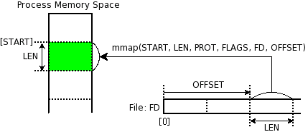
Memory Mapped Files
„A memory-mapped file is a segment of virtual memory which has been assigned a direct byte-for-byte correlation with some portion of a file or file-like resource.”¹
mmap()
¹: http://en.wikipedia.org/wiki/Memory-mapped_file
Notes:
http://docs.mongodb.org/manual/faq/storage/

Slide 23

Replica Sets
Host1:10000
Redundancy and Failover
Zero downtime for upgrades and maintaince
Master-slave replication
Strong Consistency
Delayed Consistency
Geospatial features
Host2:10001
Host3:10002
replica₁
Client
Notes:
DC – Data center

Slide 24
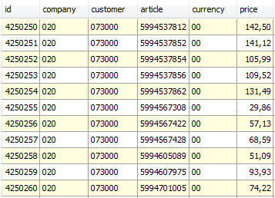
Sharding
Partition your data
Scale write throughput
Increase capacity
Auto-balancing
shard₁
shard₂
Host1:10000
Host2:10010
configdb
Host3:20000
Client
Host4:30000
Notes:
1970 – 2000: Vertical Scalability (scale-up)
Google, ~2000: Horizontal Scalability (scale-out)

Slide 25
Mixed
shard₁
...
Host1:10000
shard_{n}
Host2:10001
Host4:10010
Host3:10002
replica₁
configdb
Host5:20000
Client
Host6:30000
Host7:30000

Slide 26
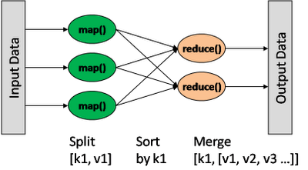
Map/Reduce
db.collection.mapReduce(
<mapfunction>,
<reducefunction>,
{
out: <collection>,
query: <>,
sort: <>,
limit: <number>,
finalize: <function>,
scope: <>,
jsMode: <boolean>,
verbose: <boolean>
}
)
var mapFunction1 = function() { emit(this.cust_id, this.price); };
var reduceFunction1 = function(keyCustId, valuesPrices)
{ return sum(valuesPrices); };
Notes:
http://docs.mongodb.org/manual/reference/method/db.collection.mapReduce/#db.collection.mapReduce

Slide 27
Other features
Easy to install and use
Detailed documentation
Various APIs
JavaScript, Python, Ruby, Perl, Java, Java, Scala, C#, C++, Haskell, Erlang
Community
Open source

Slide 28
Theory of noSQL: CAP
C
Many nodes
Nodes contain replicas of partitions of data
Consistency
all replicas contain the same version of data
Availability
system remains operational on failing nodes
Partition tolarence
multiple entry points
system remains operational on system split
A
P
CAP Theorem: satisfying all three at the same time is impossible

Slide 29

Theory of noSQL: CAP
C
Many nodes
Nodes contain replicas of partitions of data
Consistency
all replicas contain the same version of data
Availability
system remains operational on failing nodes
Partition tolarence
multiple entry points
system remains operational on system split
A
P
CAP Theorem: satisfying all three at the same time is impossible
Notes:
MongoDB
A: What if a primary node is down?

Slide 30
ACID - BASE
Atomicity
Consistency
Isolation
Durability
Basically
Available (CP)
Soft-state
Eventually consistent (AP)
Pritchett, D.: BASE: An Acid Alternative (queue.acm.org/detail.cfm?id=1394128)
Notes:
ACID
Atomicity. All of the operations in the transaction will complete, or none will.
Consistency. The database will be in a consistent state when the transaction begins and ends.
Isolation. The transaction will behave as if it is the only operation being performed upon the database.
Durability. Upon completion of the transaction, the operation will not be reversed.
BASE
Basically Available: some parts of system remain availabe on failure
Soft-state:
(the information will expire unless it is refreshed )
system will change state without user intervention due to eventual consistency
Eventually consistency:
asynchron propagation
consistancy window

