Slide 1
Social Intelligence & IQ as Academic Performance Predictors
California State University Los Angeles
Student A, Student B, Student C
DISCLAIMER: This presentation is completely gibberish.
Presented here as a reference for what I would expect your
project to show. Only a RECOMMENDATION.

Slide 2
Research Question
How is social intelligence a better predictor of academic performance than IQ?

Slide 3
Research Methodology
Generate IQ data model based on normal distribution.
Acquired social intelligence rating based on social media rating using sentiment analysis.
Detect religious reference and job satisfaction
Map against IQ distribution
Tools used:
Numpy for numerical analysis
Sentimental Analysis python library
Pandas for data analytic

Slide 4
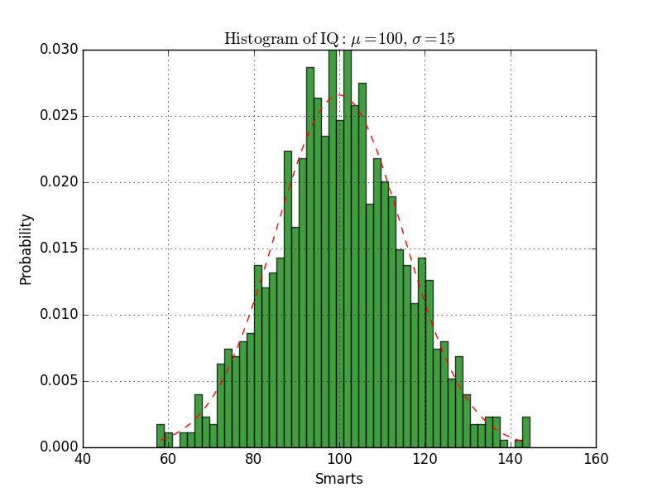
Statistical Calculation
Random IQ distribution generated using Gaussian function

Slide 5
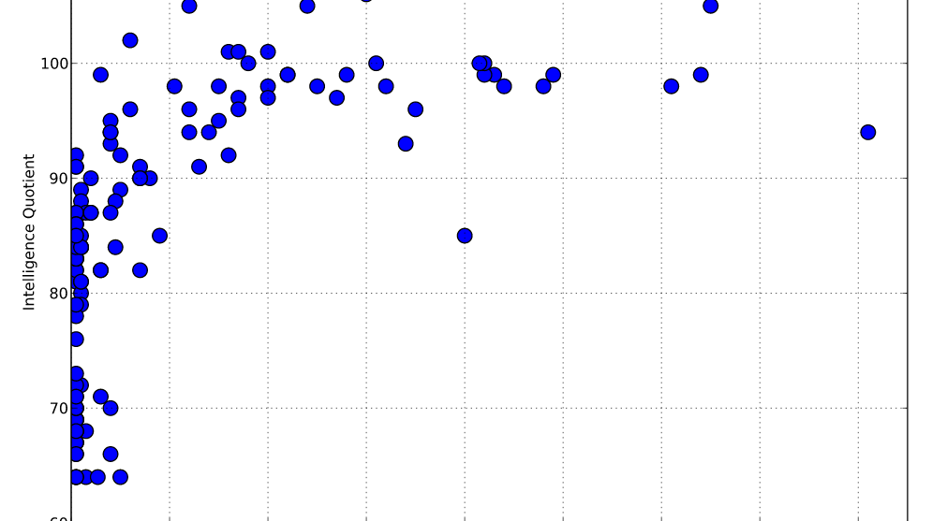
Atheism vs. Intelligence Metrics
Lack of religious Preference does not translate to high IQ

Slide 6
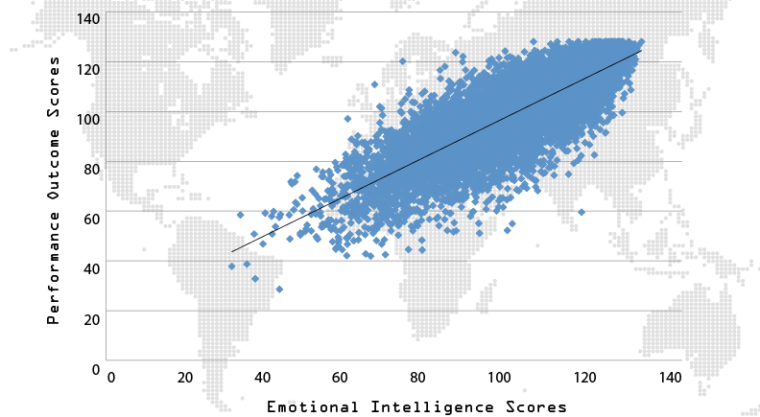
Social Intelligence vs. Score Predictor

Slide 7
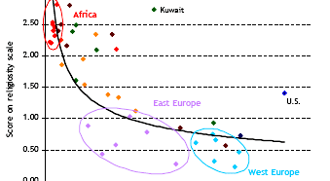
Global Wealth and Religion Distribution

Slide 8
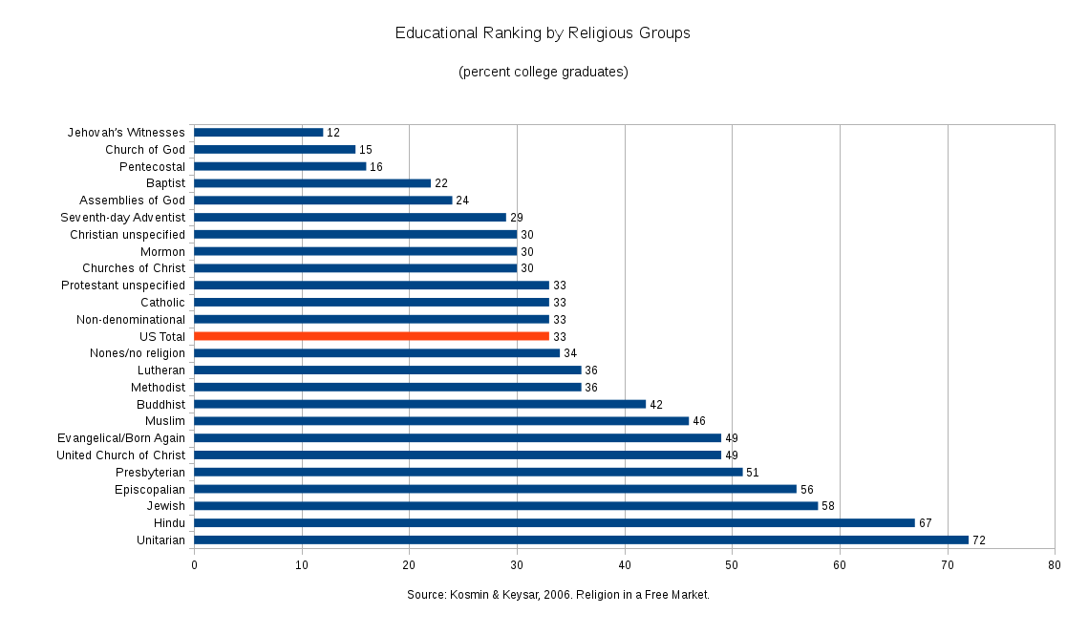
Educational Outcome Categorized by Religious Affiliation

Slide 9
Conclusion
Emotional Intelligence is a good predictor of academics performance
Not necessarily better than IQ
Religious sentiment influence academics performance
Recommendation:
Balanced outlook on religion and social intelligence

