Slide 1
ImageNet Classification with Deep Convolutional Neural Networks
By Patrapee Pongtana

Slide 2
The Architecture
Goal
Eight learned layers
Five convolutional
Three fully-connected
Accomplish the training the dataset as fast as possible while maintaining the robust of the model

Slide 3
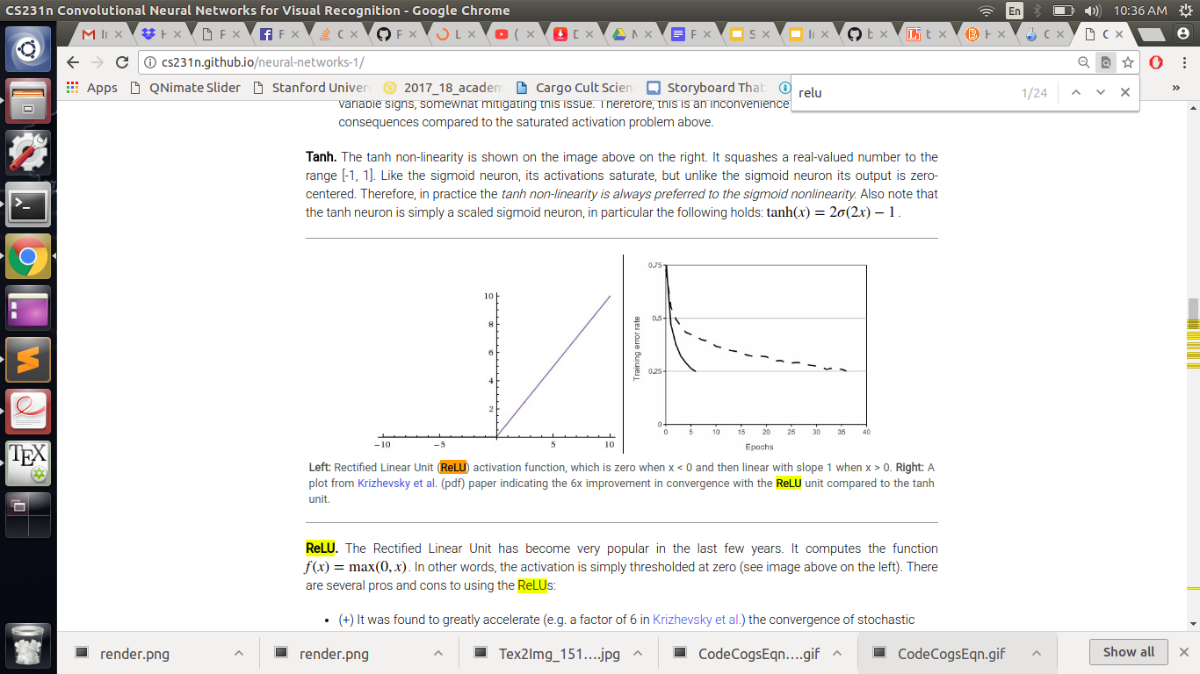
Rectified Linear Units (ReLUs)
Standard model without ReLUs is
The model with ReLUs activation function is
By using ReLUs and trained on four-layer convolutional network, the result is shown below

Slide 4
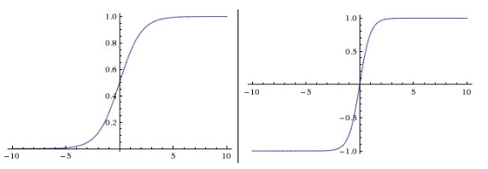
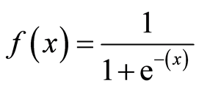
Traditional Activation Functions
Sigmoid Function:
tanh Function:

Slide 5
Not Fast Enough? Add more GPUs!
GPU has a big role in term of computation speed
Some GPUs, such as GTX 580, is capable of cross-GPU paralleization
It can read and write memory without a delay from host memory
Cross-validation should be considered

Slide 6
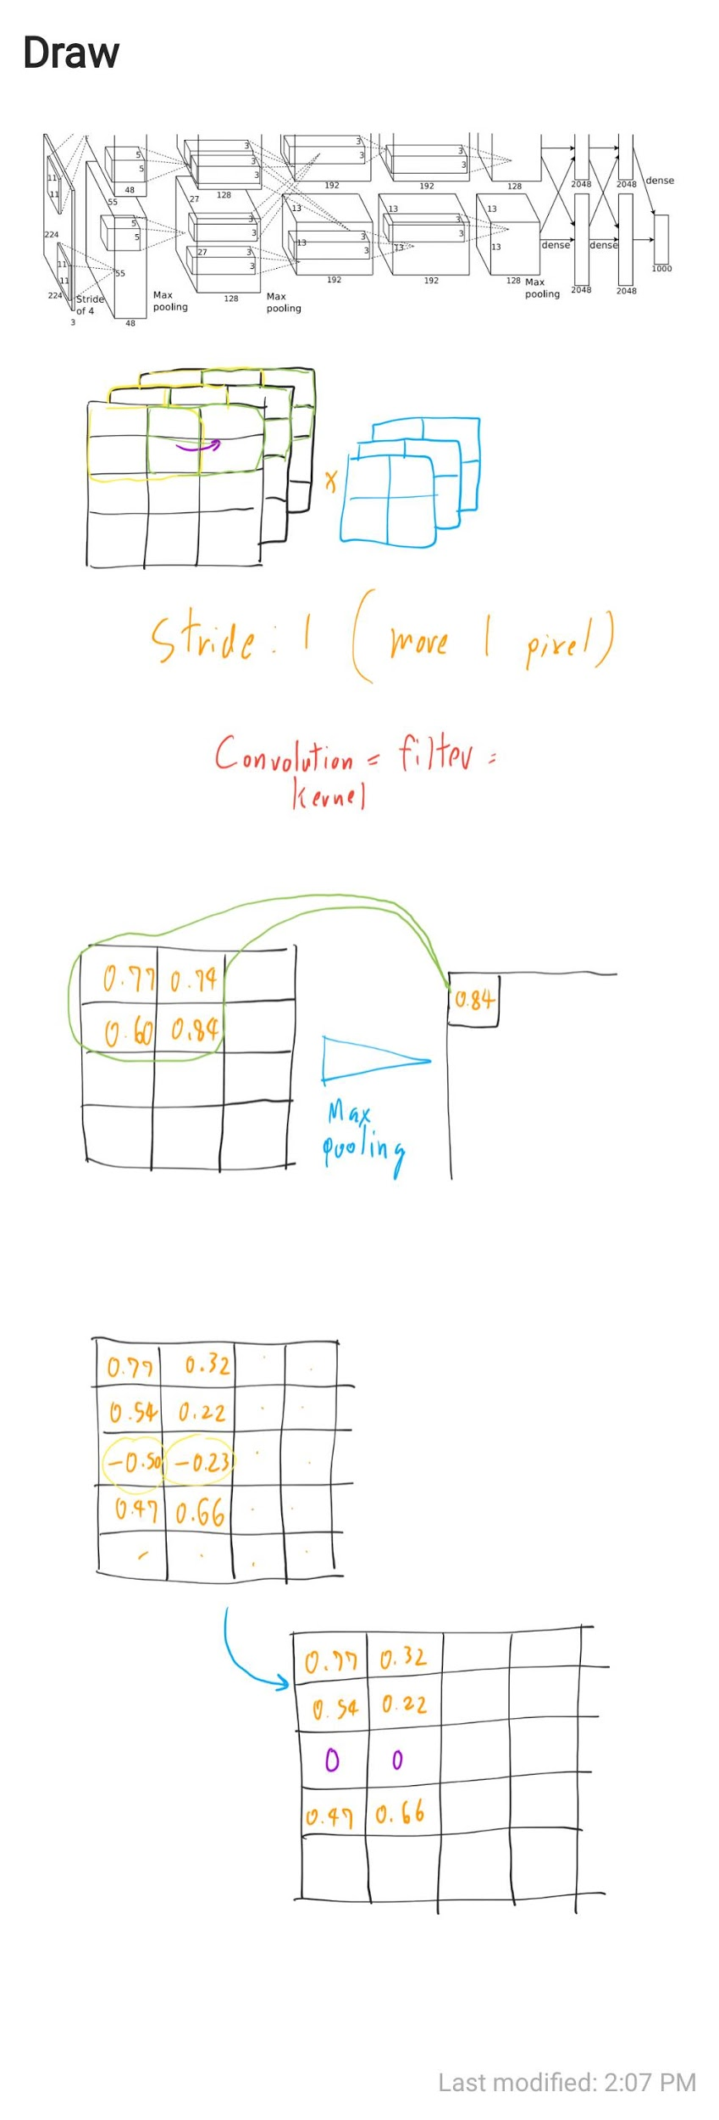
Overall Architecture

Slide 7
Filtering

Slide 8
Max Pooling

Slide 9
ReLUs Activation

Slide 10
Conclusion
If one convolutional layer is removed, then the performance massively decreased. Thus, this specific architecture will be strictly tie to this accuracy
The longer and larger dataset we can obtain, the better performance we will get

