Slide 1
Recurrent Encoder-Decoder Networks for Time-Varying Dense Predictions
Presented By: Chanon Chantaduly

Slide 2
Time-Varying Dense Predictions
Dense Predictions
When we predict a label for each of the input units rather than the entire input
Example: predicting the pixels that represent a cat
Time-varying dataset
Spatial and Temporal
Example: video analysis, medical imaging

Slide 3
Recurrent Neural Networks (RNN)
Primarily used in sequencing, where preservation of temporal information is needed.
no no no no no yes
a <0>
a <1>
a <2>
a <3>
a <4>
a <5>
The chicken butt t-shirt is Anthony’s

Slide 4
Problems with RNNs
Not very good at capturing long term dependencies
Vanishing/exploding gradient problem
Next layer gets information only from the previous layer
What if we need information from later on in the sequence?

Slide 5
Modified RNNs – Two main types
Gated Recurrent Unit (GRU)
Two gates
Simpler model, which allows for building bigger models
Long Short Term Memory (LSTM)
Three gates
More powerful historically, but higher computational costs

Slide 6
Information From The Future Bidirectional RNNs!
yes
no
no
no
a<1>
a<1>
a<2>
a<2>
a<3>
a<3>
a<4>
a<4>
RNN #1
RNN #2
a<1>
a<2>
a<3>
a<2>
a<3>
a<4>
Pat loves Doge memes

Slide 7
Spatial vs Temporal
Convolutional Neural Networks (CNN) are very good at preserving spatial information.
Recurrent Neural Networks (RNN) are very good at processing temporal information.
So how do we process datasets that require preserving both spatial and temporal information?

Slide 8
Convolutional Recurrent Neural Networks (CRNN)
Combines together CNN and RNN by replacing the fully connected layers in the RNN with convolutional connections.
Transforms GRU/LSTM to CGRU/CLSTM by adding the convolutional connections.
Limitation: Very high computational cost/high memory consumption.

Slide 9
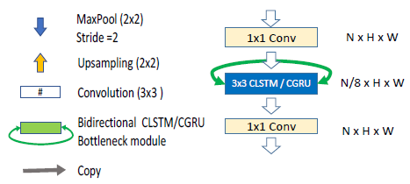
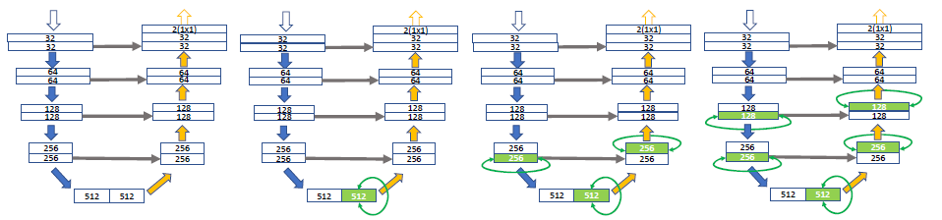
Incorporating CRNN units into FCN
U-Net example:
U-Net
U-Net + 1 CLSTM/CGRU
U-Net + 3 CLSTM/CGRU
U-Net + 5 CLSTM/CGRU

Slide 10
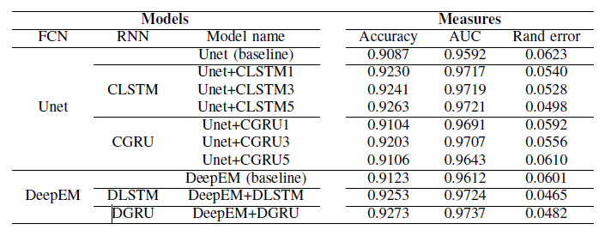
Results

