Slide 1
U-Net: Convolutional Network for Segmentation
Presented by: Chanon Chantaduly

Slide 2

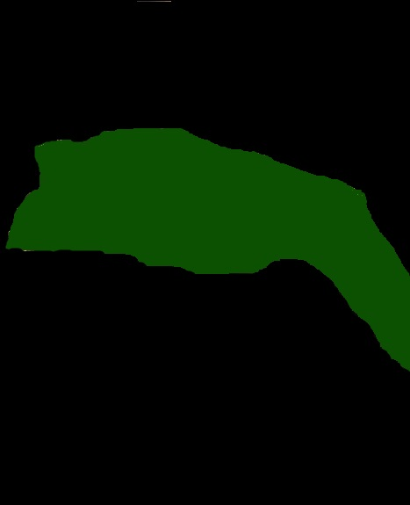
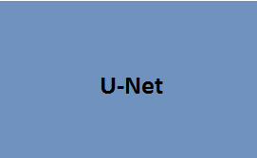
What does a U-Net do?
Learns Segmentation
Input Image
Output Segmentation Map

Slide 3
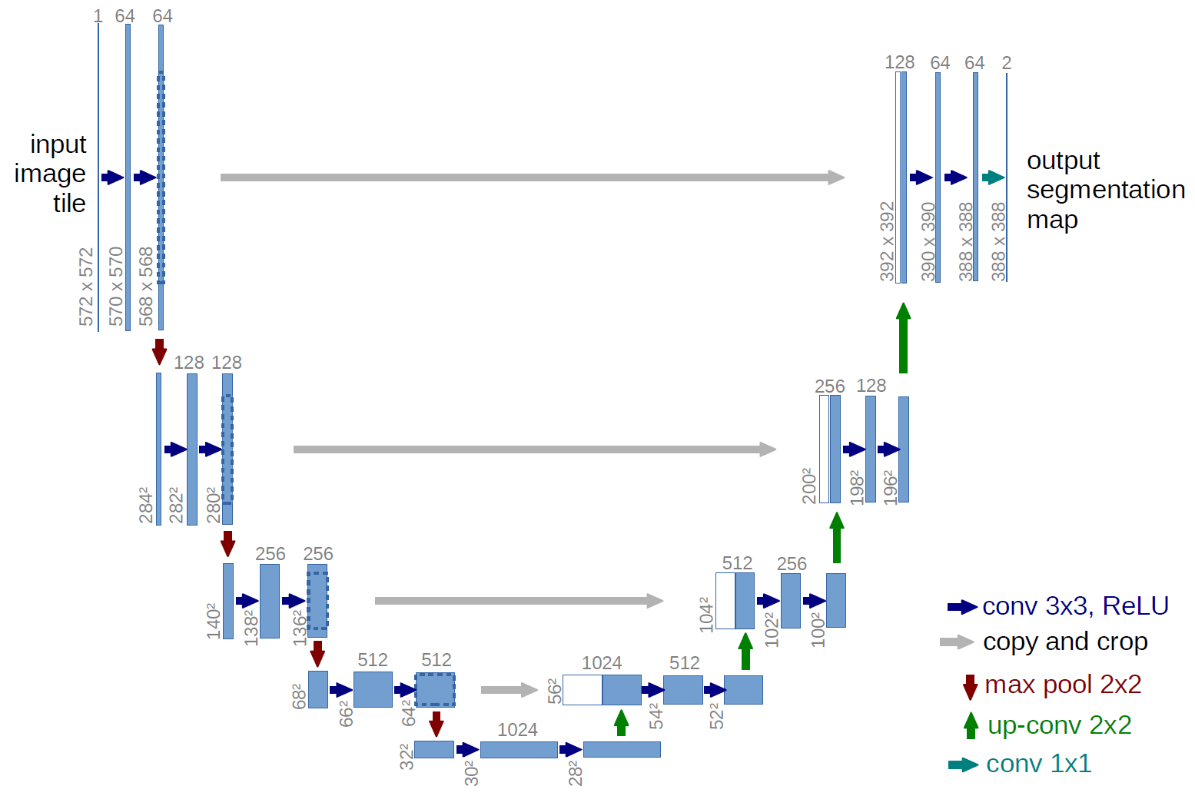
U-Net Architecture
Ronneberger et al. (2015) U-net Architecture

Slide 4
U-Net Architecture
“Contraction” Phase
- Increases field of view
- Lose Spatial Information
Ronneberger et al. (2015) U-net Architecture

Slide 5
U-Net Architecture
“Expansion” Phase
Create High Resolution
Mapping
Ronneberger et al. (2015) U-net Architecture

Slide 6
U-Net Architecture
Concatenate with high-resolution feature maps from the Contraction Phase
Ronneberger et al. (2015) U-net Architecture

Slide 7
U-Net Summary
Contraction Phase
Reduce spatial dimension, but increases the “what.”
Expansion Phase
Recovers object details and the dimensions, which is the “where.”
Concatenating feature maps from the Contraction phase helps the Expansion phase with recovering the “where” information.

Slide 8
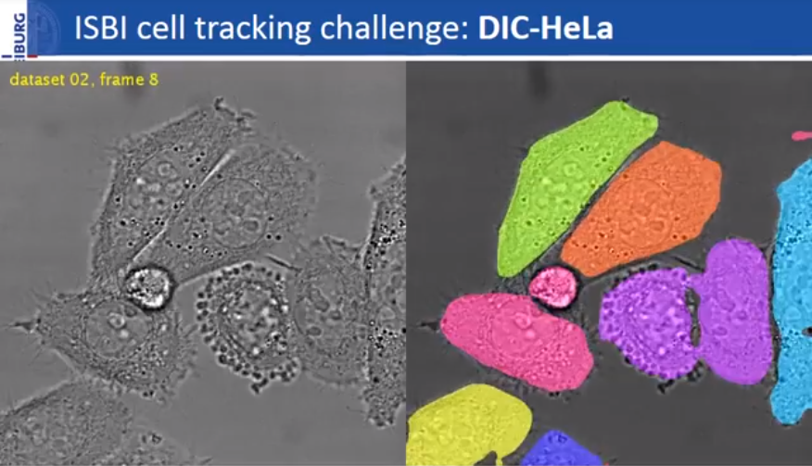
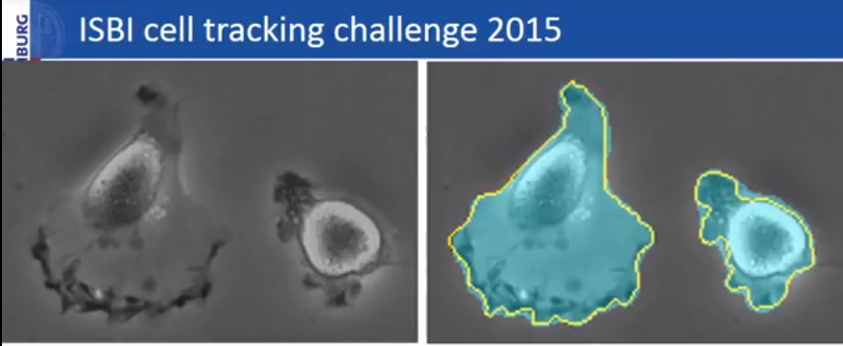
Author Results
Ronneberger et al. (2015) ISBI cell tracking challenge

