Slide 1

Paper Summary of:
Going Deeper with Convolutions codename: Inception
By Anthony Martinez

Slide 2
Goal
  Primary focus was not on accuracy
  Motivated by mobile and embedded computing
  Self imposed limitation of 1.5 billion add and multiplies
    Want adaptation

Slide 3
At the time:
  For larger data sets
    Simple solution : Increase network size.
  Drawbacks
    Explosion of parameter size
    Overfitting
    Increase in computational resources

Slide 4
Go Deeper
Don’t just add more layers
Design a smarter architecture
  Sparse matrix
    Can’t do that
    Dense matrix have a similar property
    You can build it in modules
  Network in Network

Slide 5
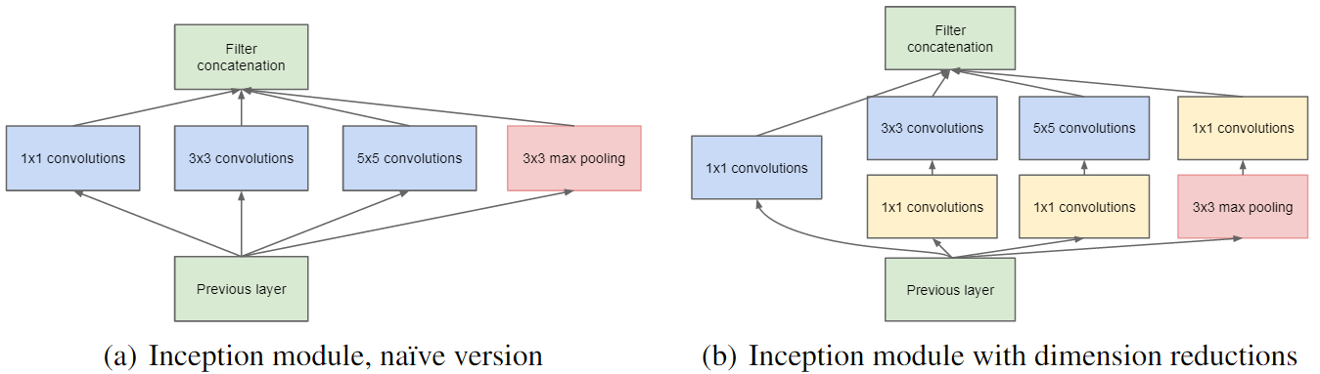
Inception Module
Groups areas of high correlated statistics

Slide 6
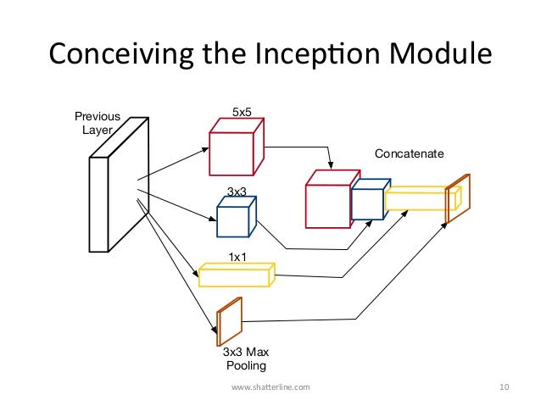
Why 1x1, 3x3, and 5x5?

Slide 7
NIN

Slide 8
1 x 1 convolution
Mainly used as dimension reduction modules
  Remove computational bottlenecks
Allows increase in
  Depth
  Width
A way to reduce C = Channels
  Keep the size down

Slide 9
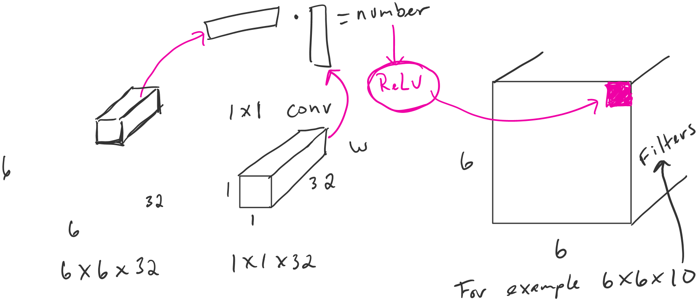
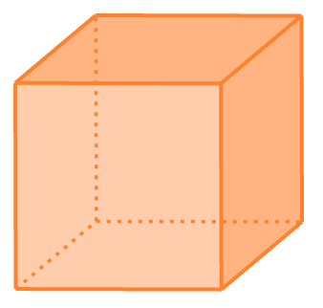
NIN
Computation size if we want 10 filters: 6x6x10x1x1x32 = 11520

Slide 10
Computational Cost
28x28x192
Conv 5 x5,
Same,
32 filters
28x28x32
28x28x32x5x5x192 = 120 million

Slide 11
1x1 to 5x5
28x28x192
Conv 5 x5,
32 filters
Conv 1x1,
16 filters
28x28x16
28x28x32
+
28x28x192x16 = 2.4 million
28x28x16x5x5x32 = 10million
About 12.4 million

Slide 12
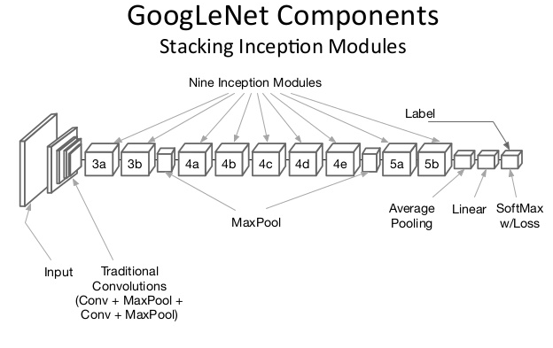

Slide 13
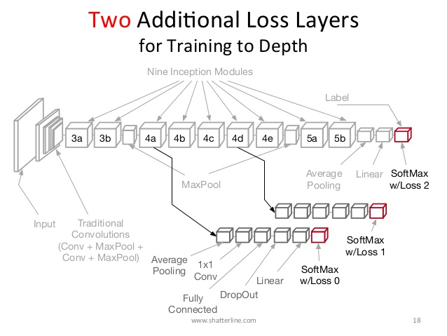

Slide 14
