Slide 1
Very Deep Convolutional Networks for Large-Scale Image Recognition
By Vincent Cheong

Slide 2
VGG Net
Attempt to improve upon Krizhevsky et al. (2012)’s architecture.
Increasing depth while other architectural parameters are fixed.

Slide 3
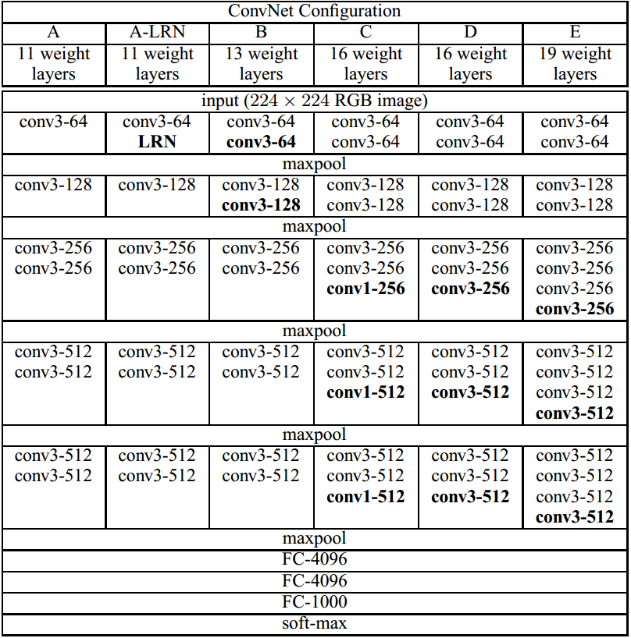
Architecture
8 – 16 Convolution Layers (3 x 3, 1 x 1)
Stride: 1
Padding (for 3 x 3): 1
Convolution filter width starting from 64 and doubling after each max-pooling layer until it reaches 512
ReLU
Following each hidden layer
5 Max pooling layers (2 x 2)
Stride: 2
After every few convolution layers
3 Fully connected layers
Dropout applied to first two layers
Local response normalization removed for most configurations

Slide 4
3 x 3 vs 7 x 7 Convolution Layers
A stack of three 3 x 3 conv. layers has an effective receptive field of 7 x 7.
Why three 3 x 3 layers over a single 7 x 7?
Three non-linear rectification layers instead of one
Lower number of parameters
Three 3 x 3 with C channels = 3(3C²) = 27C² parameters
7 x 7 = 49C² parameters
3 x 3 is the minimum size for capturing features such as left/right, up/down, and center

Slide 5
1 x 1
Projection onto space of same dimensionality
Increases non-linearity without affecting receptive fields

Slide 6
Training
Weight initialization
Random initialization for configuration A
Layers used to initialize deeper architectures
Multinomial logistic regression utilizing mini-batch gradient descent with momentum
Image cropping
Training scale S where S is the shortest dimension of the image (Min S = 224)
Multi-scale cropping
S is randomly generated from [S_{min}, S_{max}] with S_{min}=256 and S_{max} =512
Augmentation through scale jittering
Random horizontal flipping and RGB color shifting of crops

Slide 7
Testing
Multi-scale
Large difference between training and testing scales will drop performance
The smallest image side is scaled to test scale Q
Q = {S – 32, S, S+32}
Horizontal flipping of image
Dense Evaluation
FC layers converted to convolutional layers
7 x 7, 1 x 1, 1 x 1
Result is spatially averaged to produce a vector of class scores
Applied to uncropped image
Avoids recomputation for multiple crops

Slide 8
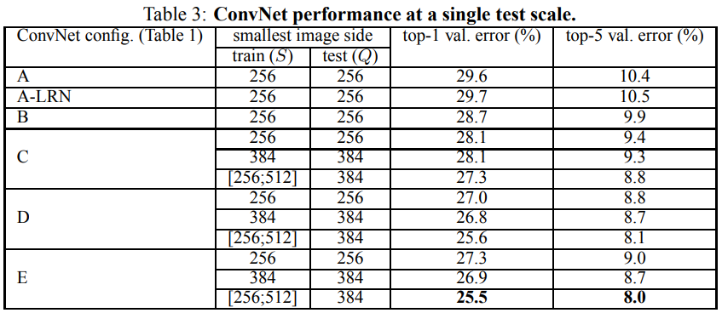
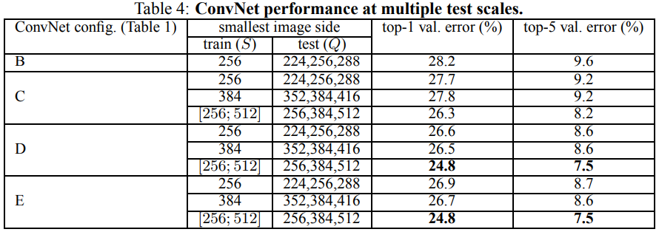
Results
A – 8 conv-3
B – 10 conv-3
C – 10 conv-3, 3 conv-1
D – 13 conv-3
E – 16 conv-3

Slide 9
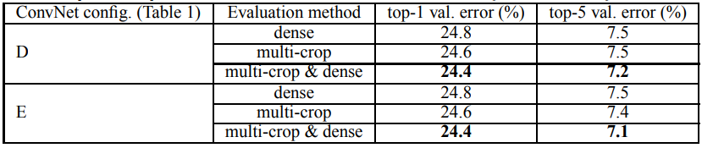
Dense and Multi-Crop
Multi-crop slightly more effective than dense
Soft-max average of both produce better results

Slide 10
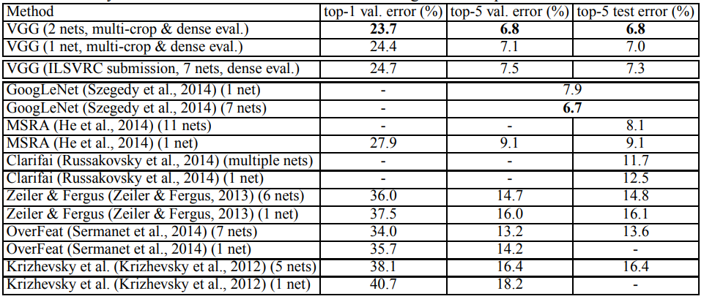
Results

Slide 11
Summary
LRN does not improve performance
More depth with smaller filters is better than a shallow network with large filters
Three 3 x 3 vs one 7 x 7
Increased depth reduces classification error
Error saturates at 19 layers
Spatial context is important (3 x 3 vs 1 x 1)
Scale jittering and dense evaluation work in conjunction to improve accuracy

