Slide 1
Fully Convolutional Network for Semantic Segmentation
By Anthony Sanchez

Slide 2
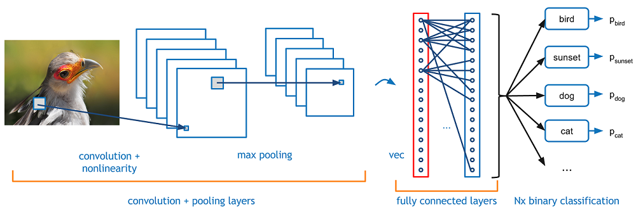
Traditional Convolutional Neural Network
Notes:
Receives input and performs a classification of the entire picture.

Slide 3
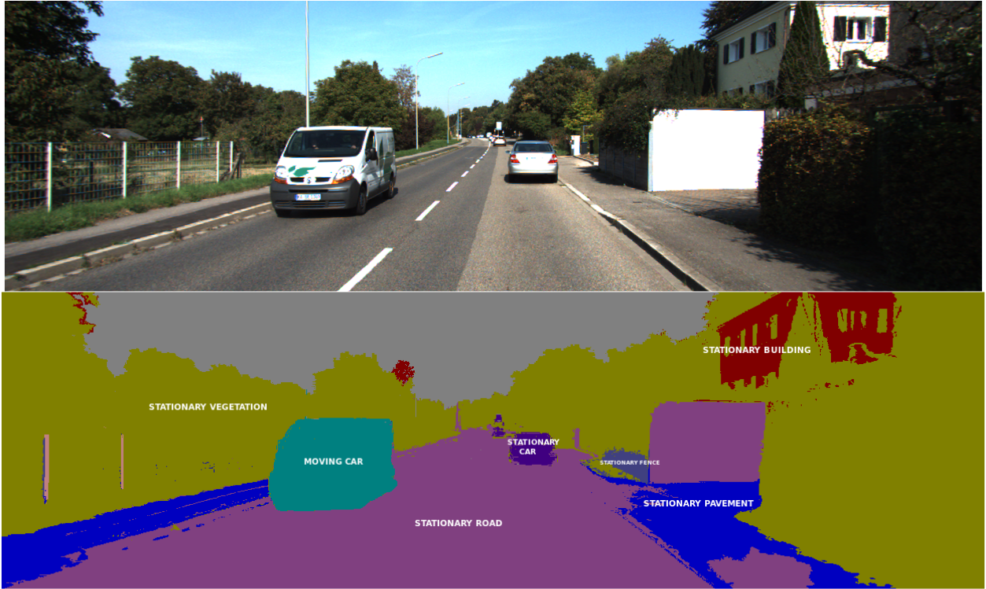
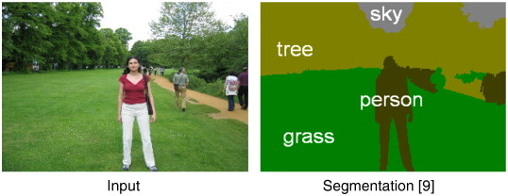
What is Semantic Segmentation?
Notes:
Labeling each pixel instead of the entire image, this requires the network to localize the parts of the image.

Slide 4
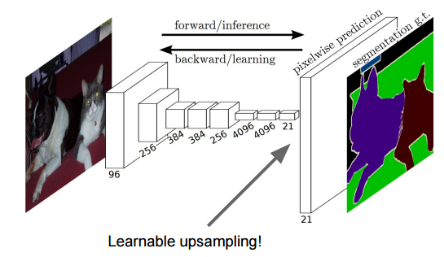
Fully Convolutional Neural Network
Up Samples the last layer to perform pixel-wise prediction
Notes:
In Fully convolutional Neural Networks, the last layer is upsampled to perform pixel-wise prediction.

Slide 5
Traditional Convolution
Filter 2x2 Stride = 2

Slide 6
Traditional Convolution

Slide 7
Traditional Convolution

Slide 8
Traditional Convolution

Slide 9
Traditional Convolution

Slide 10
Upsampling/Transpose Convolution
To transpose convolve, you decrease filter size by factor you downsized
Increase number of filters by factor of 4
[Wenze Shi, 2016]

Slide 11
Upsampling/Transpose Convolution
EX: Upsampling to double size
The transpose filter size is ¼ of the input size
Increase number of filters by factor of 4
What would be the transpose filter size for previously displayed convolution, output of 2x2?
[Wenze Shi, 2016]

Slide 12
Upsampling/Transpose Convolution
EX: Upsampling to double size
The transpose filter size is ¼ of the input size
Increase number of filters by factor of 4
What would be the transpose filter size for previously displayed convolution, output of 2x2?
A 1x1 transpose filter
[Wenze Shi, 2016]

Slide 13
Upsampling/Transpose Convolution
Transpose Filters
Feature map
[Wenze Shi, 2016]

Slide 14
Upsampling/Transpose Convolution
Treat features as a scalar
Transpose convolution weights are multiplied by feature scalar
  This is different from normal convolutional filters that use a dot product
[Wenze Shi, 2016]

Slide 15
Upsampling/Transpose Convolution
Transpose Filters
Feature map
[Wenze Shi, 2016]

Slide 16
Upsampling/Transpose Convolution
[Wenze Shi, 2016]

Slide 17
Upsampling/Transpose Convolution
[Wenze Shi, 2016]

Slide 18
Upsampling/Transpose Convolution
[Wenze Shi, 2016]

Slide 19
Upsampling/Transpose Convolution
[Wenze Shi, 2016]

Slide 20
Upsampling/Transpose Convolution
[Wenze Shi, 2016]

Slide 21
Upsampling/Transpose Convolution
...
[Wenze Shi, 2016]

Slide 22
Upsampling/Transpose Convolution
[Wenze Shi, 2016]

Slide 23
Upsampling/Transpose Convolution
[Wenze Shi, 2016]
Notes:
Interpolate the output feature maps to upsample.

Slide 24
Loss
The loss function is the sum of the accuracy over every pixel divided by the mean.

Slide 25
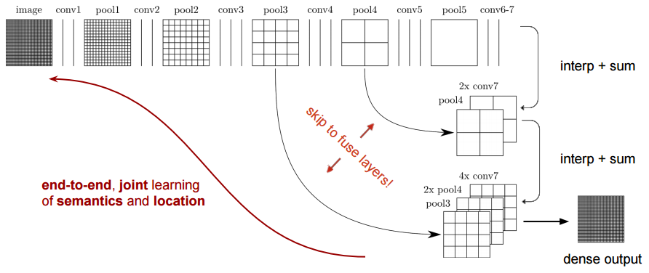
Fully Convolutional Network - Skip Architecture
[Jonathan Long, 2015]

Slide 26
Fully Convolutional Network - Skip Architecture
[Jonathan Long, 2015]

Slide 27
Fully Convolutional Network - Skip Architecture
[Jonathan Long, 2015]

Slide 28
Fully Convolutional Network - Skip Architecture
[Jonathan Long, 2015]

Slide 29
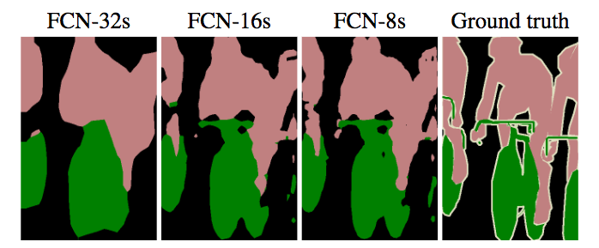
Fully Convolutional Network - Skip Architecture
[Jonathan Long, 2015]

Slide 30
Results
PASCAL VOC 2012 Dataset Benchmark
 | Mean IU VOC 2012 Test
SDS | 51.6 | ~ 50 s
FCN -8s | 62.2 | ~ 175 ms
[Jonathan Long, 2015]

Slide 31
Contributions
End-to-End learning
Single interpolation layer used for final deconvolution*
Skip architecture

