Slide 1


The Boeing Project
Robert Santoso – The Boeing Company
Alex Ortiz – Embedded Applications Technology
Richard Wang – Association for Computing Machinery

Slide 2
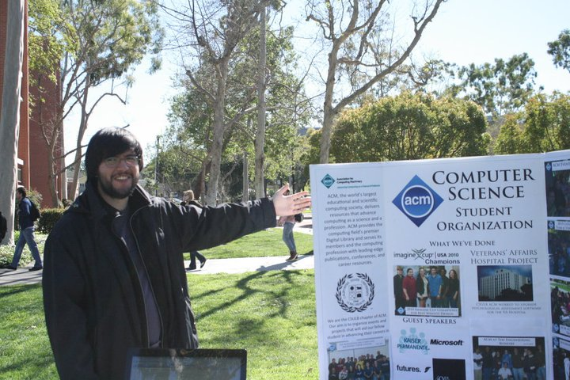
Who We Are...
Boeing
EAT
ACM

Slide 3
The Projects
Psychology Department (Aviation Lab/CHAAT Lab)
C-17 Lighting Mock-up Lab
C-17 Airborne Networking- Distributed Environment and Secure facilities
Boeing Mobility Integration Center
The Results

Slide 4
More...
B. Develop application to integrate data from different bus architectures for display on EFB or other portable devices.
* Provides students with meaningful projects.
* Leverage students' software development skills using latest open source technologies
* Applications provide simulation or demonstration capability to Boeing.
Actions:
1. Boeing defines application scope.
2. Identify requirements for development tools
3. Boeing provides development hardware
4. Boeing provides software development tools

Slide 5
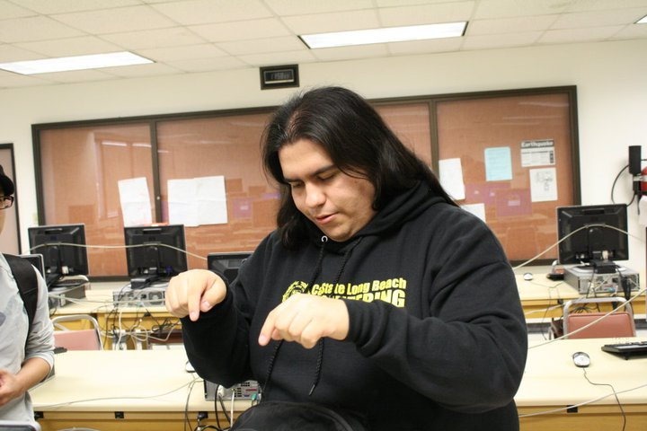
Questions? Comments? Concerns?

Slide 6
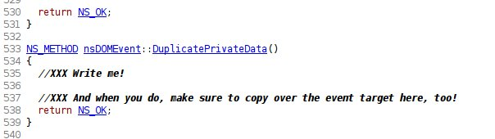
How Important Is Design?
November 29th, 2005

Slide 7
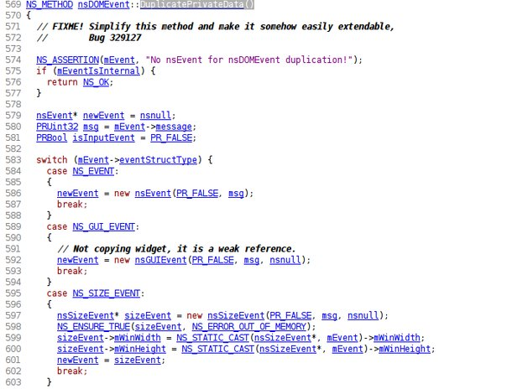
October 24th, 2006

Slide 8
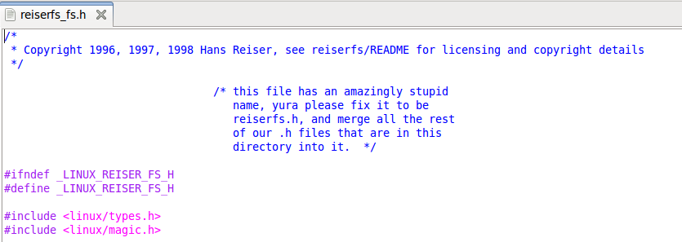

Slide 9
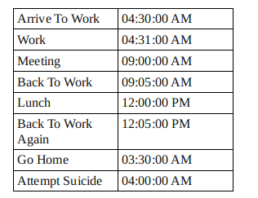
Time Line

