Slide 1
Analyze demand history and predict future sales
Using Prophet and ARIMA

Slide 2
Project Background and Objective
This project investigates the historical weekly sales of 45 stores in 81 departments, and use machine learning to predict future sales .
The training dataset consists of the weekly date, store number, dept number, sales for the given store/dept, whether week is special holiday week.
Since the data follows a time sequence, I have used time series prediction models - ARIMA and Prophet.
The objective of the project is to analyze the demand history, look for seasonality/trends in the data, and forecast the sales for the future timeframe.

Slide 3
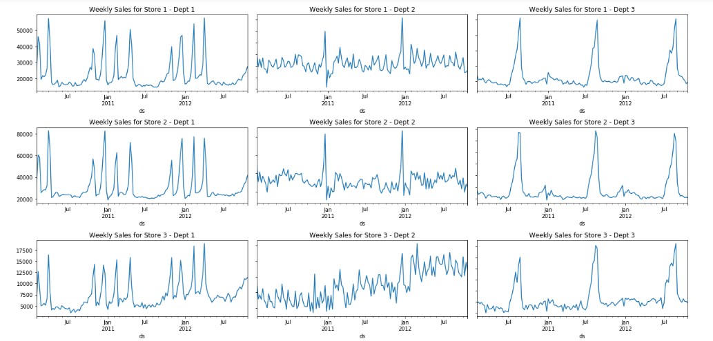
Exploratory Data Analysis
Visualize weekly sales in different stores/depts.

Slide 4
The Process
Step 1: Build Models
Split the historical demand data into train and test sets.
Create Prophet and ARIMA models on the training data set.
Using the models, predict for the test data set.
Step 2: Make predictions
New data is fed into both the models, and sales predictions are made.
Step 3: Make decisions
The model with least mean absolute error between the actual and predicted sales is recommended.

Slide 5
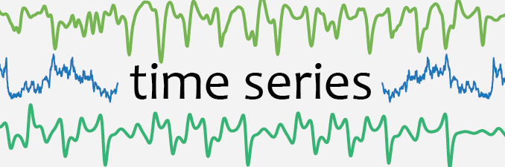
Time series analysis using Machine Learning

Slide 6
Time series prediction models
Prophet
Prophet is a procedure for forecasting time series data.
It is based on an additive model where non-linear trends are fit with yearly and weekly seasonality, plus holidays.
ARIMA
ARIMA stands for AutoRegressive Integrated Moving Average (ARIMA) model.
It is fitted to time series data to predict future points in the series (forecasting).

Slide 7
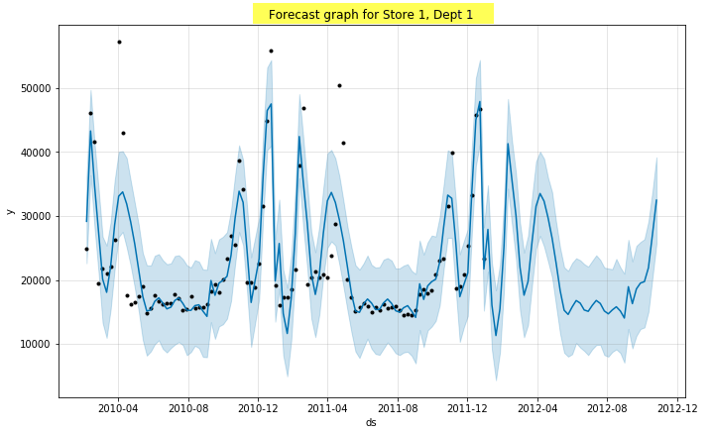
Observed vs Forecast – Prophet
Black dots – are the Observed values
Blue lines – are the Forecasted values
Shaded blue area – are the Uncertainty intervals of our forecast

Slide 8
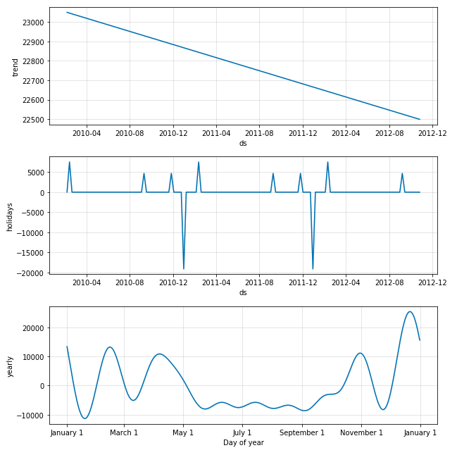
Visualize the components - Prophet

Slide 9
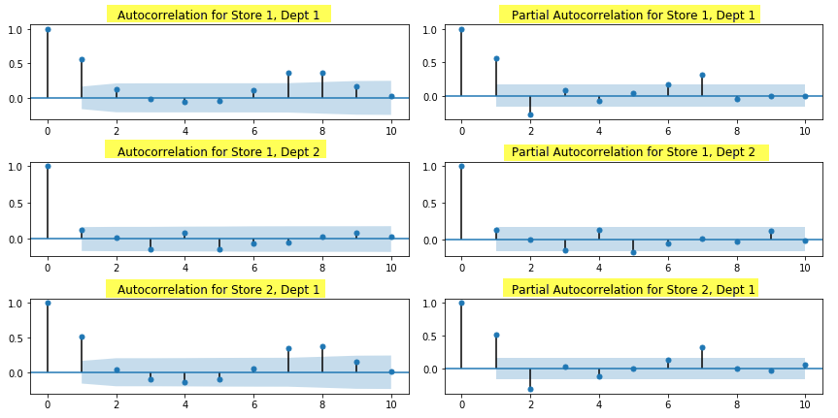
Forecasting – Using ARIMA
By looking at the autocorrelation function (ACF) and partial autocorrelation (PACF) plots of the time series, we can tentatively identify the numbers of AR and/or MA terms that are needed for calculation.

Slide 10
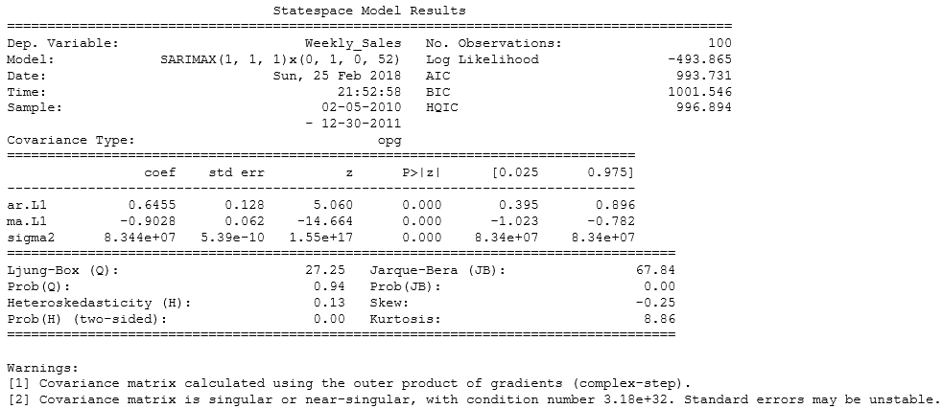
Summary results of ARIMA
The coef column shows the weight of each feature, and how each one impacts the time series.

Slide 11
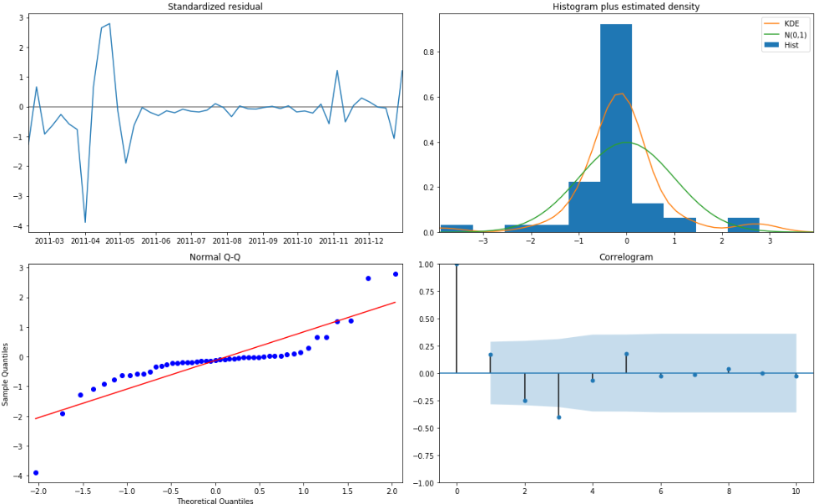
Diagnostics - ARIMA

Slide 12
The model diagnostics in the above slide suggests that the model residuals are normally distributed based on the following:
The residuals does not display any seasonality or trend behavior. It appears to be white noise.
In the histogram, the green line is the standard normal distribution, and the kde of the time series is plotted in the orange line.
The qq-plot shows that the ordered distribution of residuals (blue dots) follows an almost the linear trend of the samples taken from a standard normal distribution with N(0, 1).
Correlogram shows that the time series residuals show low correlations with lagged residuals. Although there is one big spike at 2.5.

Slide 13
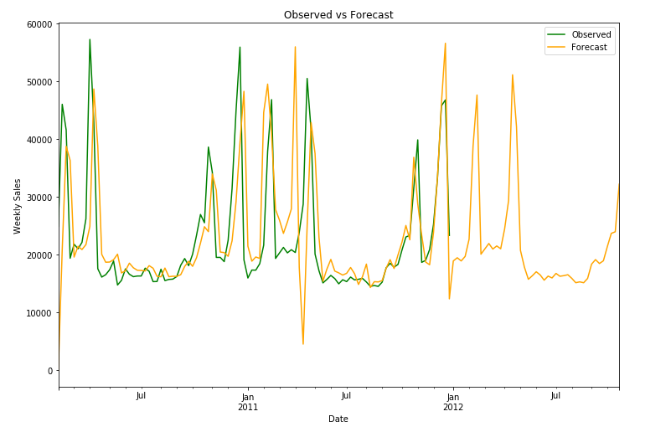
Observed vs Forecast - ARIMA

Slide 14
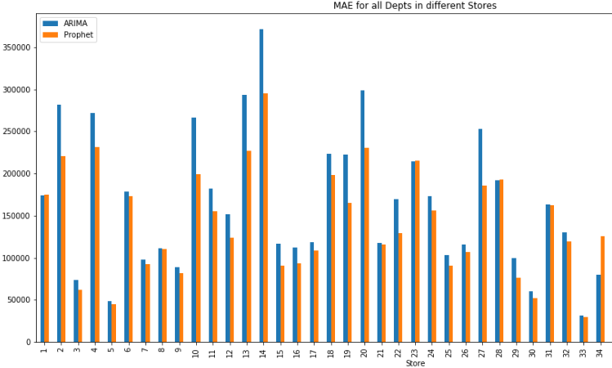
Mean Absolute Errors – Prophet vs ARIMA

Slide 15
Conclusion & Recommendations
From above graph, it is evident that the errors are smaller in Prophet compared to ARIMA. So Prophet is more accurate than ARIMA model.
Moreover, Prophet works easily with holidays/shifting events, and is robust to missing data, shifts in trend.
With ARIMA, we can have the parameters modified to see if there is an improvement in the fit.
Overall, with the current results, we can conclude that the Prophet is a better model to use.

